Slide 1
HUAC v. Hollywood
The Impact of the Second Red Scare

Slide 2
Essential Question
What impact did the Second Red Scare have on the United States?

Slide 3
Learning Objectives
Students will be able to:
Deconstruct the Second Red Scare to determine the effects it had on the public and their fear of communism and to understand why the decision to form HUAC was made.
Compare and contrast the events that happened in the era of McCarthyism to those happening in present-day America.

Slide 4

T.A.C.O.S.
Use the acronym T.A.C.O.S. to analyze the cartoon. .
T: Time and Place - Estimate the time period and region where the cartoon takes place.
A: Action - Describe what is happening in the cartoon.
C: Caption - If there is a caption, write it down.
O: Objects/People - List any people or objects shown, including symbols and use of color.
S: Summary - Explain the meaning of the cartoon in one sentence.
Notes:
K20 Center. (2021, April 15). T.A.C.O.S. Strategies. https://learn.k20center.ou.edu/strategy/1196.

Slide 5
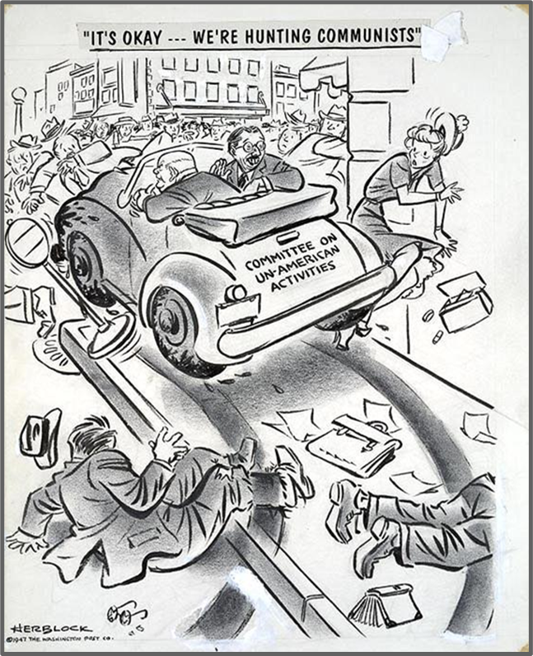
T.A.C.O.S.
T: Time and Place - Estimate the time period and region where the cartoon takes place.
A: Action - Describe what is happening in the cartoon.
C: Caption - If there is a caption, write it down.
O: Objects/People - List any people or objects shown, including symbols and use of color.
S: Summary - Explain the meaning of the cartoon in one sentence.
Notes:
K20 Center. (2021, April 15). T.A.C.O.S. Strategies. https://learn.k20center.ou.edu/strategy/1196.
Block, H. (1947, October 31). It's okay...we're hunting communists. Library of Congress. Library of Congress Prints and Photographs Division. Retrieved April 13, 2022, from https://www.loc.gov/pictures/item/00652190/.

Slide 6
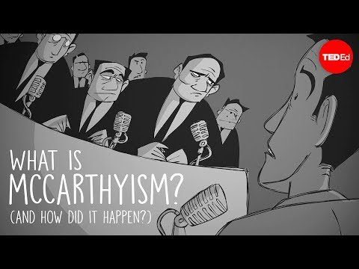
Notes:
TED-Ed. (2017, March 14). What is McCarthyism? And how did it happen? Retrieved April 13, 2022, from https://www.youtube.com/watch?v=N35IugBYH04.

Slide 7

What is McCarthyism (Second Red Scare)?
Write down the Point of Most Significance (POMS) about the video content.
Share your POMS with an Elbow Partner.
Share your POMS with the class.
https://learn.k20center.ou.edu/lesson/729
Notes:
K20 Center. (2020, September 16). POMS: Point of most significance. Strategies. https://learn.k20center.ou.edu/strategy/101.
K20 Center. (n.d.). Elbow partners. https://learn.k20center.ou.edu/strategy/116.
This slide is optional.

Slide 8

What is McCarthyism (Second Red Scare)?
Think about what you just watched and complete the table:
  Write one idea that you found surprising.
  Write one idea that you found interesting.
  Write one idea that you found troubling.
Notes:
K20 Center. (2021, February 12). S-I-T (Surprising, Interesting, Troubling). Strategies. https://learn.k20center.ou.edu/strategy/926.
This slide is optional.

Slide 9
What is HUAC?
HUAC is an acronym for the House Un-American Activities Committee;
HUAC was established in 1938 to investigate subversive activities committed by Americans;
Each year, 7-9 members of the U.S. House of Representatives served on the committee;
In the 1940s and ‘50s, HUAC investigated American citizens with suspected ties to the Communist Party;
The Committee often targeted entertainers because of their influence on the American public;
The Committee was abolished in January 1975.

Slide 10
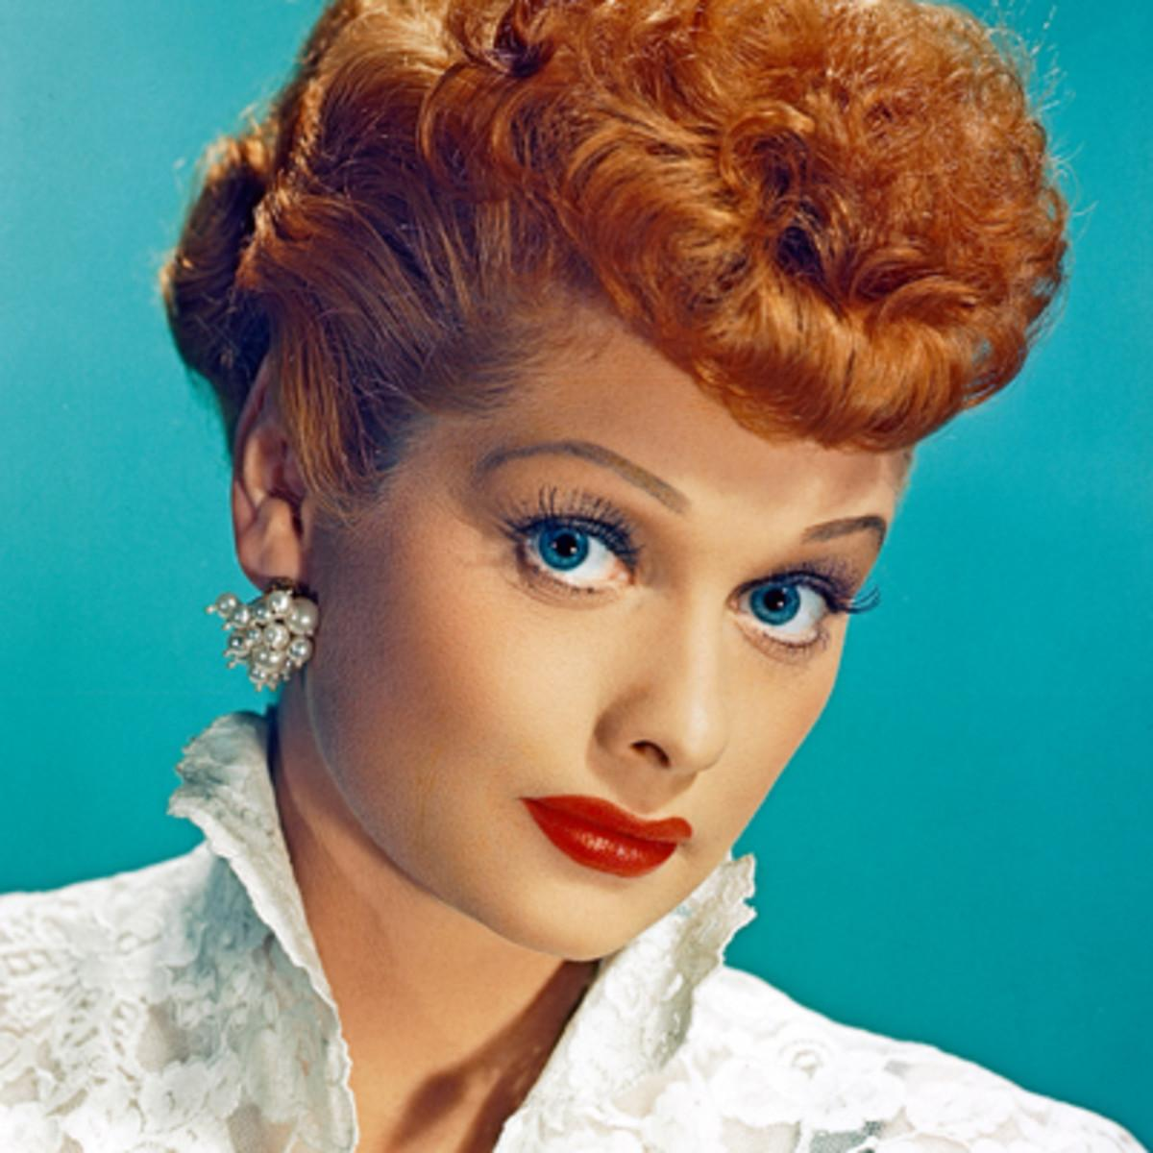
Who was Lucille Ball?
August 6, 1911 - April 26, 1989;
American actress, comedian, and producer;
Registered to vote in 1936 and listed her party affiliation as Communist;
Met with HUAC investigator in 1953 and provided sealed testimony.
Notes:
AustinMini 1275. (2018, February 9). Lucille Ball. Flickr. https://www.flickr.com/photos/14639118@N03/26302339438.

Slide 11
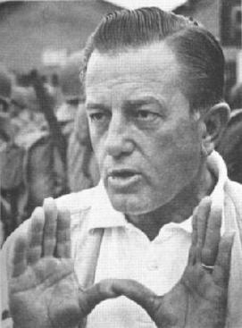
Who was Edward Dmytryk?
September 4, 1908 - July 1, 1999;
Canadian-born, American film director;
Named one of the “Hollywood Ten;”
Served over 4 months in jail;
Testified in front of HUAC in 1951 after imprisonment and cooperated with them.
Notes:
Wikipedia. (2018, January 9). U.S. filmmaker, Edward Dmytryk. https://en.wikipedia.org/wiki/File:Edward_Dmytryk.jpg.

Slide 12
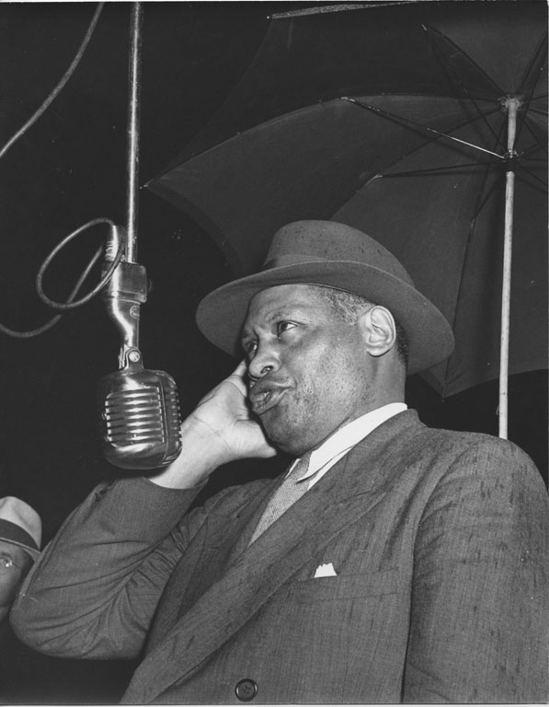
Who was Paul Robeson?
April 9, 1898 - January 23, 1976;
American bass-baritone concert artist, stage and film actor, athlete, and activist;
Called before HUAC in 1956 after refusing to sign an affidavit affirming that he was not a Communist;
Invoked the Fifth Amendment and refused to reveal his political affiliations during testimony.
Notes:
Washington Area Spark. (1946, September 23). Paul Robeson sings out against lynching: 1946. Flickr. https://www.flickr.com/photos/washington_area_spark/15201050315.

Slide 13
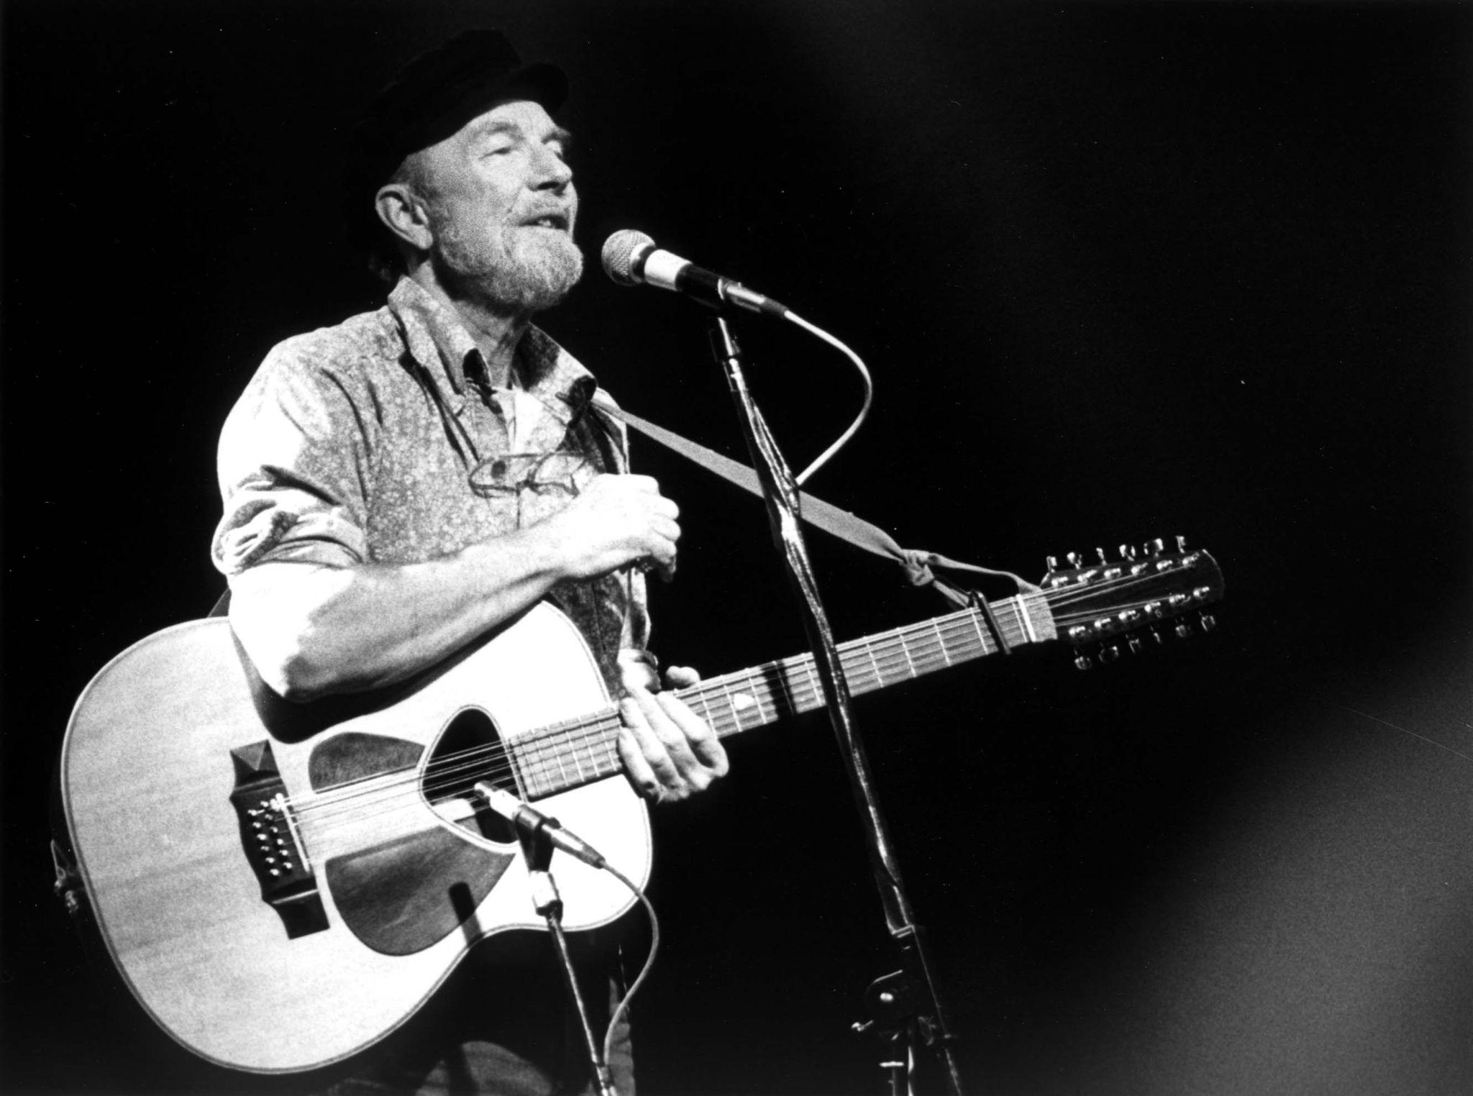
Who was Pete Seeger?
May 3, 1919 - January 27, 2014;
American folk singer and social activist;
Was subpoenaed to testify before HUAC in 1955;
Refused to name personal and political associations on grounds that it would violate his First Amendment rights.
Notes:
Schwarz, J. (1986, February 20). Pete Seeger concert photo b&w. Wikimedia Commons. https://commons.wikimedia.org/wiki/File:Pete_Seeger_1986.jpg.

Slide 14
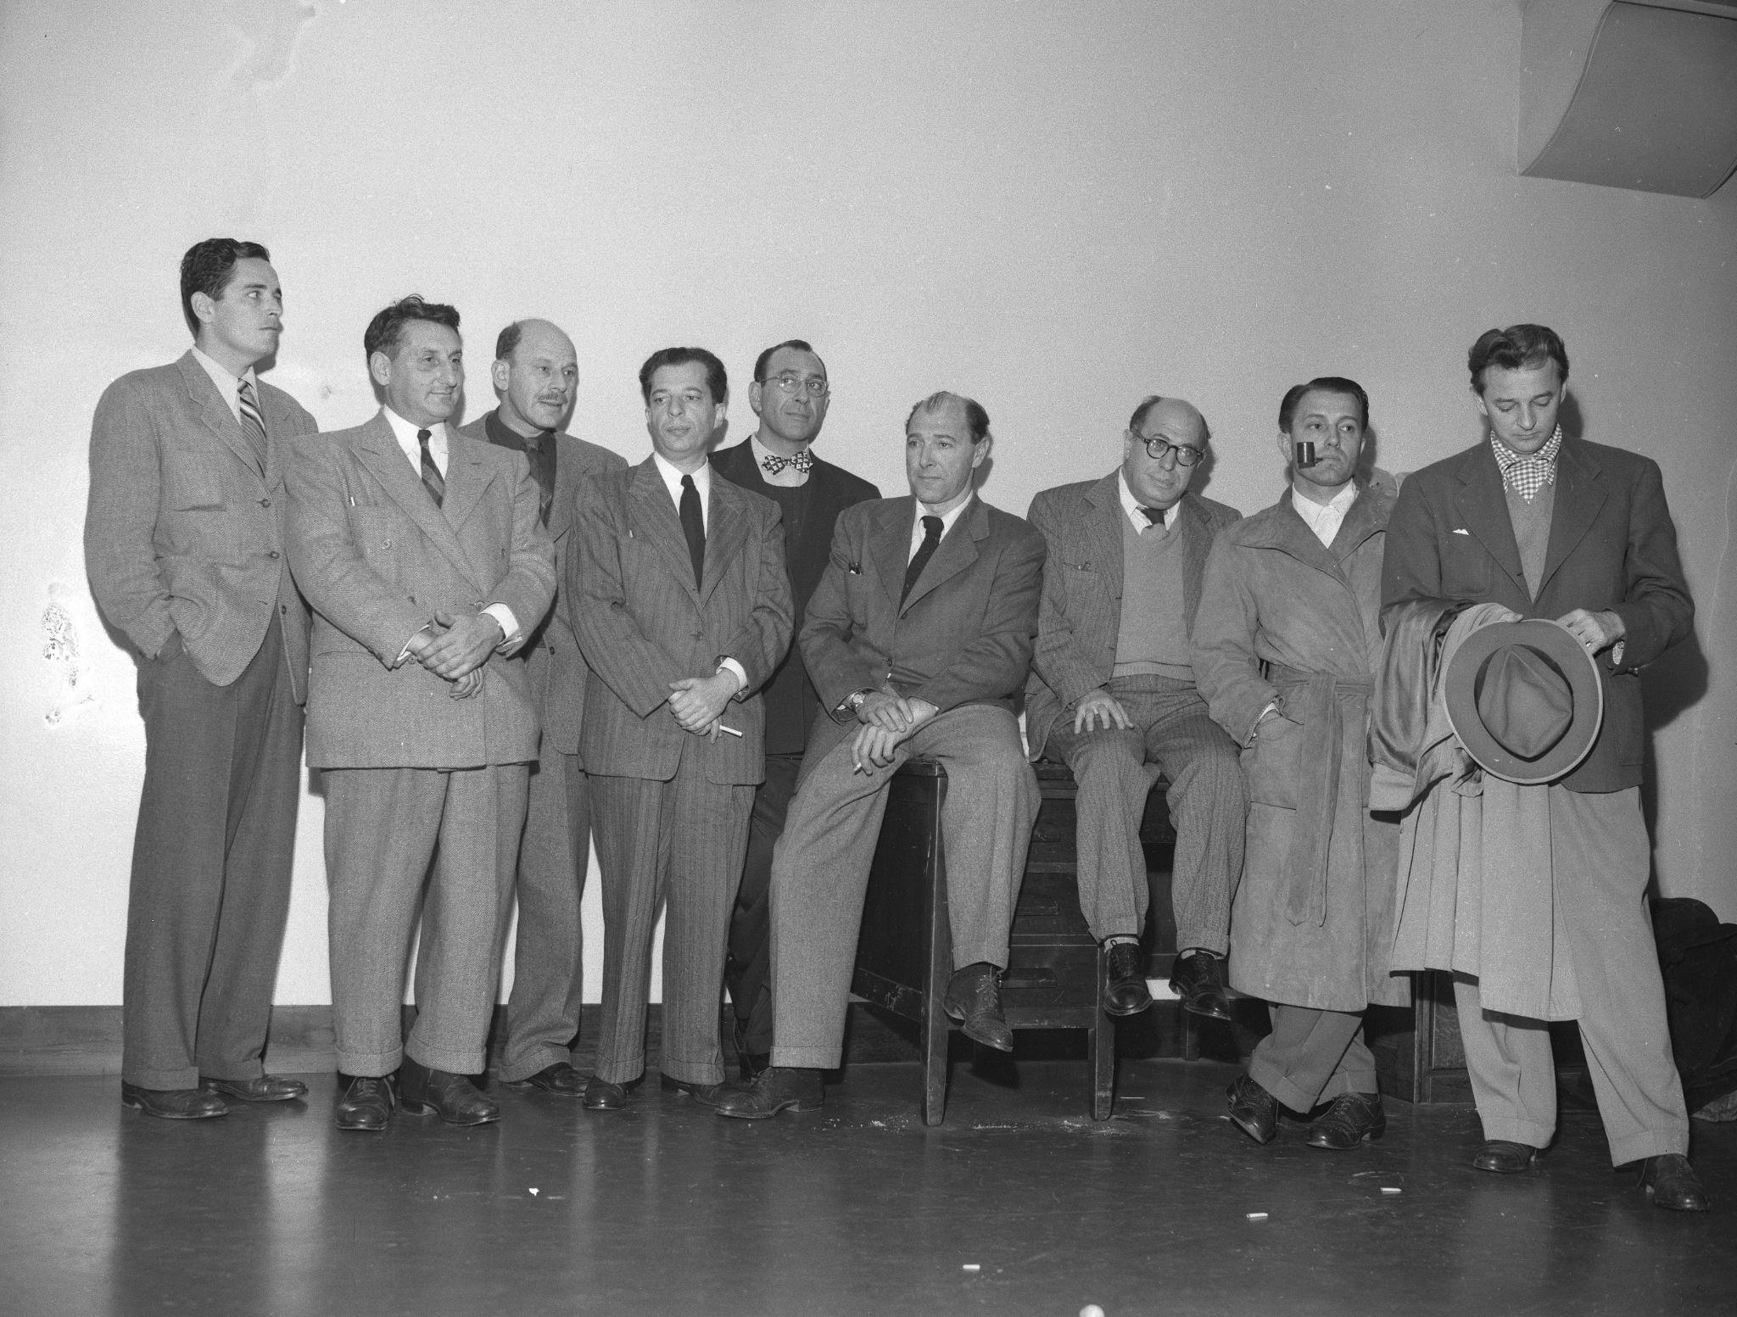
Who were the Hollywood Ten?
Ten (10) motion picture producers, directors, and screenwriters who appeared before HUAC in October 1947. They refused to answer questions regarding their possible communist affiliations.
After spending time in prison for contempt of Congress, they were mostly blacklisted by the Hollywood studios.
Notes:
Los Angeles Times. (1947, December 11). Charged with contempt of Congress, nine Hollywood men give themselves up to U.S. Marshal today. From left: Robert Adrian Scott, Edward Dmytryk, Samuel Ornitz, Lester Cole, Herbert Biberman, Albert Maltz, Alvah Bessie, John Howard Lawson and Ring Lardner Jr. Wikimedia Commons. https://commons.wikimedia.org/wiki/File:Nine_of_the_Hollywood_10_charged_with_contempt_of_Congress_1947.jpg.

Slide 15

SOAPSTone
While reading the testimony given, identify the following:
S: Who is the SPEAKER?
O: What is the OCCASION?
A: Who is the AUDIENCE?
P: What is the PURPOSE?
S: What is the SUBJECT matter?
T: What is the TONE?
Notes:
K20 Center. (2021, May 28). SOAPStone. Strategies. https://learn.k20center.ou.edu/strategy/889.

Slide 16

SOAPSTone
While reading the testimony given, identify the following:
S: Who is the SPEAKER?
O: What is the OCCASION?
A: Who is the AUDIENCE?
P: What is the PURPOSE?
S: What is the SUBJECT matter?
T: What is the TONE?
Notes:
Give students following links for Wakelet
English Wakelet: HUAC Versus Hollywood - Wakelet
Spanish Wakelet: HUAC vs Hollywood - Wakelet
K20 Center. (2021, May 28). SOAPStone. Strategies. https://learn.k20center.ou.edu/strategy/889.

Slide 17

True for Who?
Discuss the statement.
  What kind of situation was it made in?
  Who made it or would make it?
  What were their intentions and goals?
  What was at stake?
As a group, determine how each individual would have felt about this statement?
  Would this person think this statement is true?
    Circle their name.
  False?
    Cross out their name.
  Uncertain?
    Put a question mark by their name.
Take notes on your discussion in the right-hand column of the handout.
Notes:
K20 Center. (2021, July 30). True for who? Strategies. https://learn.k20center.ou.edu/strategy/1586.

Slide 18
True for Who?
Lucille Ball
Edward Dmytryk
Paul Robeson
Pete Seeger
Honorable Francis E. Walter
I had much more opportunity to observe the workings of the Communist Party while I was a member of the “Hollywood Ten” than I did when I was a member of the Communist Party.

Slide 19
True for Who?
Lucille Ball
Edward Dmytryk
Paul Robeson
Pete Seeger
Honorable Francis E. Walter
I will provide you with the names of the other members that I am aware of…

Slide 20
True for Who?
Lucille Ball
Edward Dmytryk
Paul Robeson
Pete Seeger
Honorable Francis E. Walter
I registered as a Communist to please my grandfather.

Slide 21
True for Who?
I would have never done that. Did I do that?
Lucille Ball
Edward Dmytryk
Paul Robeson
Pete Seeger
Honorable Francis E. Walter

Slide 22
True for Who?
I invoke the Fifth Amendment.
Lucille Ball
Edward Dmytryk
Paul Robeson
Pete Seeger
Honorable Francis E. Walter

Slide 23
True for Who?
This is complete nonsense.
Lucille Ball
Edward Dmytryk
Paul Robeson
Pete Seeger
Honorable Francis E. Walter

Slide 24
True for Who?
Lucille Ball
Edward Dmytryk
Paul Robeson
Pete Seeger
Honorable Francis E. Walter
I have no idea what you are talking about.

Slide 25
True for Who?
Lucille Ball
Edward Dmytryk
Paul Robeson
Pete Seeger
Honorable Francis E. Walter
You are the author of all of the bills that are going to keep all kinds of decent people out of the country.

Slide 26
True for Who?
Lucille Ball
Edward Dmytryk
Paul Robeson
Pete Seeger
Honorable Francis E. Walter
I refuse to answer that question whether it was a quote from the New York Times or the Vegetarian Journal.

Slide 27
True for Who?
I am not going to answer any questions as to my associations.
Lucille Ball
Edward Dmytryk
Paul Robeson
Pete Seeger
Honorable Francis E. Walter

Slide 28
True for Who?
Lucille Ball
Edward Dmytryk
Paul Robeson
Pete Seeger
Honorable Francis E. Walter
My answer is the same as before.

Slide 29
True for Who?
Lucille Ball
Edward Dmytryk
Paul Robeson
Pete Seeger
Honorable Francis E. Walter
I resent very much and very deeply the implication of being called before this committee that in some way because my opinions may be different from yours that I am less of an American.

Slide 30
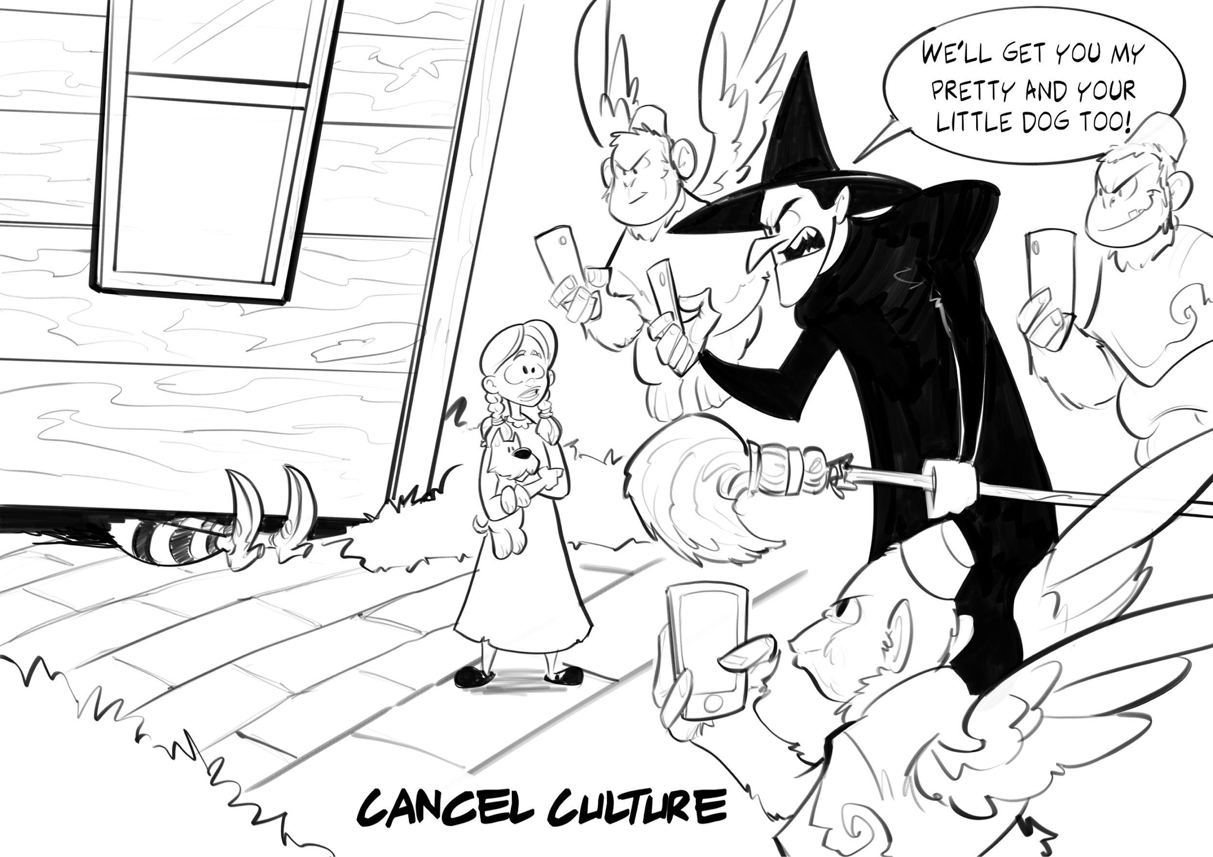
Exit Ticket
Take out a sheet of paper and answer the following questions:
What is the cartoonist trying to say about our current society?
Compare and contrast the behavior hinted at in this cartoon with the effects of the public fear of communism during the Second Red Scare.
Notes:
Webster, S. (2022). Cancel culture. K20 Center.
K20 Center. (2020, September 16). Bell ringers and exit tickets. Strategies. https://learn.k20center.ou.edu/strategy/125

Slide 31
What Happened to Lucille Ball?
HUAC ended their investigation into Ball, believing her testimony about registering in order to make her grandfather happy.
She was able to avoid being blacklisted and continue her popular sitcom, I Love Lucy.
Her husband, Desi Arnaz, defended her, saying, “The only thing red about Lucy is her hair, and even that is not legitimate.”
Notes:
AustinMini 1275. (2018, February 9). Lucille Ball. Flickr. https://www.flickr.com/photos/14639118@N03/26302339438.

Slide 32
What Happened to Edward Dmytryk?
After testifying before HUAC in 1951, Dmytryk was eventually able to go back to directing famous films, including The Caine Mutiny.
He wrote a memoir about his experiences during the Second Red Scare, called Odd Man Out.
Notes:
Wikipedia. (2018, January 9). U.S. filmmaker, Edward Dmytryk. https://en.wikipedia.org/wiki/File:Edward_Dmytryk.jpg.

Slide 33
What Happened to Paul Robeson?
As a result of being blacklisted, Robeson was unable to sing at concerts in the U.S.
Recordings of his songs and movies he acted in were not distributed to the American public for many years.
He sang at concerts in the United Kingdom, Australia, and other countries, but he stopped touring in the 1960s as a result of depression.
Notes:
Washington Area Spark. (1946, September 23). Paul Robeson sings out against lynching: 1946. Flickr. https://www.flickr.com/photos/washington_area_spark/15201050315.

Slide 34
What Happened to Pete Seeger?
On March 26, 1957, he was indicted for contempt of Congress.
He had to keep the federal government apprised of where he was going if he left New York.
Although he was convicted by a jury in March 1961 and sentenced to ten one-year terms, the conviction was overturned the following year.
He continued writing songs and touring as a folk singer until shortly before his death at age 94.
Notes:
Schwarz, J. (1986, February 20). Pete Seeger concert photo b&w. Wikimedia Commons. https://commons.wikimedia.org/wiki/File:Pete_Seeger_1986.jpg.

