Slide 2

¡Sí Se Puede!
United Farm Workers Union and the Delano Grape Strike

Slide 3
Learning Objectives(s)
Examine the creation of the United Farm Workers (UFW) labor union.
Explore actions taken by labor union leaders.

Slide 4
“We don’t need perfect political systems; we need perfect participation.”
-César Chávez

Slide 5
T-Chart
Imperfect Political Systems
Perfect Political Participation
In what ways can political systems be imperfect?
What are some examples of perfect political participation?
Notes:
K20 Center. (n.d.). T-chart. Strategies. https://learn.k20center.ou.edu/strategy/86

Slide 6
Essential Question
How can political participation effect change?

Slide 7

Painting a Picture
You will be presented with a set of images labeled “A/B”
With your partner you will discuss and record your observations and inferences in the Painting a Picture Chart for each image.
  Observation: anything you see in the images.
  Inferences: a conclusion you make based on your observations and prior knowledge.
Notes:
K20 Center. (n.d.). Painting a picture. Strategies. https://learn.k20center.ou.edu/strategy/1331

Slide 8
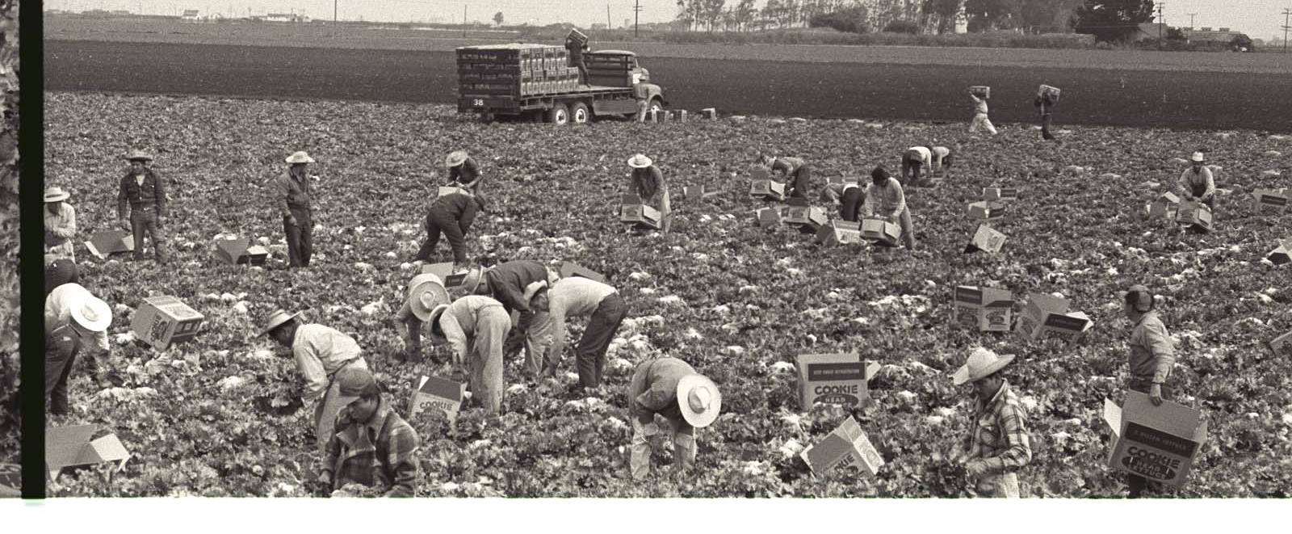
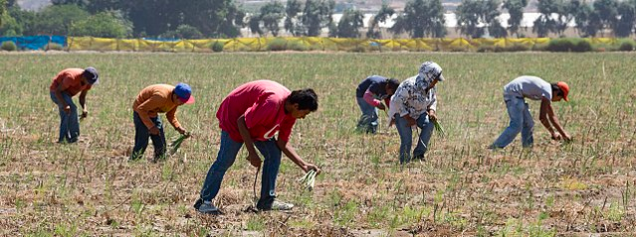
Picture 1A
Picture 1B
Notes:
(Photo A): Nadel, L. (1956). Nadel, L. (1956). Braceros pick lettuce and fill it into Cookie head lettuce boxes in a field in California [Photograph]. The Leonard Nadel Collection, National Museum of American History. https://braceroarchive.org/files/original/NAD-200401385618.jpg
(Photo B): Tomascastelazo. (2014). Sparragus pickers. Photo taken in the valley of Maneadero, south of Ensenada, Baja California [Photograph]. Wikimedia Commons. https://commons.wikimedia.org/wiki/File:Sparragus_pickers.jpg

Slide 9
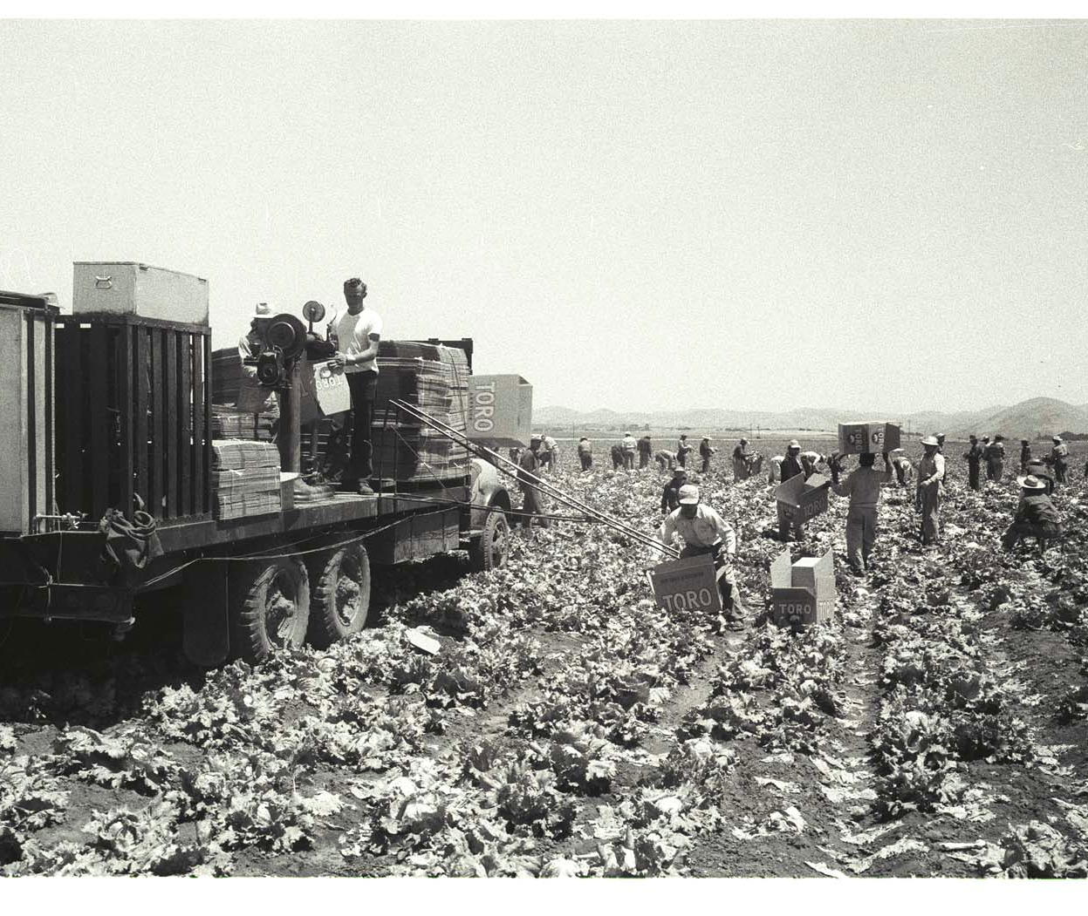
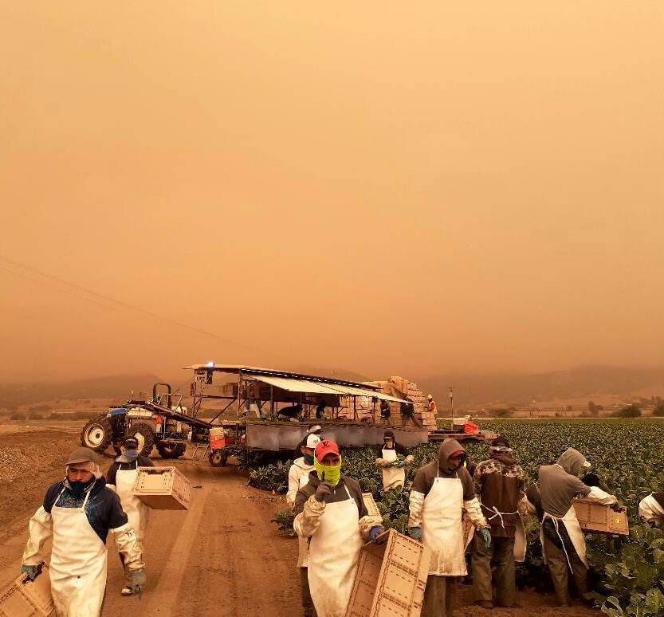
Picture 2B
Picture 2A
Notes:
(Photo A): Nadel, L. (1956). Braceros load Toro lettuce boxes on a truck on a lettuce field in the Salinas Valley, California [Photograph]. The Leonard Nadel Collection, National Museum of American History. https://braceroarchive.org/files/original/NAD200401383703.jpg
(Photo B): United Farm Workers [@UFWupdates]. (2020). Erick shared this photo arriving to work in King City CA. He shares “There is nothing heroic about what we do…” [Image attached] [Tweet]. Twitter. https://twitter.com/UFWupdates/status/1304196728208461825/photo/1

Slide 10
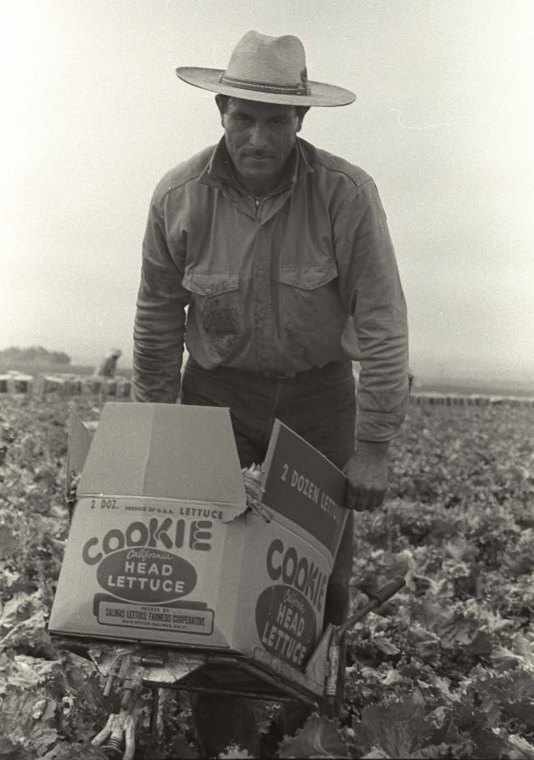
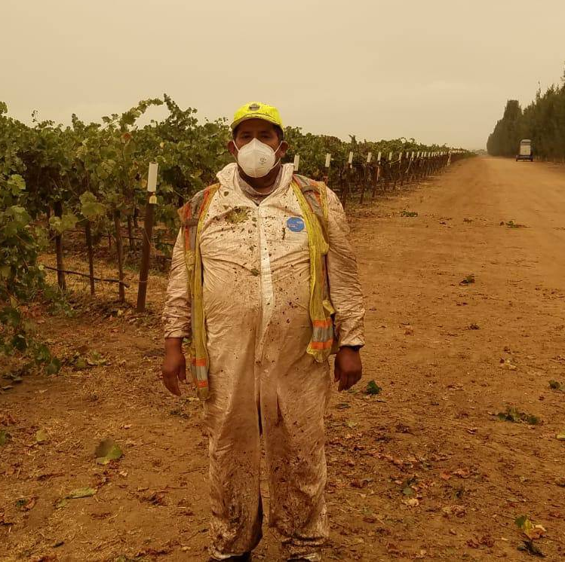
Picture 3A
Picture 3B
Notes:
(Photo A): Nadel, L. (1956). A bracero carries a full Cookie Head lettuce box on a trolley in a field in the Salinas Valley, California [Photograph]. The Leonard Nadel Collection, National Museum of American History. https://braceroarchive.org/files/original/NAD-200401385634.jpg
(Photo B): United Farm Workers [@UFWupdates]. (2020). The UFW distributed P95 masks to farmworkers in Monterey County CA who are laboring despite poor air quality from nearby fires… [Image attached] [Tweet]. Twitter. https://twitter.com/UFWupdates/status/1305189651230187521/photo/1

Slide 11
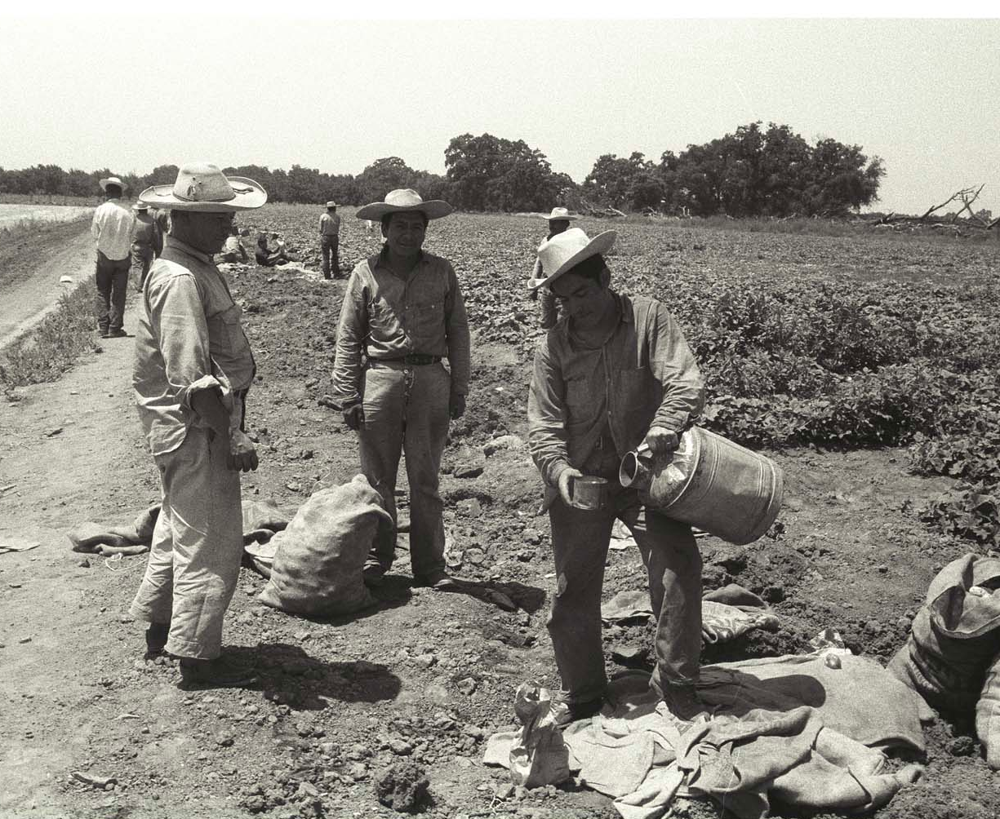
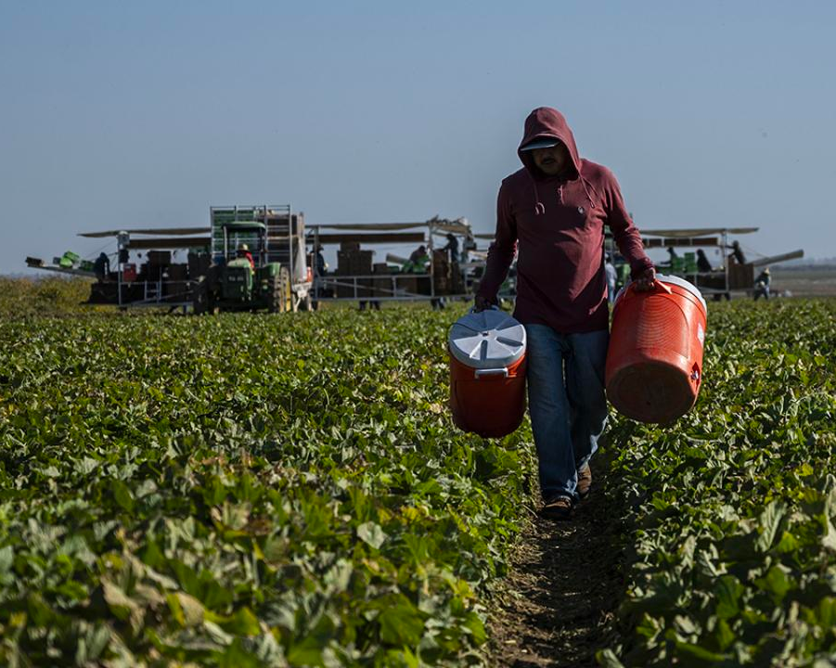
Picture 4A
Picture 4B
Notes:
(Photo A): Nadel, L. (1956). A bracero fills water from a vat into a cup on the edge of a field in California [Photograph]. The Leonard Nadel Collection, National Museum of American History. https://braceroarchive.org/files/original/NAD-200401384515.jpg
(Photo B): Amezcua, H. (2019). Farmworker wearing a bandana mask in a field in California [Photograph]. College of Agriculture and Environmental Sciences at UC Davis. https://aghealth.ucdavis.edu/news/research-highlight-stressors-and-psychological-distress-latino-immigrant-agricultural-workers

Slide 12
Sí Se Puede Infogram
Use the following link(s) to reach the infogram:
  English version: http://k20.ou.edu/sisepuede
  Spanish version: http://k20.ou.edu/sisepuede-esp
As you read through the infogram, use the provided Infogram Graphic Organizer to take notes.

Slide 13

K20 Center 30 Minutes
Notes:
K20 Center. (2021, September 21). 30 Minute Timer. YouTube. https://youtu.be/yxGM6oVHqFc?si=cMeACHo0CTE5sImZ

Slide 14

Surprising, Interesting, Troubling
Based on the information you gathered, with your partner discuss the following:
  One Surprising fact or statement
  One Interesting fact or statement
  One Troubling fact or statement
Notes:
K20 Center. (n.d.). S-I-T (Surprising, Interesting, Troubling). Strategies. https://learn.k20center.ou.edu/strategy/926

Slide 15
Laborers’ International Union of North America-LiUNA!
Arturo Delgado serves as the Business Manager for Laborers Local 107 chapter.
LiUNA is an American and Canadian Labor union with over half a million members.
This labor union primarily represents construction workers as well as public service employees.

Slide 16
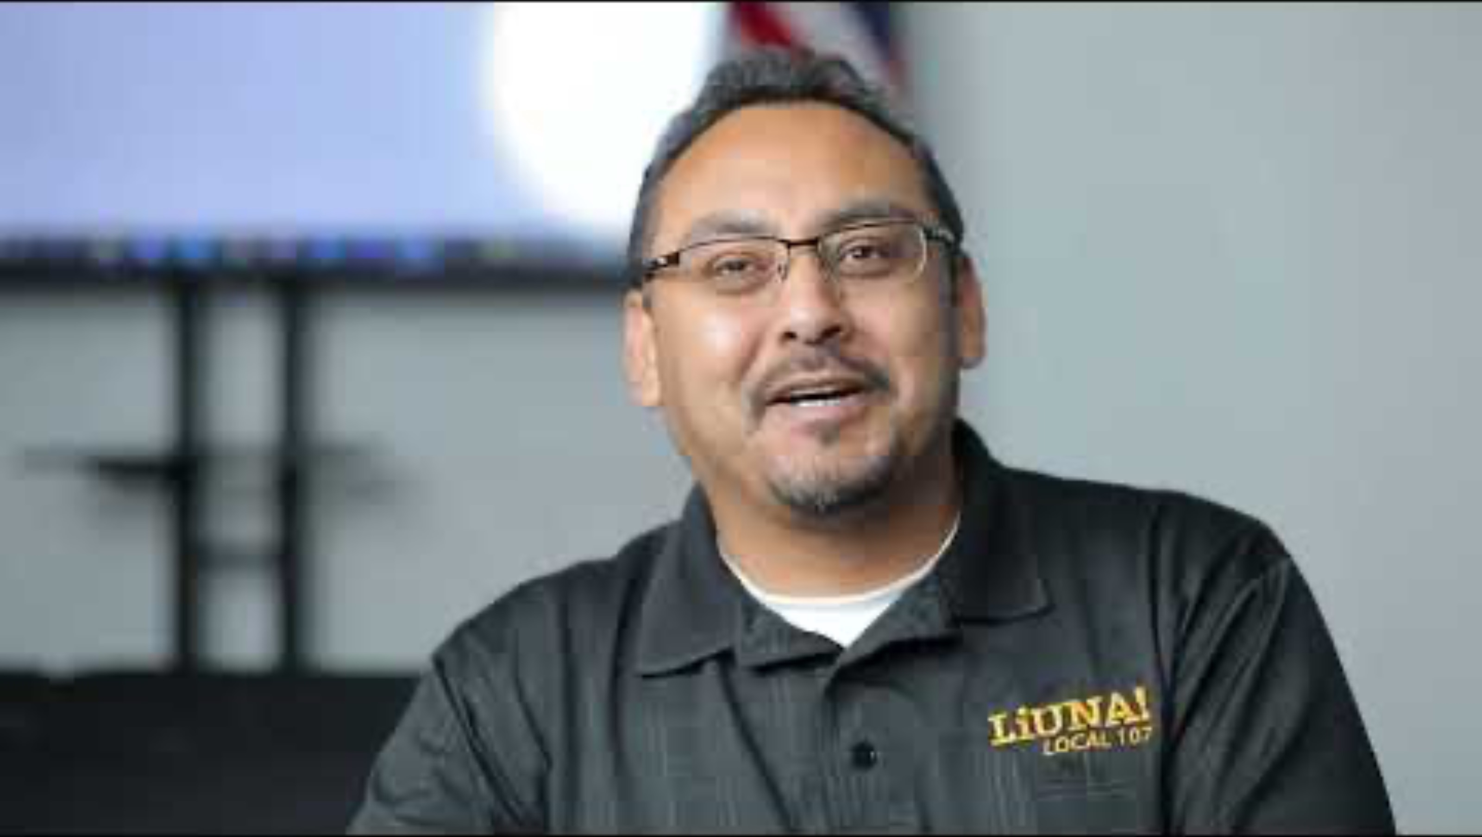
LiUNA Local Union Leader
Notes:
K20 Center. (2022, July 21). ICAP-LiUNA Local Union Leader. YouTube. https://youtu.be/bI-n7kGomck?si=MfDYvVVhkhvhaU4x

Slide 17
Discussion Questions
With your elbow partner, discuss the following questions and be prepared to share out.
  What stood out to you the most from Mr. Delgado’s interview?
  What connections can we make between the United Farm Works and what the video mentions regarding labor unions today?

Slide 18
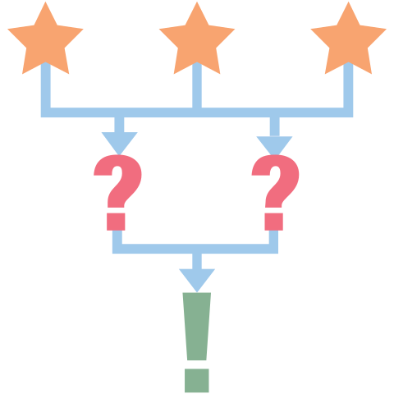
3-2-1 Reflection
List three issues that led to the Delano Grape Strike.
List two nonviolent tactics that were used in the strike.
Explain how political participation can effect change.
Notes:
K20 Center. (n.d.). 3-2-1. Strategies. https://learn.k20center.ou.edu/strategy/117

