Slide 2
Reframing the Argument
Examining Argument Through a New Lens

Slide 3
Essential Question
How do our experiences affect the way we argue?

Slide 4
Lesson Objectives
Assert and defend a position on an issue using evidence and logical reasoning in an oral and written response.
Watch an interview with a defense attorney and describe how they use argumentative writing in their everyday work.

Slide 5
Bell Ringer
Read each statement on the Anticipation Guide.
Determine whether you agree or disagree with each statement.
Be prepared to discuss your responses.

Slide 6

Fold the Line
Line up according to how much you agree or disagree with the following statements.

Slide 7
Fold the Line
My individual feelings, choices, and needs are more important than everyone else’s.

Slide 8
Fold the Line
Stealing is always wrong.

Slide 9
Fold the Line
People who do not break the law are good people.

Slide 10
The Heinz Dilemma
Discuss your responses on the The Heinz Dilemma handout.
Use the Talk Moves handout to support your discussion.
Reflect on the following questions in your group.
  Did anyone have different answers within the group?
  Is there anything you changed your mind about after discussing the questions with your group?
  Why is it important to consider all sides of an issue?
  Who is the victim in this story and why?

Slide 11
Claims and Counterclaims
Write your assigned claim at the top of the paper.
  He shouldn’t steal because stealing is always wrong.
  He should steal because medicine should always be free.
  He shouldn’t steal because the chemist might have bills/sick spouse/sick child and need the money in an equally urgent way.
  He should steal because it’s saving a life and a life is worth more than money.
Write three counterclaims to your assigned claim.
Read the other claims and counterclaims, add any other counterclaims your group can think of.

Slide 12
Gallery Walk
Hang up your group’s paper.
Move around and read the counterclaims made by each group.
  Which of the four claims are the most difficult to defend? Why?
  Which of these claims is the easiest to defend? Why?
  Why is it important to consider counterclaims?
  What counterclaims did your classmates produce that your group didn’t?
  What counter-arguments could you use to respond to your classmates’ counterclaims?

Slide 13
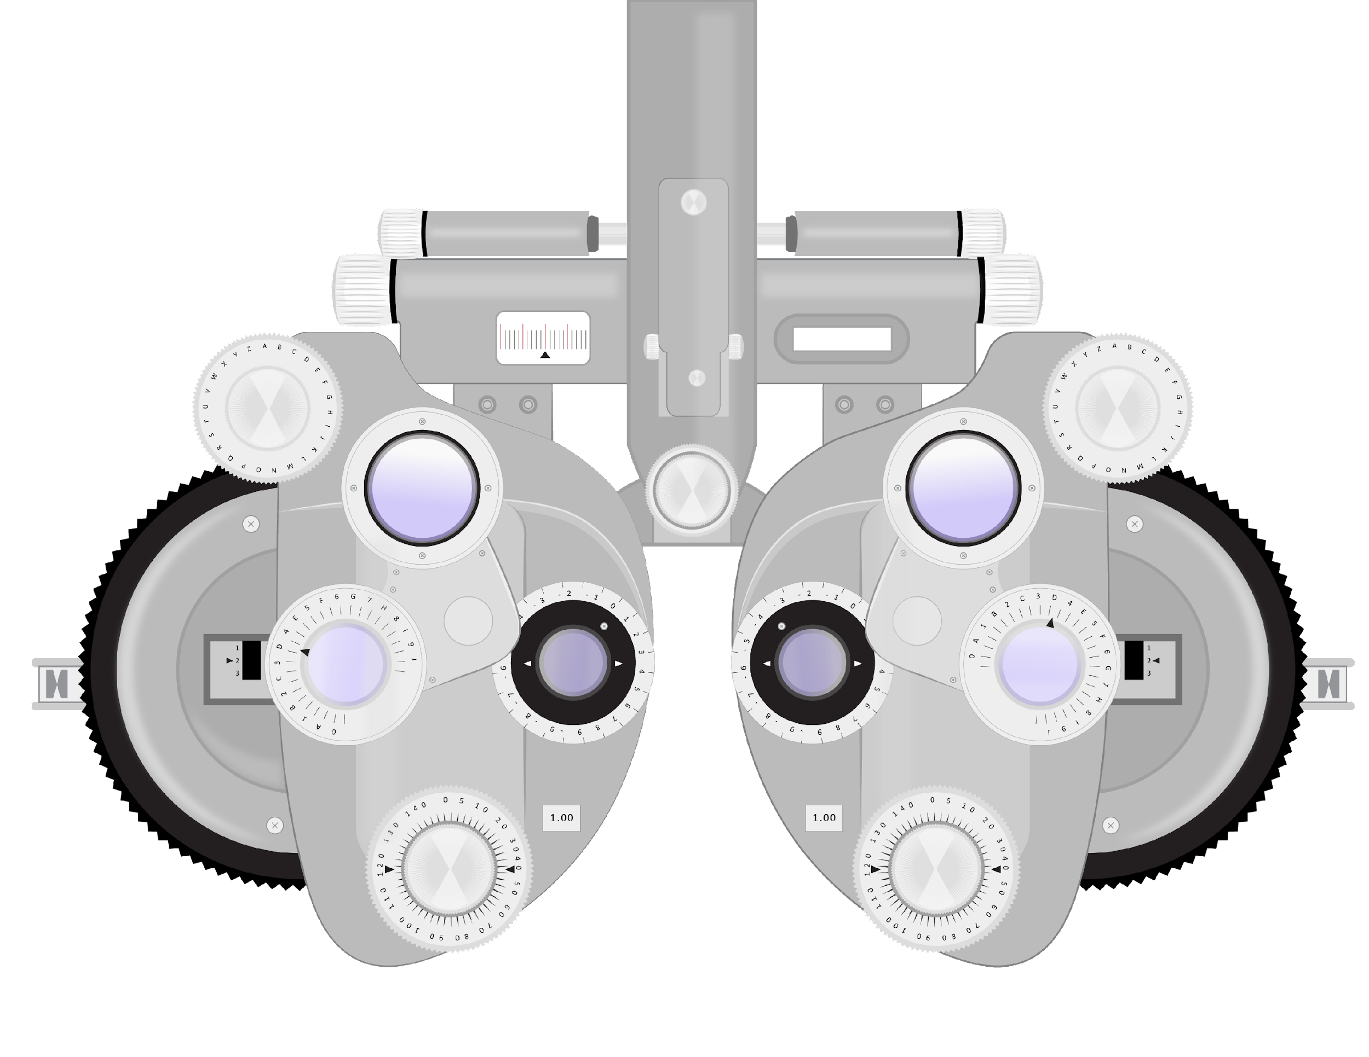

Slide 14
What does this machine do?
Where have you seen this machine?
Notes:
Can the graphic appear first and then the text on click?

Slide 15
Looking Through a Phoropter
How can viewing something from different lenses help you when creating an argument?
  It helps form your position on a topic and look at the topic from different perspectives.
  Writing an argument is like using a refractor you find at the eye doctor’s office. You need to look through different lenses to see a full, clear picture.
Notes:
Bullets appear on clicks

Slide 16
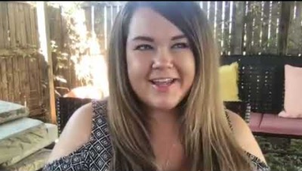
Kate Loughlin: Criminal Defense Attorney
https://www.youtube.com/watch?v=Cw8hCX8eFEE
Notes:
K20 Center. (2022, Sept. 22). K20 ICAP – Reframing the Argument [Video]. YouTube. https://www.youtube.com/watch?v=Cw8hCX8eFEE

Slide 17
Kate Loughlin: Criminal Defense Attorney
What did you take away from this interview?
What are her first steps when assigned a new case? How is this similar to argumentative writing?
How does her experience as a prosecutor help her as a defense attorney? How does this relate to the lenses analogy we discussed earlier?
When discussing the Heinz Dilemma, she forms her argument by using facts to ask for leniency. Why does viewing the circumstances from this lens help her defend Heinz?

Slide 18
Let’s Practice
Select one of the topics below.
Write two paragraphs asserting and defending your position.
  One Claim, Evidence, Reasoning paragraph defending your position.
  One Counterclaim/counter-argument paragraph.
Should schools abolish homework?
Should all students receive free breakfast and lunch?
Should teachers be held accountable for poor test scores?
Is online learning effective?

Slide 19

Claim, Evidence, Reasoning
Notes:
K20 Center. (2021, August 19). Claims, evidence, and reasoning [Video]. YouTube. https://www.youtube.com/watch?v=JGOxVIgmGWE&t=1s

Slide 20
CER Sentence Starters
Claim: | State claim.
Evidence: | For example, _________.
Reasoning: | This shows _________. This is important because ________.
Evidence: | Furthermore, ____________.
Reasoning: | This shows __________. This is important because ______________.
Counterclaim/Counter-Argument Sentence Starters
Counterclaim: | On the other hand, some people will say ________. This point of view makes sense because _____________.
Counter-Argument: | However, _________. Therefore, __________.

