Slide 2
Deconstructing Reconstruction
The Reconstruction Era

Slide 3
Lesson Objective
Students analyze the transformation of the United States during the Reconstruction Era.

Slide 4

Bell Ringer
What does it mean to reconstruct something?
Notes:
K20 Center. (n.d.). Bell ringers and exit tickets. Strategies. https://learn.k20center.ou.edu/strategy/125

Slide 5
Bell Ringer 2
When something needs to be reconstructed,
what does that say about the original version?

Slide 6
Essential Question
How did Reconstruction shape America?

Slide 7
A Freedman Writes His Former Master
Read the letter with an Elbow Partner. Each pair will have one sticky note and will come up with a statement or question using sentence starters.
Make a prediction, ask a question, clarify a source of confusion, or comment on what is happening in the text.
Notes:
Anderson, J. (n.d.). Letter from Jourdan Anderson: A Freedman Writes His Former Master. Retrieved from Facing History. https://www.facinghistory.org/reconstruction-era/letter-jourdon-anderson-freedman-writes-former-master
K20 Center. (n.d.). Elbow partners. Strategies. https://learn.k20center.ou.edu/strategy/116

Slide 8
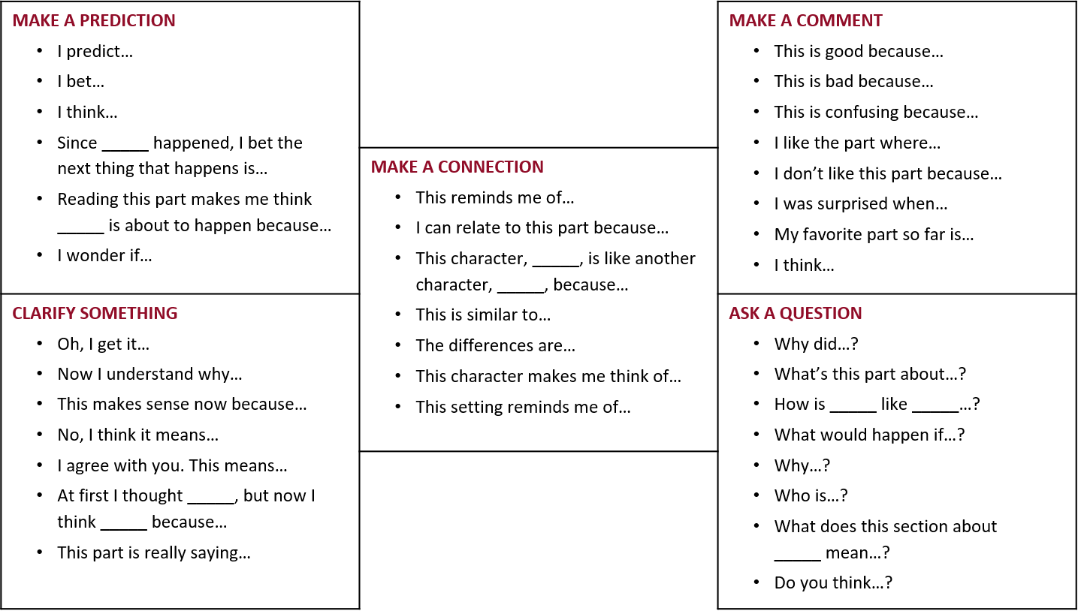
Say Something
Notes:
K20 Center. (n.d.). Say Something. Strategies. https://learn.k20center.ou.edu/strategy/778

Slide 9
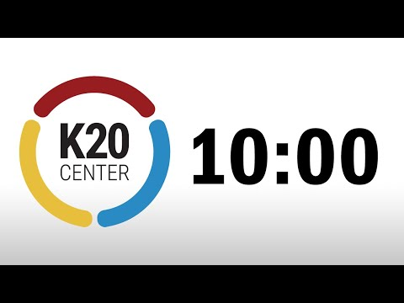
Reconstruction Jigsaw Timer
Notes:
K20 Center. (n.d). Jigsaw. Strategies. https://learn.k20center.ou.edu/strategy/179

Slide 10

S-I-T (Surprising, Interesting, Troubling)
As you watch the video, write down the following:
A surprising fact or idea
An interesting fact or idea
A troubling fact or idea
Notes:
K20 Center. (n.d.). S-I-T. Strategies. https://learn.k20center.ou.edu/strategy/926

Slide 11
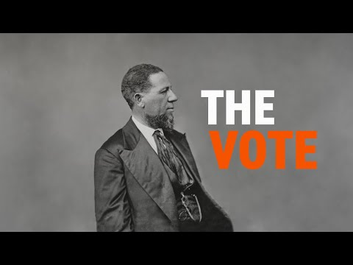
Reconstruction: The Vote
Notes:
https://youtu.be/7x_m1EkyB_E

Slide 12
Exit Ticket
How did Reconstruction shape America?
Notes:
K20 Center. (n.d.). Bell ringers and exit tickets. Strategies. https://learn.k20center.ou.edu/strategy/125

