Slide 2
The Maine Event
The Role of the Media in the Spanish-American War

Slide 3
Essential Question
How much influence does the media have on
major events?

Slide 4
Lesson Objectives
Explain the role of yellow journalism during the Spanish-American War.
Evaluate the role of journalism in understanding our world.

Slide 5
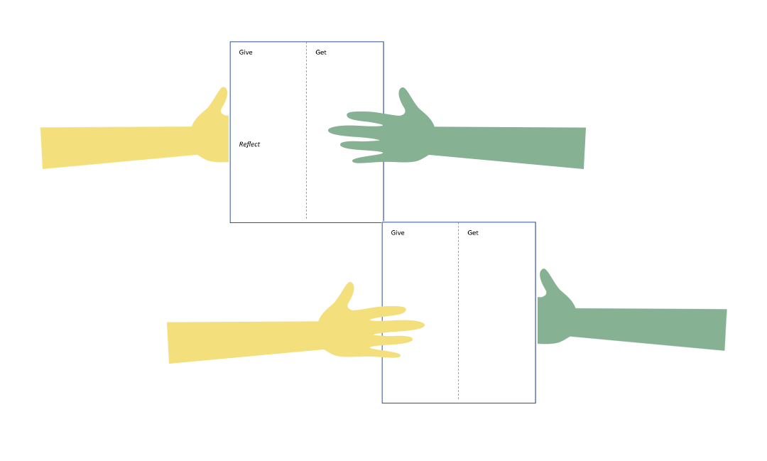
Give-Get-Reflect
Give | Get | Reflect
Notes:
K20 Center. (n.d.).Give, Get, Reflect. Strategies. https://learn.k20center.ou.edu/strategy/2184

Slide 6
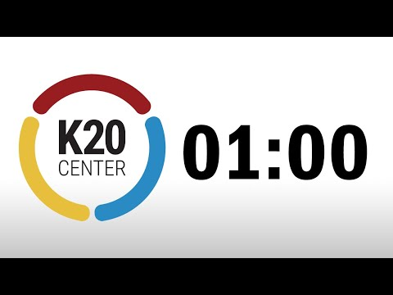
What is the purpose of the news?
Write your response under the “Give” column.
Trade papers with another student. Write your response under the “Get” column on their paper.
Repeat this process with two other students.
Review what is written in your “Get” column.
Write what you have learned under “Reflect.”
  Has your thinking changed?
  What do you think now that you have read other students’ responses?
1 minute timer
Notes:
K20 Center. (2021.). One minute timer. YouTube. Retrieved June 15, 2022, from https://www.youtube.com/watch?v=6ilD555O_RE.

Slide 7
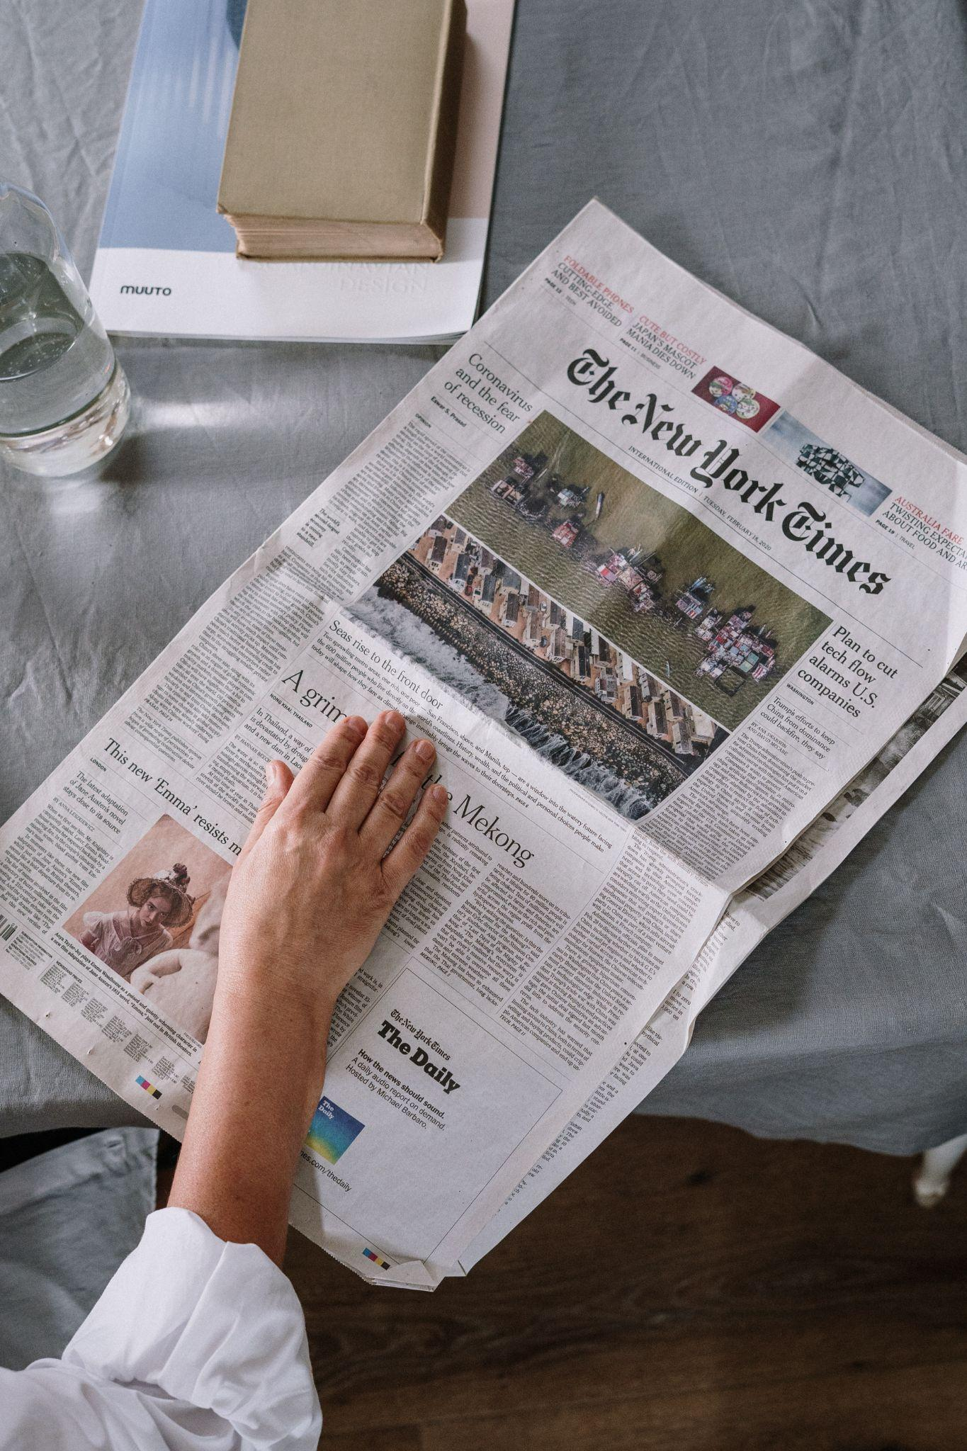
Group Discussion
What is the purpose of the news?
Notes:
Strategy for Group Discussion?
Cottonbro. (2020). Person Reading Newspaper on Table. https://www.pexels.com/photo/person-reading-newspaper-on-table-4057766/. Retrieved June 21, 2022.

Slide 8

Elbow Partners
Find a partner near you.
With your partner, compare and contrast the two images on the next slide.
Notes:
K20 Center. (n.d.). Elbow partners. Strategies. https://learn.k20center.ou.edu/strategy/116

Slide 9
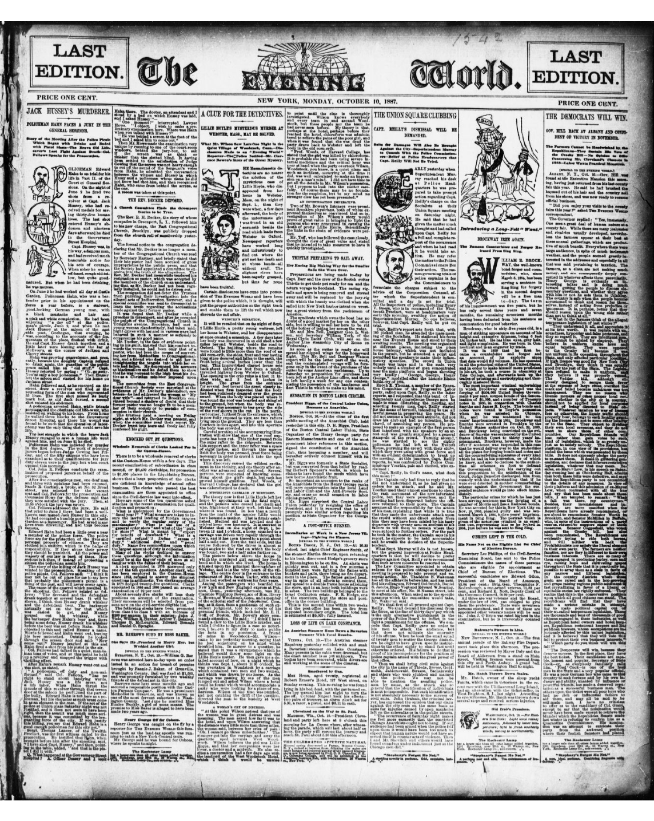
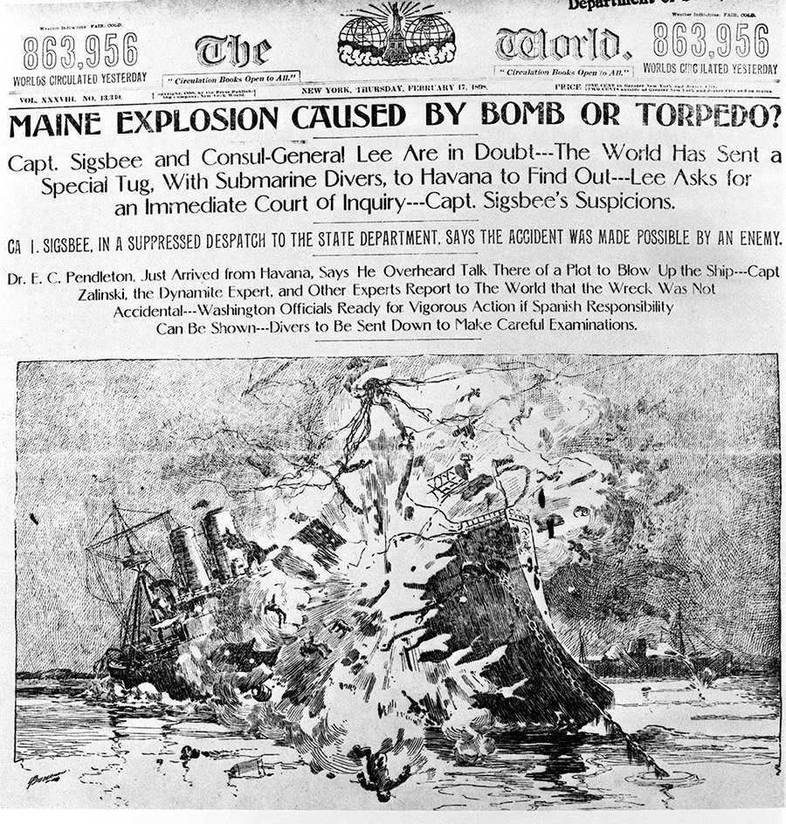
Before Yellow Journalism
During Yellow Journalism
Notes:
Library of Congress. (n.d.) The evening world (New York, N.Y.), October 10, 1887, (last edition). Retrieved June 15, 2022, from https://www.loc.gov/item/sn83030193/1887-10-10/ed-1/
Yellow Press Headlines. (n.d.) Yellow Press headlines. Retrieved June 15, 2022, from https://lsintspl3.wgbh.org/en-us/lesson/spanish-american-war/6?as_guest=True

Slide 10
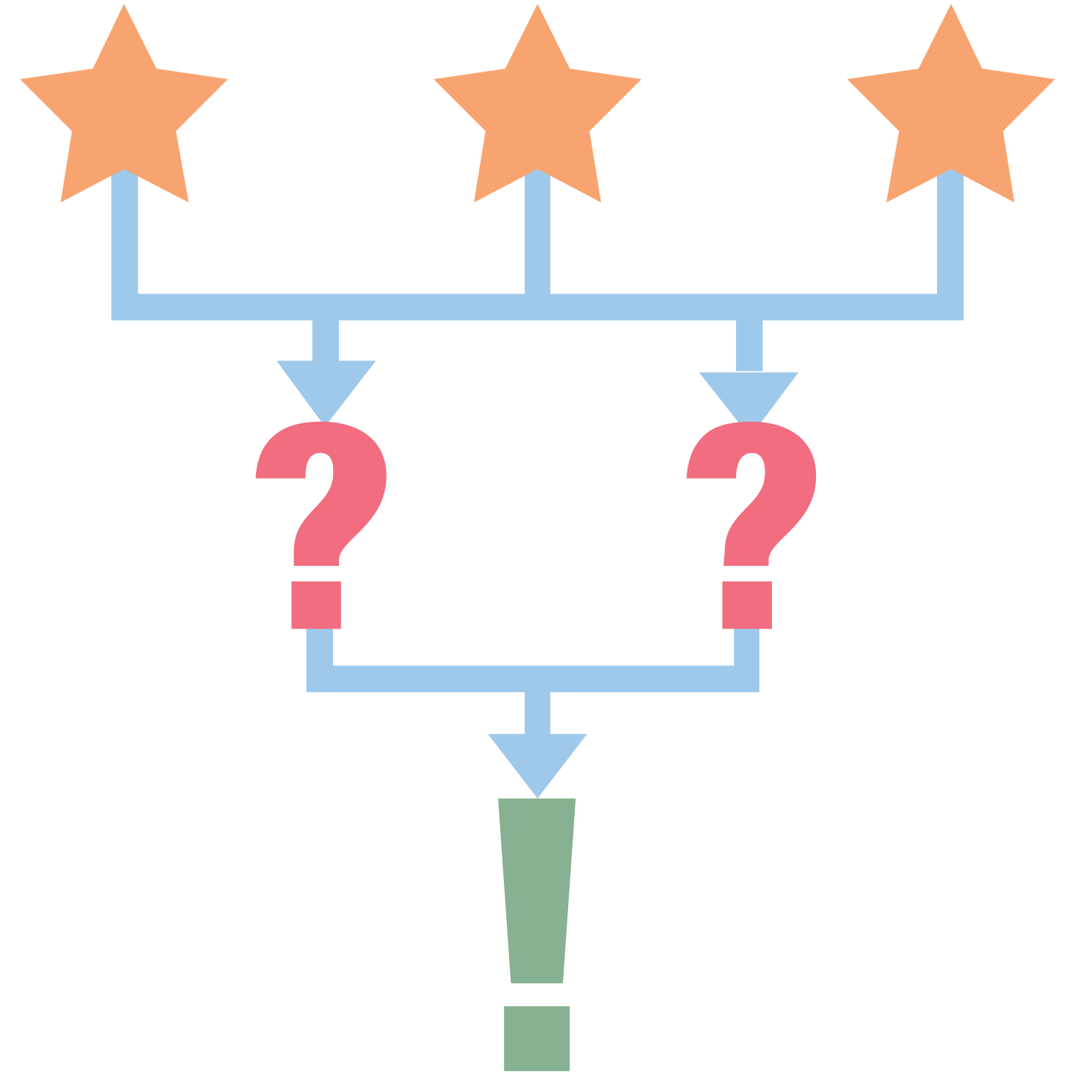
Yellow Journalism 3-2-1
On the next slide you will watch a video about yellow journalism.
  As you watch the video, write the following information on your paper.
    3 attributes of yellow journalism.
    2 questions you have about yellow journalism.
    1 way yellow journalism impacted the United States’ going to war with Spain.
Notes:
K20 Center. (n.d.). 3-2-1. Strategies. https://learn.k20center.ou.edu/strategy/117

Slide 11
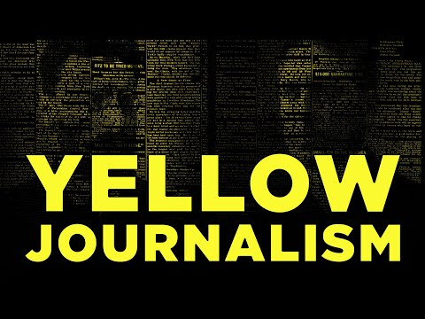
Yellow Journalism
Notes:
YouTube. (2021). YouTube. Retrieved June 15, 2022, from https://www.youtube.com/watch?v=oU2BjNTcToU.

Slide 12
Stand Up, Sit Down
Stand up at your desk.
One at a time, share one attribute of yellow journalism with the class.
If someone shares an idea you have written down, mark it off your page.
When all three of your ideas have been shared out by you or your classmates, sit down.
Notes:
K20 Center. (n.d.). Stand Up, Sit Down. Strategies. https://learn.k20center.ou.edu/strategy/1771

Slide 13
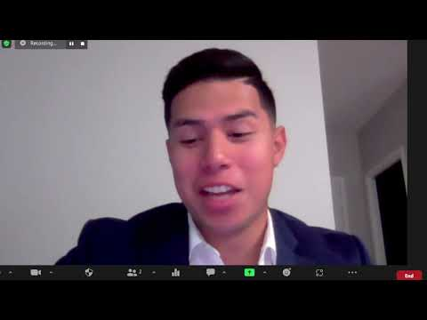
Interview with a News Reporter
Reporter Interview

Slide 14

POMS
What was the most significant
point you learned about
the career of a news reporter?
Notes:
K20 Center. (n.d.). POMS: point of most significance. Strategies. https://learn.k20center.ou.edu/strategy/b30762a7557ba0b391f207f4c600f5ac

Slide 15
Extra! Extra! Read All About it!
Read about the explosion of the USS Maine.
Using the components of yellow journalism, create a front-page newspaper.
  Write a sensationalized headline.
  Rewrite the paragraph using biased and sensationalized language.
  Include a large illustration.
Refer to the Anchor Chart to create your front page.

