Slide 2
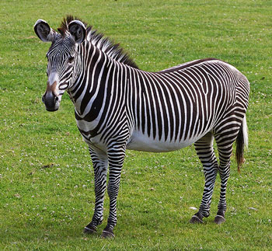
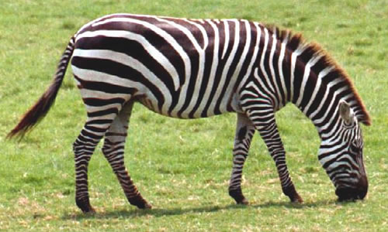
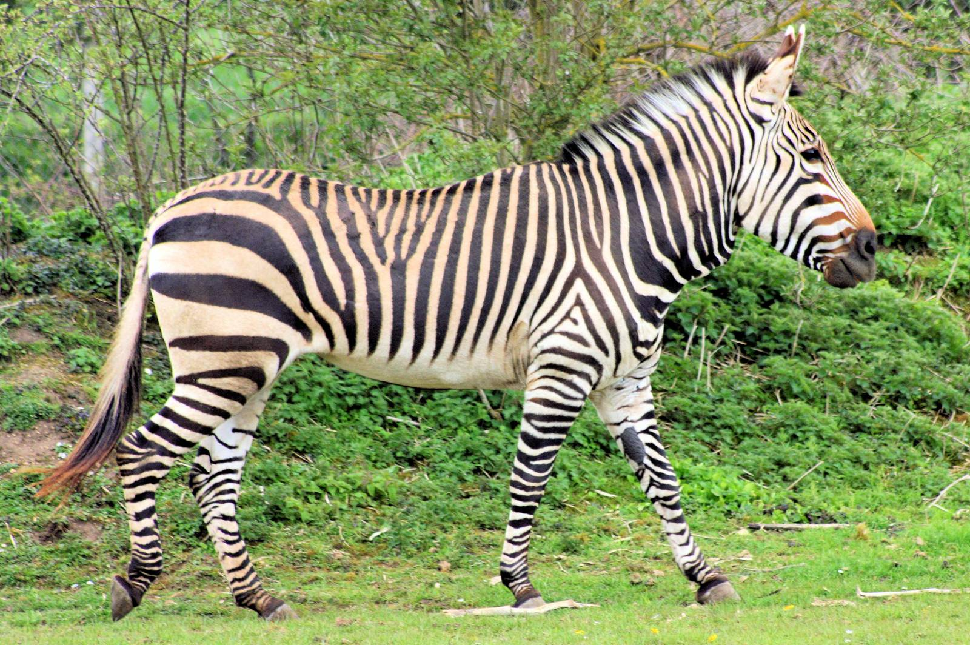
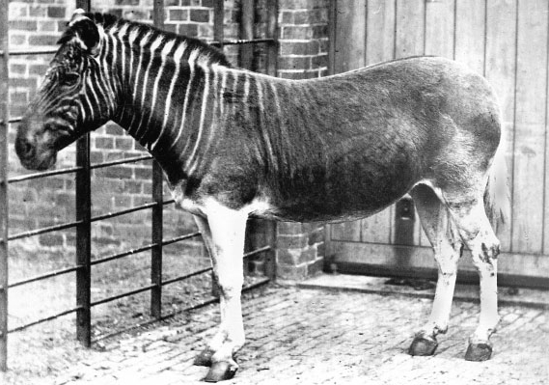
How are they the same?
How are they different?
What are the evolutionary relationships between organisms and how do we illustrate those relationships?

Slide 3
Grévy’s Zebra
Endangered
Plains Zebra
Threatened
Mountain Zebra
Vulnerable
Quagga
Extinct
Notes:
Fun facts, if you want to share them with the students:
Grévy’s Zebra is the biggest of all the zebras. They are also called the imperial zebra because of their size. They are also the most threatened zebra species that is still around, with only 2000 estimated to be left in the wild (some numbers put it as low as 250-750 mature adults in the wild).
(All species that are endangered is because of poaching for their hides and habitat restriction.)
Plains Zebras are also called the “common zebra,” because it’s range is the largest of all the zebra species. Its status is near threatened, so it’s the least endangered of all the species. However, in 2008, they were listed as least concerned, so the population is declining quickly. There are actually three subspecies of Plains Zebras: Grant’s Zebra, Chapman’s Zebra, and Burchell’s Zebra (Burchell’s is extinct now, though).
Mountain Zebras are classified as vulnerable, which is between threatened and endangered. They usually group in much smaller herds than the other species, and unlike the other species, this zebra has a dewlap (flap of skin right under the throat).
Quagga can sometimes refer to a zebra in general, but it also stands for a species of zebra that has been extinct since the 1920s. The Quagga were the first extinct animal that had DNA testing done, since some of their bodies were preserved. There is now an effort to re-establish the Quagga species through back-breeding, which is where genetically similar zebras are selectively bred to build toward the Quagga DNA profile.

Slide 4
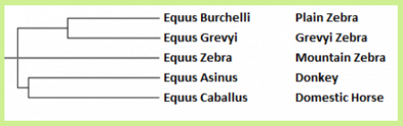
Zebra Speciation
What are the evolutionary relationships between organisms and how do we illustrate those relationships?
Notice the order of speciation
Which species diverged first?
Quagga isn’t included because they’re extinct
But, based on the pictures, where do you think Quagga would go?

Slide 5
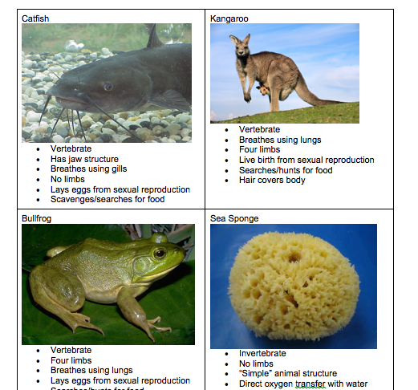
Cladogram Cards
Determine the order in which the species given diverged.
Be ready to explain the order you chose, and be ready to use evidence as part of your explanation
What are the evolutionary relationships between organisms and how do we illustrate those relationships?

Slide 6
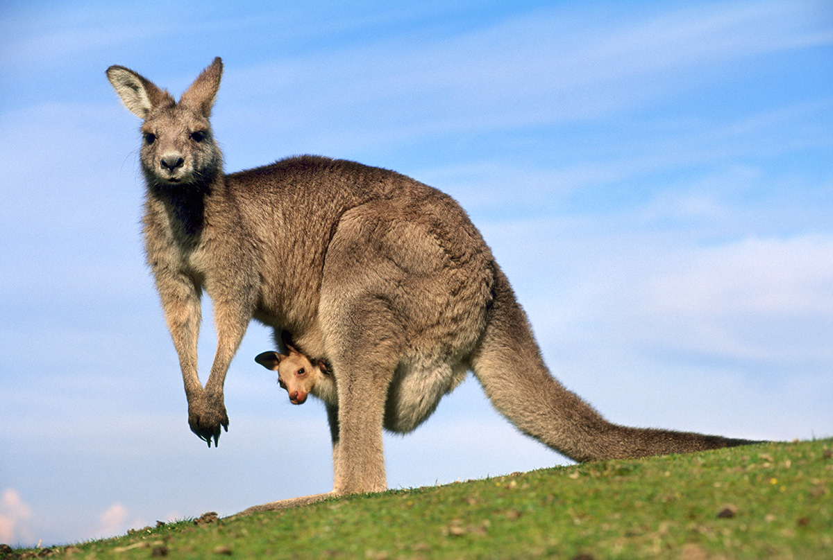
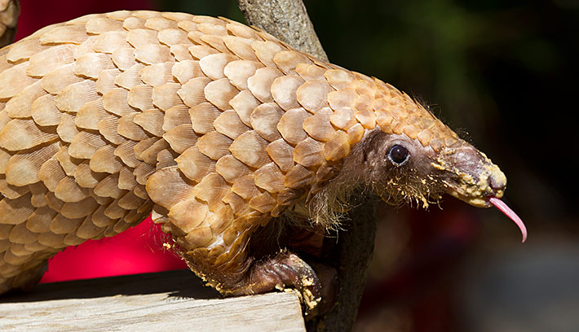
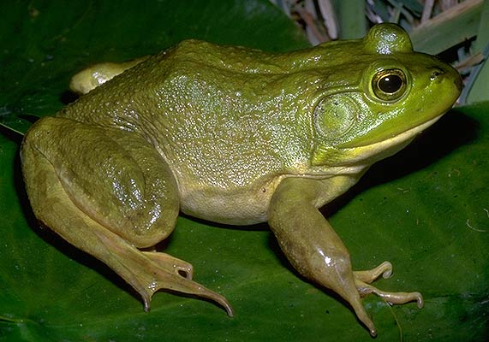
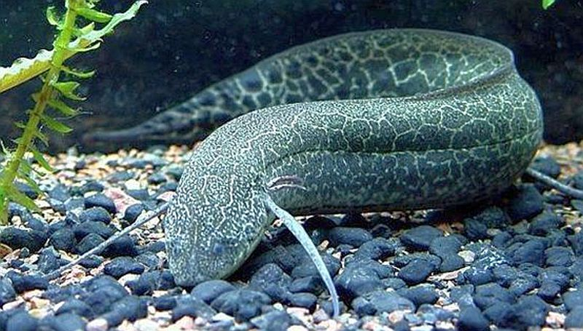
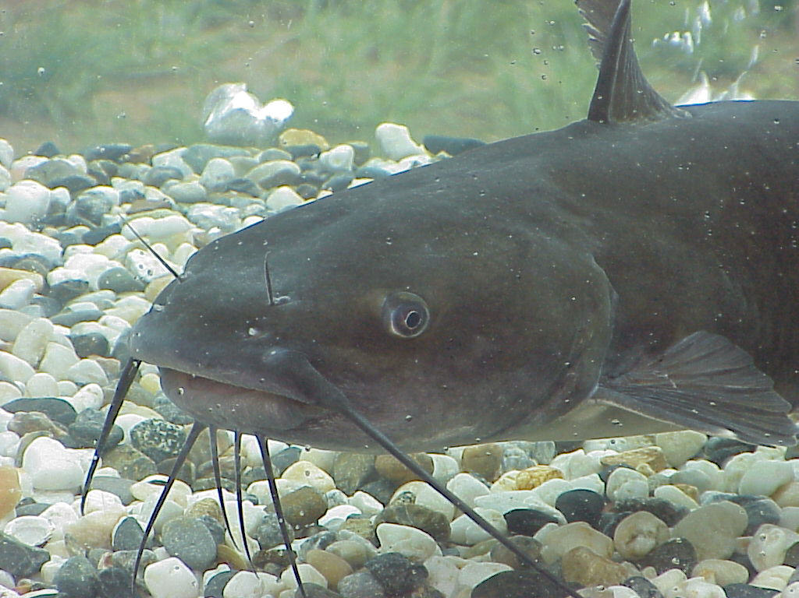
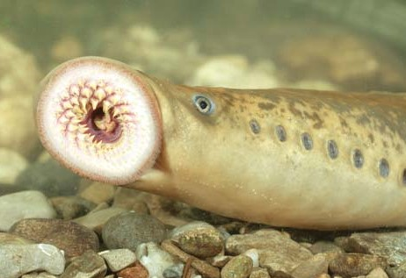
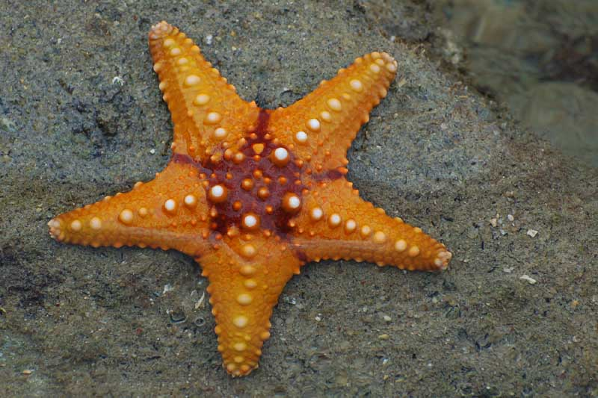
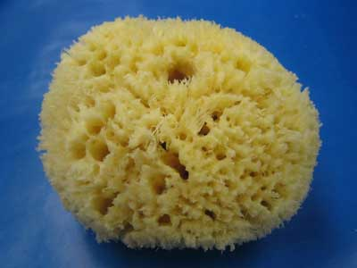
Cladogram Cards Set A Answers
Add fur
Kangaroo
Add Live Birth
Pangolin
Add Limbs
Frog
Add Lungs
Lungfish
Add Active Feeding
Catfish
Add Active Breathing
Lamprey
Add Sexual Reproduction
Starfish
Sponge

Slide 7
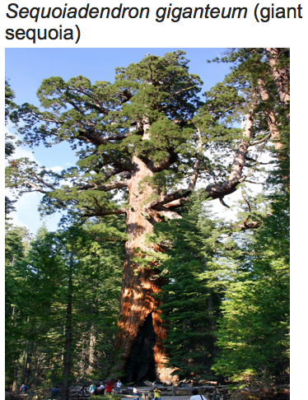
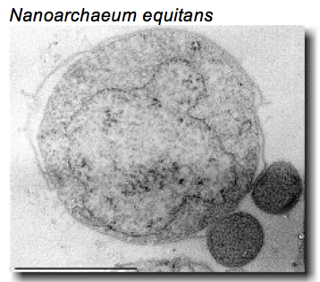
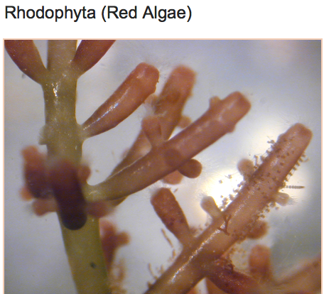
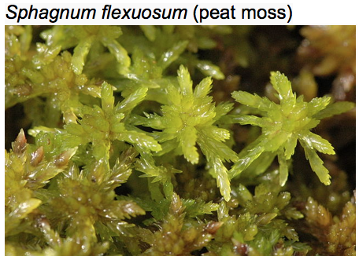
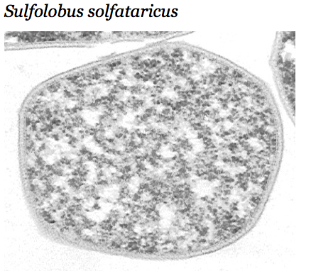
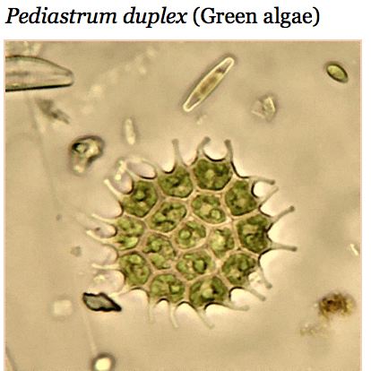
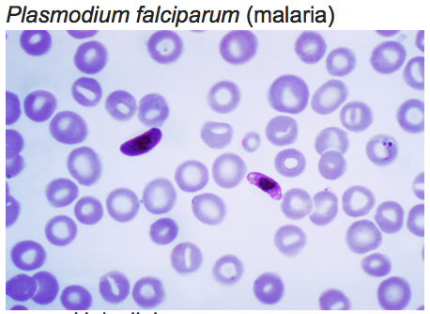
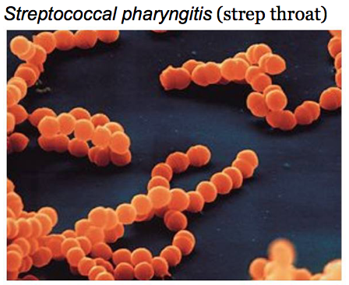
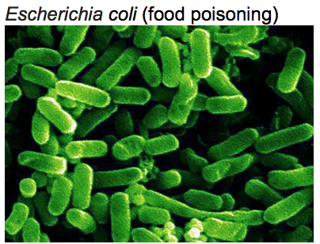
Cladogram Cards Set B Answers
Multicellular
Root
System
Membrane-bound
Organelles
Cold Conditions
Organ
Systems
Hot Conditions
Extreme
Conditions
Contains
chloroplasts
Shape
Change
Circular
Chromosome
Bacillus Shape
Coccus shape
Original Life Form

Slide 8
Think, Pair, Share
What are the evolutionary relationships between organisms and how do we illustrate those relationships?
Think about how you would answer the question
Turn to a partner. Discuss how you would answer this question
Share some answers with the whole class

Slide 9
The History and Evolution of the Cell Phone
Read the blog post about cell phones
Get into groups of 2-3
Based on what you read, can you map the evolution of cell phones?
Could you put that evolution into a cladogram?
Pick any topic that you want, and get ready to research it
Your group will construct a cladogram of your topic based on what you found in your research

Slide 10
Gallery Walk
Grab a rubric for reference
Wander about, looking at the other group’s cladograms
Using the rubric as a guide, use Post-it notes to give feedback to the other groups.
Make sure you’re not just giving positive feedback but constructive ideas to help the groups improve, as well.

