Slide 2
Goodness Gracious, Great Balls of Fire!
Chemical Reactions

Slide 3
Essential Questions
What happens to atoms during chemical reactions?

Slide 4
Learning Objectives
Identify reactions in everyday activities.
Apply understanding of reactants compared to products for different types of chemical reactions.
Apply the principle that energy and matter are conserved, not created or destroyed.

Slide 5

Chain Notes—Round 1
On your handout in the “You” row, write three (3) things you already know about chemical reactions.
Pass your handout the person on your left when time is called.
Notes:
K20 Center. (n.d.). Chain notes. Strategies. https://learn.k20center.ou.edu/strategy/52

Slide 6
Chain Notes—Round 2
Read the three (3) points written in the first row made by your classmate.
Choose one of the points and draw an arrow down to the section labeled “Partner 1.”
Add an additional fact, idea, or correction through words or a drawing.
Pass the handout to the person on your left.
Notes:
K20 Center. (n.d.). Chain notes. Strategies. https://learn.k20center.ou.edu/strategy/52

Slide 7
Chain Notes—Round 3
Read the three (3) points written in the first row made by your classmate.
Choose one of the points and draw an arrow down to the section labeled “Partner 2.”
Add an additional fact, idea, or correction through words or a drawing.
Pass the handout to the person on your left.
Notes:
K20 Center. (n.d.). Chain notes. Strategies. https://learn.k20center.ou.edu/strategy/52

Slide 8
Chain Notes—Round 4
Read the three (3) points written in the first row made by your classmate.
Choose one of the points and draw an arrow down to the section labeled “Partner 3.”
Add an additional fact, idea, or correction through words or a drawing.
Pass the handout back to the original person.
Notes:
K20 Center. (n.d.). Chain notes. Strategies. https://learn.k20center.ou.edu/strategy/52

Slide 9
Chain Notes—Round 5
Take 5 minutes to review the comments you received on your paper.
Once everyone has finished reviewing their papers, take another 5 minutes as a group to summarize what everyone knows about chemical reactions.
Be prepare to share out.
Notes:
K20 Center. (n.d.). Chain notes. Strategies. https://learn.k20center.ou.edu/strategy/52

Slide 10
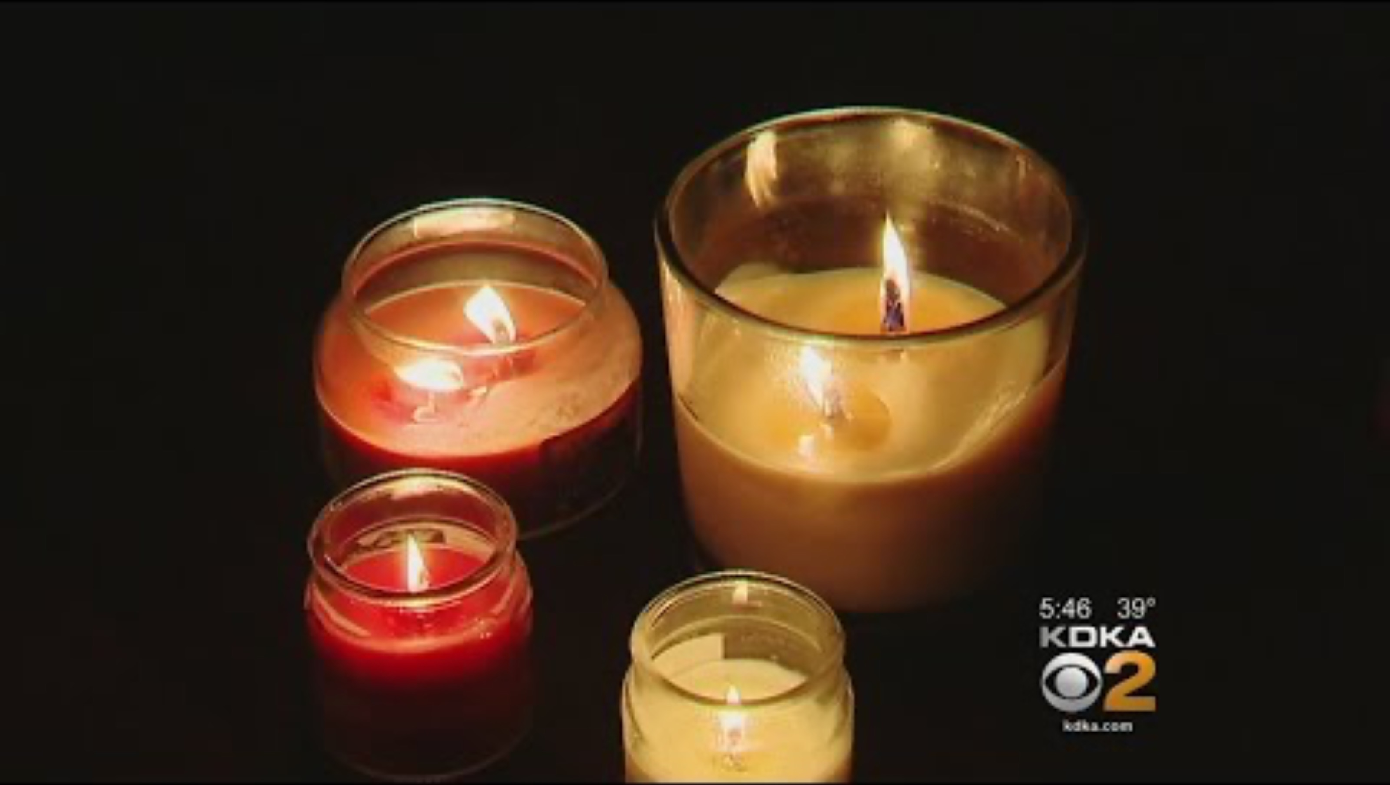
Candle Fires
Notes:
CBS Pittsburgh. (2017). Experts Warns Against Using Water to Douse Candle Fires [Video]. YouTube. https://www.youtube.com/watch?v=ZI30ZnePn60.

Slide 11
Think about this…
Reactants
Products

Slide 12

Card Sort
As a group:
Take a moment to review all of the different items you have.
Determine which cards go together.
Discuss why you might group these together
Notes:
K20 Center. (n.d.). Card sort. Strategies. https://learn.k20center.ou.edu/strategy/147

Slide 13
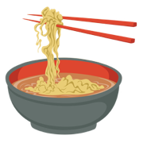
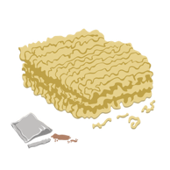
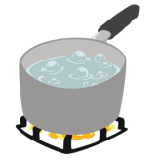
Products
Reactants
+

Slide 14



Products
Reactants
+

Slide 15
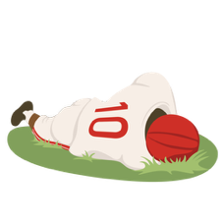

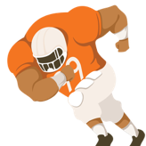
Products
Reactants
+

Slide 16

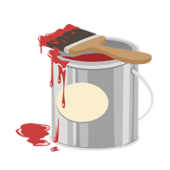
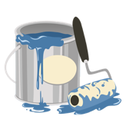
Products
Reactants
+

Slide 17
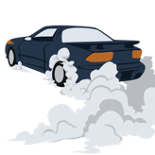
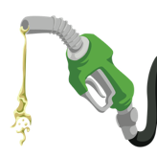

Products
Reactants
+

Slide 18
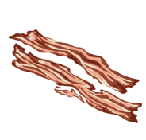
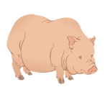
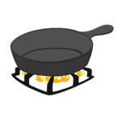
Products
Reactants
+

Slide 19
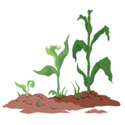



Products
Reactants
+
+

Slide 20
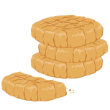



Products
Reactants
+
+

Slide 21




Products
Reactants
+
+

Slide 22




Products
Reactants
+
+

Slide 23

Types of Chemical Reactions
Notes:
K20 Center. (2022, October 6). “K20 ICAP - Goodness Gracious, Great Balls of Fire!” [Video]. YouTube. (2022). https://www.youtube.com/watch?v=15QD5I2tRNM&list=PL-aUhEQeaZXLg0yYwLKeUT2Ud1sC0inzo&index=24&t=2s

Slide 24
Meet the Battalion Chief
Notes:
K20 Center. (2022, October 6). “K20 ICAP - Goodness Gracious, Great Balls of Fire!” [Video]. YouTube. (2022). https://www.youtube.com/watch?v=15QD5I2tRNM&list=PL-aUhEQeaZXLg0yYwLKeUT2Ud1sC0inzo&index=24&t=4m35s

Slide 25

Chat Stations
You and your group will go to each station to determine the products for each problem.
Once you have solved the problem, use your answer to find the next chat station.
Notes:
Physical Science Extend
K20 Center. (n.d.). Chat stations. Strategies. https://learn.k20center.ou.edu/strategy/944

Slide 26
Chat Stations
You and your group will go to each station to determine the product for each problem and determine the molecular model for the product side.
Once you have solved the problem, record your answers on the provided handout.
Notes:
Chemistry Extend
K20 Center. (n.d.). Chat stations. Strategies. https://learn.k20center.ou.edu/strategy/944

Slide 27

I Used to Think…But Now I Know…
Write a statement of what you used to think about chemical reactions.
On the right side of your page, write at least one thing that you now understand about reactions.
Notes:
K20 Center. (n.d.). I used to think . . . but now I know. Strategies. https://learn.k20center.ou.edu/strategy/137

