Slide 2
Goodness Gracious, Great Balls of Fire!
Chemical Reactions

Slide 3
Essential Question
How are atoms/mass conserved during a chemical reaction?

Slide 4
Learning Objectives
Identify reactions in everyday activities.
Apply understanding of reactants compared to products for different types of chemical reactions.
Apply the principle that energy and matter are conserved, not created or destroyed.

Slide 5
Chain Notes: Round 1
On your handout in the “You” row, write three things you already know about chemical reactions.
Pass your handout the person on your left when time is called.
Notes:
K20 Center. (n.d.). Chain notes. Strategy. https://learn.k20center.ou.edu/strategy/52

Slide 6
Chain Notes: Round 2
Read the three points written in the first row made by your classmate.
Choose one of the points and draw an arrow down to the section labeled “Partner 1.”
Add an additional fact, idea, or correction through words or a drawing.
Pass the handout to the person on your left.

Slide 7
Chain Notes: Round 3
Read the three points written in the first row made by your classmate.
Choose one of the points and draw an arrow down to the section labeled “Partner 2.”
Add an additional fact, idea, or correction through words or a drawing.
Pass the handout to the person on your left.

Slide 8
Chain Notes: Round 4
Read the three points written in the first row made by your classmate.
Choose one of the points and draw an arrow down to the section labeled “Partner 3”
Add an additional fact, idea, or correction through words or a drawing
Pass the handout back to the original person.

Slide 9
Chain Notes: Round 5
Take 5 minutes to review the comments you received on your paper.
Once everyone has finished reviewing their papers, take another 5 minutes as a group to summarize what everyone knows about chemical reactions.
Be prepared to share out.

Slide 10
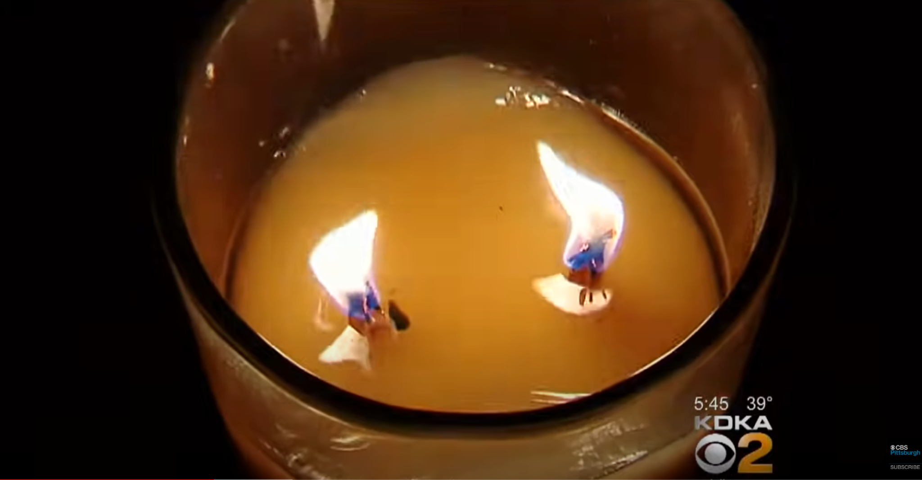
Candle Fires
Notes:
Click on the image to play the video.
YouTube. (2017). YouTube. Retrieved June 1, 2022, from https://www.youtube.com/watch?v=ZI30ZnePn60.

Slide 11
Think about this...
Reactants
Products
Notes:
Use questioning to help recap with students the proper way to set up and identify the parts of a chemical formula before sharing the slide.

Slide 12
Card Sort
As a group:
Take a moment to review all of the different items you have.
Determine which cards go together.
Discuss why you might group these together.
Notes:
Print off enough of the Card Sort document so each group has a set and cut along the dotted lines. Put students in groups of 3-4. Pass out a set of Card Sorts to each group and ask students to group similar reactions together.
The students' reaction to such an open-ended card sort (especially if this is their first time) will likely be to insist that the activity is too hard, and they can't do it. Your first reactions, as a teacher, will be to feed them hints leading into too much information and/or to just give up and move to explaining it as a whole group. The students will only work as hard as they think you'll survive, so don't let them trick you. Allow the hints to be as vague as "What do you notice that's the same? What do you notice that's different?" Wait until they answer. Seriously, resist the urge to fill the silence, put it on the students, and just wait for them to answer.

Slide 13
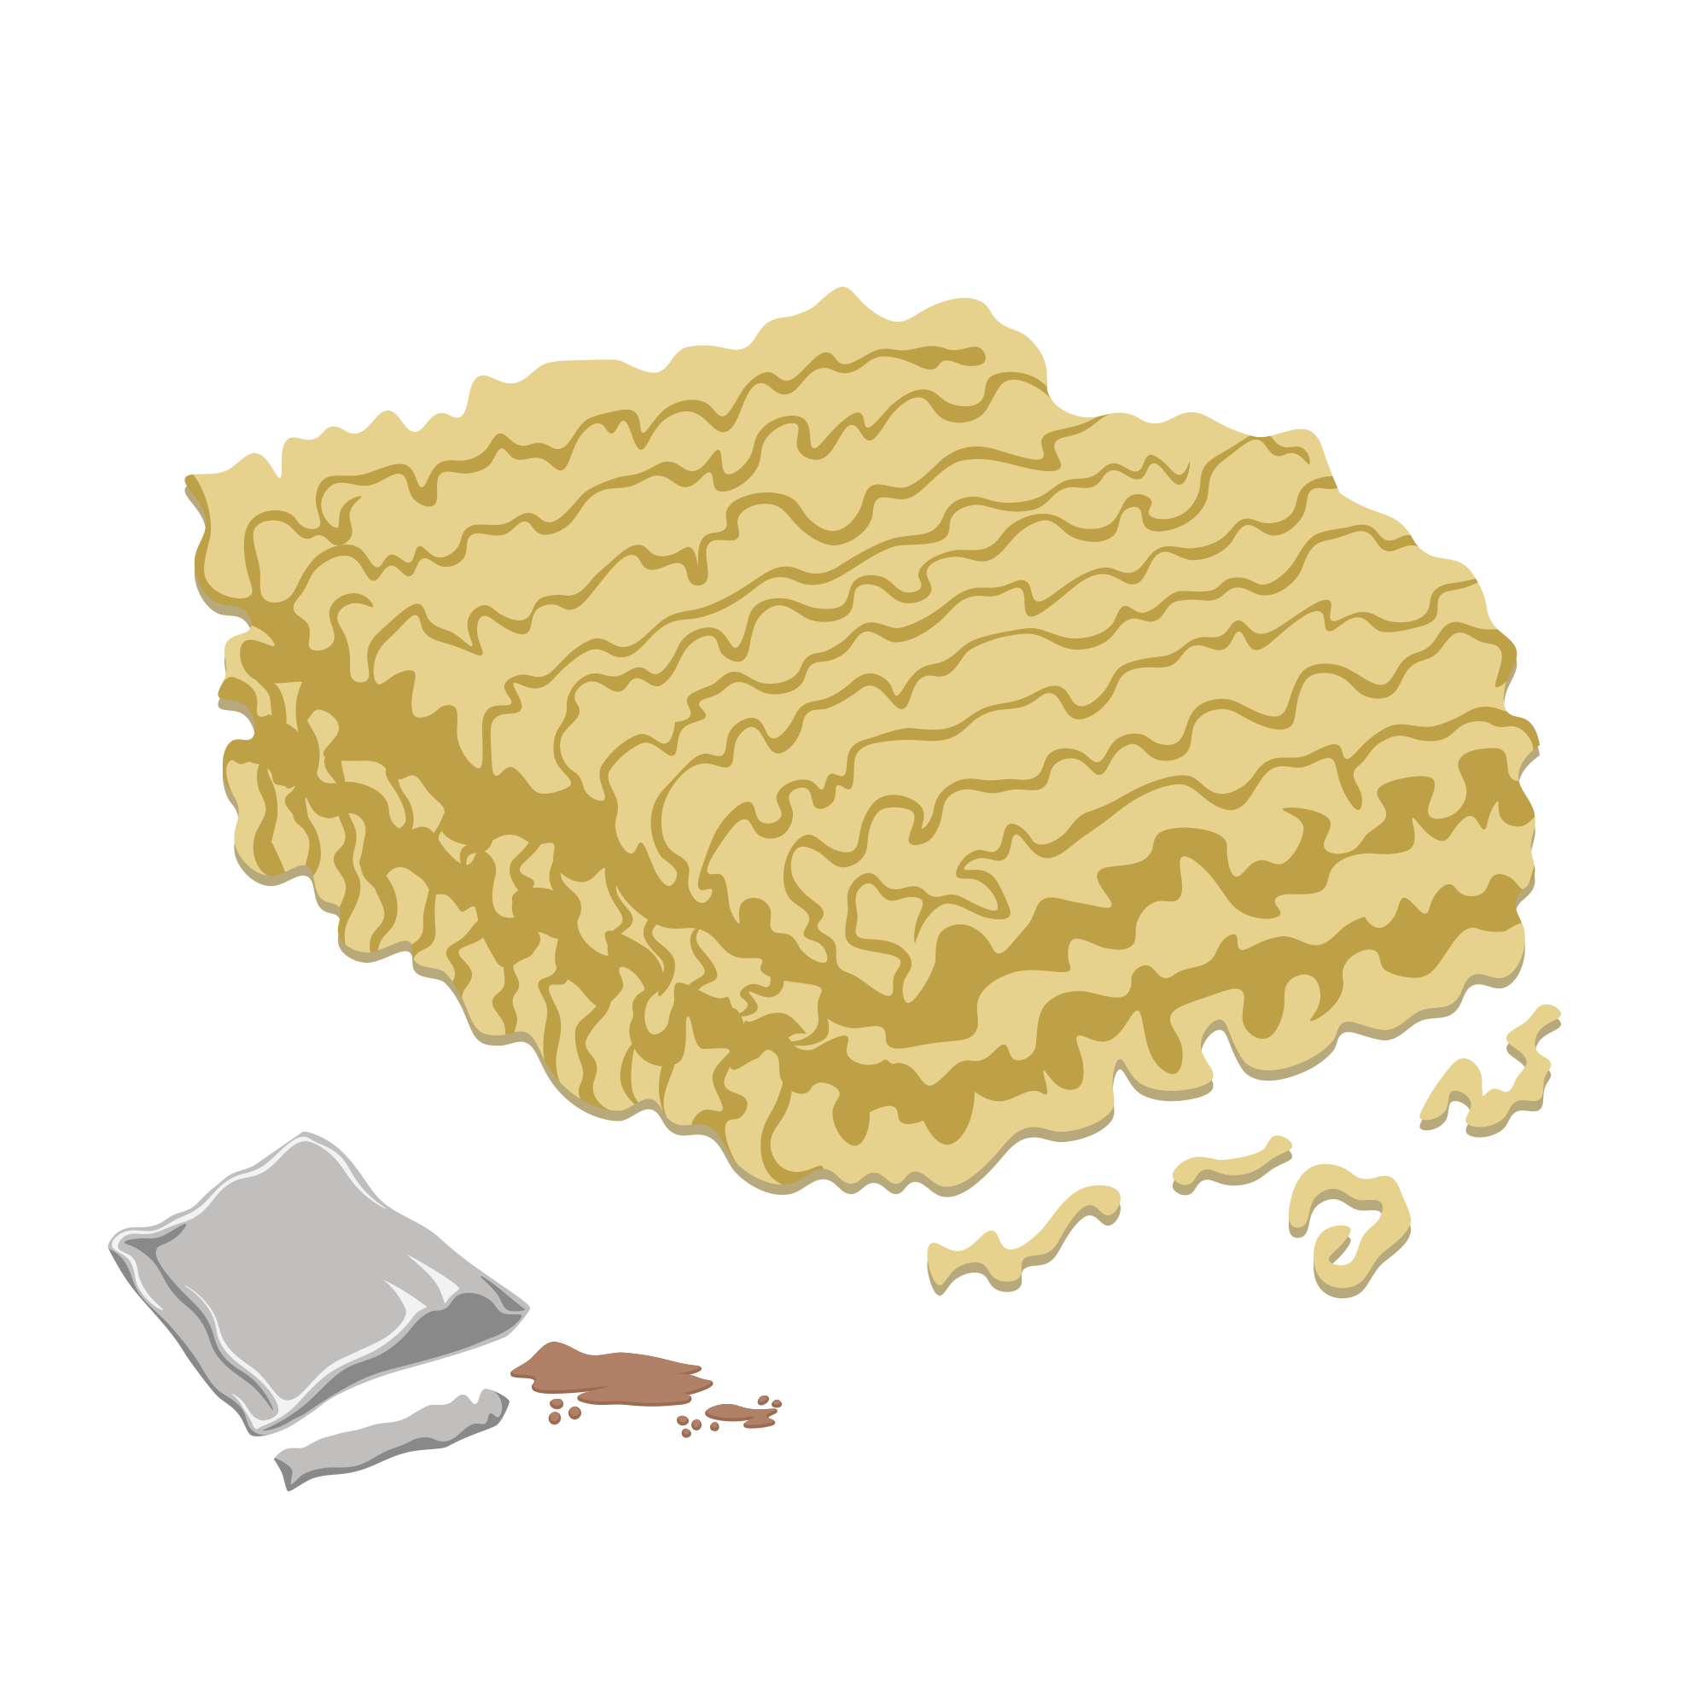
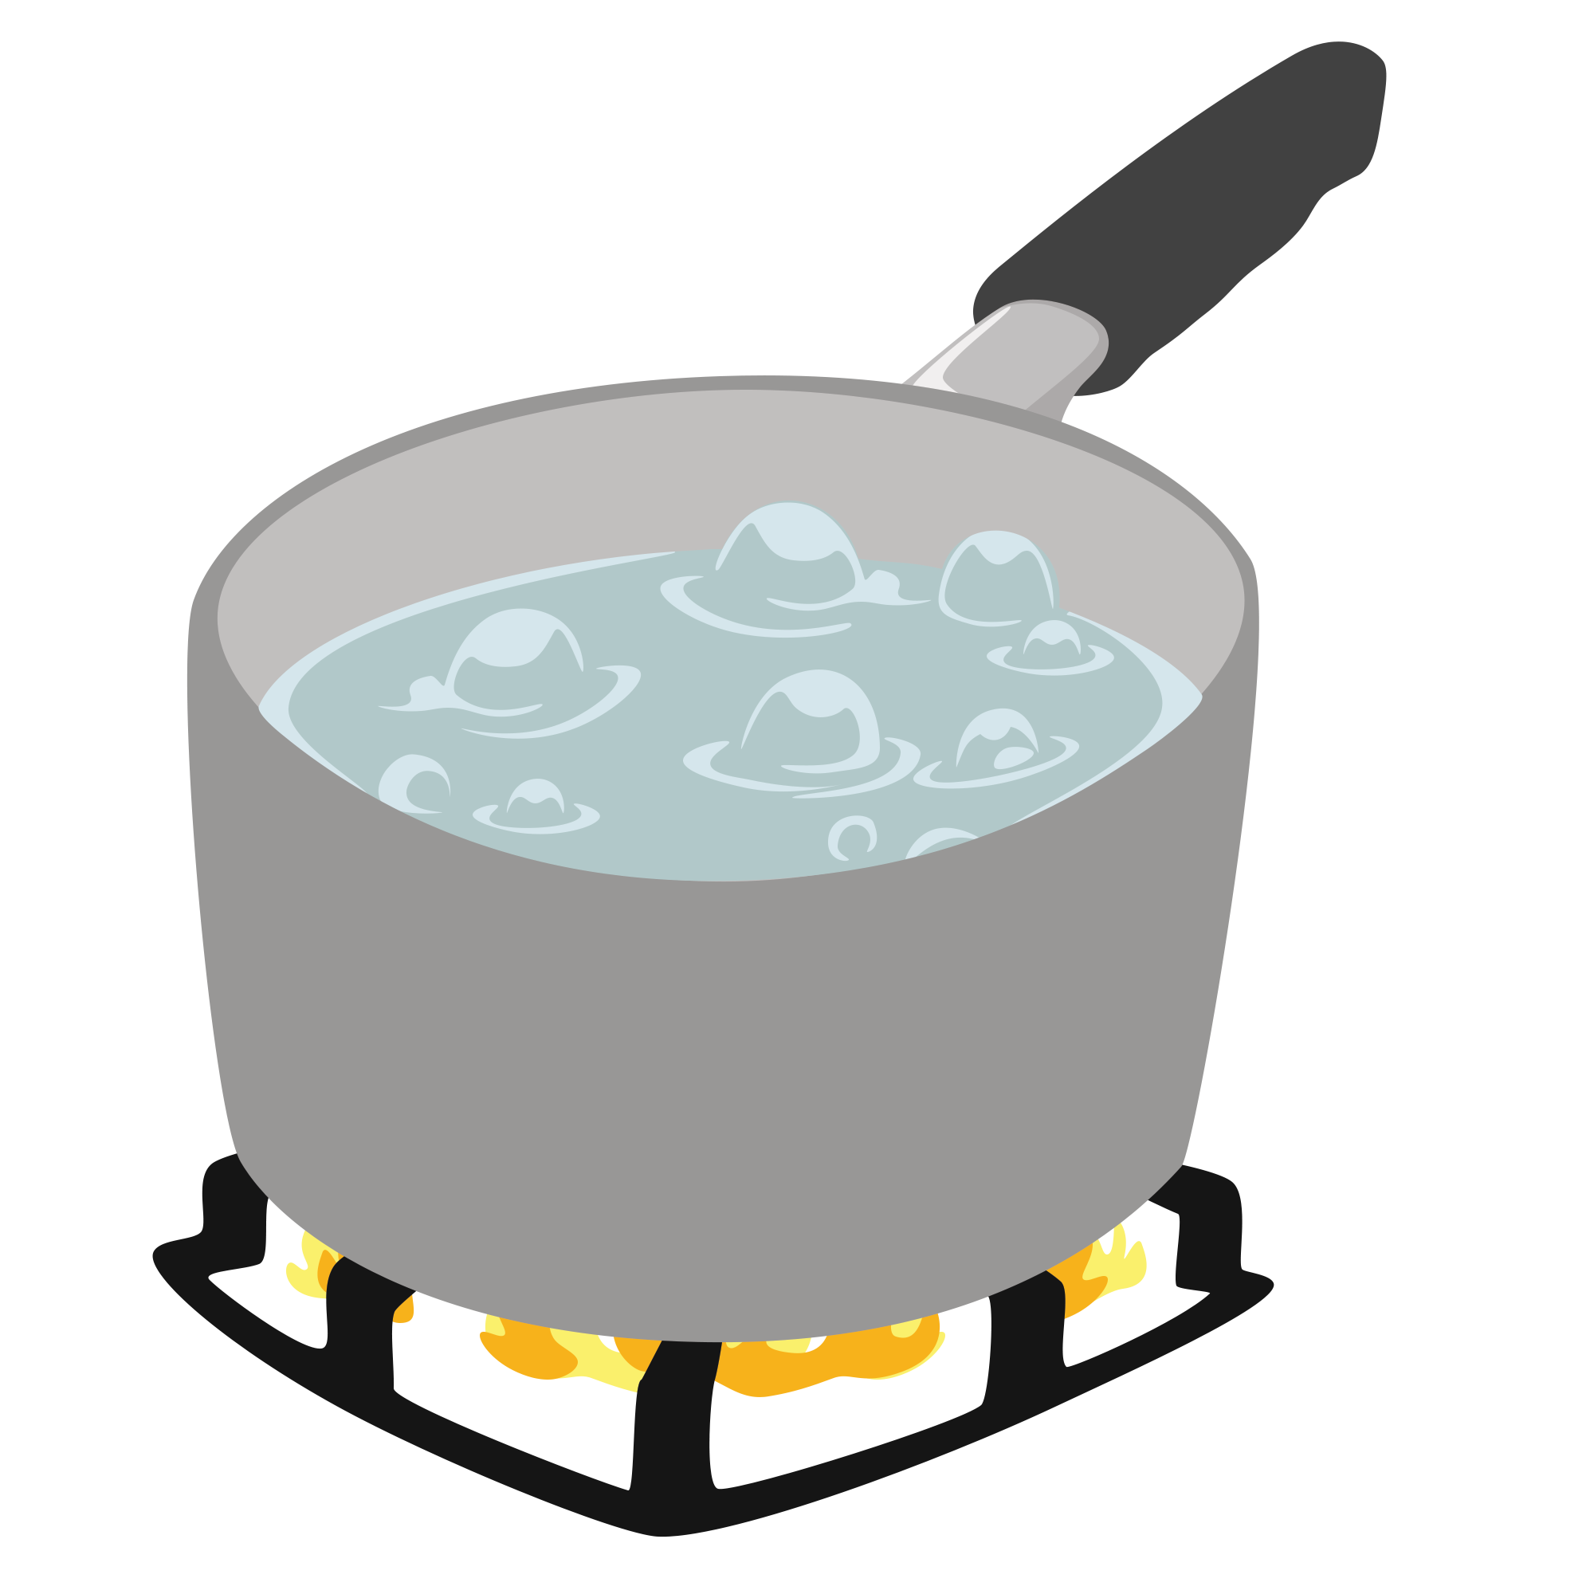
Reactants
Products
+

Slide 14
Reactants
Products
+

Slide 15
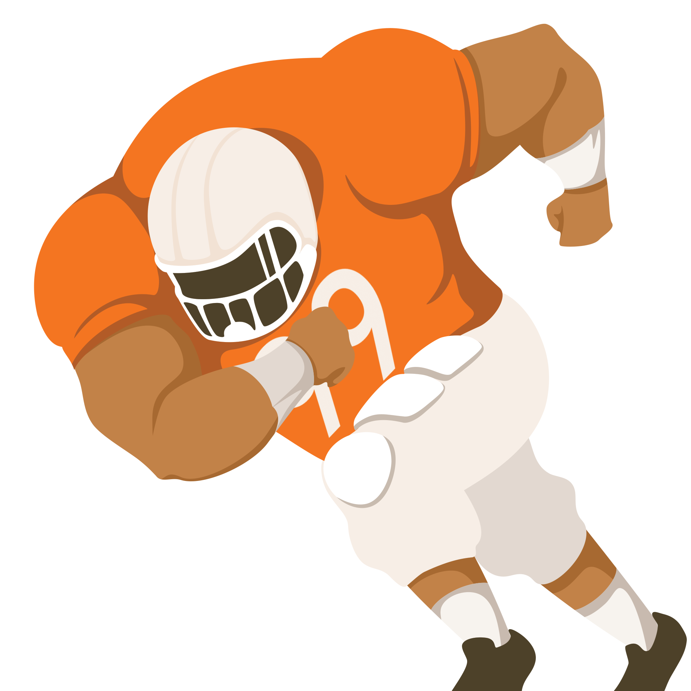
Reactants
Products
+

Slide 16
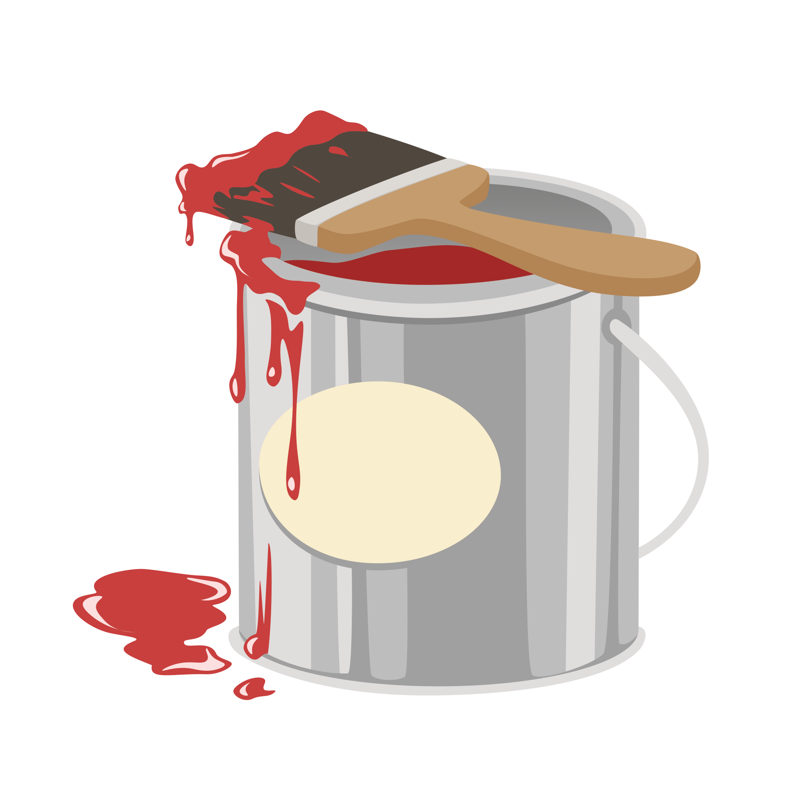
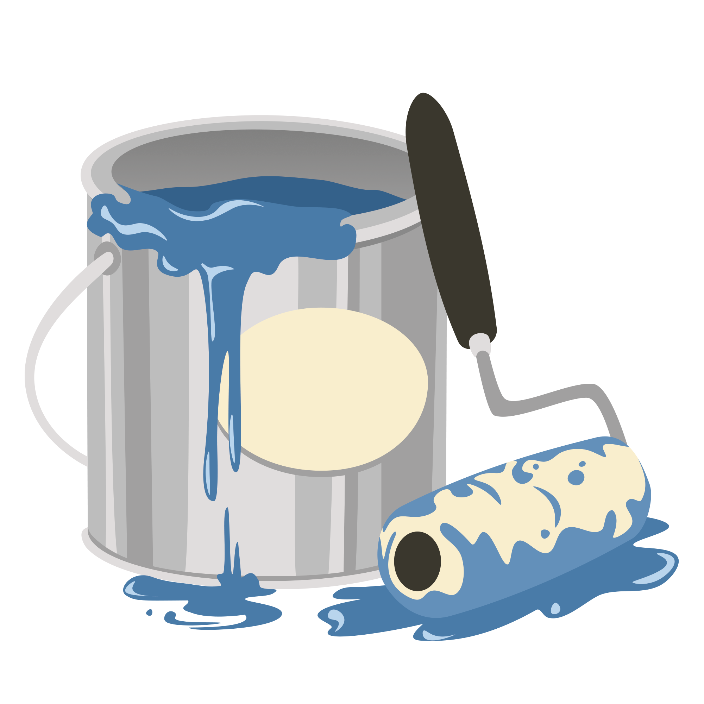
Reactants
Products
+

Slide 17
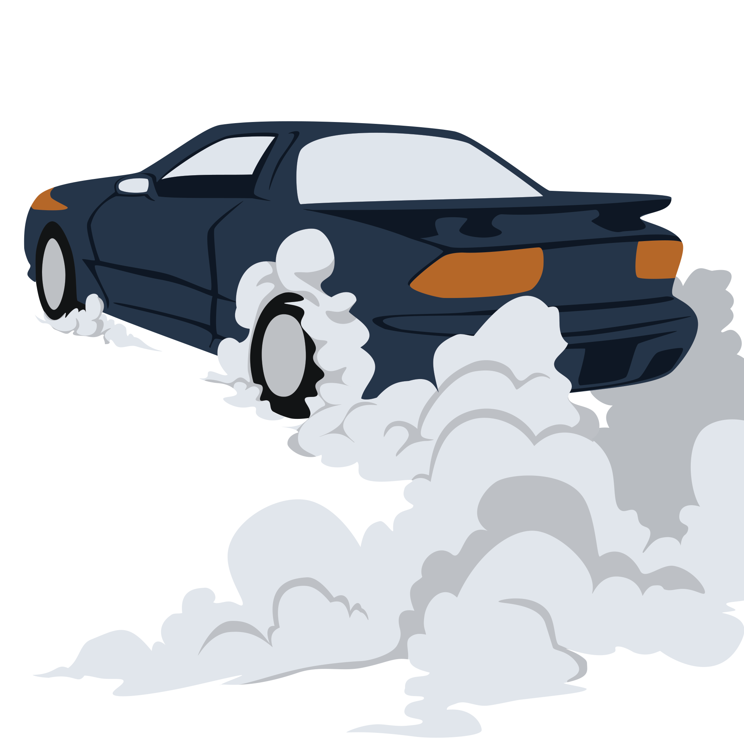
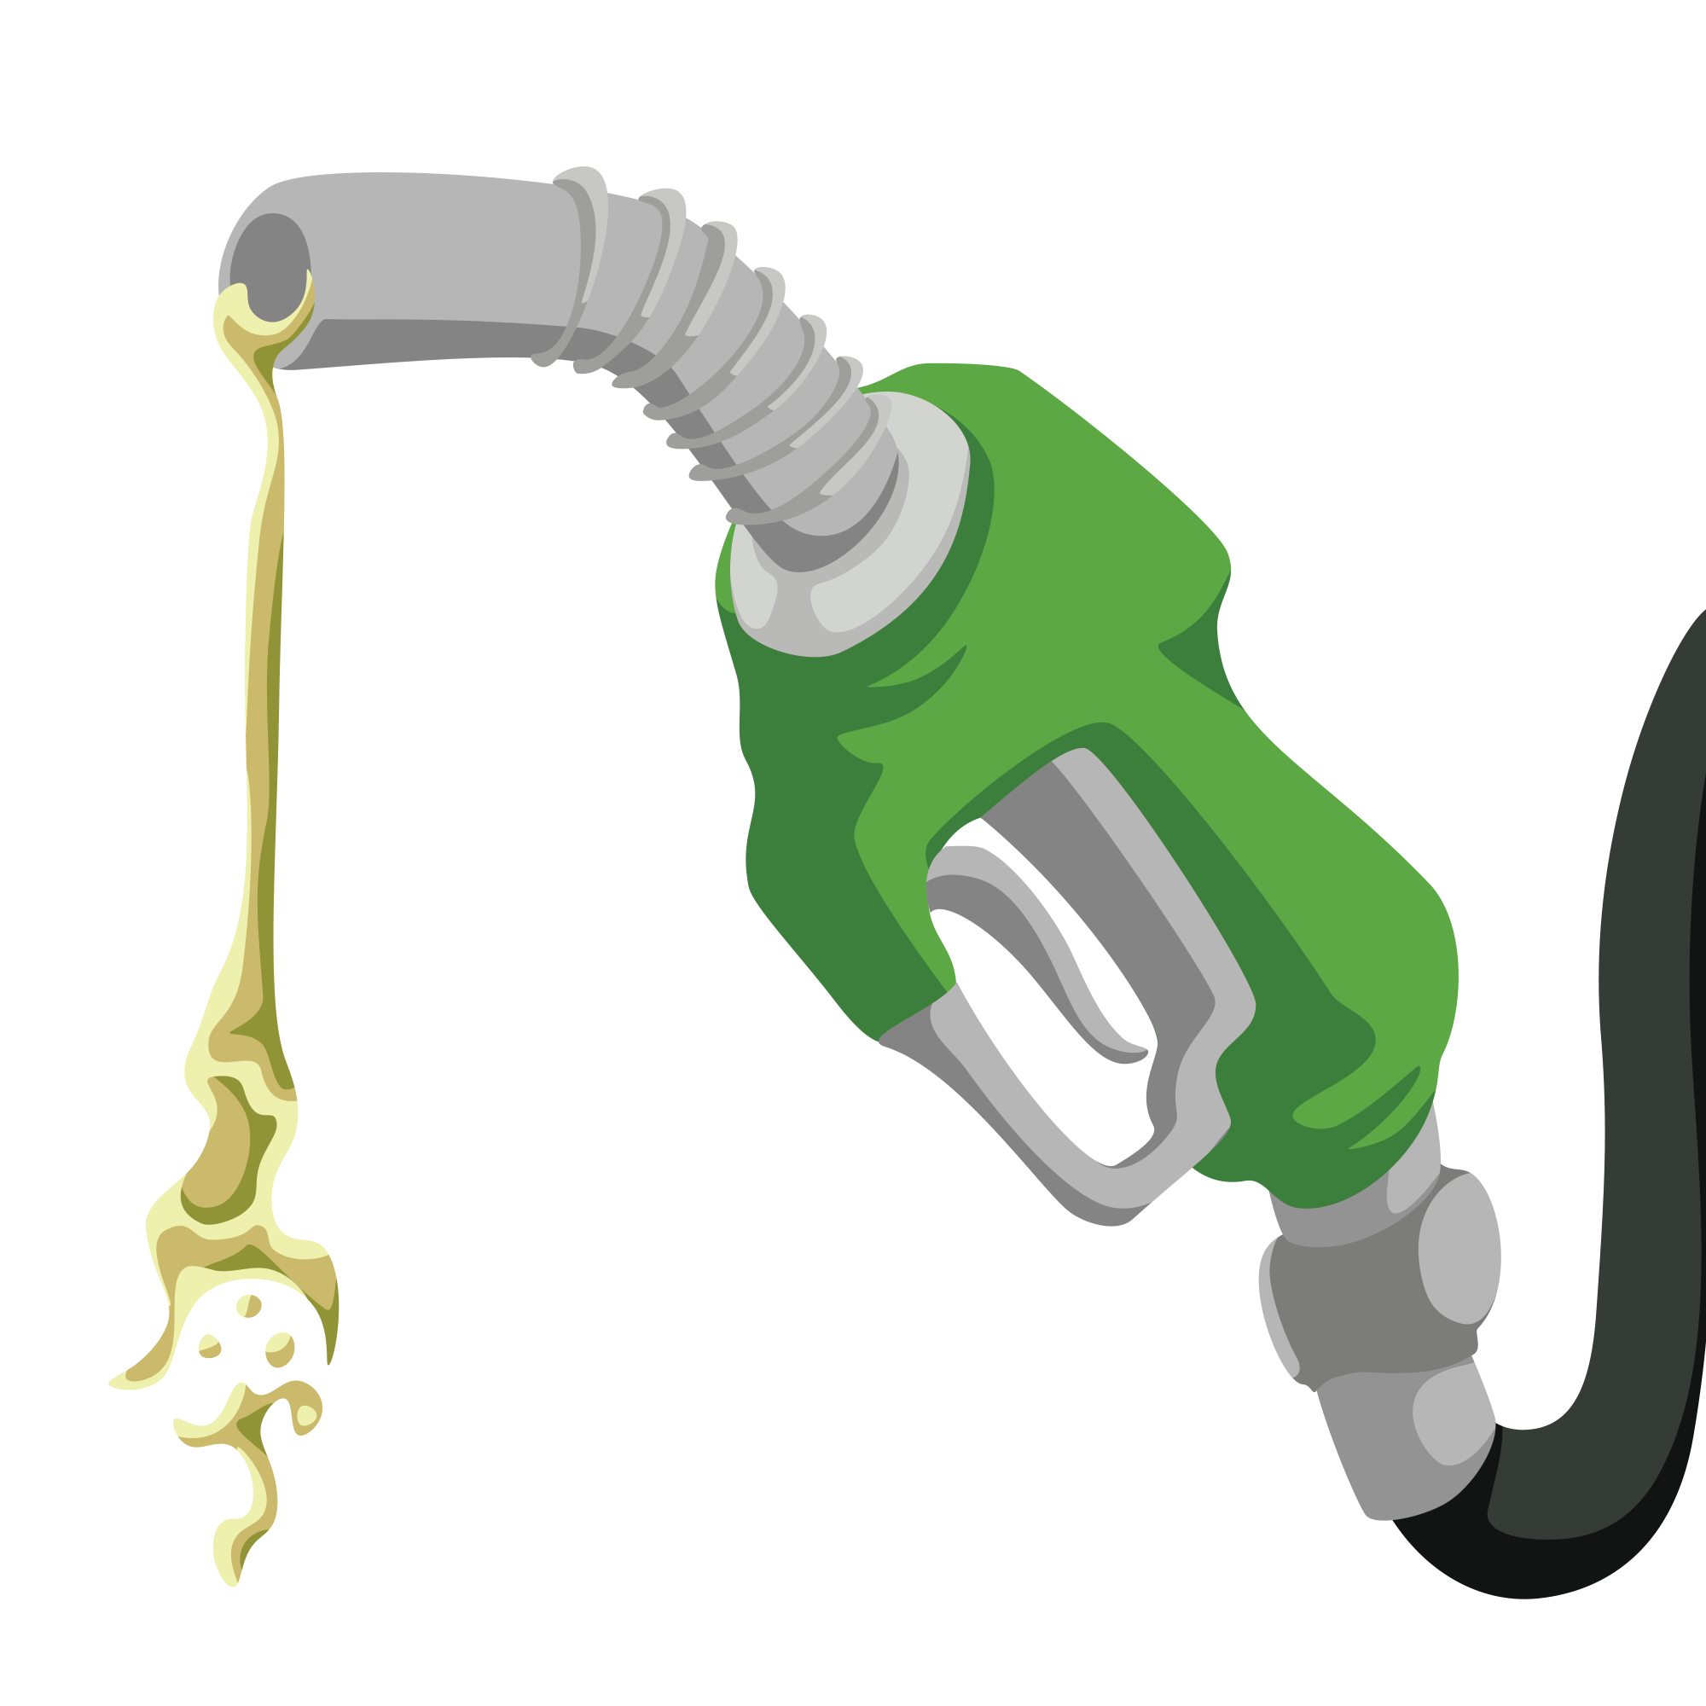
Reactants
Products
+

Slide 18
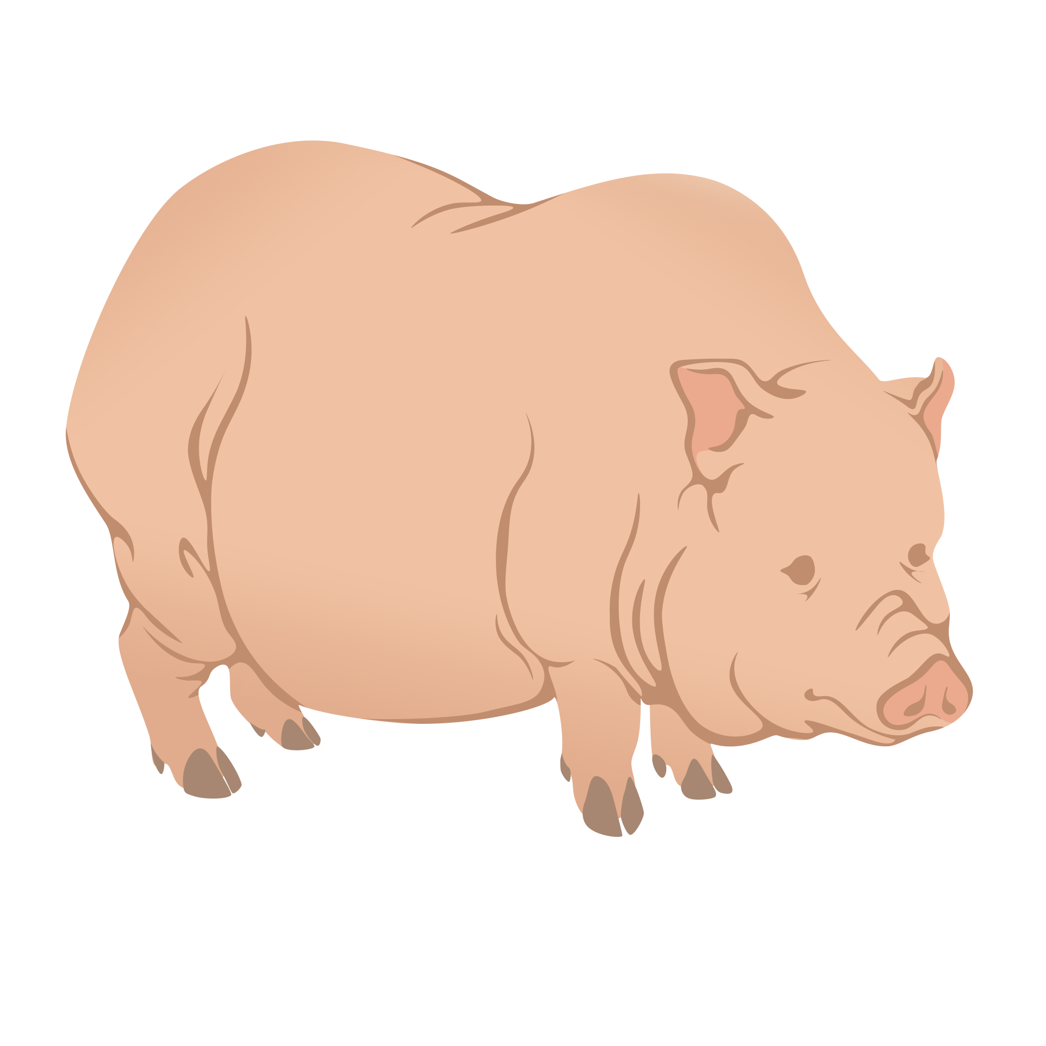
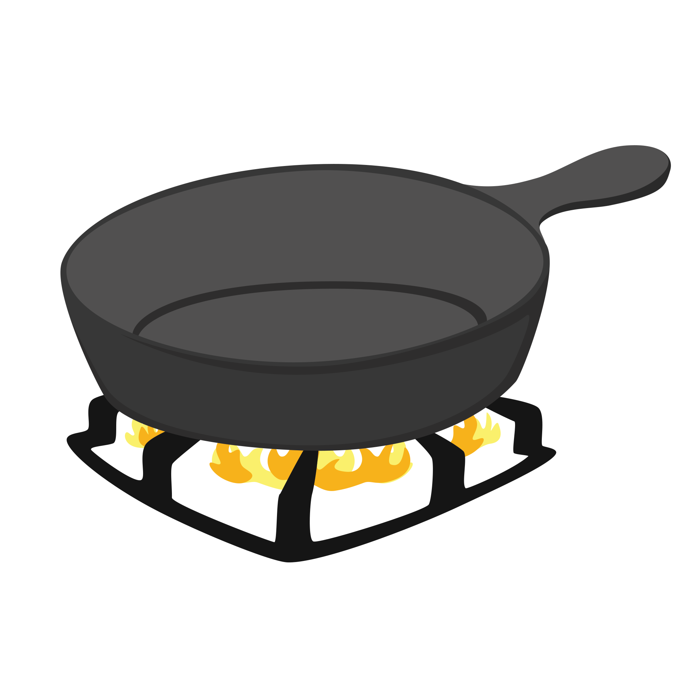
Reactants
Products
+

Slide 19
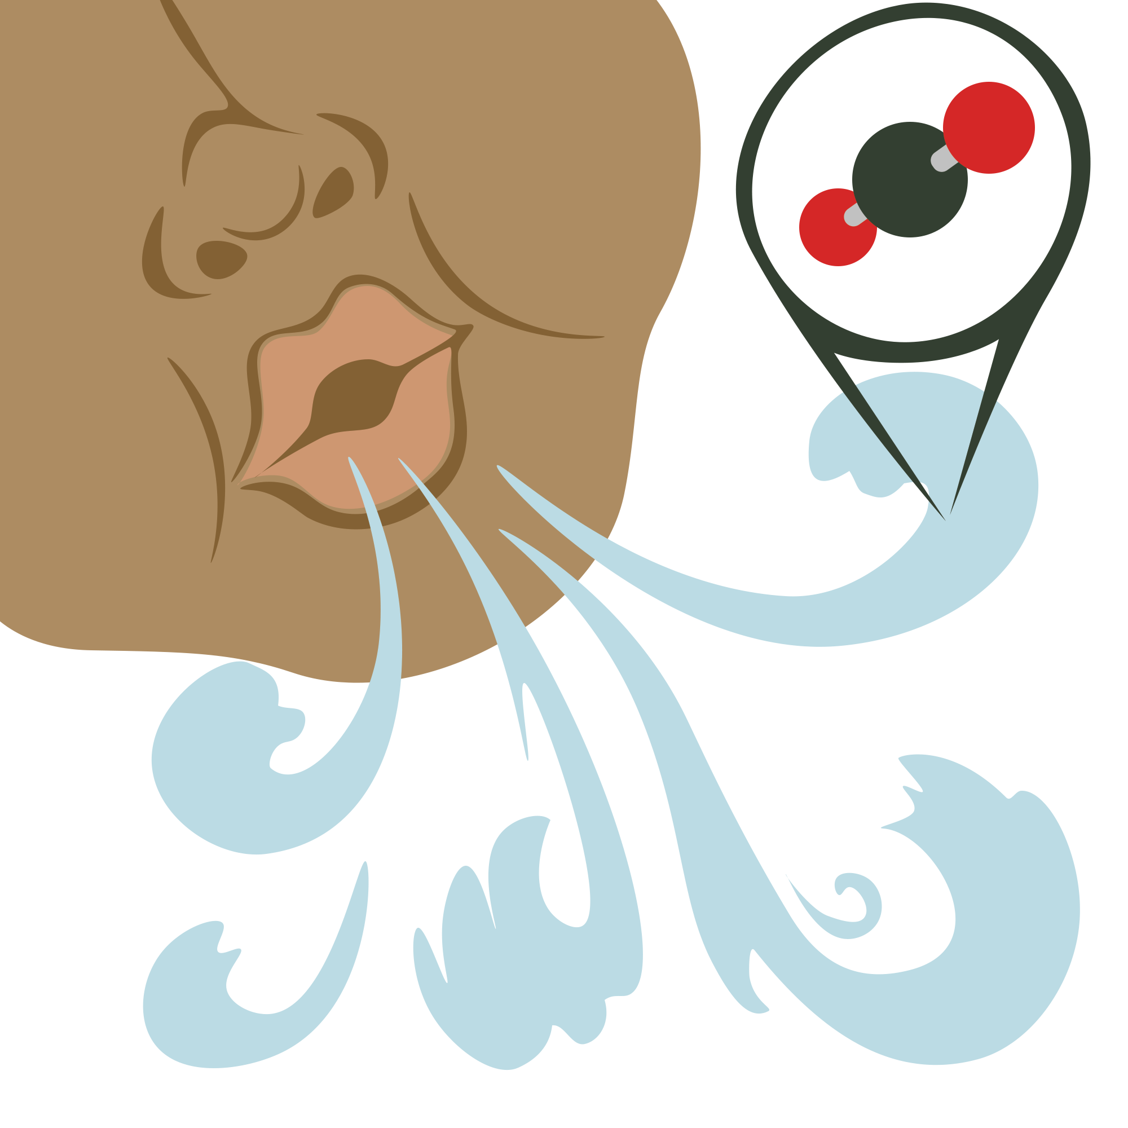
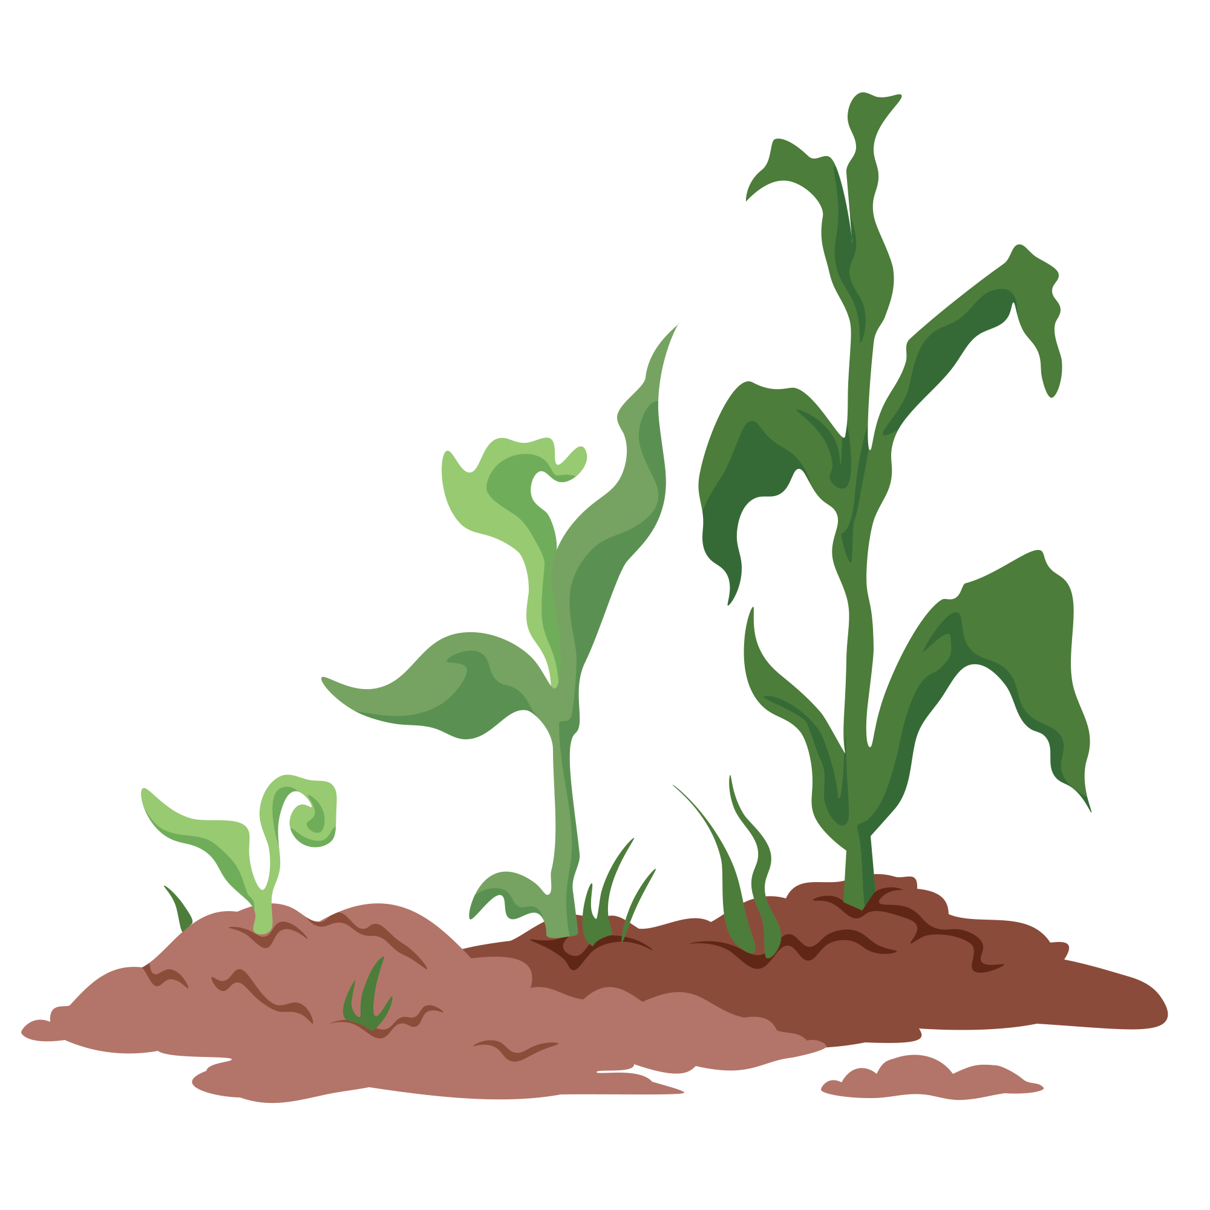
Reactants
Products
+
+

Slide 20
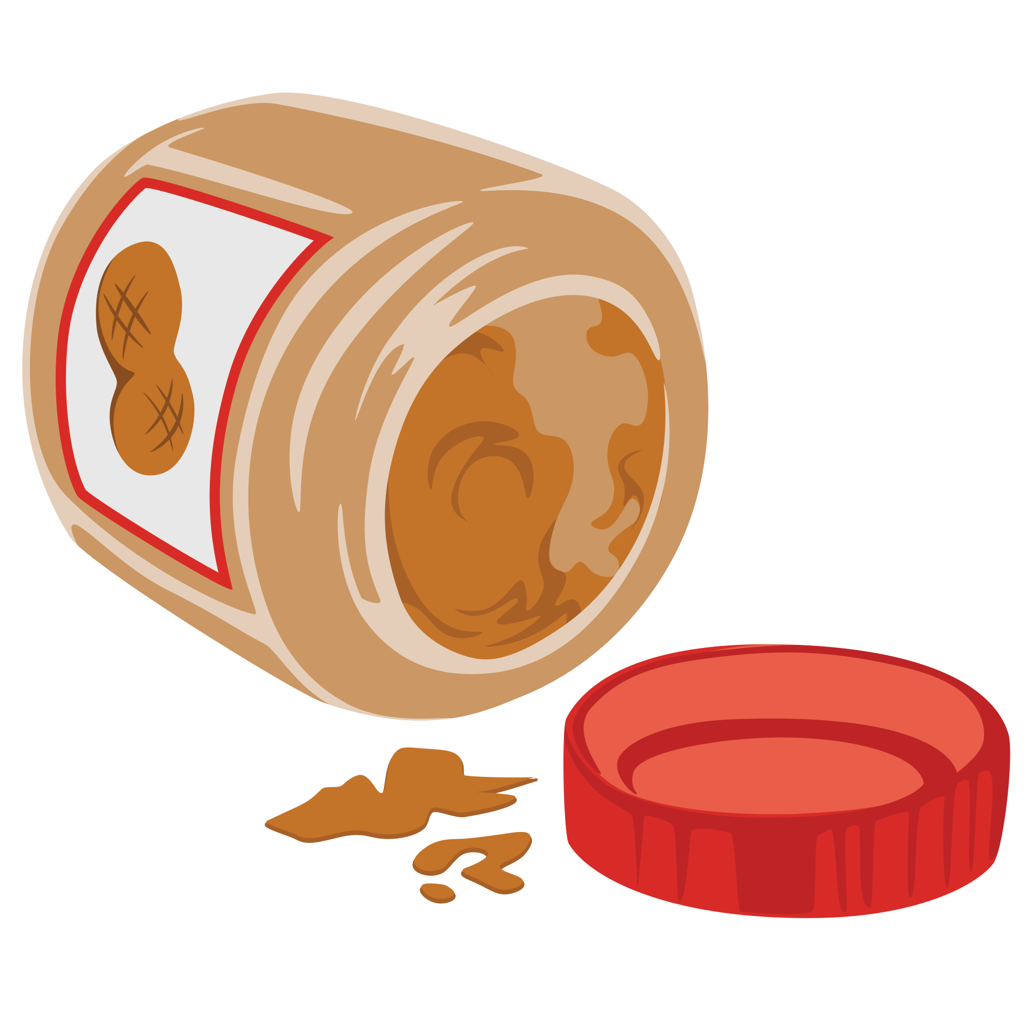
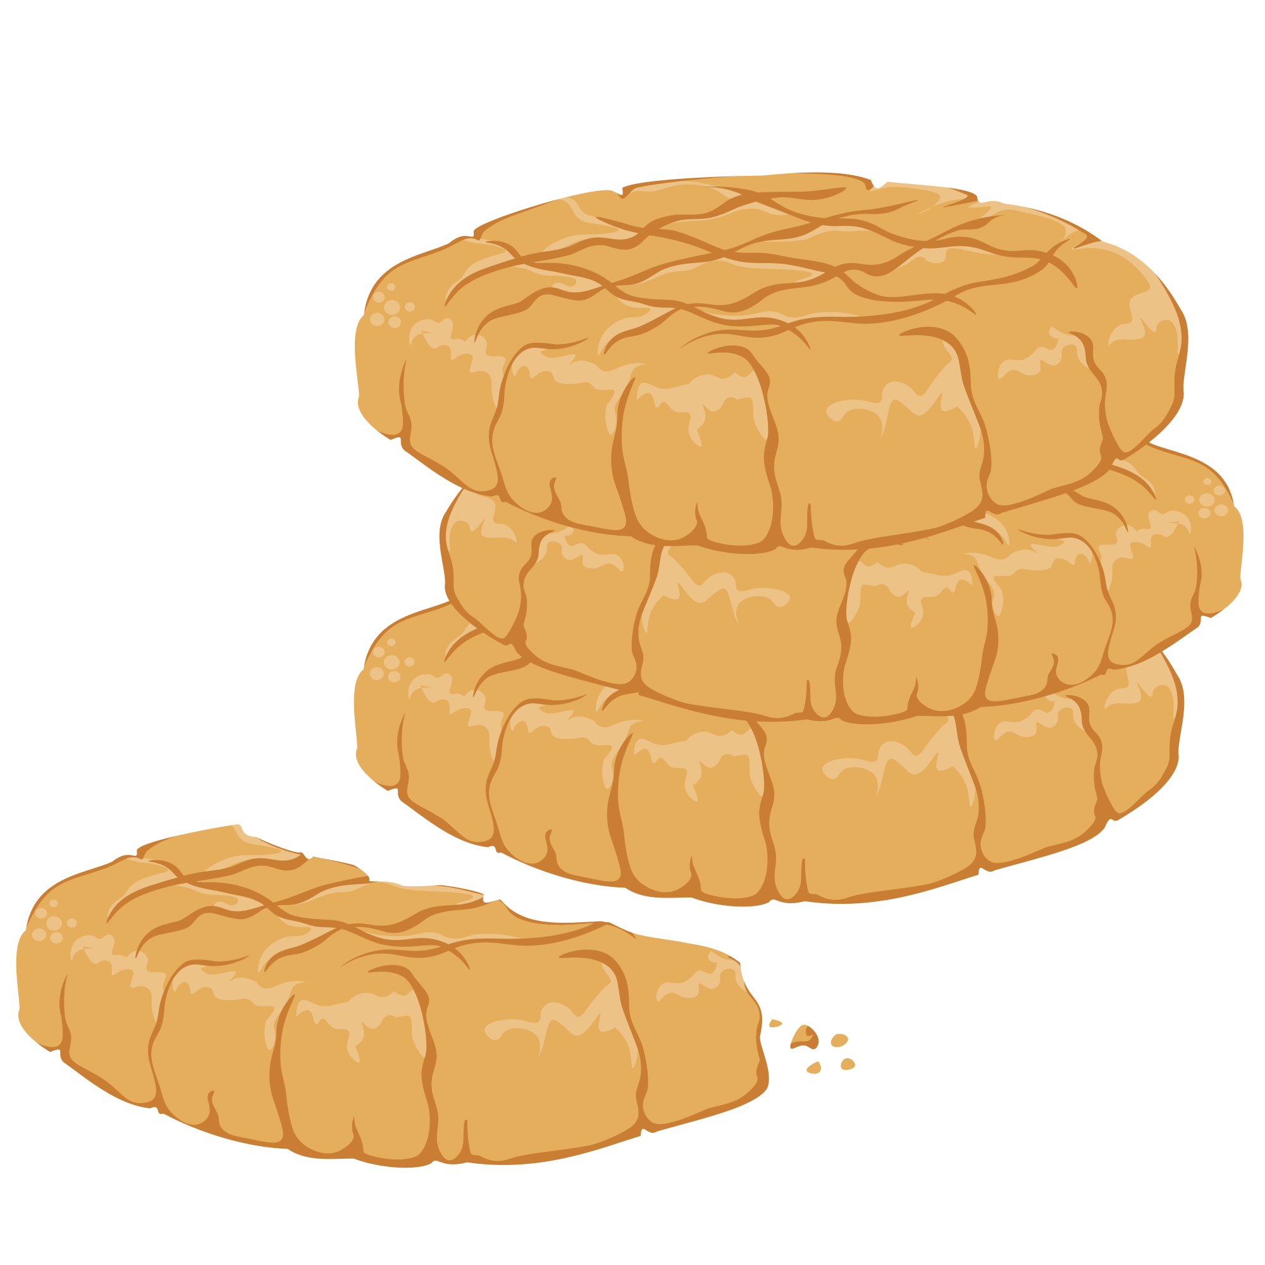
Reactants
Products
+
+

Slide 21
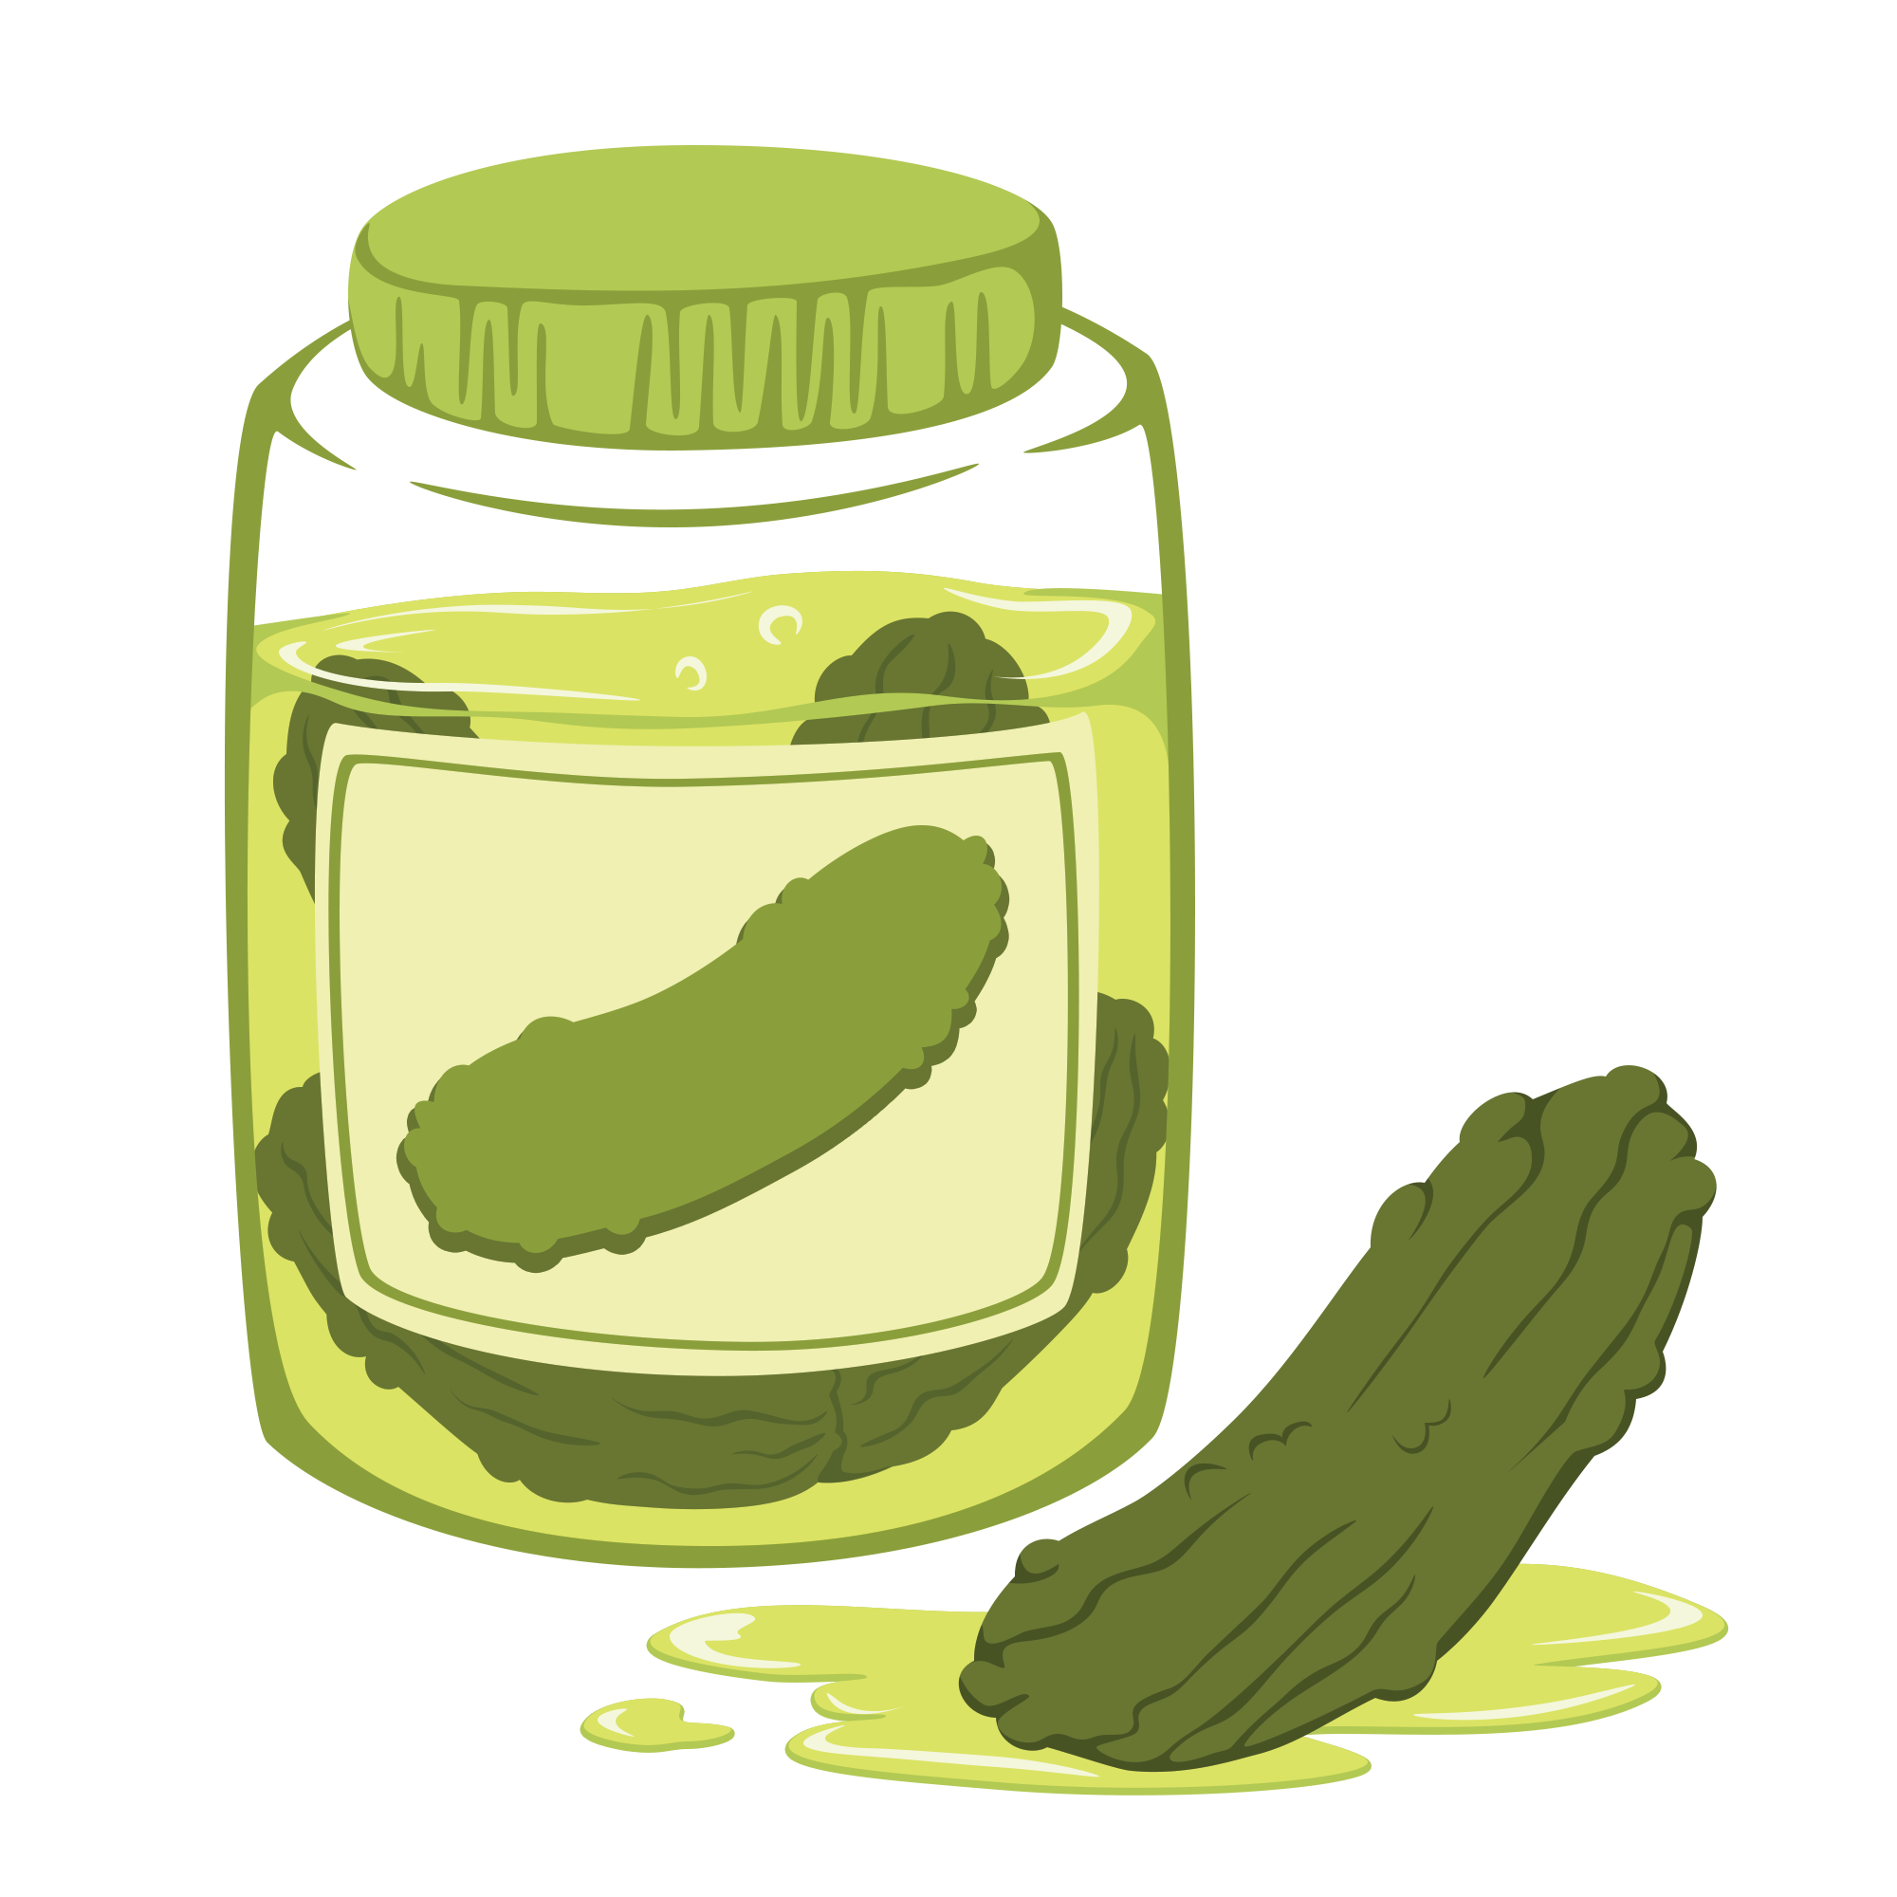
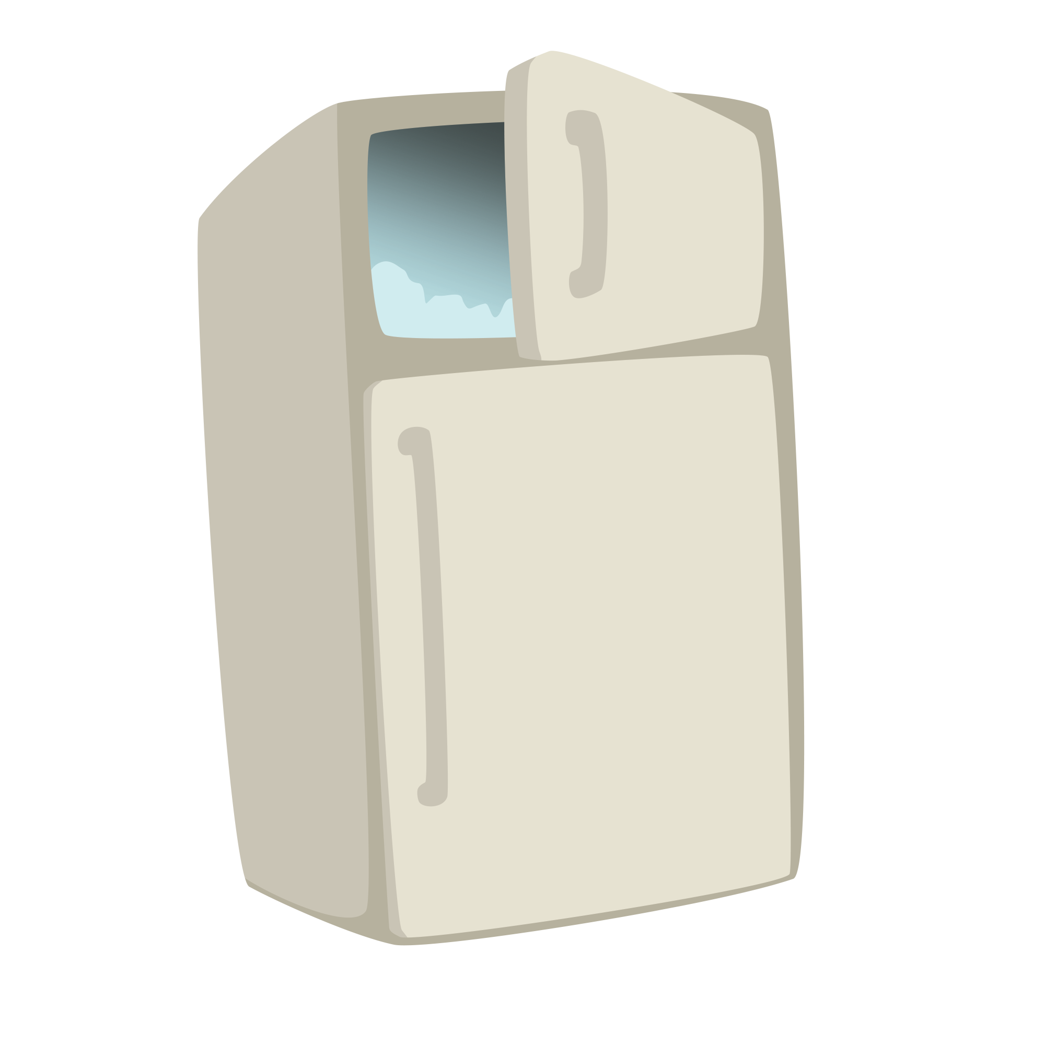
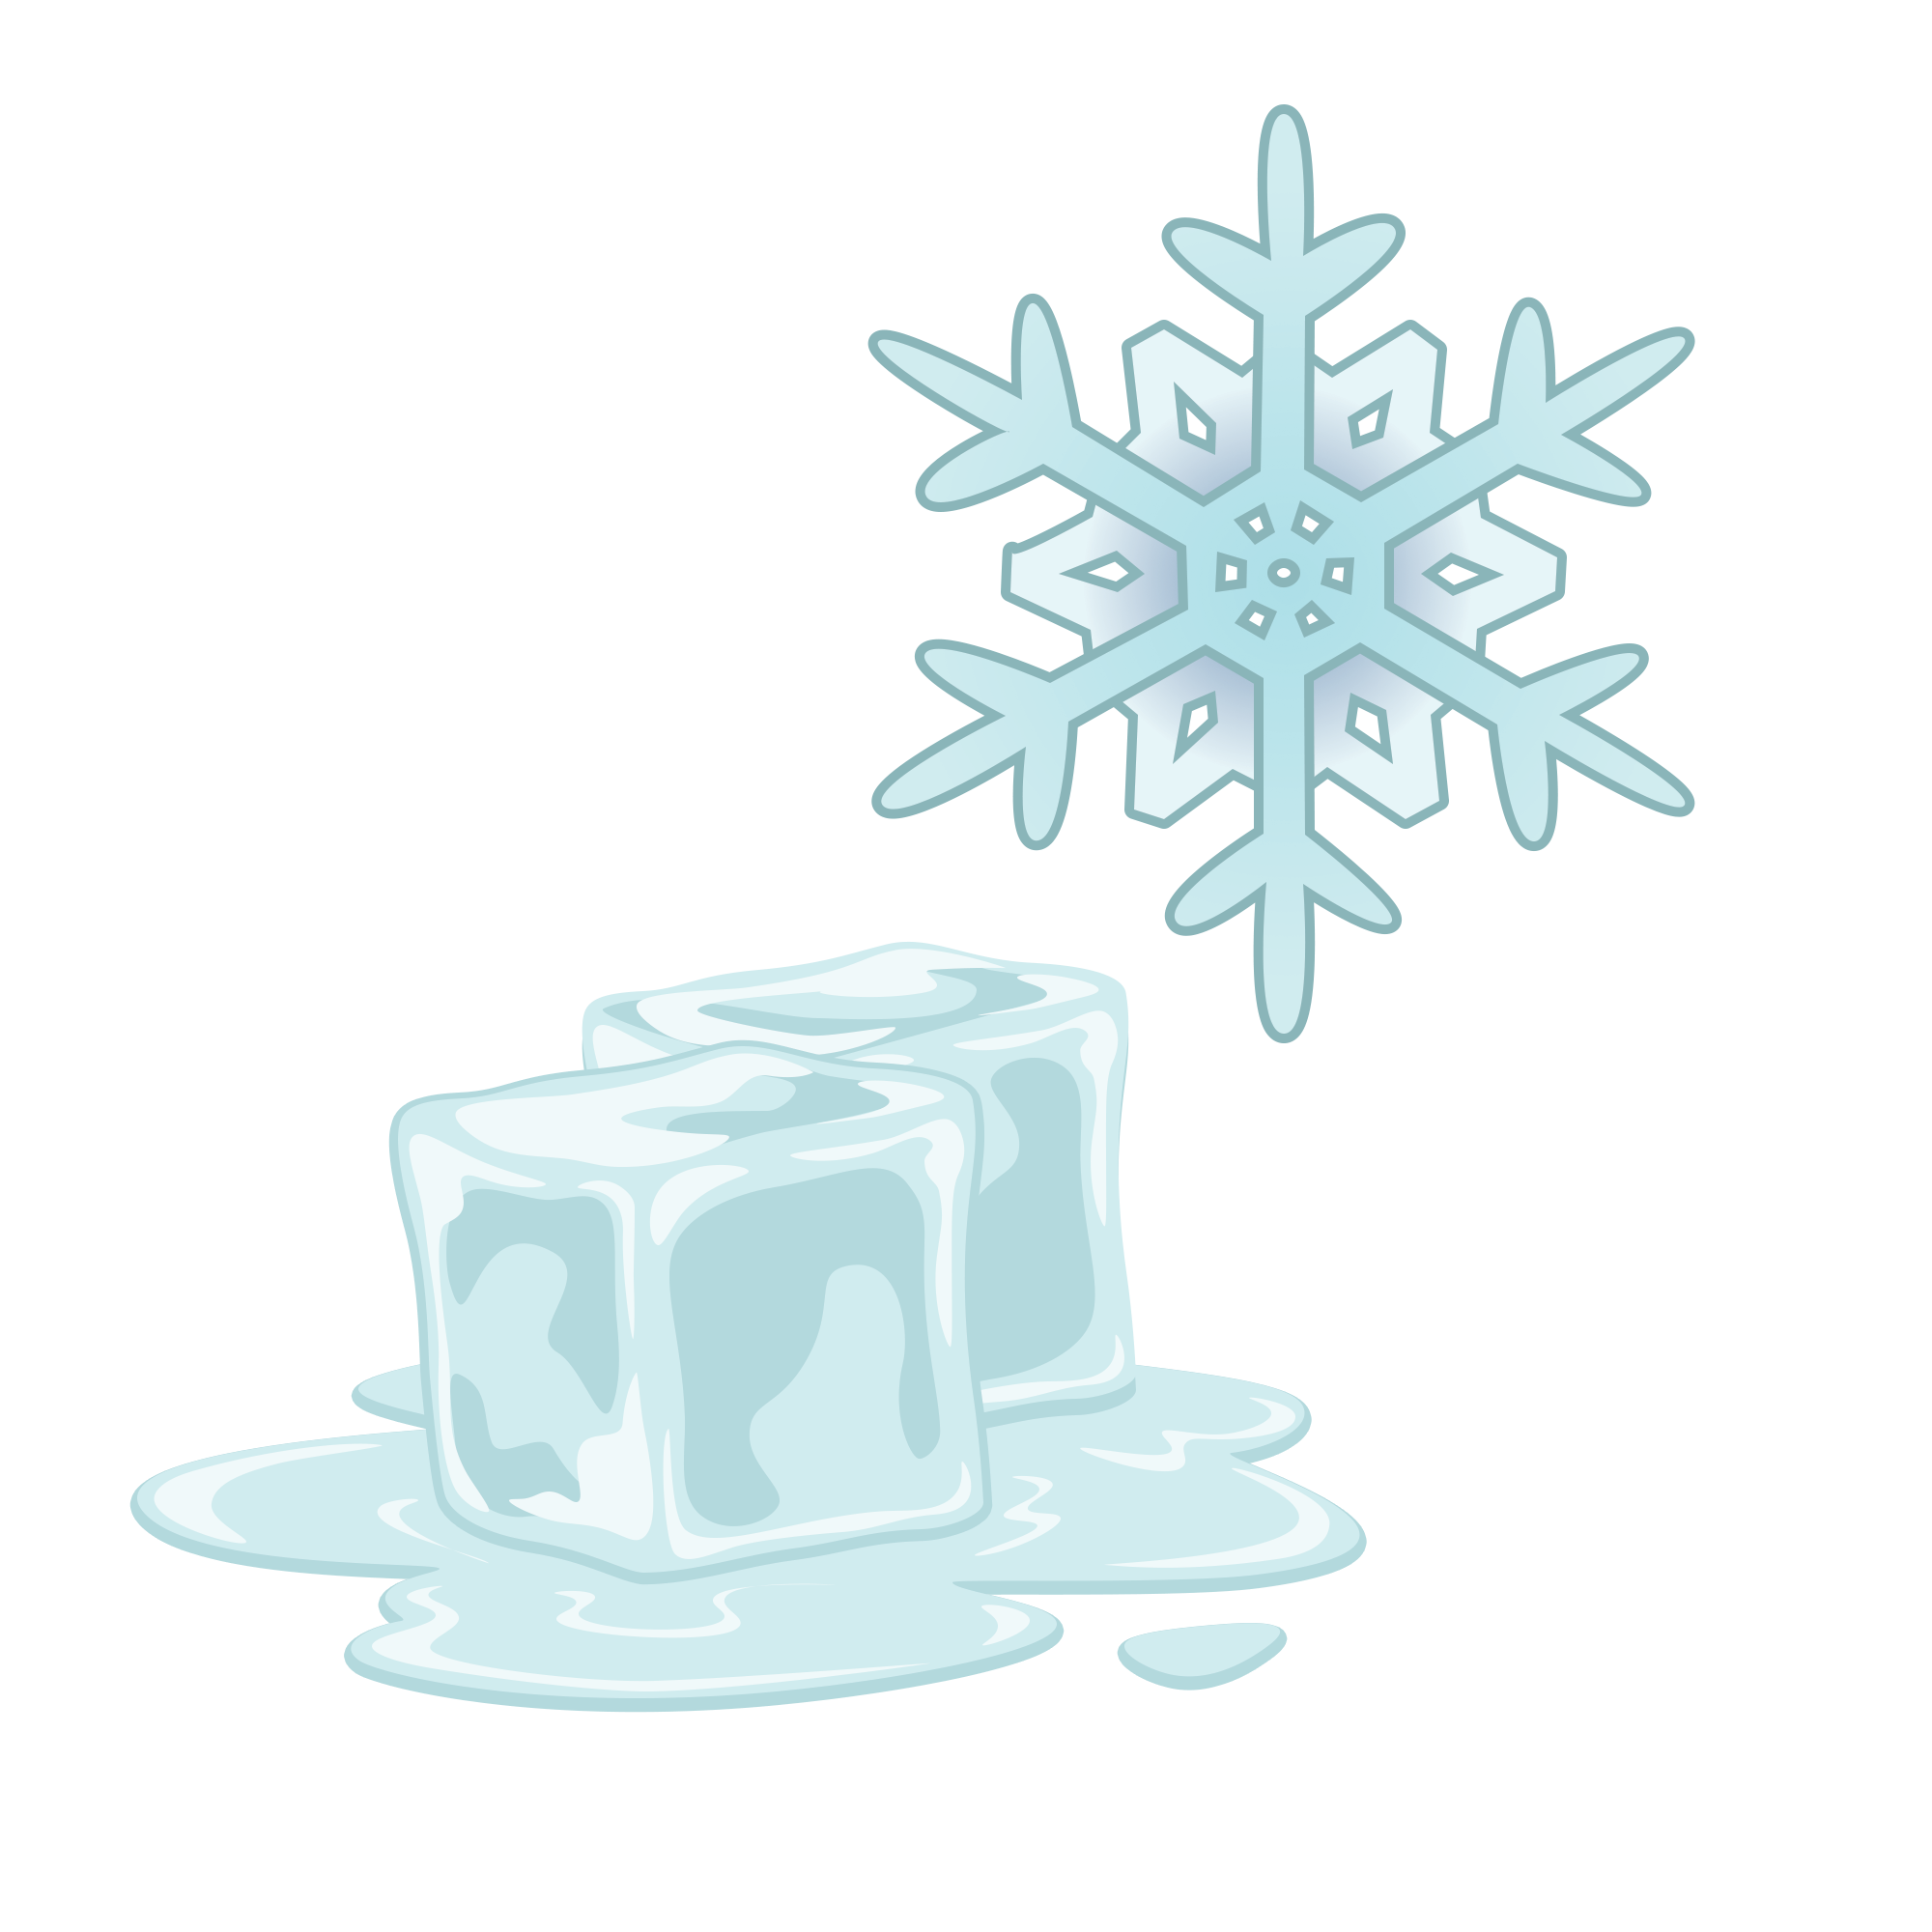
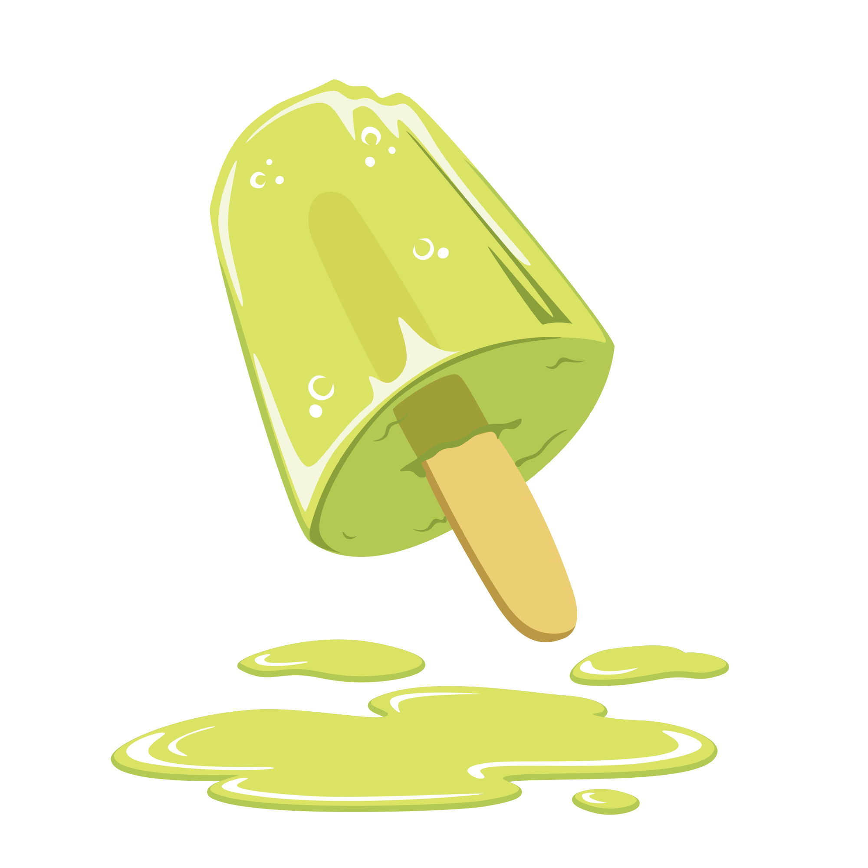
Reactants
Products
+
+

Slide 22
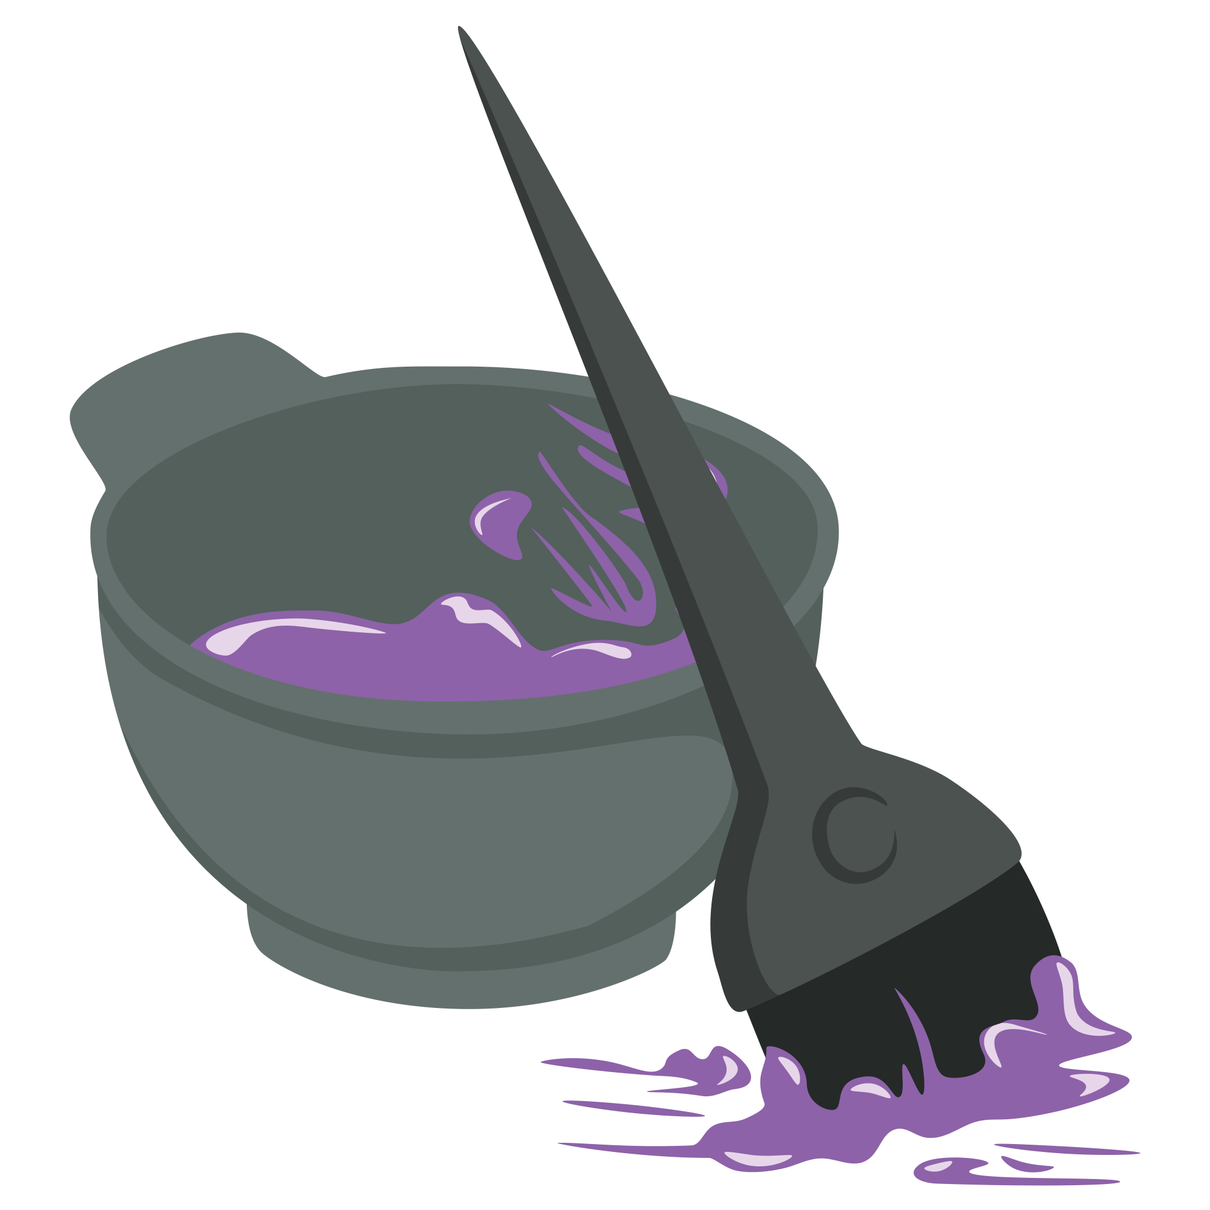
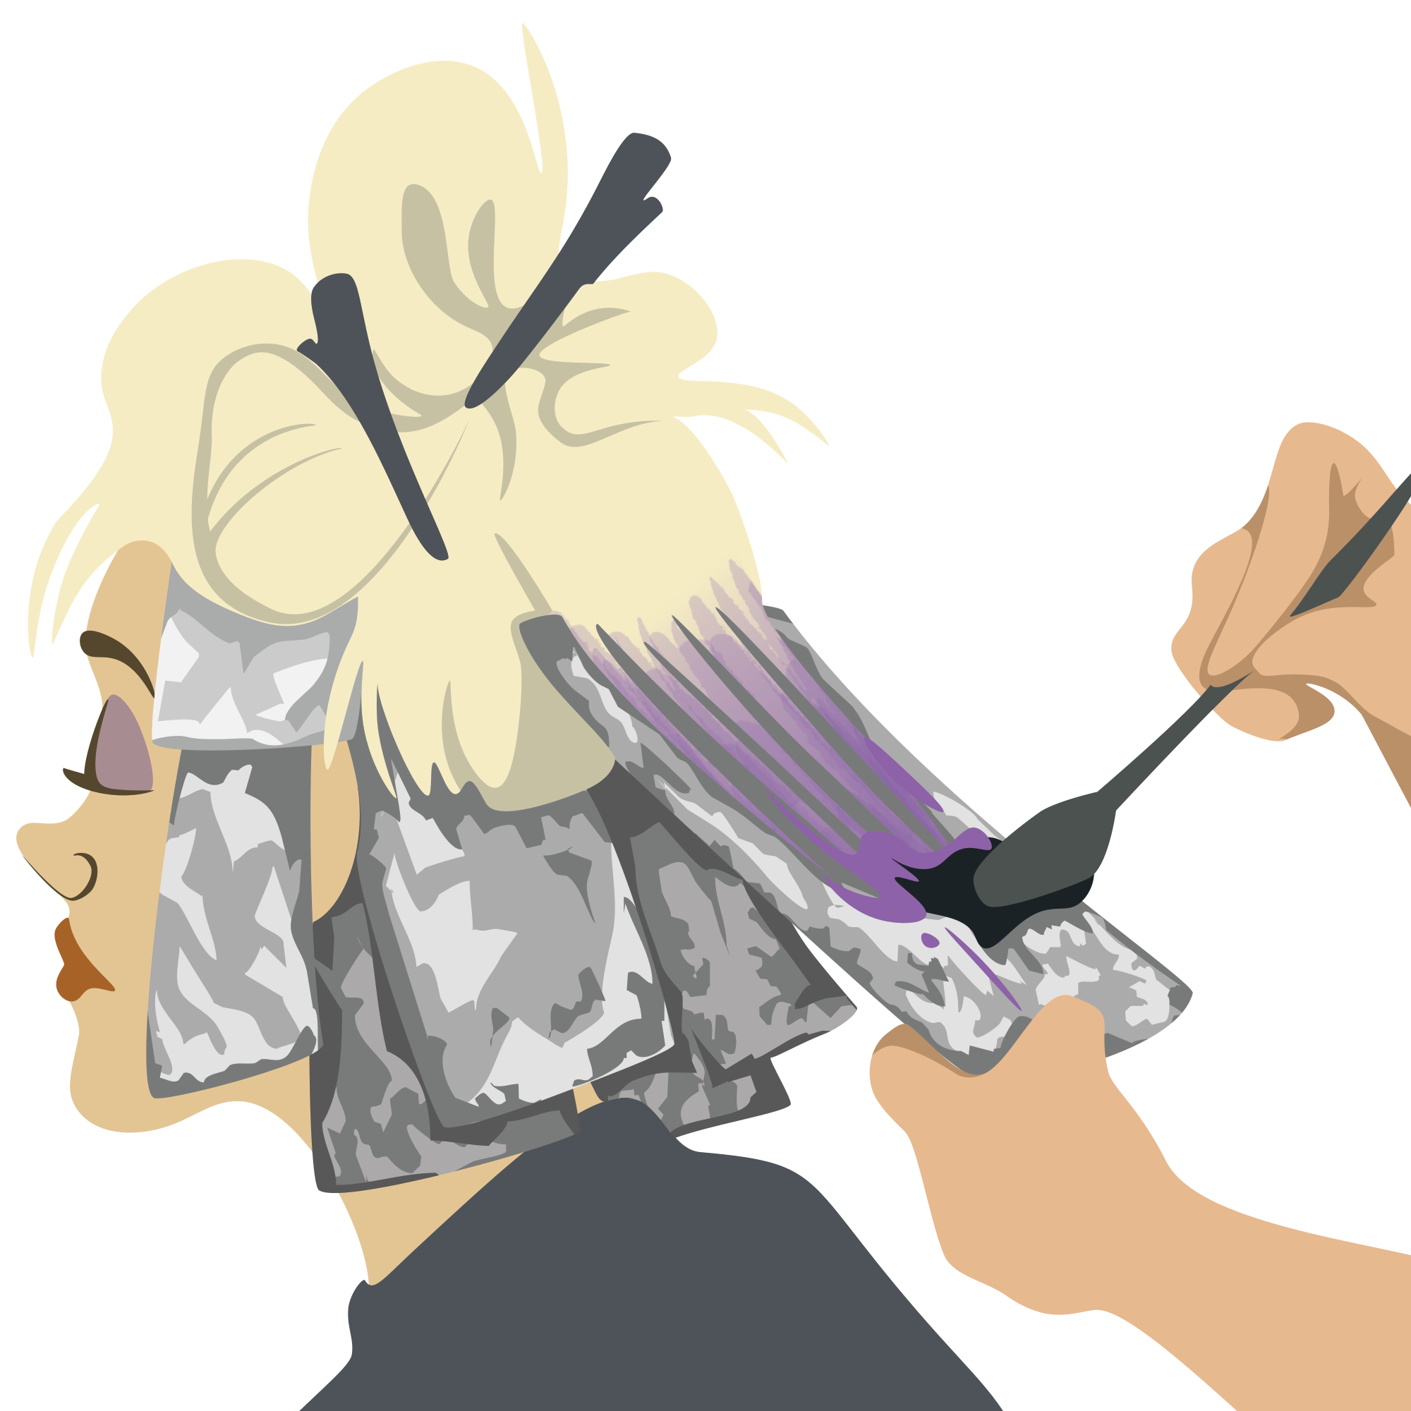
Reactants
Products
+
+

Slide 23
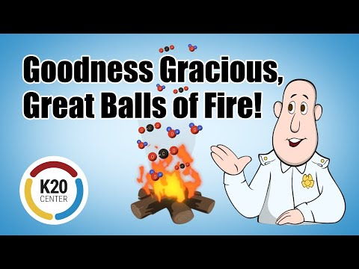
Types of Chemical Reactions
Notes:
Click on the image to play the video.
K20 Center. (2022, October 6). “K20 ICAP - Goodness Gracious, Great Balls of Fire!” [Video]. YouTube. (2022). https://www.youtube.com/watch?v=15QD5I2tRNM&list=PL-aUhEQeaZXLg0yYwLKeUT2Ud1sC0inzo&index=24&t=2s

Slide 24
Chat Stations
You and your group will go to each station to determine the products for each problem.
Once you have solved the problem, use your answer to find the next chat station.
Notes:
Physical Science Extend
K20 Center. (n.d.). Chat stations. Strategies. https://learn.k20center.ou.edu/strategy/944

Slide 25
Chat Stations
You and your group will go to each station to determine the product for each problem and determine the molecular model for the product side.
Once you have solved the problem, record your answers on the provided handout.
Notes:
Chemistry Extend

Slide 26
I Used to Think… But Now I Know...
Write a statement of what you used to think about chemical reactions.
On the right side of your page, write at least one thing that you now understand about reactions.
Notes:
K20 Center. (n.d.). I used to think . . . But now I know. Strategies. https://learn.k20center.ou.edu/strategy/137

