Slide 2
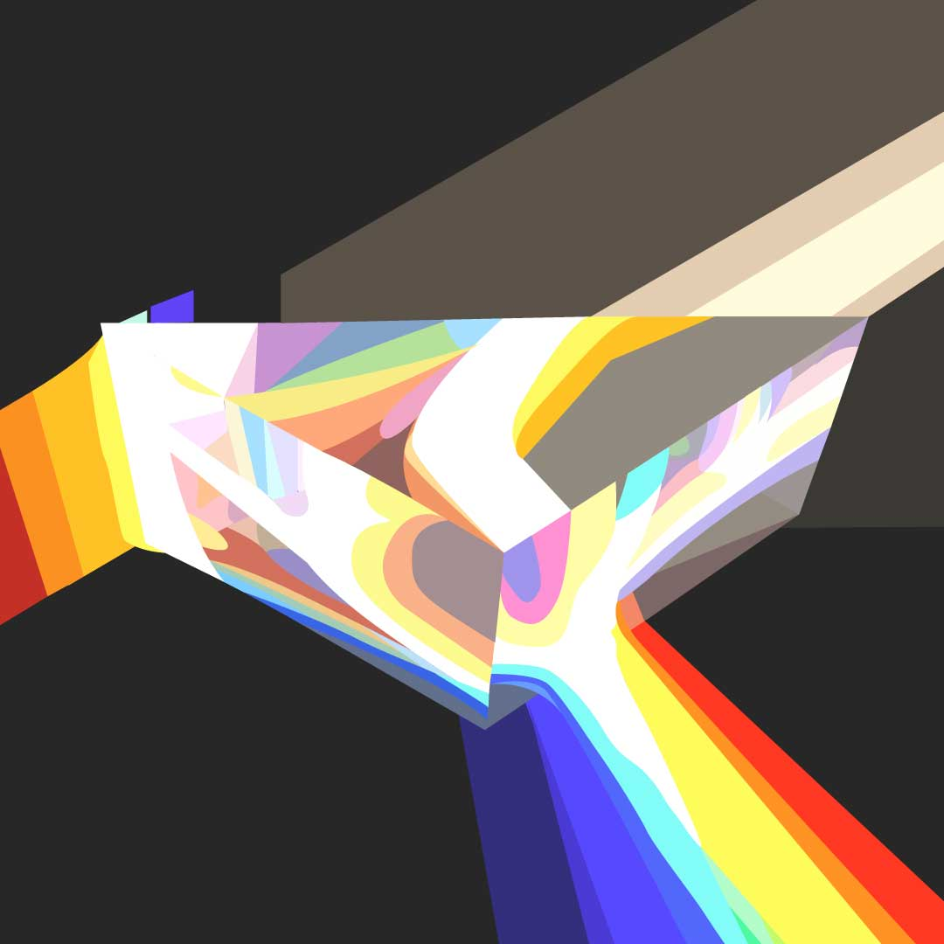
Diffraction, Lesson 1
What Is Diffraction?

Slide 3
Essential Questions
What is diffraction?
How does light bend when it passes through an object?

Slide 4
Lesson Objectives
Understand that non-monochromatic light has multiple colors that can be separated out.
Build a diffracting model.
Explain how the model helps you understand the phenomena.

Slide 5
Using Phenomena to Drive Science Instruction
As you watch the video, consider the following:
What is happening to the light inside the tube?
Why do these phenomena happen?
What is causing the colors to appear?
Do the colors always occur in the same order?

Slide 6
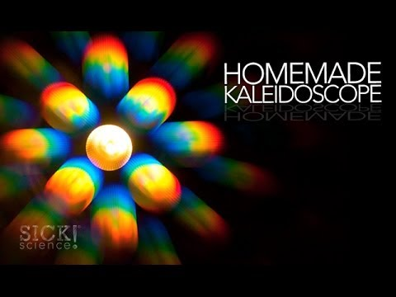
Using Phenomena to Drive Science Instruction
Notes:
Sick Science! (2014). Homemade Kaleidoscope- Sick Science! #179. YouTube. Retrieved June 17, 2022, from https://youtu.be/Qfbsog3Cqac.

Slide 7
Using Phenomena to Drive Science Instruction
What is happening to the light inside the tube?
Why do these phenomena happen?
What is causing the colors to appear?
Do the colors always occur in the same order?

Slide 8
Light Can Bend Around Edges!
Light bends when it passes around an edge or through a slit. This bending is called diffraction.
You can easily demonstrate diffraction using a candle or a small, bright flashlight bulb and a slit made with two pencils.
The diffraction pattern—the pattern of dark and light created when light bends around an edge or edges—shows that light has wavelike properties.

Slide 9
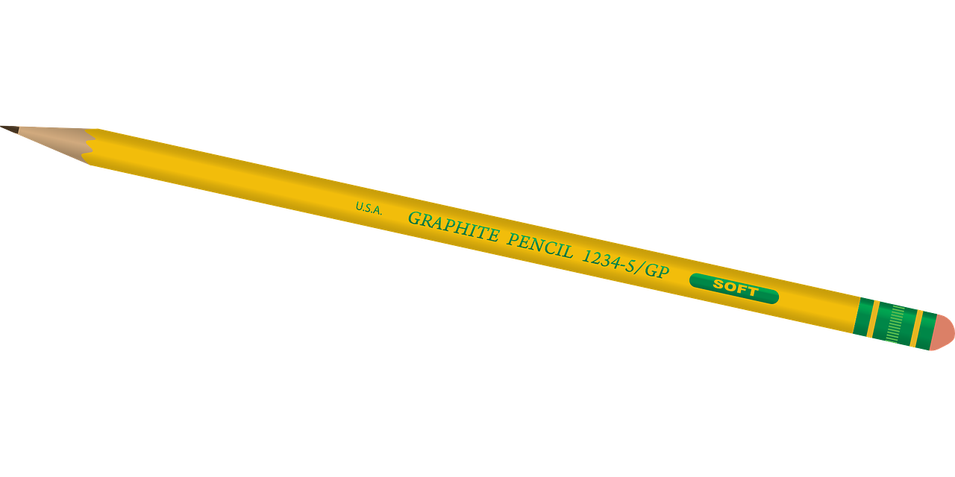
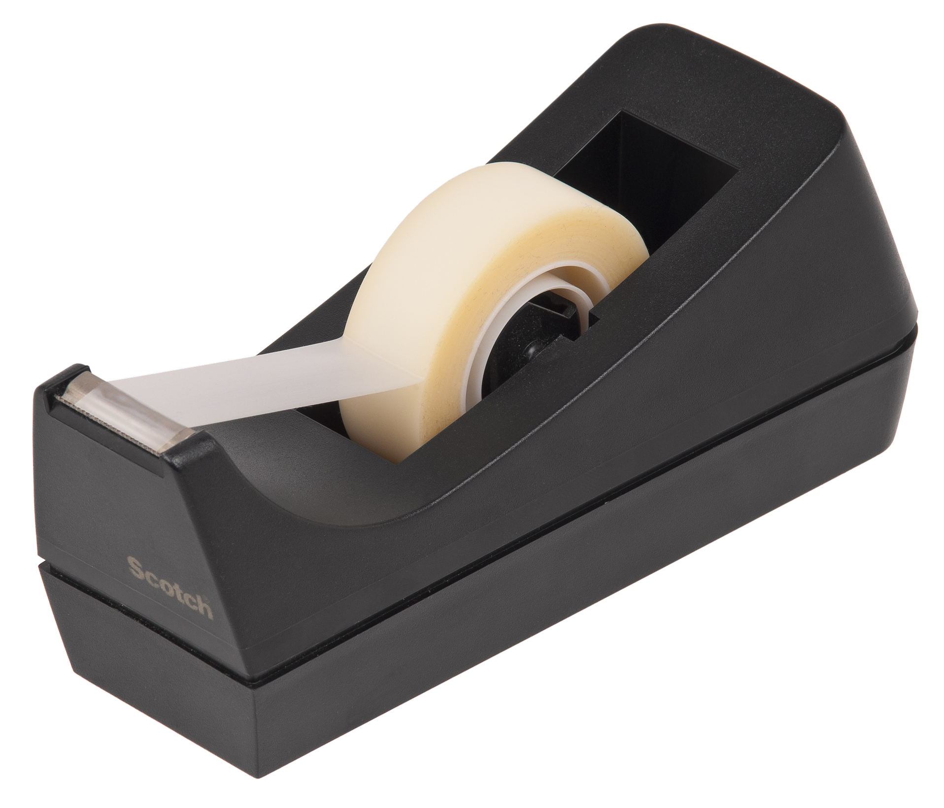
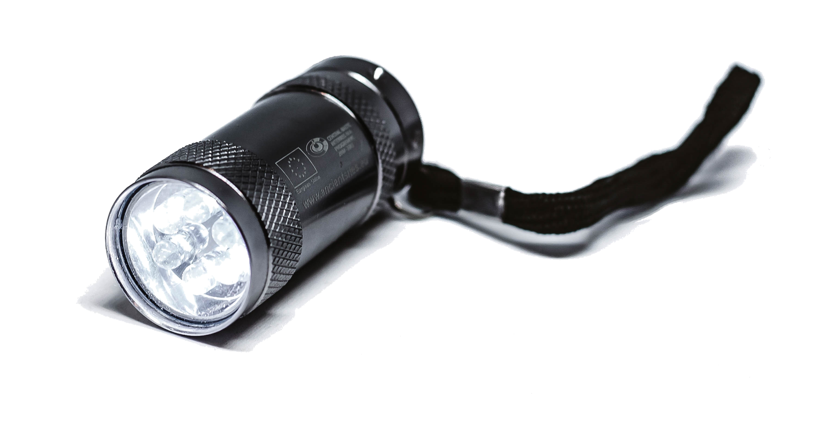
Grab Your Materials!
Two new, clean pencils with erasers
A piece of transparent tape (any thin tape will do)
A Mini Maglite flashlight (do not substitute other flashlights) or a candle with matches or a lighter
Optional: Pieces of cloth, a feather, plastic diffraction grating, metal screen, a human hair
Notes:
Clker-Free-Vector-Images . (2012). Pencil. Pixabay. Retrieved June 17, 2022, from https://pixabay.com/vectors/pencil-yellow-writing-write-tool-33449/.
Marco Verch Professional. (2017). Led flashlight on white background. Flickr. Retrieved June 17, 2022, from https://www.flickr.com/photos/30478819@N08/24393185137.
WikimediaImages. (2017). Tape. Pixabay. Retrieved June 17, 2022, from https://pixabay.com/photos/tape-dispenser-roll-adhesive-2202307/.

Slide 10
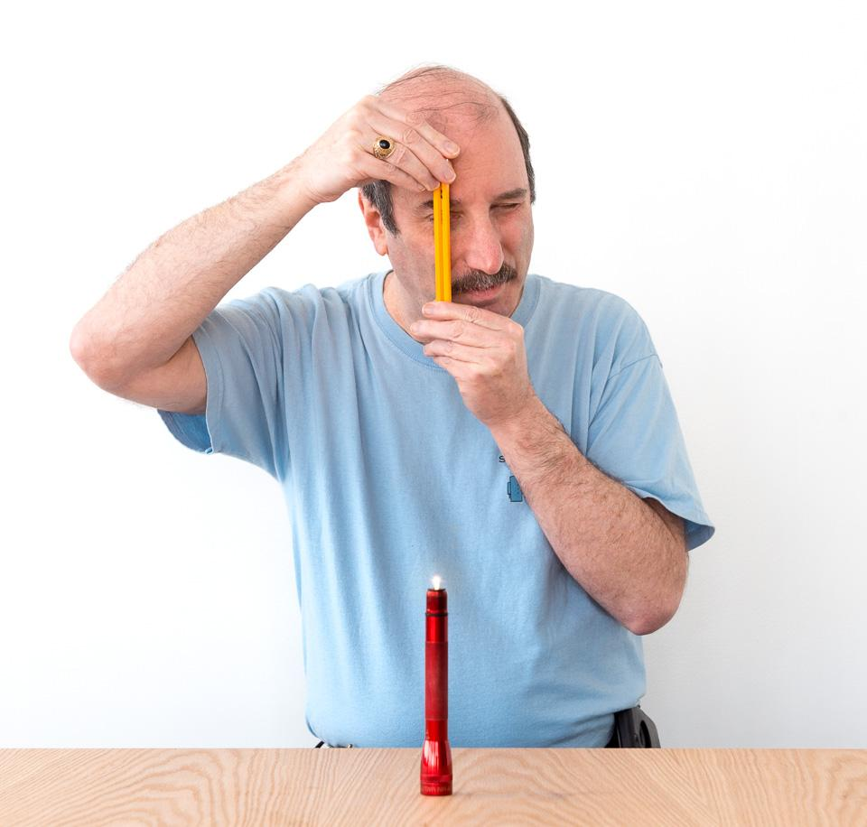
Time to Assemble Your Materials!
Wrap one layer of tape around the top of one of the pencils, just below the eraser.
Unscrew the top of the flashlight. The tiny lamp will come on and shine brightly.
CAUTION: If you are using an LED Mini Maglite, be sure it is set to dim before unscrewing the top of the flashlight. Avoid staring directly at the light for a long period of time.
Notes:
Diffraction. Exploratorium. (2020, October 2). Retrieved June 15, 2022, from https://www.exploratorium.edu/snacks/diffraction

Slide 11
Test It Out and Record Your Observations!
Place the light on a stable surface at least one arm’s length away from you.
Hold up the two pencils side by side, with the erasers at the top.
The tape wrapped around one pencil should keep the pencils slightly apart, forming a thin slit between them just below the tape.
Hold both pencils close to one eye (about 1 inch/2.5 cm away) and look at the light source through the slit between the pencils.
Squeeze the pencils together, making the slit smaller.

Slide 12
Reflection, Refraction, Diffraction, Oh My!
Reflection, refraction, and diffraction are all boundary behaviors of waves associated with the bending of the path of a wave.
Reflection occurs when there is a bouncing off of a barrier.
Refraction is the change in direction of waves that occurs when waves travel from one medium to another.
Diffraction is the bending of waves around obstacles and openings.

Slide 13
I Think/We Think
As you watch the video, write the following on your handout:
In the column labeled “I Think,” record your observations
In the column labeled “Questions,” record any questions you have during the video.

Slide 14
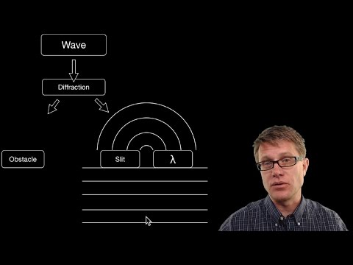
I Think/We Think
Notes:
Bozeman Science. (2015). YouTube. Retrieved June 15, 2022, from https://www.youtube.com/watch?v=1bHipDSHVG4&t=2s.

Slide 15
I Think/We Think
With your partner, discuss the following:
Observations you both made during the video.
Write a one-sentence summary of your discussion and add it to the column labeled “We Think.”
Select 1-2 questions you both have still to share with the class.

Slide 16
Driving Question Board
Based on what you discussed with your partner, what are some questions we can add to our Driving Question Board?

Slide 17
Spectroscope Engineering
Your mission is to design, build, and refine a spectroscope to observe light spectra.
With your partner:
Select one question from the Driving Question Board that you would like to research.
Watch the videos to learn more about how to create a spectroscope.
Design, build, and refine your spectroscope using diffraction materials.
Keep in mind that you will show off your spectroscope to other groups in a Gallery Walk.

Slide 18
Research
As you watch the videos that explain the science behind spectroscopes, keep track of your research and notes in your handout.

Slide 19
Spectroscope Engineering
Notes:
Exploratorium Teacher Institute. (2015). What’s Going On: CD Spectroscope- Science Snacks Activity. YouTube. Retrieved June 17, 2022, from https://www.youtube.com/watch?v=UnH3nsk-Ibs.

Slide 20
Research
With your partner:
Your job is to create your own design using the videos on your handout for inspiration.
Watch at least two of the provided videos.
You may find others you would also like to watch that will help in your research.

Slide 21
Driving Question Board
Based on what you discussed and researched with your partner, what did you learn from researching the question you chose?

Slide 22
Build Your Spectroscope
INSERT CLASS-SPECIFIC INSTRUCTIONS HERE

Slide 23
Gallery Walk
As you walk around the room to view the spectroscopes built by your peers, take time to notice the following:
At least two similarities
At least two differences
Be prepared to share with the class.

Slide 24
Test Your Spectroscope
INSERT CLASS-SPECIFIC INSTRUCTIONS HERE

Slide 25
Refine and Reflect on Your Spectroscope
INSERT CLASS-SPECIFIC INSTRUCTIONS HERE

Slide 26
Essential Questions
What is diffraction?
How does light bend when it passes through an object?

Slide 27
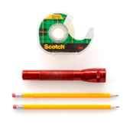
Explore: Light Can Bend Around Edges
Read your handout.
Working with a partner, gather supplies and complete the worksheet while exploring.

Slide 28
Sick Science! #179
Notes:
Video followed by class discussion: https://www.youtube.com/watch?v=Qfbsog3Cqac&t=2s

Slide 29
Elbow Partners
With your partner, discuss what is similar and what is different about what you recorded on the handout.
Add any new information or questions to your handout.

