Slide 2
OPTIC: A Reading Strategy Recipe
Visual Literacy

Slide 3
Think-Pair-Share
What does “visual literacy” mean?
Write your definition on a sticky note.
On your sheet of notebook paper, list three strategies you use to help you understand a reading or text.
Share your definition of “visual literacy” and your list of strategies with a partner.

Slide 4
Visual Literacy
“Visual literacy” communicates with visual images as well as, or instead of, words.
Reading analysis tools and a reading process help improve understanding and literacy in general.
Reading both text and art (or other non-print items) strengthen skills that affect all aspects of comprehension.

Slide 5
Essential Question
How can using reading strategies enhance one’s comprehension?

Slide 6
Lesson Objective
Understand how to use a reading strategy to analyze a variety of media.

Slide 7
Visual Literacy
“Read” the artwork on the next slide.
Read the art using the following visual literacy skills:
decode
interpret
create
question
Write a 1–2 sentence summary that describes your understanding of the image under the “Initial Comprehension” section of your handout.

Slide 8
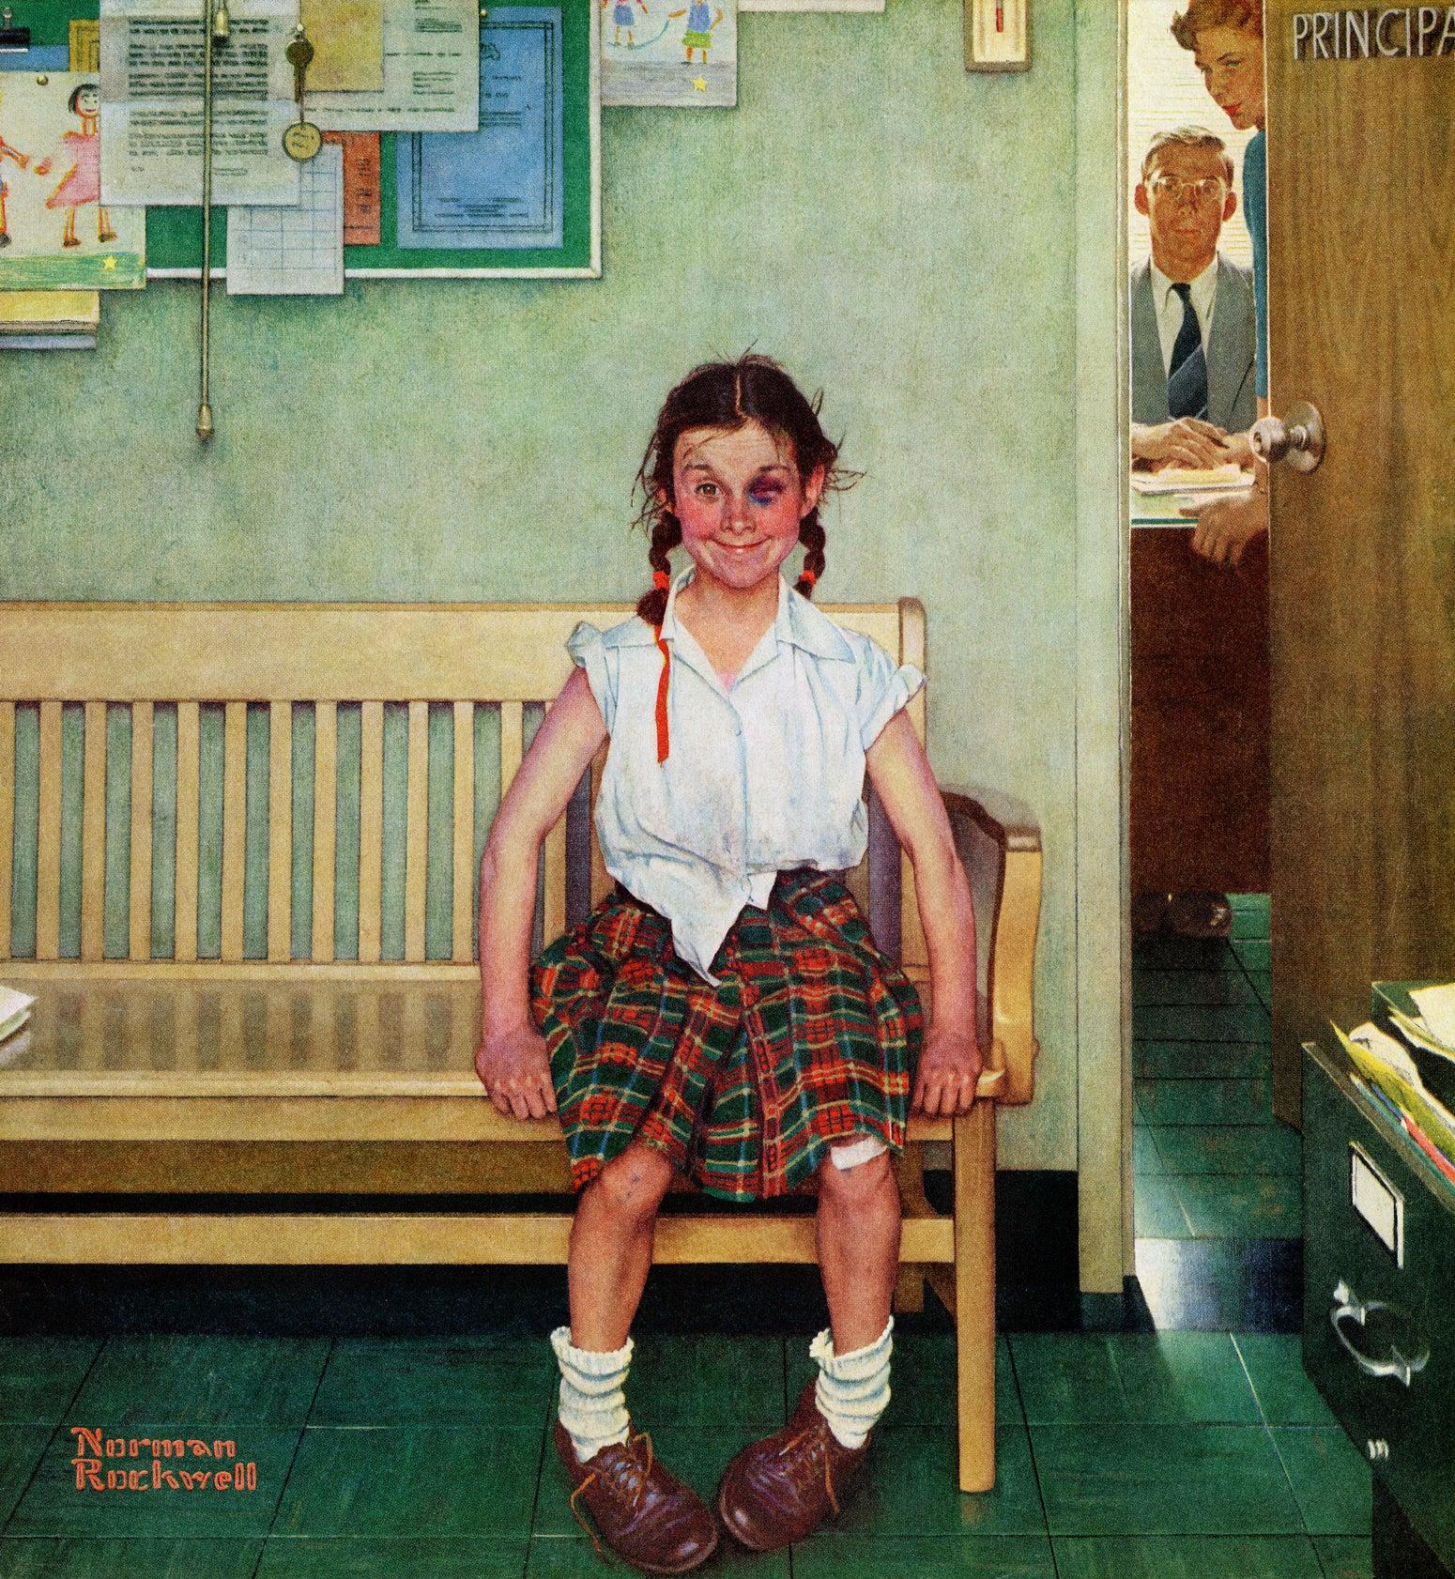
Notes:
Rockwell, N. (1953). The young lady with the shiner [Painting]. The Saturday Evening Post. http://www.saturdayeveningpost.com/2009/08/29/art-entertainment/beyond-the-canvas-art-entertainment/school-daze.html/attachment/cover_9530523

Slide 9
OPTIC
O—Observations
P—Predictions
T—Titles/Themes
I—Inferences
C—Conclusions
Notes:
K20 Center. (n.d.). It’s OPTIC-al. Strategies. https://learn.k20center.ou.edu/strategy/99

Slide 10
OPTIC
O—Observations
List 10 observations about the picture on your handout.
List only visual details.
Avoid making interpretations about the picture.
Notes:
K20 Center. (n.d.). It’s OPTIC-al. Strategies. https://learn.k20center.ou.edu/strategy/99
K20 Center. (n.d.). Photo or picture deconstruction. Strategies. https://learn.k20center.ou.edu/strategy/140
Rockwell, N. (1953). The young lady with the shiner [Painting]. The Saturday Evening Post. http://www.saturdayeveningpost.com/2009/08/29/art-entertainment/beyond-the-canvas-art-entertainment/school-daze.html/attachment/cover_9530523

Slide 11
OPTIC
P—Predictions
On your handout, record three predictions about what is happening in the picture.
Highlight each prediction in a different color.
Notes:
K20 Center. (n.d.). It’s OPTIC-al. Strategies. https://learn.k20center.ou.edu/strategy/99
K20 Center. (n.d.). Photo or picture deconstruction. Strategies. https://learn.k20center.ou.edu/strategy/140
Rockwell, N. (1953). The young lady with the shiner [Painting]. The Saturday Evening Post. http://www.saturdayeveningpost.com/2009/08/29/art-entertainment/beyond-the-canvas-art-entertainment/school-daze.html/attachment/cover_9530523

Slide 12
OPTIC
T—Titles or Themes
What would you title this artwork?
Brainstorm three possible titles.
“The Shiner”
Notes:
K20 Center. (n.d.). It’s OPTIC-al. Strategies. https://learn.k20center.ou.edu/strategy/99
K20 Center. (n.d.). Photo or picture deconstruction. Strategies. https://learn.k20center.ou.edu/strategy/140
Rockwell, N. (1953). The young lady with the shiner [Painting]. The Saturday Evening Post. http://www.saturdayeveningpost.com/2009/08/29/art-entertainment/beyond-the-canvas-art-entertainment/school-daze.html/attachment/cover_9530523

Slide 13
OPTIC
I—Inferences
Use your predictions to make inferences.
Use your observations as evidence for your inferences.
Highlight each observation in the same color as the prediction it supports.
Notes:
K20 Center. (n.d.). It’s OPTIC-al. Strategies. https://learn.k20center.ou.edu/strategy/99
K20 Center. (n.d.). Photo or picture deconstruction. Strategies. https://learn.k20center.ou.edu/strategy/140
Rockwell, N. (1953). The young lady with the shiner [Painting]. The Saturday Evening Post. http://www.saturdayeveningpost.com/2009/08/29/art-entertainment/beyond-the-canvas-art-entertainment/school-daze.html/attachment/cover_9530523

Slide 14
OPTIC
C—Conclusions
Consider who is present in the picture, what happened, and when, where, why, and how it took place.
Do not write on your handout yet.
Notes:
K20 Center. (n.d.). It’s OPTIC-al. Strategies. https://learn.k20center.ou.edu/strategy/99
K20 Center. (n.d.). Photo or picture deconstruction. Strategies. https://learn.k20center.ou.edu/strategy/140
Rockwell, N. (1953). The young lady with the shiner [Painting]. The Saturday Evening Post. http://www.saturdayeveningpost.com/2009/08/29/art-entertainment/beyond-the-canvas-art-entertainment/school-daze.html/attachment/cover_9530523

Slide 15
Pass the Problem
Pass your handout to another person each time you hear the word “pass.”
Each time you are passed a new handout, fill in one section under the “Conclusion” heading.
Notes:
K20 Center. (n.d.). Pass the problem. Strategies. https://learn.k20center.ou.edu/strategy/151

Slide 16
Pass the Problem
Pass your handout to the right. Record an answer for “Who.”
Pass the handout to the right. Record an answer for “What.”
Pass the handout to the right. Record an answer for “When.”
Pass the handout to the right. Record an answer for “Where.”
Pass the handout to the right. Record an answer for “Why.”
Pass the handout to the right. Record an answer for “How.”
Notes:
K20 Center. (n.d.). Pass the problem. Strategies. https://learn.k20center.ou.edu/strategy/151

Slide 17
The Story Behind the Painting
Review the artwork and your OPTIC Recipe Card handout.
Use the information from the “Conclusion” section on your handout to write a story.
Write at least one sentence to describe each of the question categories on the handout.
Include specific details and imagery, as well as evidence from the art, to support your inferences and conclusions.
Describe the picture’s context, setting, plot or conflict, and characters.

Slide 18
Mingle
Use the tape provided to tape and have a friend help you tape your story to your back.
As the music plays mingle.
When music stops form groups of 3 or 4.
Stand in a circle facing each other’s backs.
Read the story from the back of the person next to you.
Rotate 180 degrees and read the story from the back of the person on the other side.
Notes:
K20 Center. (n.d.). Mingle. Strategies. https://learn.k20center.ou.edu/strategy/53

Slide 19
Think-Pair-Share
Review your initial comprehension of the picture.
How did you view the picture prior to using the OPTIC strategy?
Was your initial comprehension different from your final comprehension and the story you created?
Respond to the question under the “Evaluate” heading on your handout.
Notes:
K20 Center. (n.d.). Think-pair-share. Strategies. https://learn.k20center.ou.edu/strategy/139

Slide 20
Think-Pair-Share
Find a partner.
With your partner, discuss the differences between your initial comprehension of the picture and your final comprehension.
Prepare to share your responses with the whole class.
Notes:
K20 Center. (n.d.). Think-pair-share. Strategies. https://learn.k20center.ou.edu/strategy/139

Slide 21
OPTIC: Visual Literacy
The OPTIC strategy can be applied to any text, art, video, or other piece of media.
Watch the video The Bully by Roger Dean Kiser.
As you watch, complete a new OPTIC Recipe Card about the video.
Notes:
K20 Center. (n.d.). It’s OPTIC-al. Strategies. https://learn.k20center.ou.edu/strategy/99

Slide 22
The Bully (short film)
Notes:
ANAMALoff. (2009, August 25). “The bully” [Video]. YouTube. https://www.youtube.com/watch?v=brbcN2zc77s

Slide 23
OPTIC: Text
Read the text version of “The Bully.”
Apply the OPTIC reading strategies to the reading.
Underline key details (observations).
Make predictions.
Look at the title and theme.
Cite evidence for your inferences.
Draw conclusions.
As you annotate, label the elements of who, what, where, when, why, and how as they appear in the text.
Notes:
K20 Center. (n.d.). It’s OPTIC-al. Strategies. https://learn.k20center.ou.edu/strategy/99

Slide 24
OPTIC: Text
Write a one-paragraph, descriptive summary of ”The Bully.”
Include the elements of who, what, where, when, why, and how that you previously identified.
Include details from your annotations.
Notes:
K20 Center. (n.d.). It’s OPTIC-al. Strategies. https://learn.k20center.ou.edu/strategy/99

Slide 25
I Used to Think... But Now I Know
Review your sticky note from the beginning of the lesson.
Answer the following questions on a new sticky note:
Did the OPTIC strategy aid in your comprehension?
If so, why and how did it improve your comprehension?
Notes:
K20 Center. (n.d.). I used to think . . . but now I know. Strategies. https://learn.k20center.ou.edu/strategy/137

Slide 26
OPTIC: A Reading Strategy
How were the tasks of analyzing the illustration, video, and short story similar when using the OPTIC strategy?
How were the tasks of analyzing the illustration, video, and short story different when using the OPTIC strategy?
Notes:
K20 Center. (n.d.). It’s OPTIC-al. Strategies. https://learn.k20center.ou.edu/strategy/99

