Slide 2
American Industrialists
Robber Barons or Captains of Industry?

Slide 3
Essential Question
What impact did American industrialists have on the U.S. economy in the 19th century and beyond?

Slide 4
Lesson Objectives
Recognize the differences between “Robber Barons” and “Captains of Industry.”
Consider the practices modern business leaders have used to become so successful in today’s economy.

Slide 5
I Notice, I Wonder
Please pair up with an Elbow Partner.
Analyze the image on the next slide with your partner.
Write down things that you notice in one column of the T-Chart.
In the other column, write down any questions you have about the image or what it is referencing.
Notes:
K20 Center. (n.d.). I notice, I wonder. Strategy. https://learn.k20center.ou.edu/strategy/180
K20 Center. (n.d.). Elbow partners. Strategy. https://learn.k20center.ou.edu/strategy/116

Slide 6
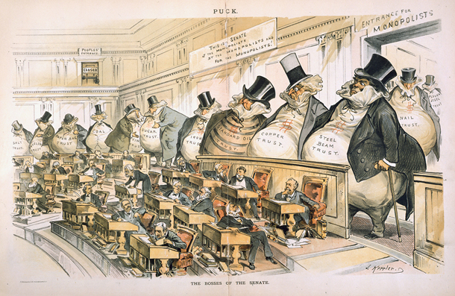
The Bosses of the Senate
Notes:
Keppler, J. (2020, November 13). The bosses of the Senate. U.S. Senate: The Bosses of the Senate. Retrieved October 10, 2022, from https://www.senate.gov/art-artifacts/historical-images/political-cartoons-caricatures/38_00392.

Slide 7
Jigsaw
Each group member will be responsible for learning about one of the four American Industrialists mentioned in the handout.
After reading your assigned section, please record what you learned on the graphic organizer.
Finally, share your findings with the rest of your group.
Notes:
K20 Center. (n.d.). Jigsaw. Strategy. https://learn.k20center.ou.edu/strategy/179

Slide 8
“Robber Barons” or “Captains of Industry”
“Robber Baron:” A derogatory term applied to powerful, wealthy industrialists from the U.S. in the 19th century. They monopolized major industries using unfair business practices.
“Captain of Industry:” A group of entrepreneurs, inventors, and businessmen who acquired great wealth and success from their endeavors. Compassionate men, they used their wealth and influence in a positive way, making important contributions to improve the lives of the American people.

Slide 9
Four Corners
Get into discussion groups based on the person you read about in your reading groups.
Each new group will be responsible for determining if the businessman they read about was a “robber baron” or a “captain of industry.”
Notes:
K20 Center. (n.d.). Four corners. Strategy. https://learn.k20center.ou.edu/strategy/138

Slide 10
Share Out
Is the businessman a robber baron or a captain of industry? Please be prepared to support your answer.

Slide 11
Research Posters
People | Business/Industry
Jeff Bezos | Entrepreneur/Media
Warren Buffett | Businessman/Philanthropist
Shawn Carter (Jay-Z) | Entertainment/Entrepreneur
Bill Gates | Businessman/Philanthropist
LeBron James | Athlete/Entertainment
Abigail Johnson | Businesswoman/Investor
Elon Musk | Engineering/Investor
Julia Sweet | Attorney/Businesswoman
Oprah Winfrey | Entertainment/Philanthropist
Mark Zuckerberg | Internet Entrepreneur/Philanthropist
Notes:
K20 Center. (n.d.). Research posters. Strategy. https://learn.k20center.ou.edu/strategy/49

Slide 12
Research Posters
Create a poster about a business leader.
Research information about their industry, business practices, careers, net worth, etc.
Be prepared to share your findings with the class.

Slide 13
Exit Ticket
In 3-5 sentences, write a response to the following questions.
Do you think the distinction between “Captain of Industry” and “Robber Baron” still holds weight today? That is, can one be a captain of industry without being a robber baron? Why or why not?
What responsibilities do millionaires or other wealthy people have to society?
Notes:
K20 Center. (n.d.). Bell ringers and exit tickets. Strategy. https://learn.k20center.ou.edu/strategy/125

