Slide 2
Remembering Emmett Till
The Early Struggles Against Jim Crow

Slide 3
Learning Objectives
Analyze the impact of Jim Crow laws in America.
Examine the history of lynching and the murder of Emmett Till.

Slide 4
“Playground Elegy”
What words from the poem stuck out to you the most?

Slide 5
“Playground Elegy”
What do you think this poem is about?

Slide 6
“Playground Elegy”
What do you think the word elegy means?

Slide 7
Defining Elegy
Elegy: a song or poem expressing sorrow or lamentation especially for one who is dead
Notes:
Merriam-Webster. (n.d.). Elegy. In Merriam-Webster.com dictionary. Retrieved July 11, 2022, from https://www.merriam-webster.com/dictionary/elegy

Slide 8
“Playground Elegy”
After reading the poem again and knowing the definition of elegy, does your understanding of the poem change? If so, how?
What do you think the author's purpose was for writing this poem?

Slide 9
Essential Question
How can one individual influence a movement?

Slide 10

Paired Text H-Chart
The Document Set contains the following two readings:
  “Jim Crow Laws in Mississippi”
  “Lynching in America”
With your group, you will read and analyze both documents using the H-Chart handout.
Notes:
K20 Center. (2020, September 16). Paired texts H-chart. Strategies. https://learn.k20center.ou.edu/strategy/132

Slide 11
Paired Text H-Chart
Begin by reading “Jim Crow Laws in Mississippi” and complete the left side of the H-Chart.
Next, read “Lynching in America” and complete the right side of the H-Chart.
Lastly, use both texts to answer the middle section.
Notes:
K20 Center. (2020, September 16). Paired texts H-chart. Strategies. https://learn.k20center.ou.edu/strategy/132

Slide 12
Emmett Louis Till
Emmett Louis Till was born in Chicago on July 25, 1941.
Emmett was the only child of Louis, a soldier who died during WWII, and Mamie Till.
In August of 1955, Emmett was 14 when he went down to Money, MS, to visit family. Before he left, Mamie gifted him a ring that had belonged to his father.
This would later be used to identify Till, following his brutal murder.
Notes:
PBS. (n.d.). Who was Emmett Till? American experience. https://www.pbs.org/wgbh/americanexperience/features/biography-emmett-till/

Slide 13

Window Notes
As you watch the video, you will use your
“Window Notes” handout to follow along.
  Facts: Which facts stood out to you?
  Feelings: What feelings are you experiencing?
  Questions: What questions do you have?
  Lasting Impact: What lasting impact did this have?
Notes:
K20 Center. (2020, September 16). Window notes. Strategies. https://learn.k20center.ou.edu/strategy/189

Slide 14
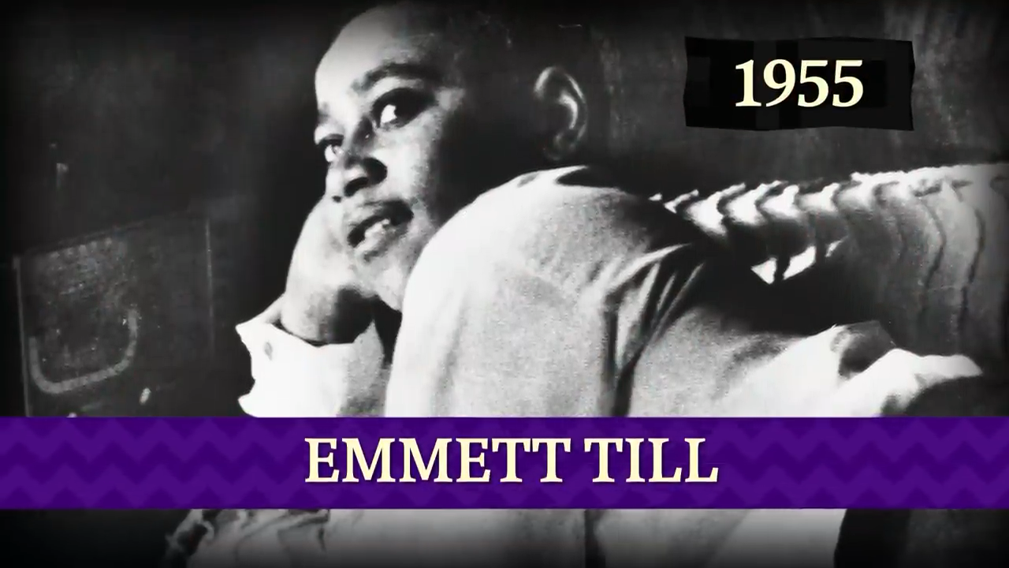
Emmett Till: Crash Course Black American History #34
Notes:
CrashCourse. (2022). Emmett Till: Crash course Black American history #34 [Video]. YouTube. https://www.youtube.com/watch?v=4HljsKwpv3g

Slide 15

Emmett Till's Mother Speaks | The Murder of Emmett Till | American Experience | PBS
Notes:
American Experience | PBS. (2020). Emmett Till’s mother speaks | The murder of Emmett Till | American experience | PBS [Video]. YouTube. www.youtube.com/watch?v=4DE22TfEMEg

Slide 16

POMS: Point of Most Significance
With your partner, discuss what stood out to you the most from the video.
  What was your “point of most significance” from the video?
Notes:
K20 Center. (n.d.). Poms: point of most significance. Strategies. https://learn.k20center.ou.edu/strategy/101​​​​​​​

Slide 17

S-I-T (Surprising, Interesting, Troubling)
With your elbow partner, read “Public Law 117-107” and come up with a response for the following:
  A surprising fact or idea
  An interesting fact or idea
  A troubling fact or idea
Notes:
K20 Center. (2021, February 12). S-I-T (Surprising, interesting, troubling). Strategies. https://learn.k20center.ou.edu/strategy/926

Slide 18

Exit-Ticket
How can one individual influence a movement?
Notes:
K20 Center. (n.d.). Bell ringers and exit tickets. Strategies. https://learn.k20center.ou.edu/strategy/125

