Slide 1
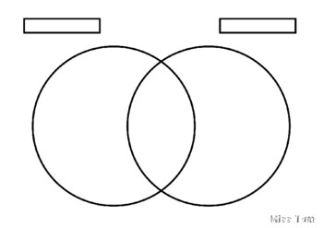
Similarities
Differences

