Slide 2
Discover the Friction Between Fact and Fiction
Identifying the Difference Between Nonfiction and Fiction Texts.

Slide 3
Essential Questions
How do you tell the difference between fiction and nonfiction books?
Why do you need to know the difference between fiction and nonfiction books?

Slide 4
Lesson Objectives
Students will be able to tell the difference between true stories and made up stories.
Students will be able to use the words nonfiction for true stories and fiction for stories that are not real.
1.2.R.2 Students will discriminate between fiction and nonfiction genres.

Slide 5
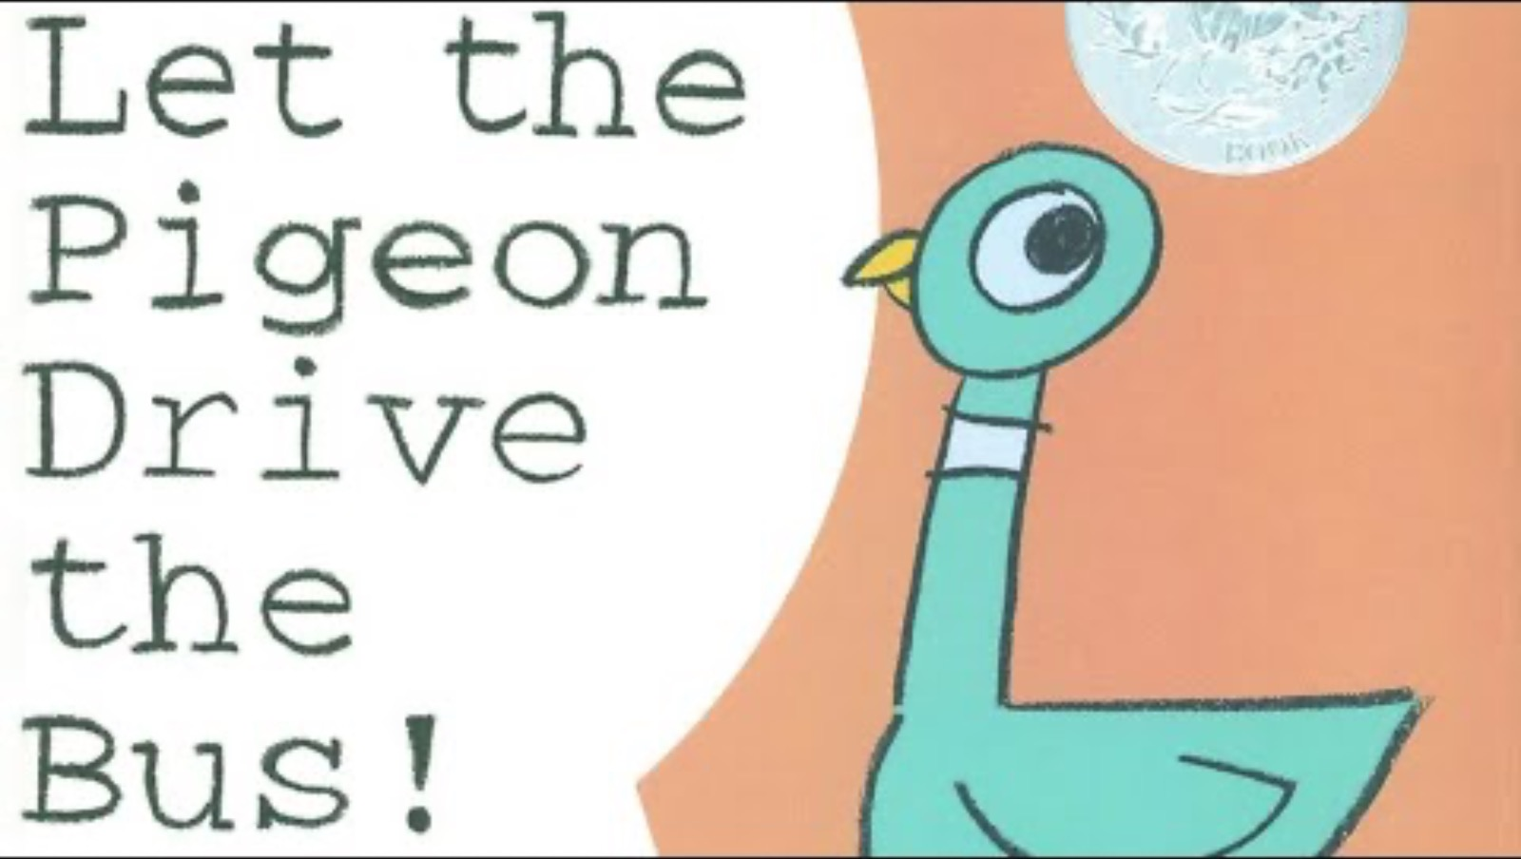
Notes:
You can use this read aloud or better yet, you read the book to the kids.
https://youtu.be/n-dHeNfXtgc?si=NX1EcqwgSyclqeUP

Slide 6
Not Fiction (REAL) | Fiction (NOT REAL)

Slide 7

Fiction and Nonfiction

Slide 8
Which One Does Not Belong?
Notes:
This is the practice slide: Students might say that the different one it is the red circle because the other two figures are blue, or they could say it is the triangle because the other two are circles. Or some of your students might say circle one is different because it does not have an outline around it.

Slide 9



Which One Does Not Belong?
Notes:
Eyewitness Dog does not belong because it is about real dogs. The other two slides are about imaginary animals.
These Photos by Unknown Author is licensed under CC BY

Slide 10
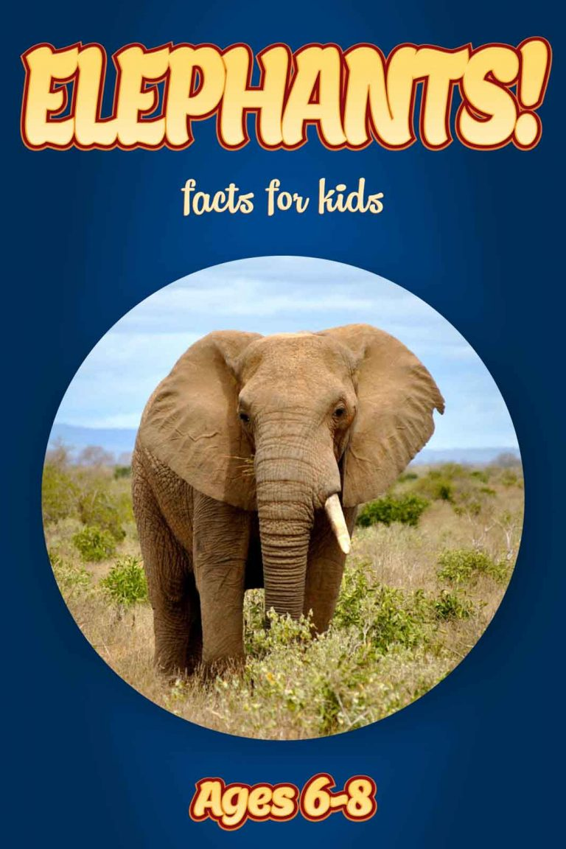
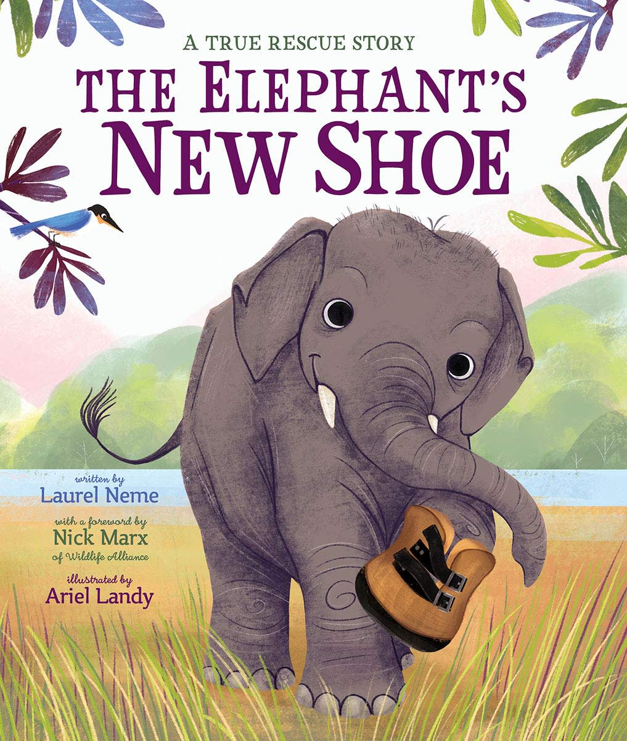
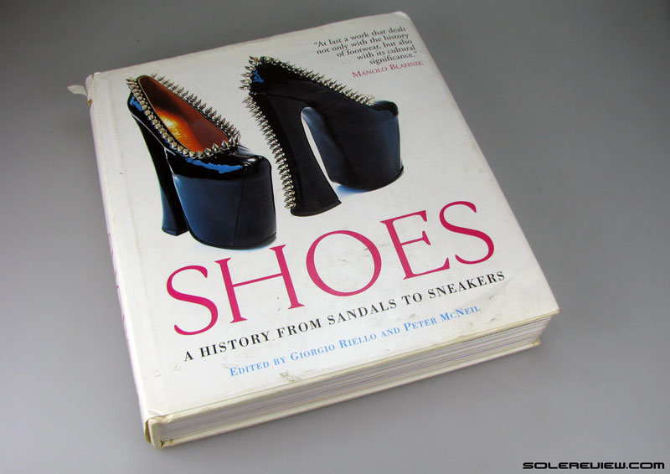
Which One Does Not Belong?
Notes:
The first book doesn't belong because it is not about elephants. The other two books are about elephants – one is a non-fictional book; the other is a fictional account of an elephant and its shoe. OR Books one and three are about shoes, and book two is not about shoes.
The Elephants book doesn’t belong because it doesn’t have shoes in it.

Slide 11
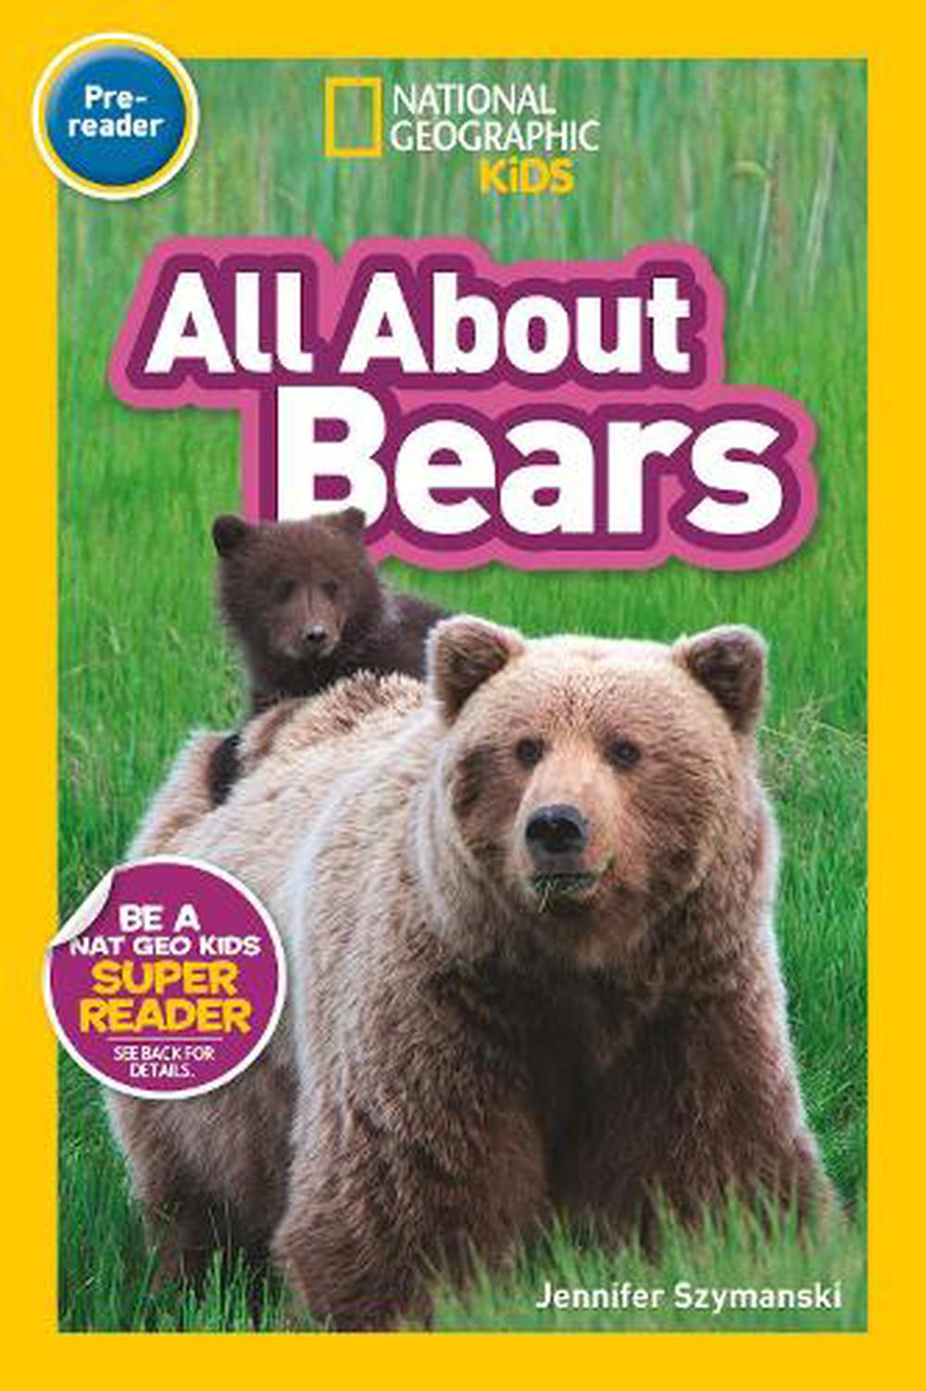

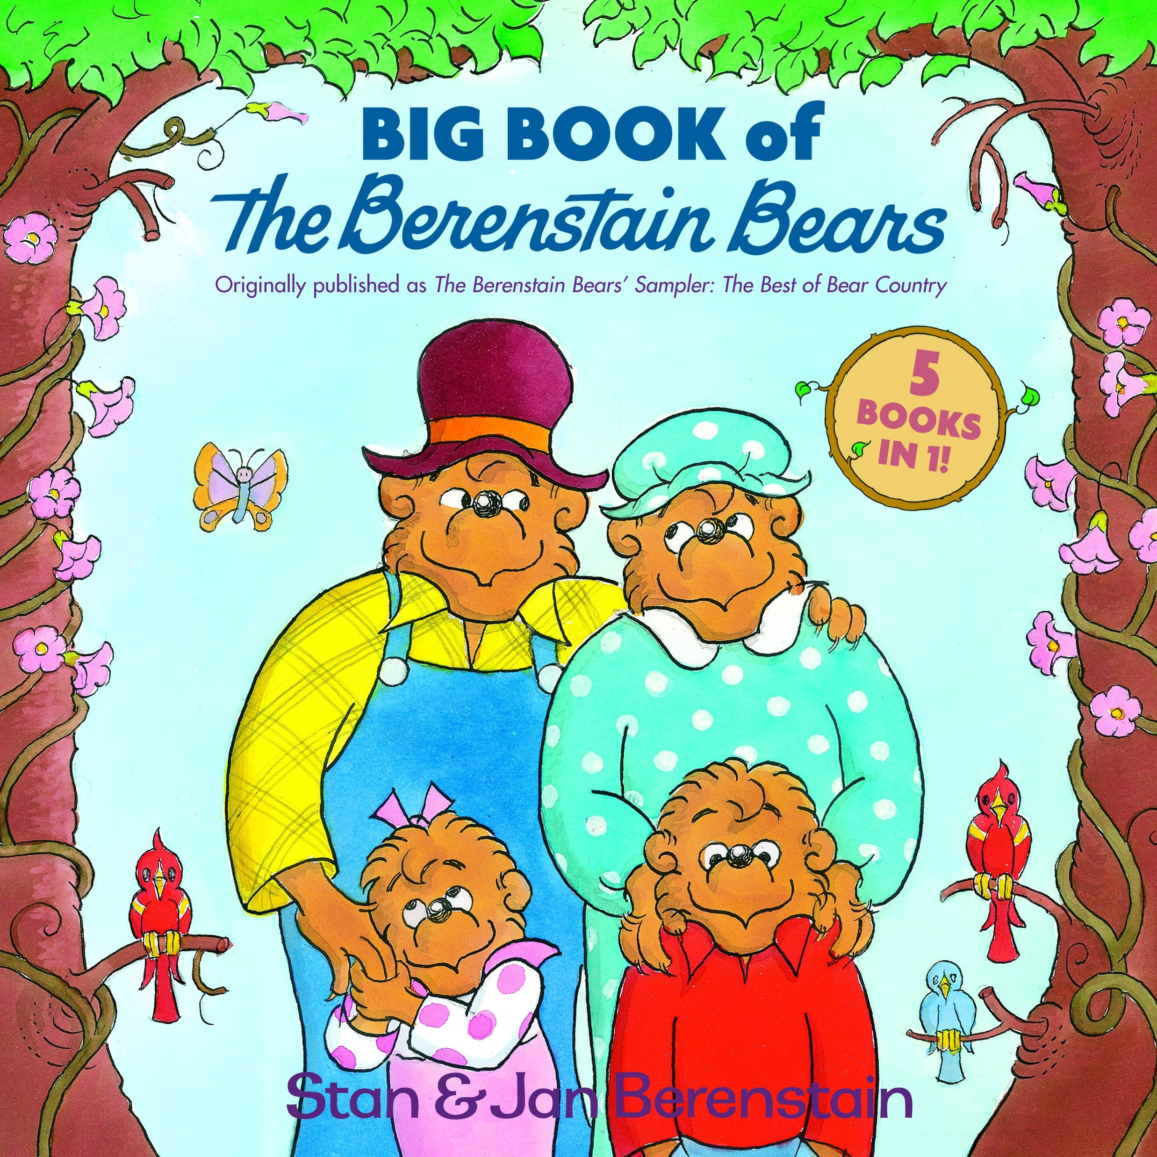
Which One Does Not Belong?
Notes:
All three books are about bears, but All About Bears is different because it is nonfiction – it is about real life bears.

Slide 12
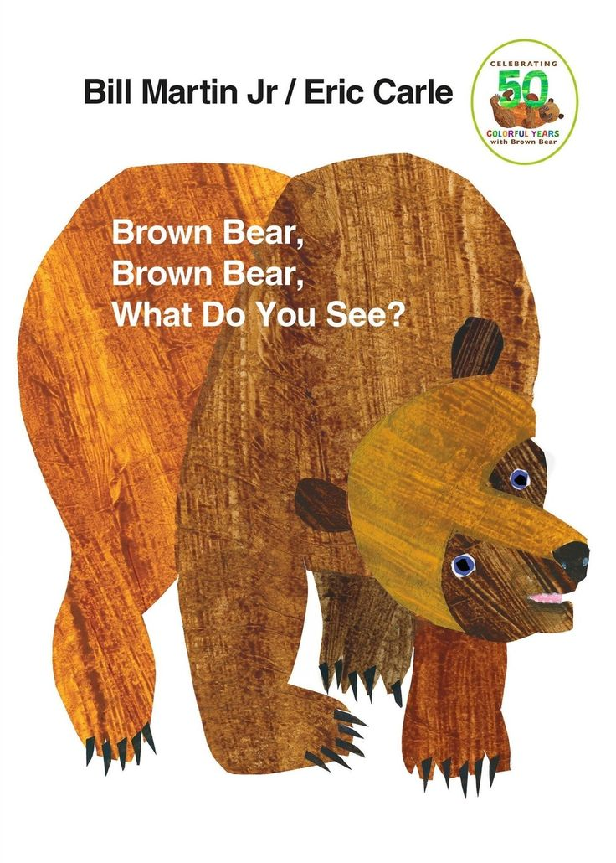
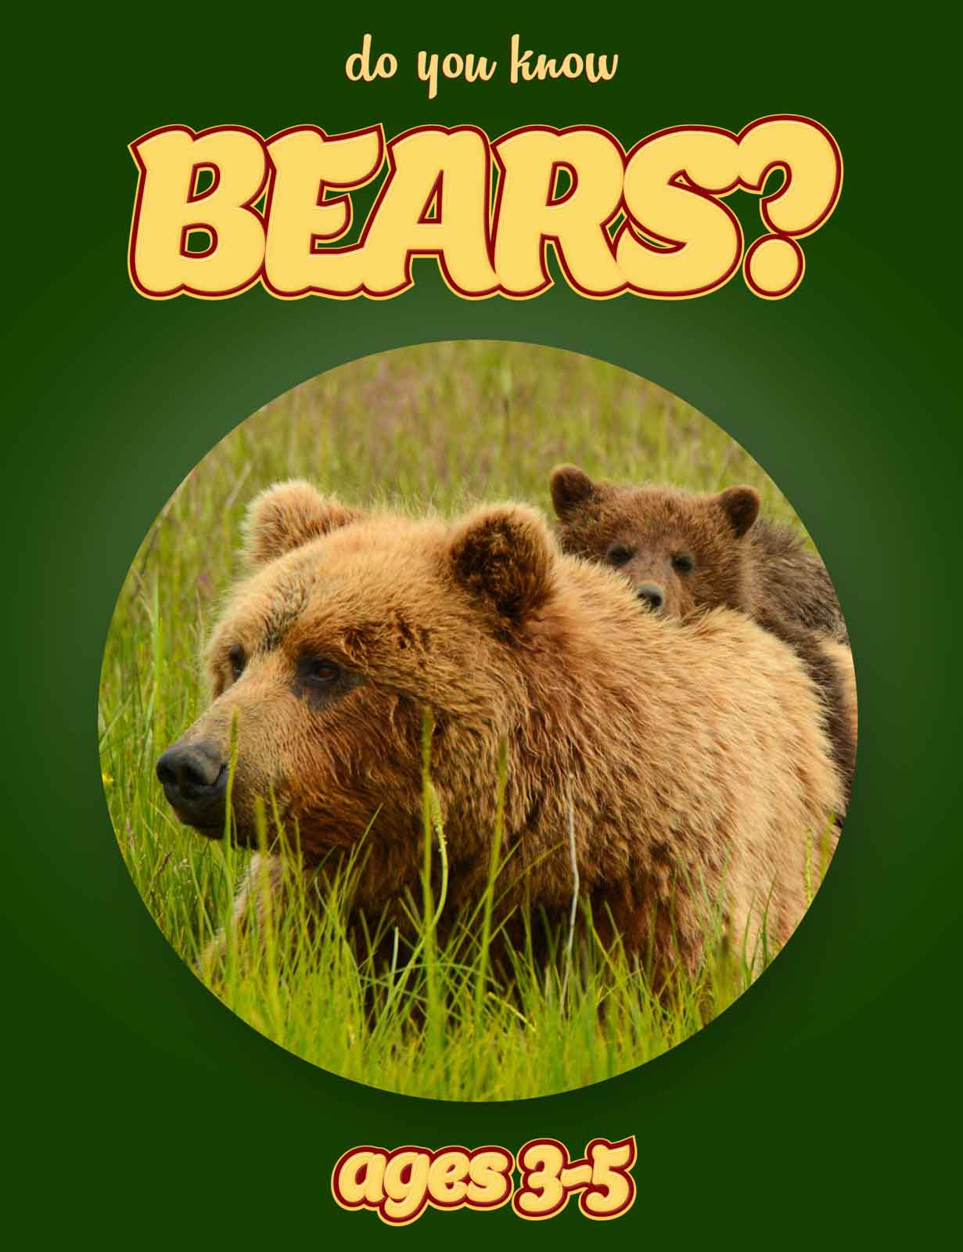
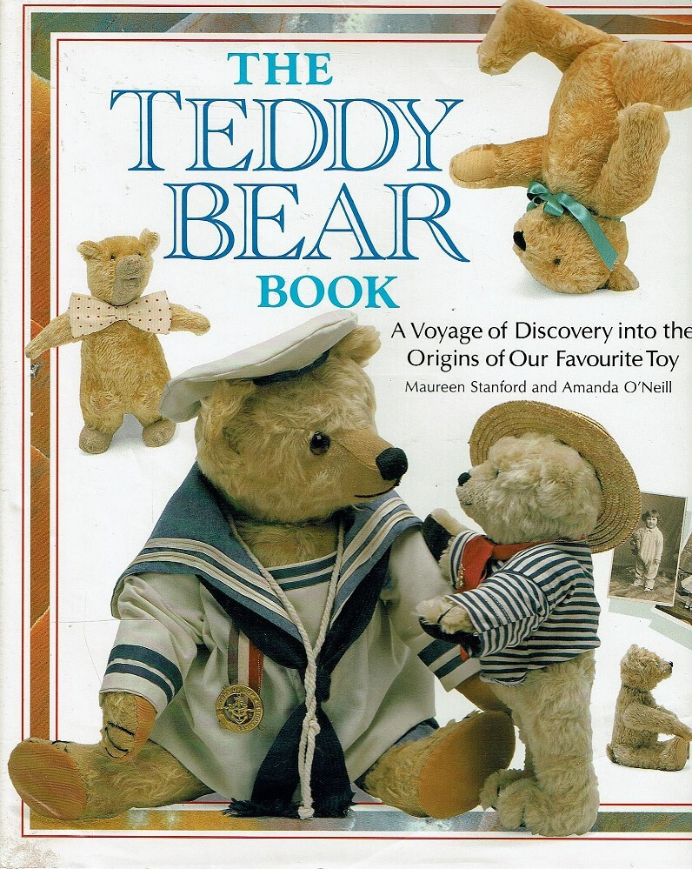
Which One Does Not Belong?
Notes:
The Teddy Bear Book is different because it is about stuffed bears and not real-life bears.
Brown Bear, Brown Bear, Brown Bear is different because it is a fictional book and the other two books are nonfiction.

Slide 13
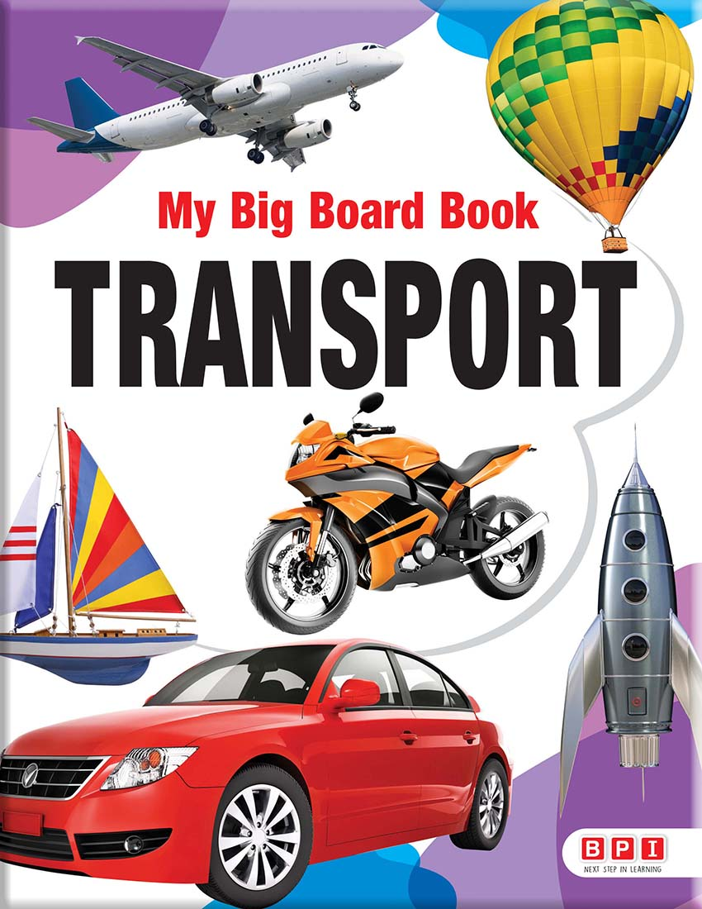

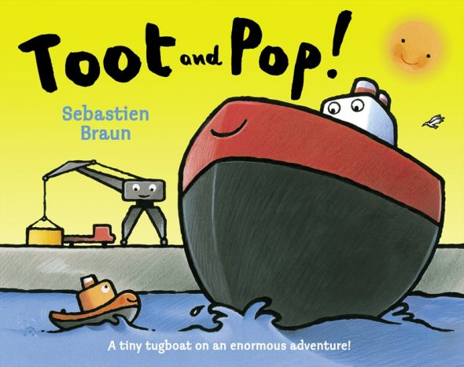
Which One Does Not Belong?
Notes:
My Big Board Book-Transport book is different because it is nonfiction. The other two books are fictional because they have been made up and are not about real-life experiences. The book Toot and Pop! Is also different because it does not have any pictures of airplanes on the cover.

Slide 14
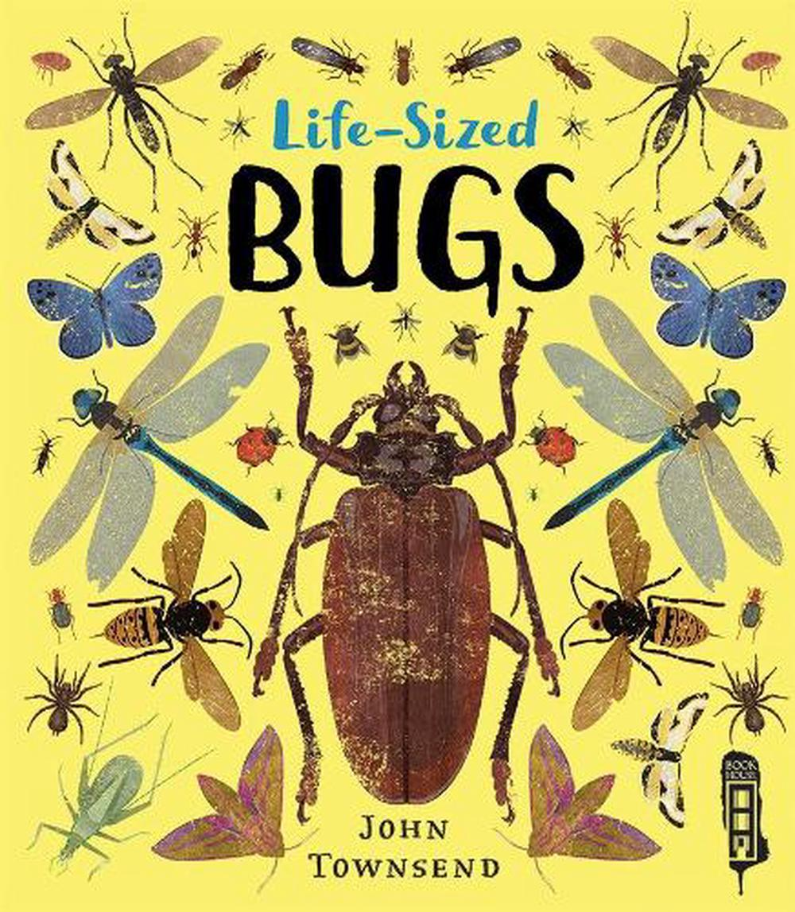
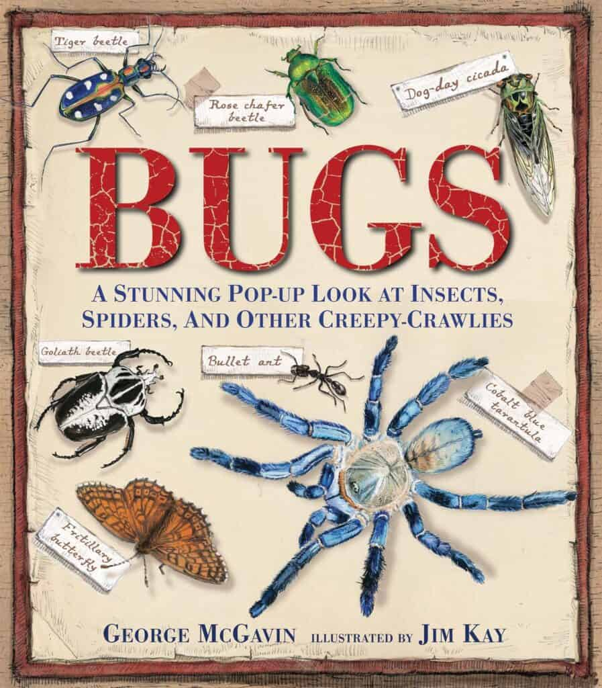

Which One Does Not Belong?
Notes:
They all belong because they are all nonfiction. Is it always easy to tell just by the cover? Are we sure these books are all nonfiction? What would we have to do to find out?
Students may give you other reasons why one book doesn't’ belong, and as long as their reasoning is correct, that is fine. For example, the book in the center has a frame around it. The others do not. Books one and two have pictures of butterflies on the cover. The Bug Book does not have a butterfly on it.

