Slide 1
Google Earth Landforms
By: TYPE NAME HERE

Slide 2
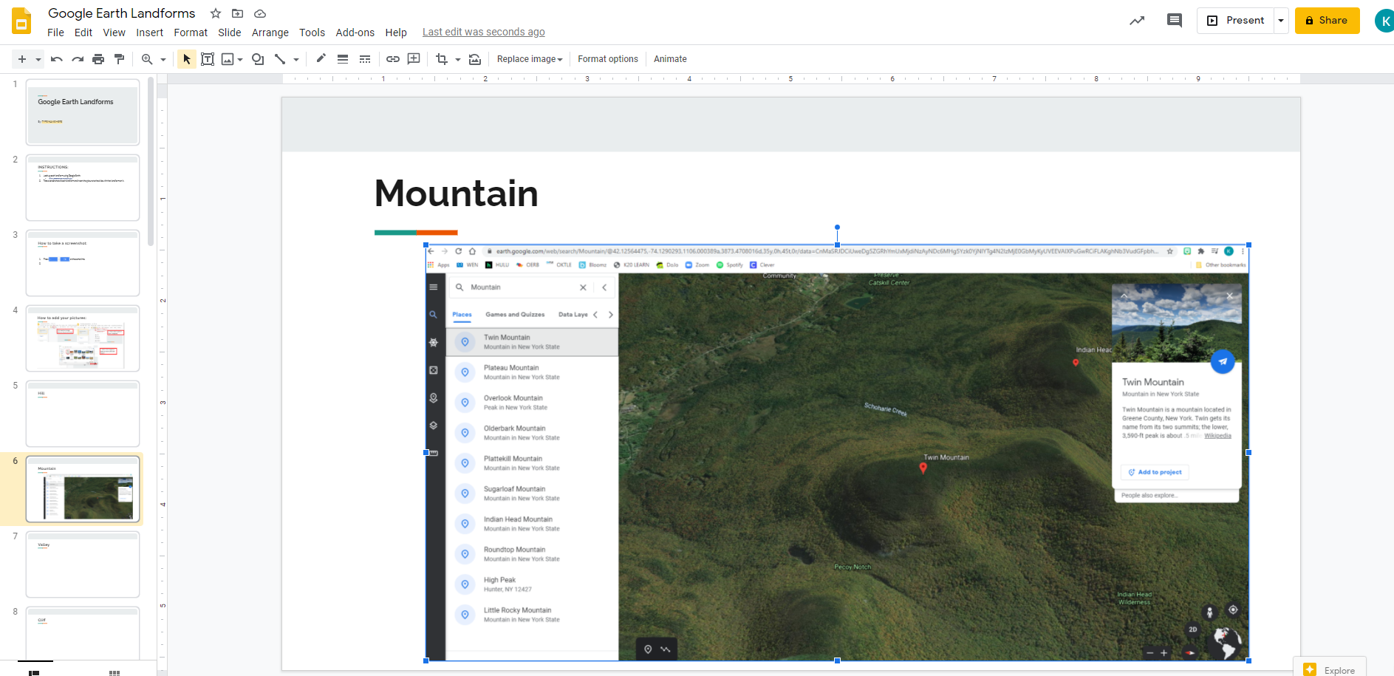
INSTRUCTIONS:
Look up each landform using Google Earth:
https://www.google.com/earth/
Take a screenshot of each landform and insert the picture to the slide with that landform on it.
I have inserted my Mountain slide as an example.

Slide 3
How to take a screenshot:
Press at the same time.
The screenshot will automatically save to your images.

Slide 4
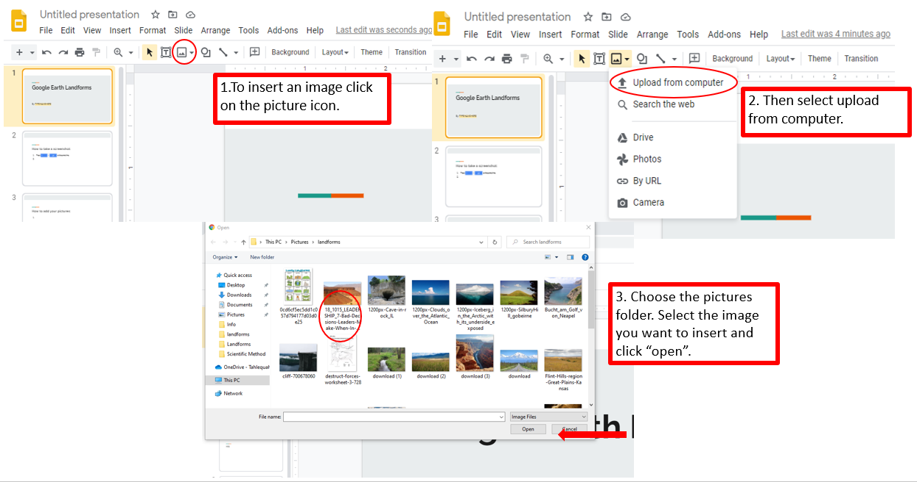
How to add your pictures:

Slide 5
Mountain

Slide 6
Valley

Slide 7
Cliff

Slide 8
Plateau

Slide 9
Cave

Slide 10
Volcano

Slide 11
Beach

Slide 12
Inlet (cove)

Slide 13
Waterfall

Slide 14
Lake

Slide 15
River

Slide 16
Ocean

Slide 17
Island

Slide 18
Glacier

Slide 19
Desert

Slide 20
Forest

Slide 21
Plain

Slide 22
Peninsula

