Slide 2
If You’re a Bird, I’m a Bird
Symbolism in Edgar Allan Poe’s “The Raven”

Slide 3
Essential Question
How are ideas communicated through symbols in poetry?

Slide 4
Lesson Objectives
Understand symbolism and be able to identify symbols.
Create a poem using symbolism.

Slide 5
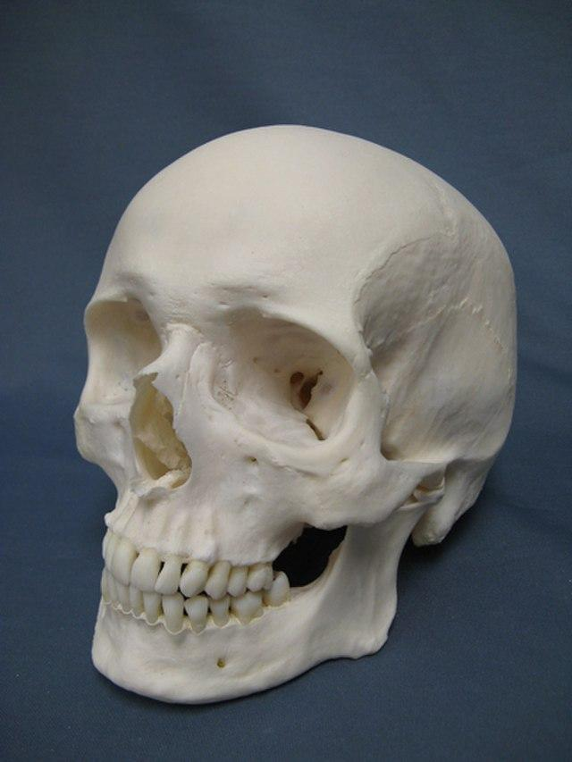
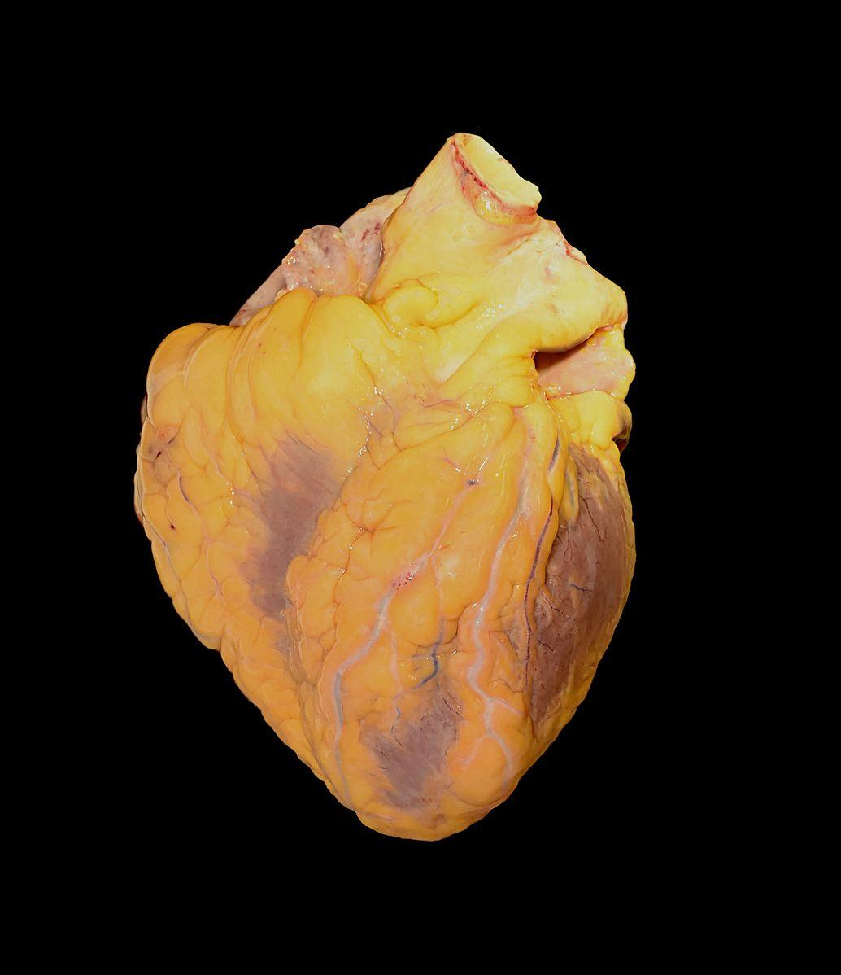
Quick Write
On your paper, respond to the following prompt:
What do these parts of human anatomy represent to you?
Notes:
K20 Center. (n.d.). Quick write. Strategies. https://learn.k20center.ou.edu/strategy/1127
https://commons.wikimedia.org/wiki/File:Caucasian_Human_Skull.jpg
https://commons.wikimedia.org/wiki/File:Human_heart_male_adult_autopsy.jpg

Slide 6
Why-Lighting
As you read “The Raven” by Edgar Allan Poe, use your highlighter to mark any passage, phrase, or word you deem important.
As you highlight, write down in the margins of your paper why you chose those particular words, phrases, or passages.
Notes:
K20 Center. (n.d.). Why-lighting. Strategies. https://learn.k20center.ou.edu/strategy/128

Slide 7
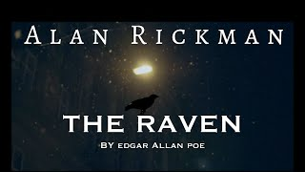
“The Raven” by Edgar Allan Poe
Notes:
https://www.youtube.com/watch?v=guEuZMwdhY4

Slide 8
Why-Lighting
With your partner, discuss what you chose to highlight and why.
Determine whether the two of you chose any of the same things to highlight.
Be ready to share your thoughts with the class.

Slide 9
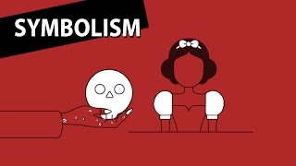
What is Symbolism?
Notes:
https://www.youtube.com/watch?v=8Vwek28P9Gk

Slide 10
Symbolism
With your partner, think of a symbol to represent each of these concepts:
Life
Death
Love
Friendship
Be ready to share with the class.

Slide 11
Stand Up, Sit Down
Stand up and have your list of symbols ready.
If someone shares the same symbol for a concept that you and your partner have already chosen, sit down.
Notes:
K20 Center. (n.d.). Stand up, sit down. Strategies. https://learn.k20center.ou.edu/strategy/1771?rev=11586

Slide 12
Claim, Evidence, Reasoning
Question: "What does the raven symbolize in Edgar Allan Poe’s poem “The Raven?”
Make a CLAIM by answering the question.
Gather EVIDENCE in support of your claim. Use your Why-Lighting as a resource.
Explain your REASONING by forming a conclusion based on your evidence.
Notes:
K20 Center. (n.d.). Claim, evidence, reasoning (CER). Strategies. https://learn.k20center.ou.edu/strategy/156

Slide 13
Symbols of Me
Using your handout as a guide, create a free-verse poem about yourself using symbolism.
Remember that a free-verse poem does not need to rhyme or follow typical grammar rules.
Sharing your poem with your classmates will be optional.

Slide 14
How Am I Feeling? What Am I thinking?
Draw a diagonal line on your sticky note to divide it in half.
On one half, draw a picture to symbolize how you are feeling about what you have learned.
On the other half, write one sentence explaining what you learned about symbolism.
Notes:
K20 Center. (n.d.). How am I feeling? What am I thinking?. Strategies. https://learn.k20center.ou.edu/strategy/187

