Slide 2
Wonky Waves
The Doppler Effect

Slide 3
Essential Question
How do you know if a siren is moving toward or away from you?

Slide 4
Lesson Objectives
Explain the origin of the shift in frequency and wavelength of the observed wavelength when observer and source moved toward or away from each other.
Derive an expression for the relativistic Doppler shift.
Apply the Doppler formula to real-world examples.
Research the effect Doppler has on weather prediction.

Slide 5

Question Generating
What is a good question?
  insert good question criteria
  insert good question criteria
While watching the video, create 2-3
good questions about what you hear.
Notes:
K20 Center. (n.d.). Generating Questions. Strategies. https://learn.k20center.ou.edu/strategy/167

Slide 6
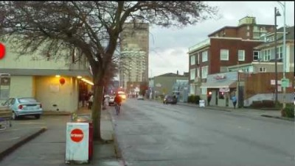
Notes:
Seacams. (2013, January 11). Ambulance screaming by at high speed - doppler effect [Video]. YouTube. https://www.youtube.com/watch?v=rqehO9yfwTA

Slide 7
Doppler Ball Activity
During the activity:
  Answer the questions you generated during the video.
  Generate new questions.
  Answer those new questions by experimenting with the Doppler ball.
Write down your answers and new questions on the Generating questions handout.

Slide 8

Doppler Ball Activity
Follow the directions on the Doppler Ball Activity handout.
Follow all safety warnings.
Be mindful of your surroundings.
Notes:
K20center. (2021, September 21). K20 Center 10 minute timer [Video]. YouTube. https://www.youtube.com/watch?v=9gy-1Z2Sa-c

Slide 9
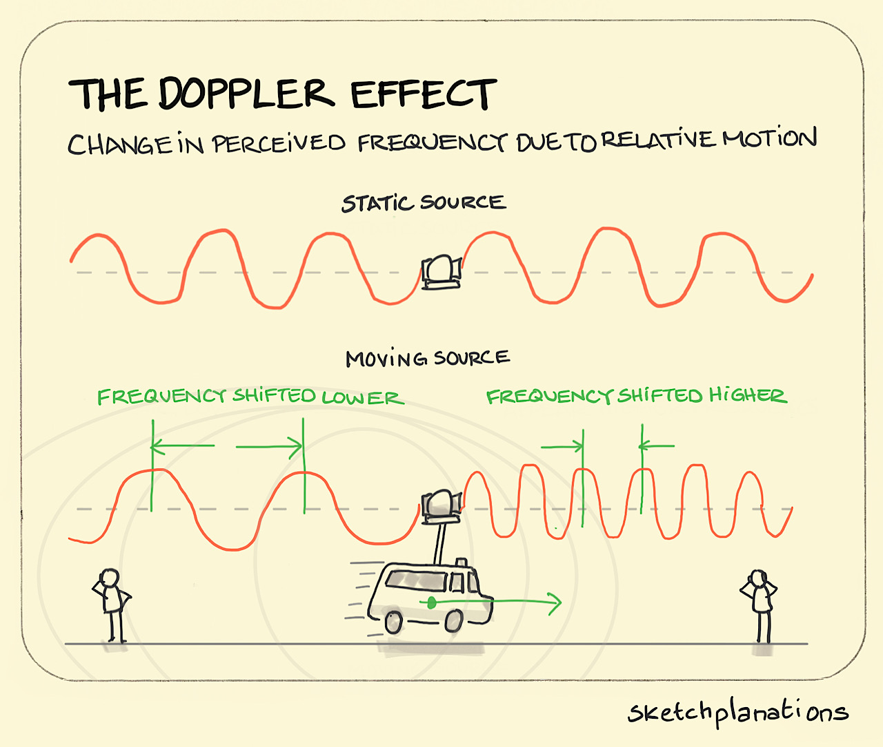
Doppler Effect
Notes:
The Doppler Effect. Sketchplanations. (n.d.). https://sketchplanations.com/the-doppler-effect

Slide 10
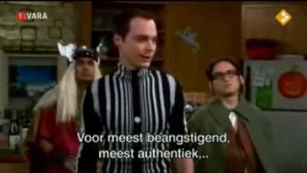
Notes:
Tomdelier1995. (2013, January 10). Doppler Effect by Dr. Sheldon Cooper [Video]. YouTube. https://www.youtube.com/watch?v=o3G_eaSaLck

Slide 11
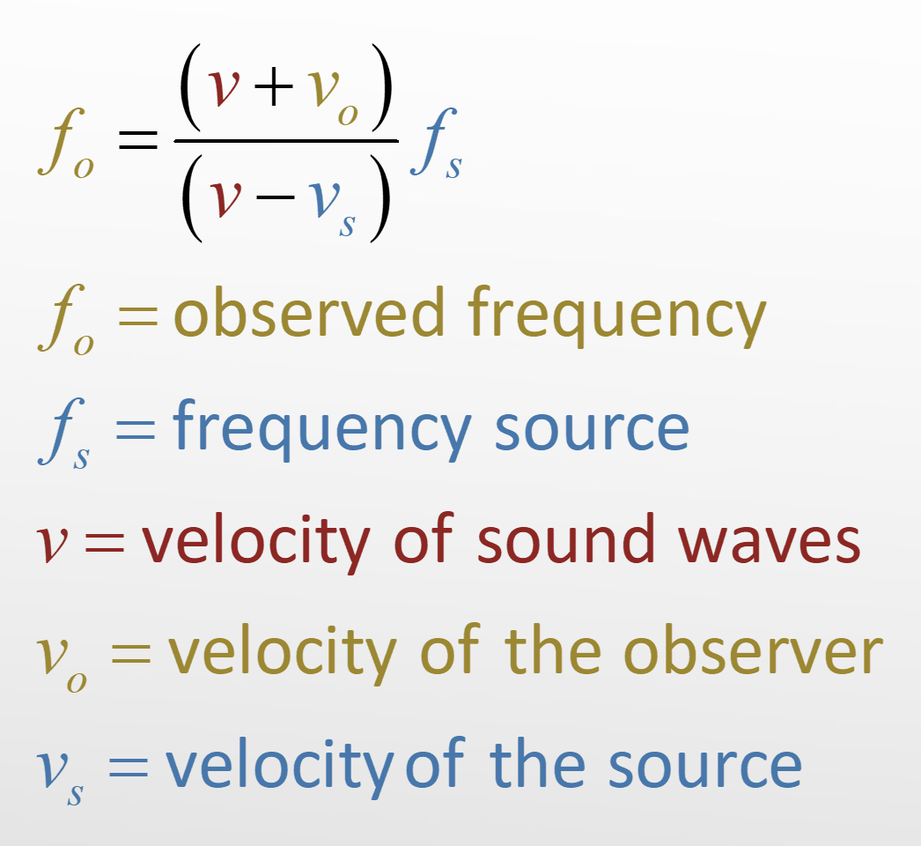
Solving Equations
Use the Doppler equation to solve the problems on your handout.

Slide 12

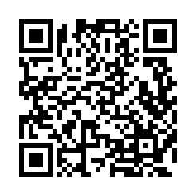
Research Poster
Use the Weather Doppler Research Wakelet to explore the Doppler effect’s uses in weather prediction.
Create a Research Poster illustrating all that you learned.
https://tinyurl.com/bdhyjvhp
Notes:
K20 Center. (n.d.). Research Poster. Strategies. https://learn.k20center.ou.edu/strategy/49
Wakelet: https://wakelet.com/wake/KzimbZztMRnR1p8Ex5gO9

Slide 13
3-2-1
Walk around the room and view the other Research Posters.
Using the 3-2-1 handout, answer these questions:
  What are three things you learned from someone else's research poster?
  What are two questions that you still have about weather prediction and the use of Doppler radar?
  What is one thing that surprised you?
Notes:
K20 Center. (n.d.). 3-2-1. Strategies. https://learn.k20center.ou.edu/strategy/117

Slide 14
Choice Board
Use the Choice board to choose how you would like to show your answer to the essential question:
  How do you know if a siren is moving toward or away from you?
Give a written response | Create a video | Draw and label a model with formula
Create a song or lyric | Draw a comic strip | Create a slide presentation
Create an informational brochure | Create a poem | Record a podcast
Notes:
K20 Center. (n.d.). Choice Board. Strategies. https://learn.k20center.ou.edu/strategy/73

Slide 15
