Slide 1
The Gift of the Magi
ELA 8th or 9th grade

Slide 2
Essential Questions
What motivates people to take action?
How do we determine selfless actions?

Slide 3
Learning Objectives
Students will be able to:
Understand character motivation.
Translate character’s motivations from “The Gift of the Magi,” into a written present day situation.

Slide 4
I used to think…
Look at each image in the slideshow.
In the column next to the image on your handout, write down the emotions these people feel or the things that motivate them.

Slide 5
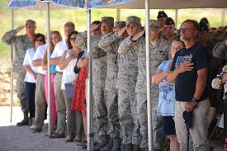
What are these people doing and why?
Notes:
Image source: Matthews, D. (2013, July 2). Ceremony honors NC Guardsmen killed fighting fire [Photograph]. Defense Visual Information Distribution Service. https://static.dvidshub.net/media/thumbs/photos/1307/964528/250x166_q75.jpg

Slide 6
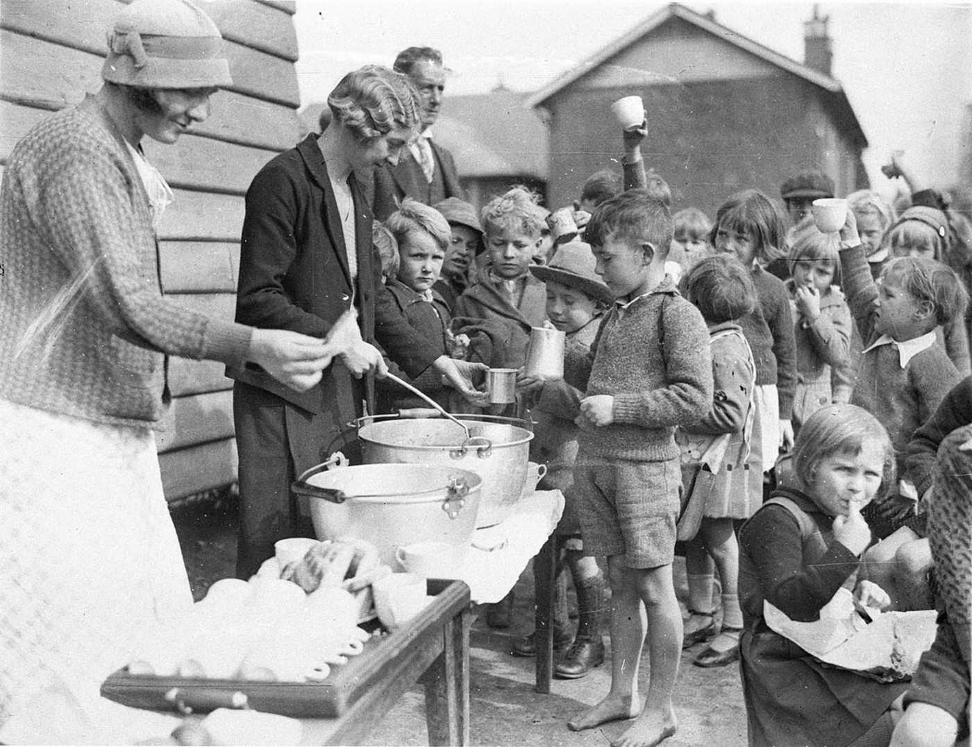
What is motivating the adults and children?
Notes:
Image source: Hood, S. (1934, Aug. 2). Schoolchildren line up for tree issue of soup and a slice of bread in the Depression [Photograph]. Wikimedia Commons. https://commons.wikimedia.org/wiki/File:Schoolchildren_line_up_for_free_issue_of_soup_and_a_slice_of_bread_in_the_Depression,_Belmore_North_Public_School,_Sydney,_2_August_1934_-_Sam_Hood_(3550268287).jpg#filelinks

Slide 7
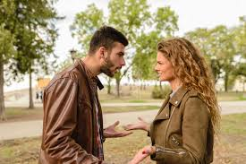
What is motivating this couple?
Notes:
Image source: https://pxhere.com/en/photo/1552621.
Public Domain

Slide 8
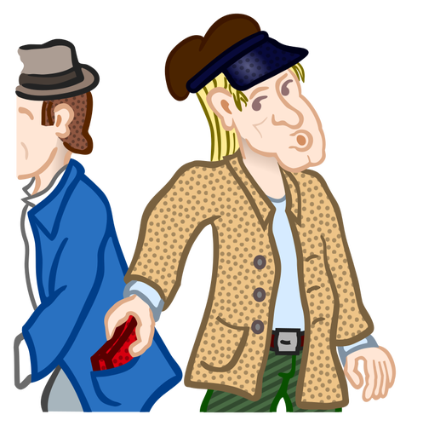
What do you see in this image?
Notes:
Image Source: https://www.pngkey.com/maxpic/u2e6r5w7e6o0i1q8/
Public Domain

Slide 9
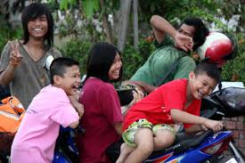
How do you think these people are feeling?
Notes:
Image source: https://pxhere.com/en/photo/852011

Slide 10
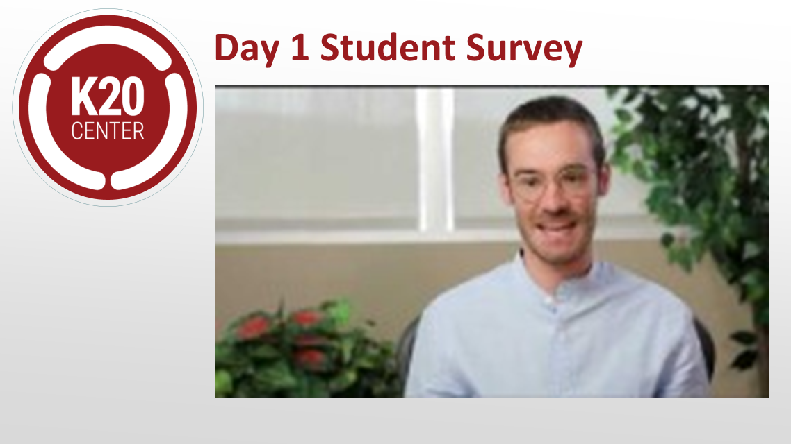
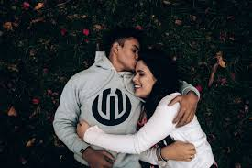
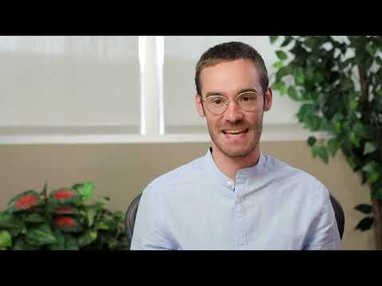
How do you think this couple is feeling?
Notes:
Image source: https://www.pexels.com/photo/happy-multiracial-couple-hugging-on-waterfront-while-having-romantic-date-in-city-3775605/

Slide 11
Survey
<include QR and bit.ly for survey>

Slide 12
Collaborative Word Cloud
What are some words or actions the characters in the story displayed?
Add those words to the mentimeter: insert code here

Slide 13
Cognitive Comics
Using the three (3) boxes:
Rewrite “The Gift of the Magi” as if it were happening in the present.
Illustrate these changes in the boxes above the text.

Slide 14
...But now I know
Let’s revisit each image in the slideshow.
On the right side of your template, write down how your thoughts about each might have changed or any clarifications you now have.

Slide 15
What are these people doing and why?

Slide 16
What is motivating the adults and children?
Notes:
https://commons.wikimedia.org/wiki/File:Schoolchildren_line_up_for_free_issue_of_soup_and_a_slice_of_bread_in_the_Depression,_Belmore_North_Public_School,_Sydney,_2_August_1934_-_Sam_Hood_(3550268287).jpg#filelinks

Slide 17
What is motivating this couple?
Notes:
https://pxhere.com/en/photo/1552621

Slide 18
What do you see in this image?
Notes:
https://www.pngkey.com/maxpic/u2e6r5w7e6o0i1q8/

Slide 19
How do you think these people are feeling?
Notes:
https://pxhere.com/en/photo/852011

Slide 20
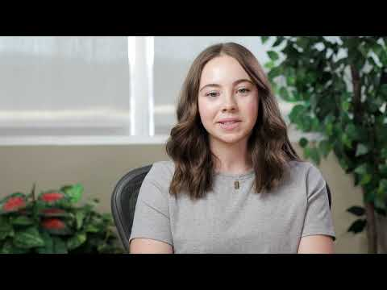
How do you think this couple is feeling?

Slide 21
