Slide 2
Chemical Equations
Physical Science/Chemistry

Slide 3
Essential Question
How are atoms conserved during a chemical reaction?

Slide 4
Learning Objectives
Identify and apply understanding of reactants compared to products for different types of chemical reactions.
Apply the principle that energy and matter are conserved, not created or destroyed.

Slide 5

Bell Ringer
On a piece of paper, write down any three things you know about chemical reactions.
After time is up, share with your partner what you wrote and come up with a group summary.
Be prepared to share out. :)
Notes:
Pair up students after all students have written their three points.
K20 Center. (2020, Sept 16). Bell ringers and exit tickets. Strategies. https://learn.k20center.ou.edu/strategy/125
K20 Center. (2020, Sept 16). Elbow partners. Strategies. https://learn.k20center.ou.edu/strategy/116

Slide 6
Think about this...
Reactants
Products
Notes:
Recap with students the proper way to set up and identify the parts of a chemical formula before sharing slide.

Slide 7

Card Sort
As a group:
Take a moment to review all of the different items you have.
Determine what cards go together.
Discuss why you might group these together.
Notes:
K20 Center. (2020, Sept 16). Card sort. Strategies. https://learn.k20center.ou.edu/strategy/147
Print off enough of the Card Sort document so each group has a set and cut along the dotted lines. Put students in groups of 3-4. Pass out a set of Card Sorts to each group, and ask students to group similar reactions together.
The students' reaction to such an open-ended card sort (especially if this is their first time) will likely be to insist that the activity is too hard and they can't do it. Your first reactions, as a teacher, will be to feed them hints leading into too much information and/or to just give up and move to explaining it as a whole group. The students will only work as hard as they think you'll survive, so don't let them trick you. Allow the hints to be as vague as "What do you notice that's the same? What do you notice that's different?" and wait until they answer. Seriously, resist the urge to fill the silence, put it on the students, and just wait for them to answer.

Slide 8
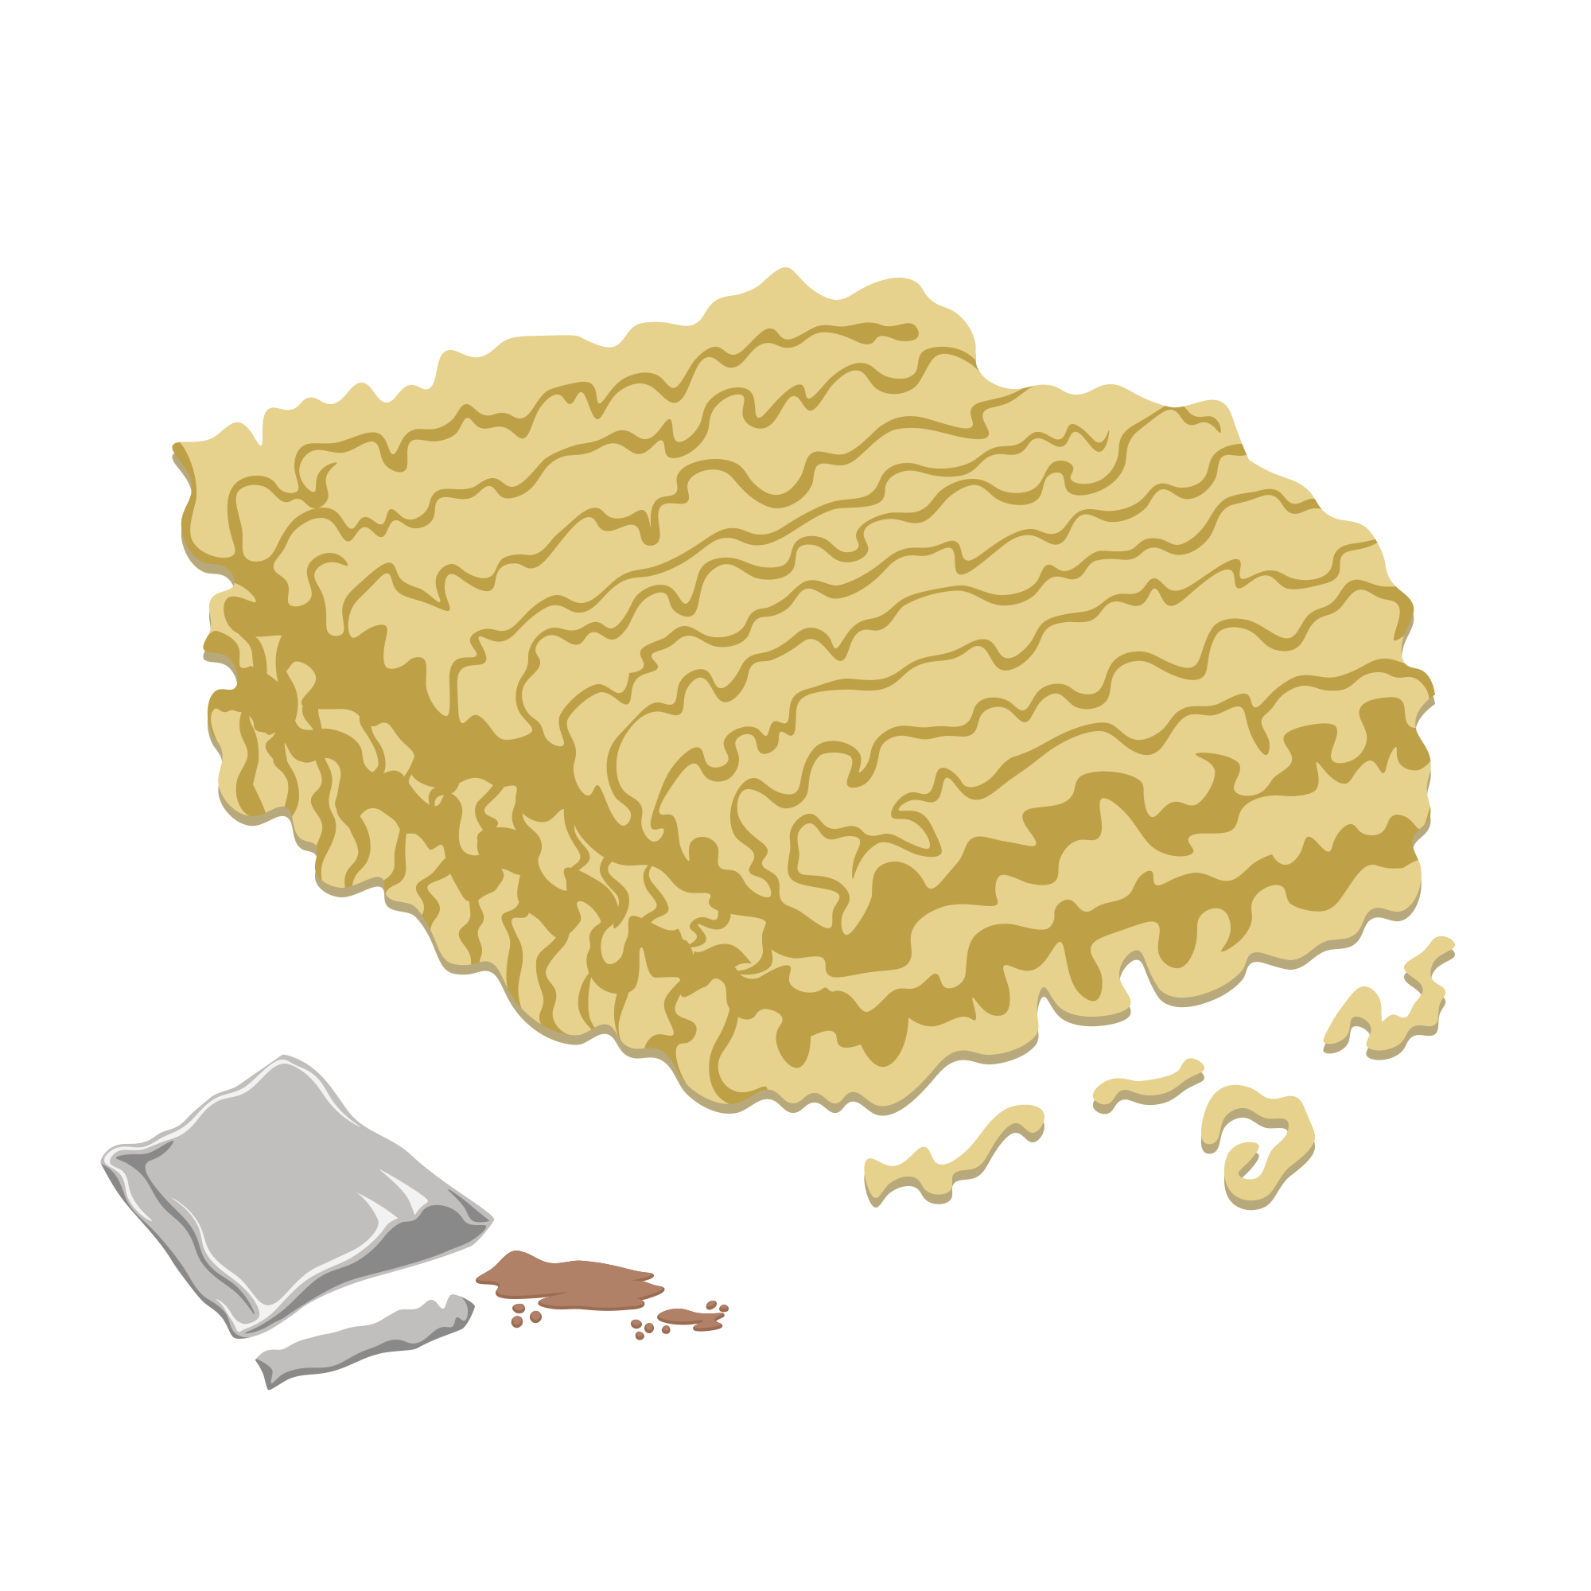

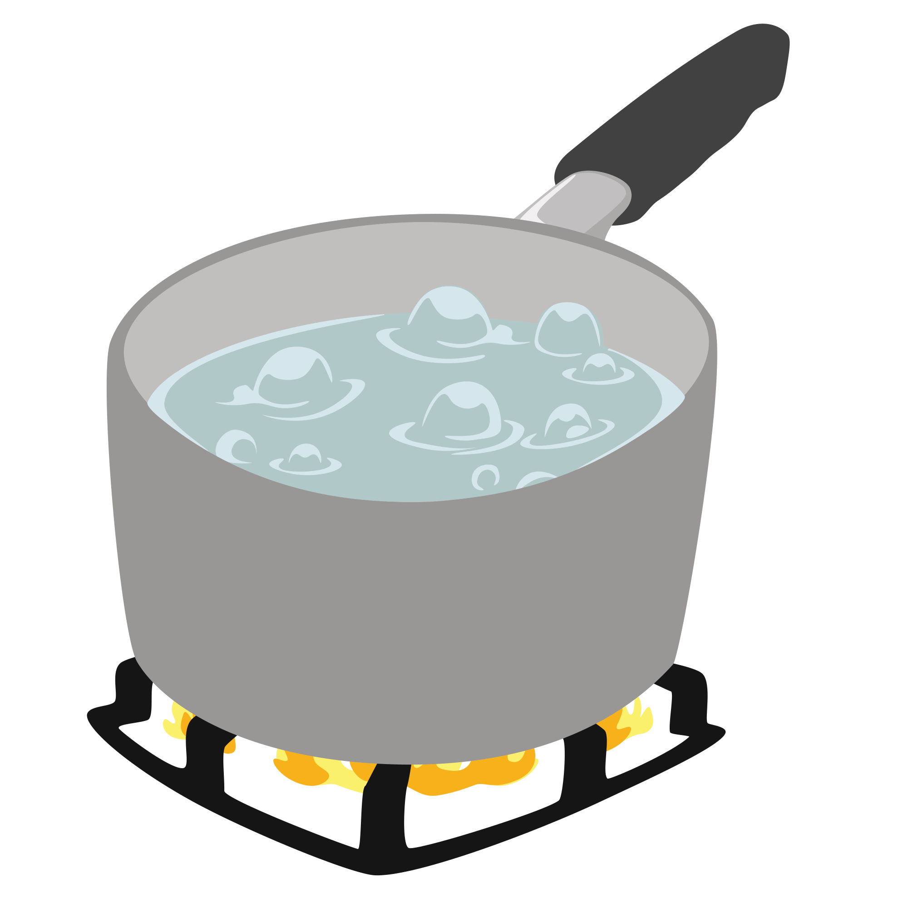
Reactants
Products
+

Slide 9


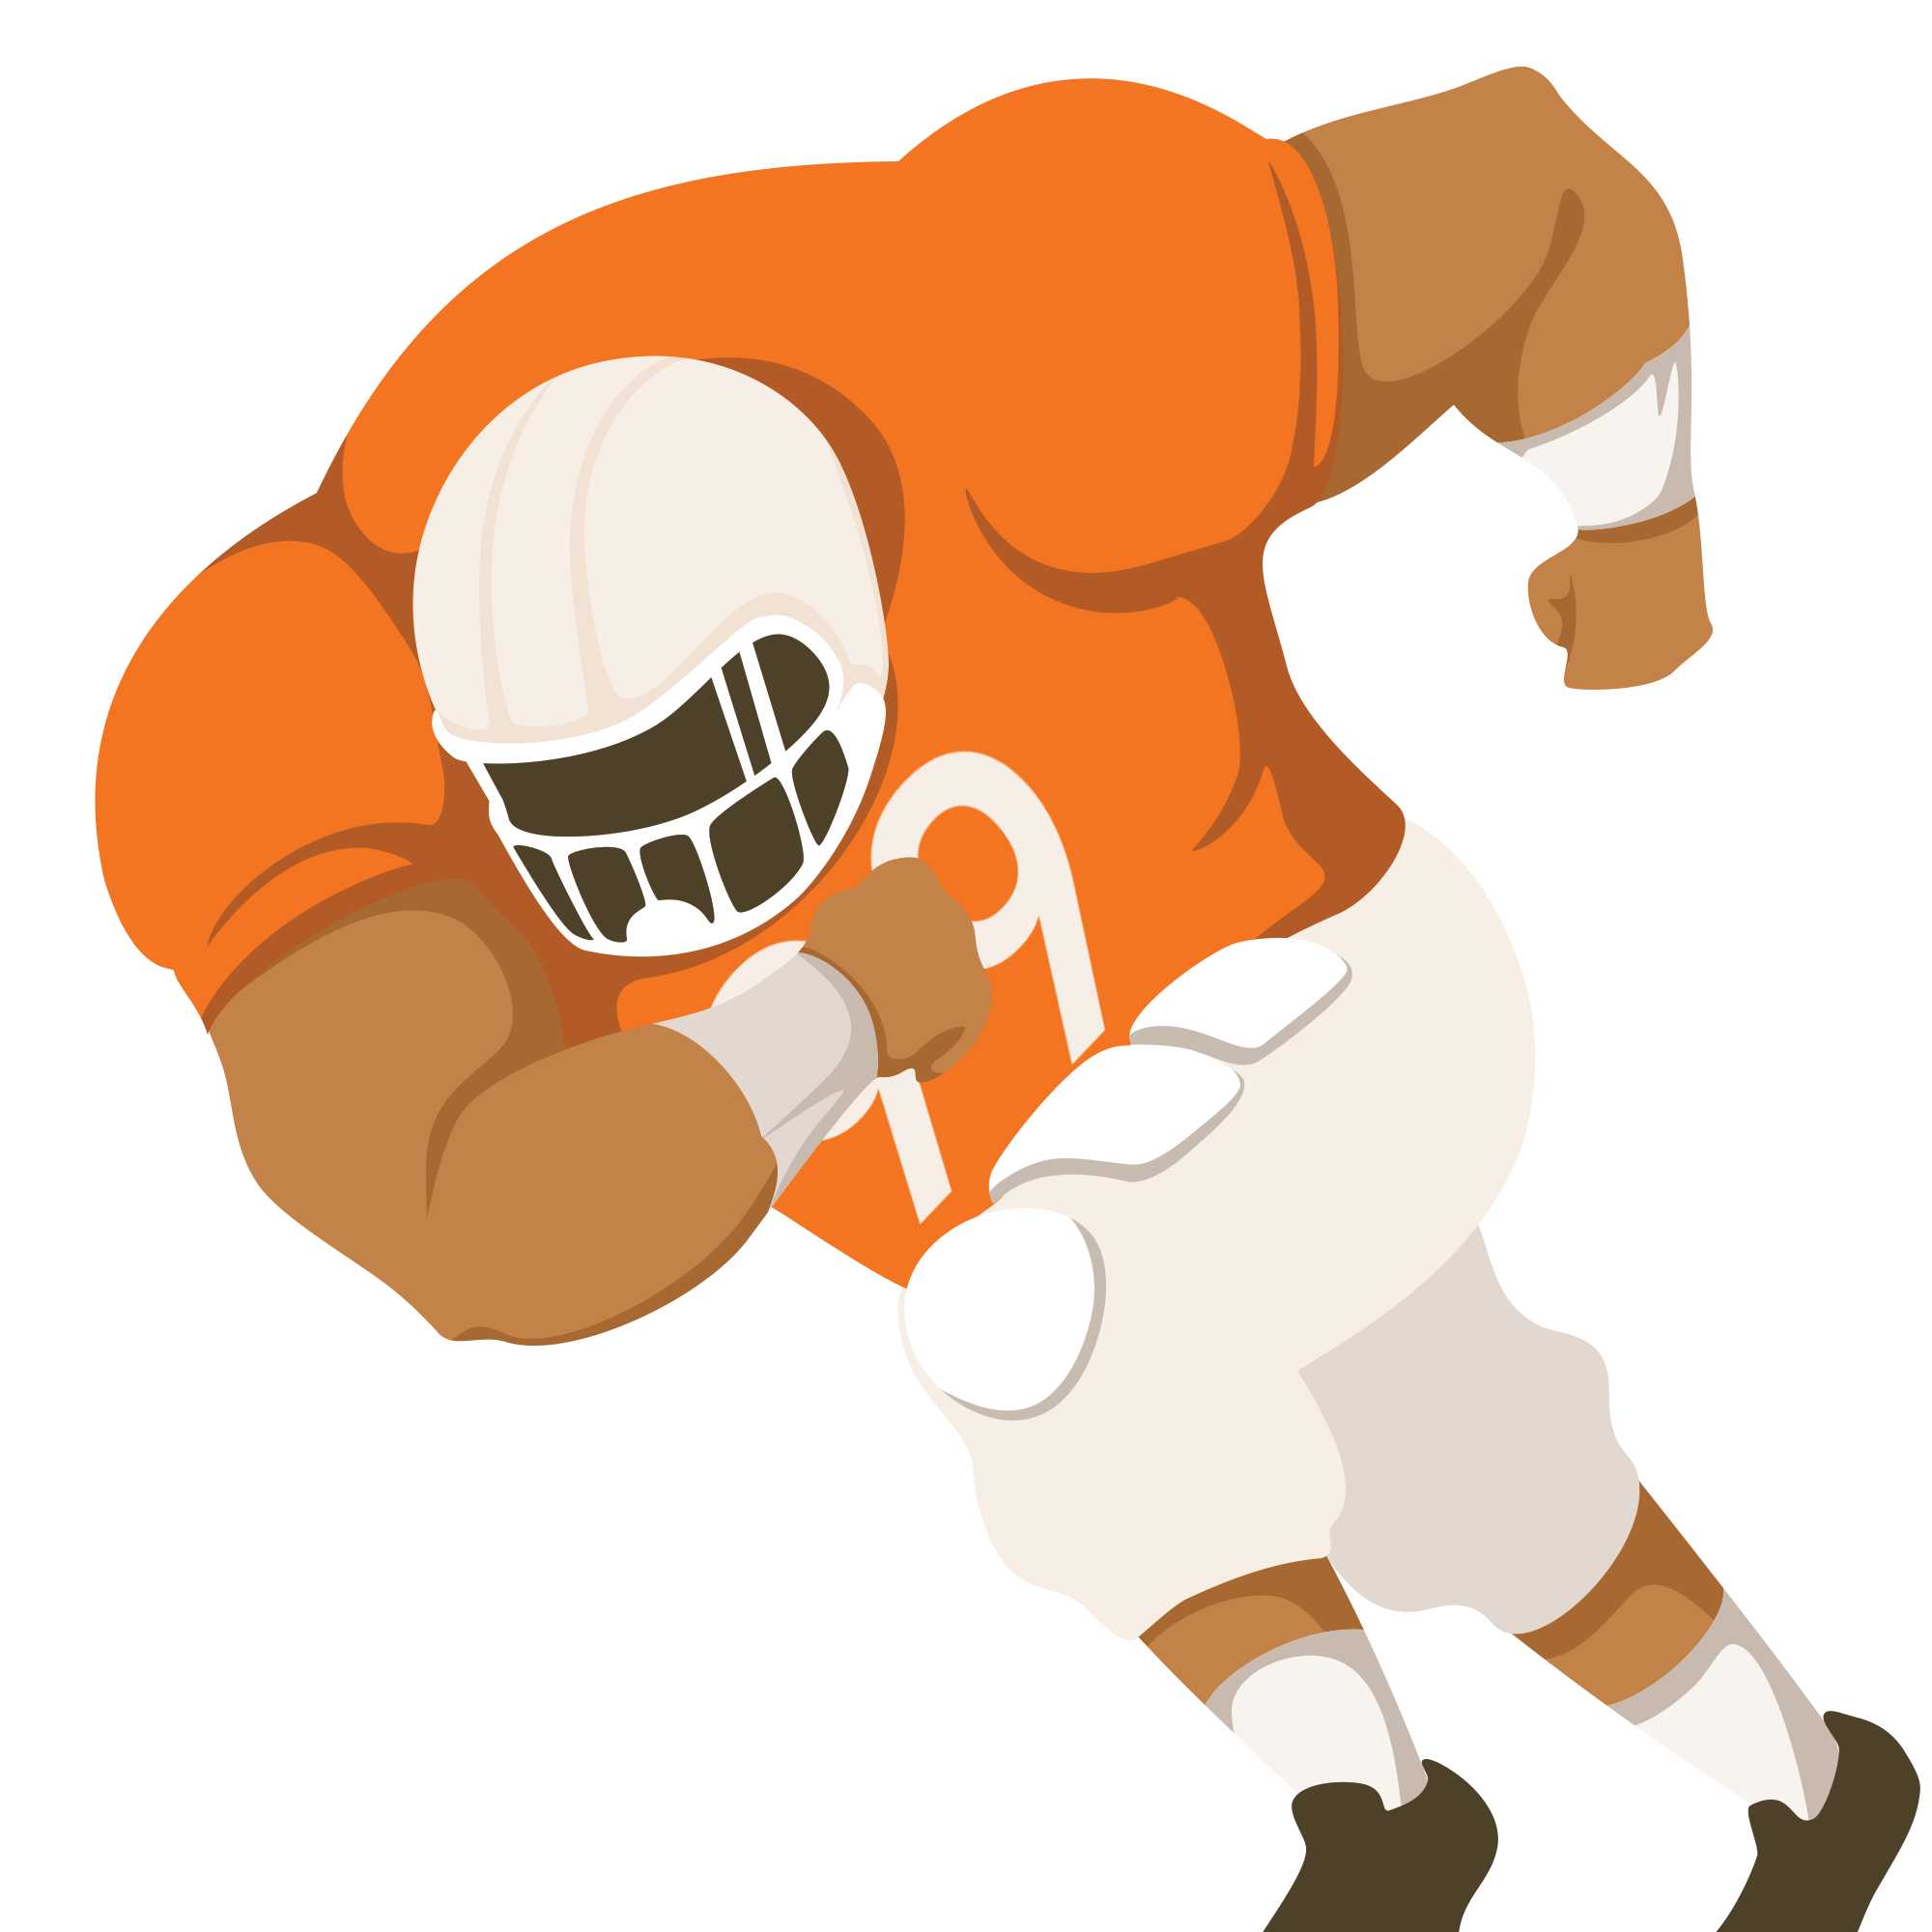
Reactants
Products
+

Slide 10

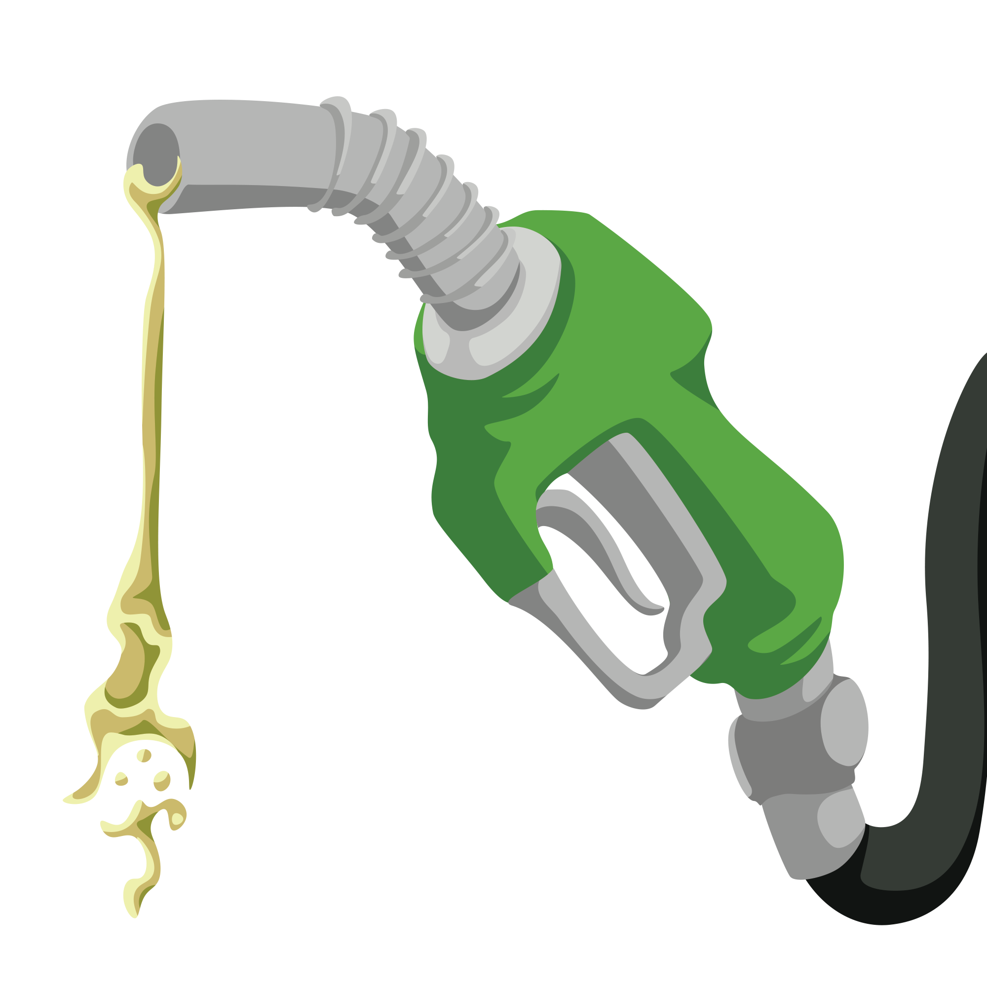

Reactants
Products
+

Slide 11

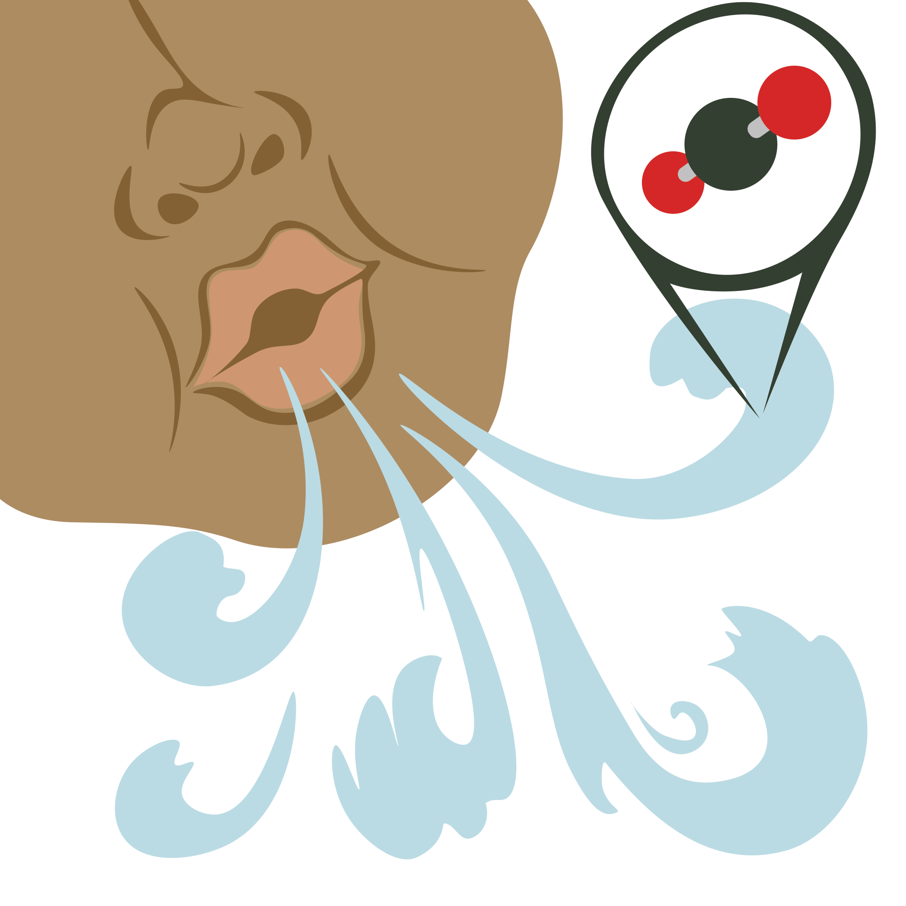


Reactants
Products
+
+

Slide 12


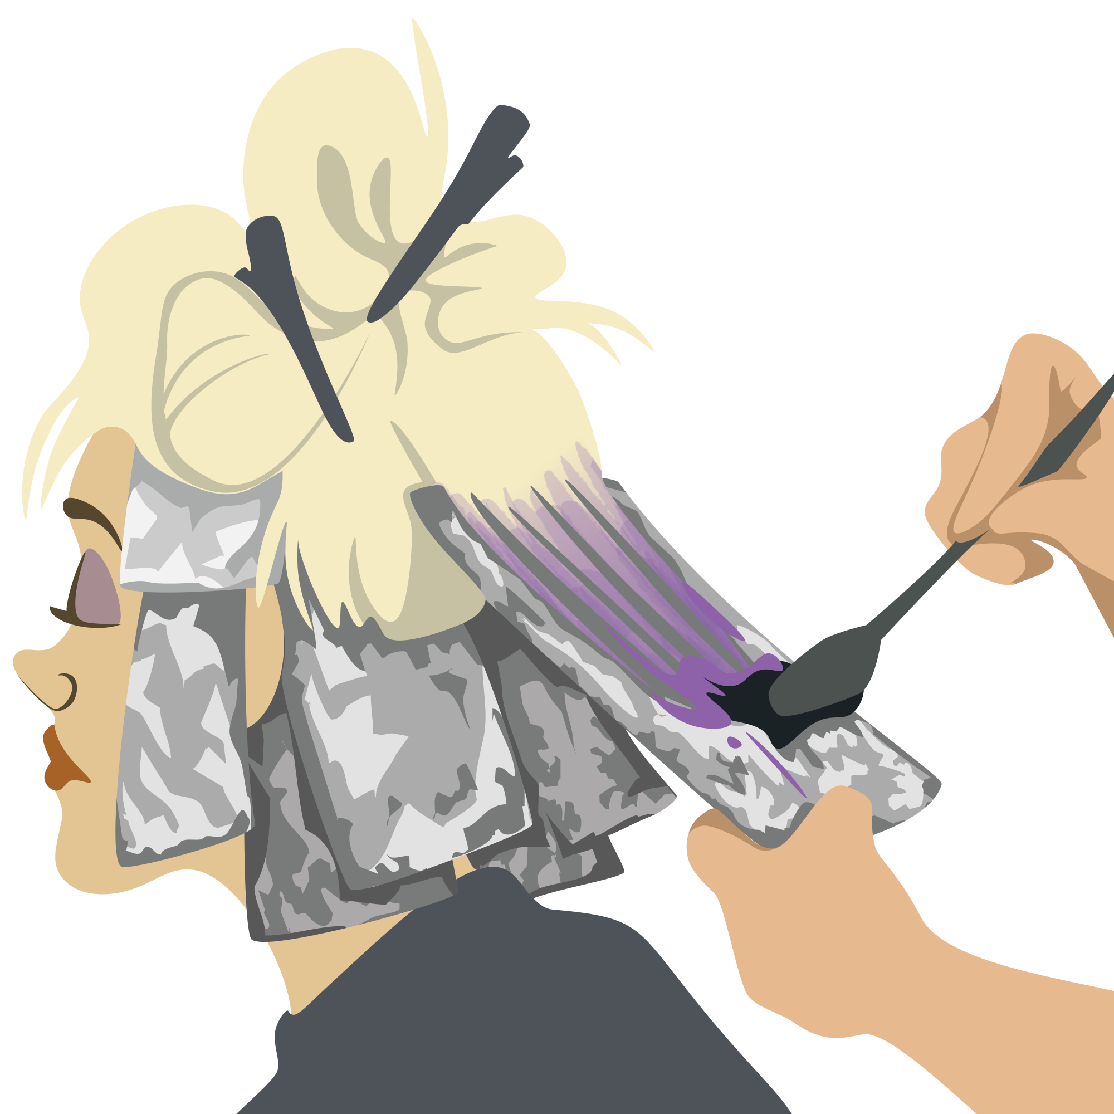

Reactants
Products
+
+

Slide 13

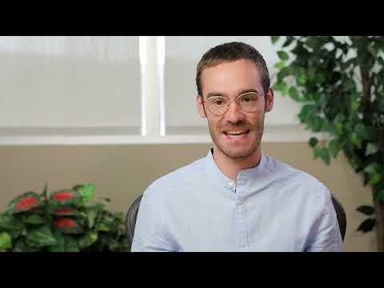
Day 1 Student Survey
Notes:
https://www.youtube.com/watch?v=KUqHWMUljSw&feature=emb_logo

Slide 14

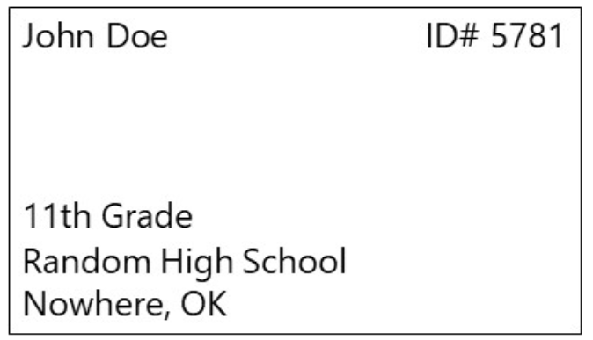
Day 1 Student Survey
https://bit.ly/day1-k20Lesson

Slide 15
DAY 2

Slide 16
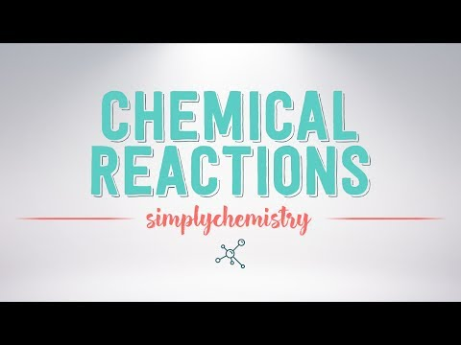
Types of Chemical Reactions
Notes:
Click on the image to play video
YouTube. (2017). YouTube. Retrieved June 1, 2022, from https://www.youtube.com/watch?v=92XUa76AZ6c&t=2s.

Slide 17
Equation Set Up
Type of Reaction | Equation Set Up
Synthesis | A+B→AB
Decomposition | AB→A+B
Combustion | C_{x}H_{x}(O₂) + O₂ -> CO₂ + H₂O
Single Replacement | A+BC→AC+B
Double Replacement | AB+CD→AD+CB

Slide 18
Now You Try
What type of Chemical Reaction are each of these? How do you know?
Al₂S₃ -> 2Al + 3S
C₄H₁₂ + 7O₂->4CO₂ +6H₂0
2NaOH + CuSO₄-> Na₂SO₄ + CU(OH)₂
Notes:
Decomposition
Combustion
Double Replacement

Slide 19

Chat Stations
You and your group will go to each station to determine the product for each problem.
Once you have determined the reaction, use your answer to find the next chat station.
Notes:
Physical Science Extend
When the time has ended, inform students to wrap up the practice problem they are on if they aren’t finished yet and move to the exit ticket.

Slide 20
Chat Stations
You and your group will go to each station to determine the product for each problem and determine the molecular model.
Once you have solved the problem, record your answers on the provided handout.
Notes:
Chemistry Extend
When the time has expended inform students to wrap up the practice problem they are on if they aren’t finished yet and move to the exit ticket.

Slide 21

I Used to Think…But Now I Know...
On the left side of the table, write a statement of what you used to think about chemical reactions.
On the right side, write at least one thing that you now understand about reactions.

Slide 22
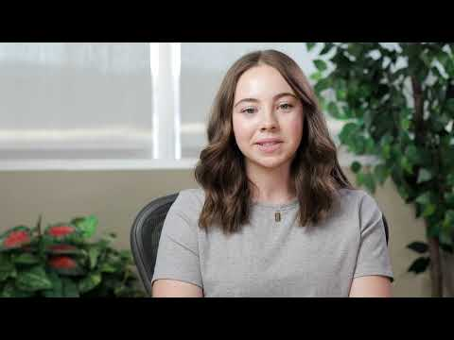
Day 2 Student Survey
Notes:
https://www.youtube.com/watch?time_continue=1&v=hHqmk_9XVR0&feature=emb_logo

Slide 23

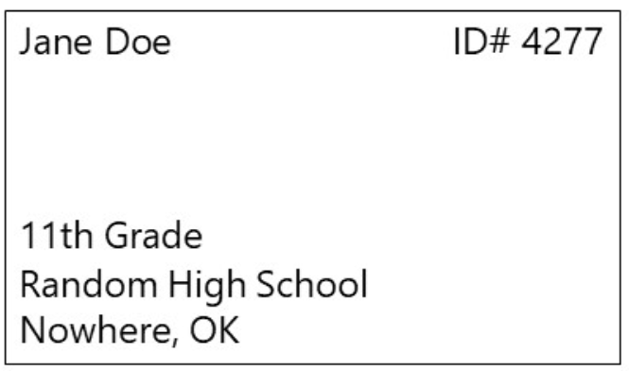
Day 2 Student Survey
https://bit.ly/day2-k20lesson

