Slide 2
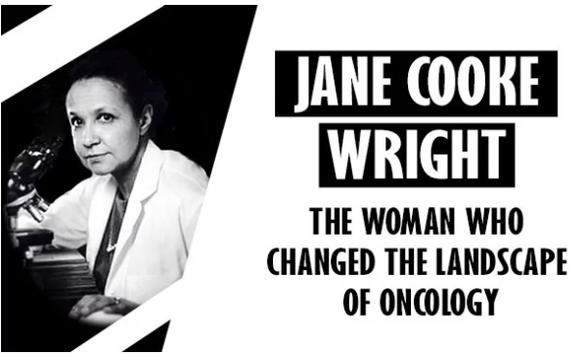
Woman Crush Wednesday: Jane Cooke Wright
Understanding Mitosis
Notes:
Large, H. (2020, Mar 8). Jane C. Wright: The woman who changed the landscape of oncology. [Digital image]. Technology Networks. https://www.technologynetworks.com/tn/articles/jane-c-wright-the-woman-who-changed-the-landscape-of-oncology-331263

Slide 3
Essential Questions
What happens when there is uncontrolled cell division during mitosis?
How have women in history shaped science today?

Slide 4
Lesson Objectives
Analyze the role that mitosis plays in cancer.
Identify the contributions of Jane Cooke Wright to science.

Slide 5
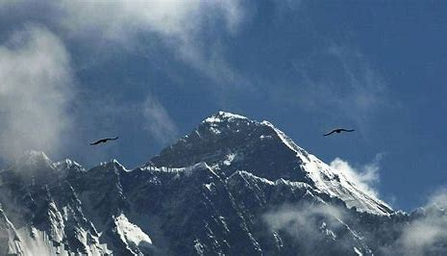
Bell Ringer
What is a trailblazer?
Can you think of any trailblazers?
What makes them a trailblazer?

Slide 6
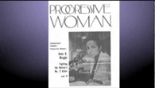
Let’s meet a real-life trailblazer!
Notes:
ConquerCancerFdtn. (2011, June 21). Paying Tribute to ASCO Founder Jane C. Wright, MD [video]. YouTube. https://www.youtube.com/watch?v=6hHiWeki9GE

Slide 7
Dr. Jane Cooke Wright
Graduated with honors from New York Medical College in 1954
Became Professor of Surgery, Head of the Cancer Chemotherapy department, and Associate Dean at the New York Medical College in 1967
Developed new ways to test chemotherapy drugs
Discovered non-surgical ways to treat hard-to-reach tumors
Co-founded the American Society of Clinical Oncology
Researched methotrexate (breast, lung, leukemia cancer drug)
Discovered tumors could be studied in labs (called tissue cultures) vs. inside a body
Notes:
Hibrida. (2020). Black History Month Firsts. Stock.adobe.com. http://www.mycitymag.com/black-history-month-firsts/

Slide 8
Tag Round 1
One person is the “tagger” and is an abnormal cell.
Any cell that gets tagged should raise their hand and may then immediately start tagging other healthy cells (students).

Slide 9
Tag Round 2
“Tagger” starts tagging healthy cells.
New abnormal cells raise their hands and keep tagging healthy cells.
“Treatment” taggers seek out and tag abnormal cell taggers.
Any abnormal cell tagger must FREEZE in place if tagged by the “Treatment” tagger.
“Treatment” taggers CANNOT be tagged.

Slide 10
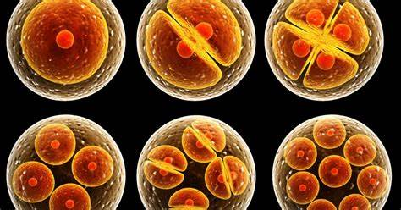
Unpacking the Game of Tag
How did this game demonstrate uncontrolled cell division?
How did Round 1 differ from Round 2?
How did the game reflect Jane Cooke Wright’s work?
Notes:
Stanford University, (2015). Stanford biologists crack centuries-od mystery of how cell growth triggers cell division. [Digital image]. https://biox.stanford.edu/highlight/stanford-biologists-crack-centuries-old-mystery-how-cell-growth-triggers-cell-division

Slide 11
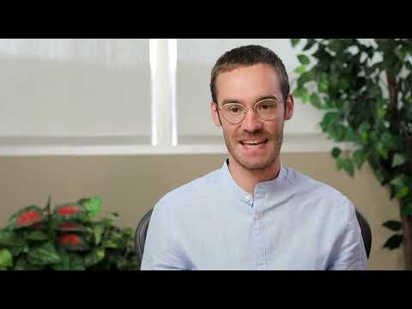
Day 1 Student Survey

Slide 12
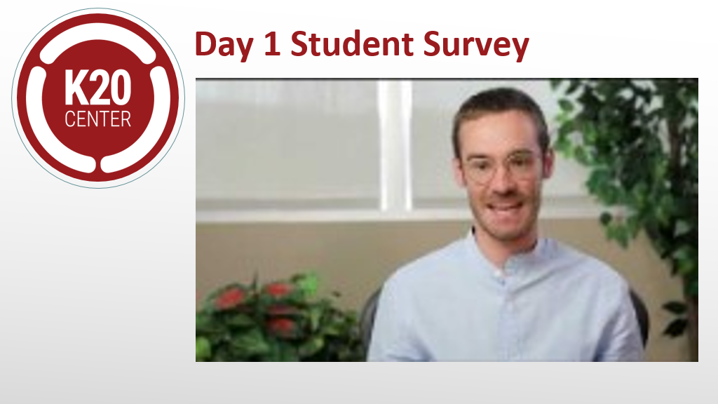
Unpacking the Game of Tag
How did this game demonstrate uncontrolled cell division?
How did Round 1 differ from Round 2?
How did the game reflect Jane Cooke Wright’s work?
Notes:
Stanford University, (2015). Stanford biologists crack centuries-od mystery of how cell growth triggers cell division. [Digital image]. https://biox.stanford.edu/highlight/stanford-biologists-crack-centuries-old-mystery-how-cell-growth-triggers-cell-division

Slide 13
TIP Chart
Term | Information | Picture
Mitosis
Cancer
Tumor
Radiation
Chemotherapy

Slide 14
Notes:
Amoeba Sisters. (2018, March 20). The Cell Cycle (and cancer) [Updated]. [video]. Youtube. https://www.youtube.com/watch?v=QVCjdNxJreE

Slide 15
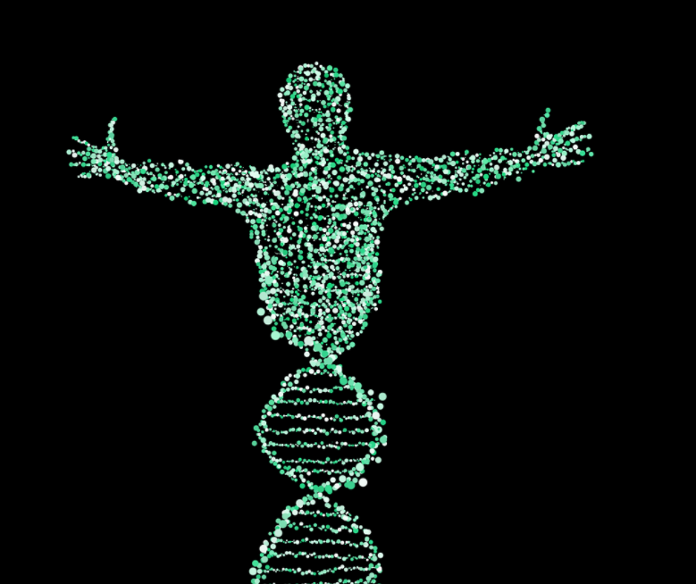
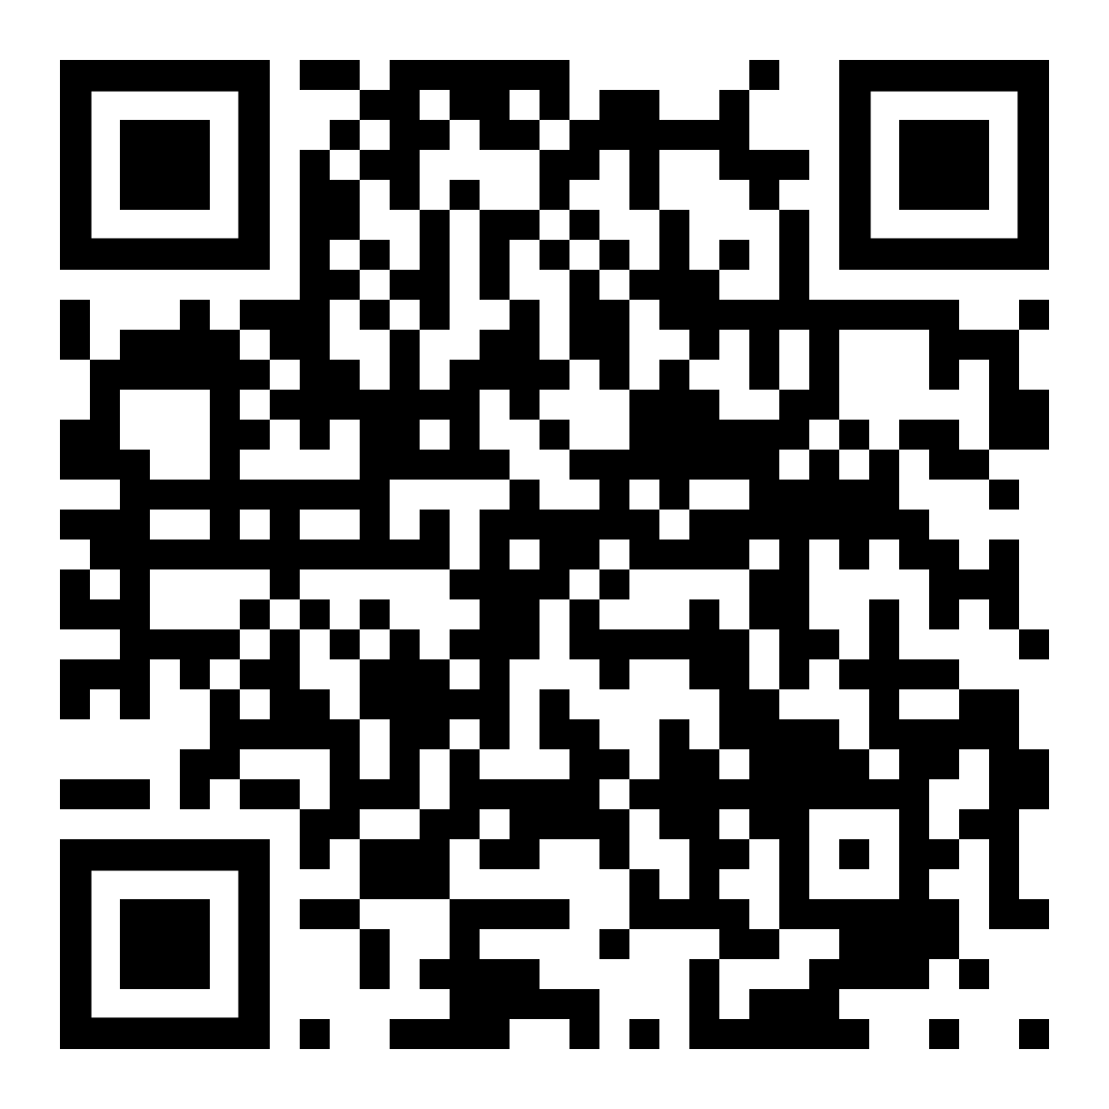
Cancer Treatments
Biomarker testing
Chemotherapy
Hormone therapy
Immunotherapy
Radiation
Stem cell transplant
Surgery
Targeted therapy
https://www.cancer.gov/about-cancer/treatment/types
Notes:
Link to National Cancer Institute: https://www.cancer.gov/about-cancer/treatment/types
Schaferle. (2017). Man DNA Spiral. Pixabay. https://pixabay.com/illustrations/man-dna-spiral-biology-merge-2125123/

Slide 16
Exit Ticket
What happens when there is uncontrolled cell division during mitosis?

Slide 17
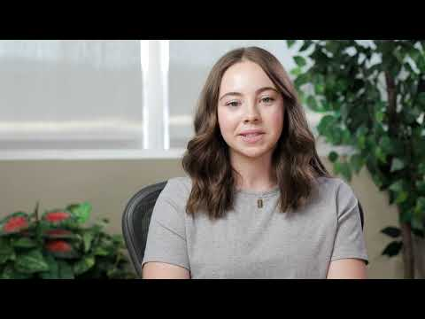
Day 2 Student Survey

Slide 18
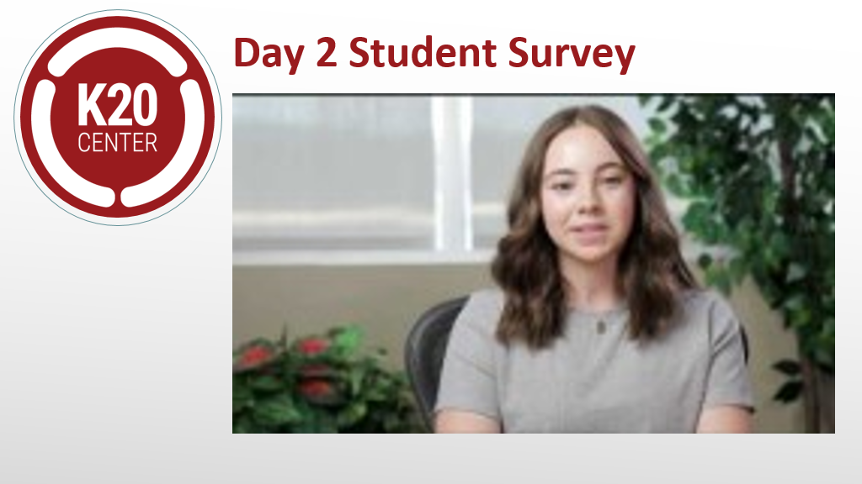
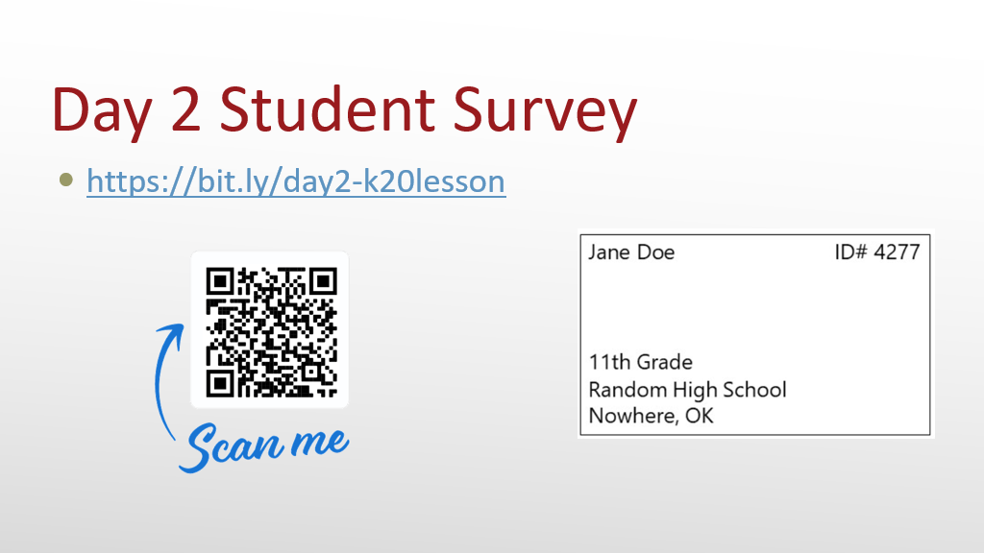
Exit Ticket
What happens when there is uncontrolled cell division during mitosis?

