Slide 2

What are you watching?
Take a minute to discuss with someone near you what you typically watch on YouTube.
If you don’t watch YouTube, share what you watch on TikTok, Twitch, or Instagram.
Notes:
Subscribe button subscription - free image on Pixabay. (n.d.). Retrieved August 25, 2022, from https://pixabay.com/illustrations/subscribe-button-subscription-6244462/

Slide 3
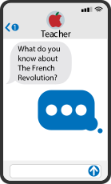
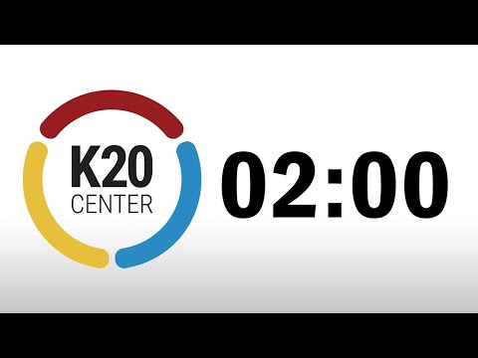
Quick Write
Take 2 minutes to answer the following questions about what you normally watch. Do not worry about grammar, just think of it as texting or messaging a friend.
Who is your favorite content creator?
Are they on YouTube, or are they on TikTok, Twitch, or Instagram?
What separates them from other creators?
Do you follow other creators in the same “genre” of content?
Notes:
K20 Center. (n.d.). Quick Write. Strategies. https://learn.k20center.ou.edu/strategy/1127
K20center. (2021, September 21). K20 Center 2 minute timer. YouTube. Retrieved August 25, 2022, from https://www.youtube.com/watch?v=HcEEAnwOt2c

Slide 4
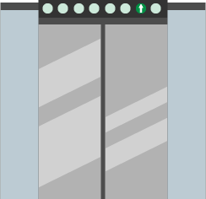
Elevator Speech
Pretend you are trying to convince your friend that your favorite Youtuber is worth watching. Write 8-10 sentences in (insert language) answering the following questions.
Who is your favorite content creator?
(If you don’t have one, pick someone who does content creation videos on TikTok or Instagram.)
What separates them from other creators?
Do you follow other creators in the same “genre” of content?
Notes:
Insert the language of the course.
K20 Center. (n.d.). Elevator Speech. Strategies. https://learn.k20center.ou.edu/strategy/57

Slide 5
“Kind of like an Octopus”
Creating instructional content for YouTube using World Languages

Slide 6
Essential Questions
How do Content Creators communicate through engaging videos?
How can you use your language skills to teach others a new skill?

Slide 7
Lesson Objective
Make a How-To Video using your World Language skills in the style of a YouTube “content creator.”

Slide 8
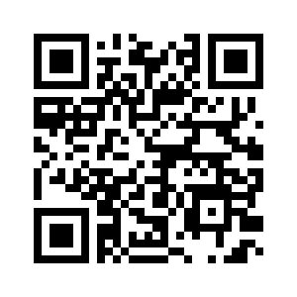
Youtube Content Creator Gallery
Go to the Wakelet: https://bit.ly/3cfCkH2 or use the QR Code.
Take time to view some of the videos that have topics that are most interesting to you.
As you watch the videos, think about the following question:
  Which videos are most interesting to you? Why?
Notes:
K20 Center. (n.d.). Wakelet. Tech tools. https://learn.k20center.ou.edu/tech-tool/2180

Slide 9

Magnetic Statements
As we go through the next few slides, complete the following:
Move to the side of the room that either attracts or repels you.
Discuss your choice with the other students in your group.
Share why your group was attracted to the statement.
Notes:
K20 Center. (n.d.). Magnetic Statements. Strategies. https://learn.k20center.ou.edu/strategy/166

Slide 10
I prefer content creators who are:
Loud
Quiet

Slide 11
I prefer content creators who are:
Silly
Serious

Slide 12
I prefer content creators who are:
Detailed
Brief

Slide 13
I prefer content creators who are:
Flashy
Understated

Slide 14
I prefer content creators who are:
Educational
Entertaining

Slide 15
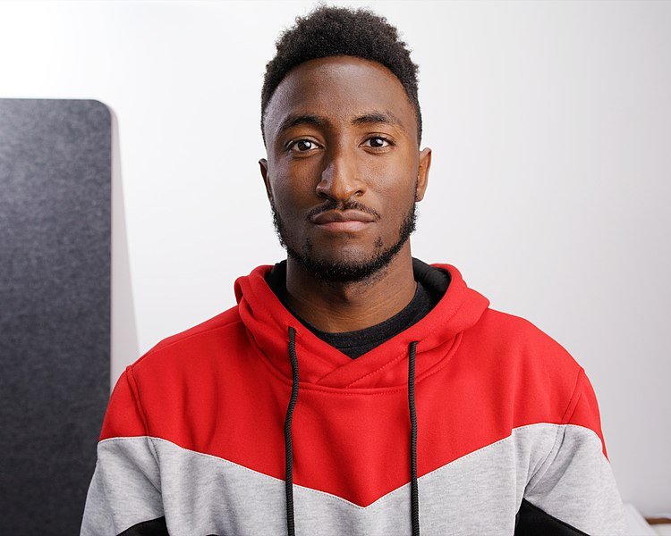
YouTube Content Creator
This is Marques Brownlee a.k.a. MKBHD. His tech channel is consistently a top performer of YouTube. In 2021, he was featured in the Forbes 30 Under 30. Take time to read the paragraph about Marques Brownlee on your handout.
Photo credit: https://commons.wikimedia.org/wiki/File:Marques_Brownlee_cropped.jpg

Slide 16


On being a Youtuber/Content Creator
Click to play audio
Photo credit: https://commons.wikimedia.org/wiki/File:Marques_Brownlee_cropped.jpg
Notes:
Full podcast link: https://www.theverge.com/22231657/mkbhd-marques-brownlee-interview-youtube-creator-influencer-decoder
Patel, N. (2021, January 22). The business of influence with MKBHD. The Verge. Retrieved August 24, 2022, from https://www.theverge.com/22231657/mkbhd-marques-brownlee-interview-youtube-creator-influencer-decoder

Slide 17

POMS
Think about the podcast clip we just listened to.
What do you think is the point of most significance?
Write down your thoughts at the bottom of your handout.
Notes:
K20 Center. (n.d.). POMS. Strategies. https://learn.k20center.ou.edu/strategy/101

Slide 18
“…kind of like an octopus”
“...maybe this is a weird analogy, but stick with me. First, being a YouTuber is a bunch of different jobs in one. Let’s say you’re a tech YouTuber. Part of your job is writing, part of your job is being on camera, part of your job is shooting the video, part of your job is editing the video, and part of your job is promoting, uploading, sharing, and content strategy. I thought of myself as this business that was growing and as I was making these things, kind of like an octopus where I have one arm doing one thing, another arm doing one thing, and some are more precious than others. Like being on camera, writing, and editing are very important to what makes an MKBHD video.”

Slide 19

CUS and Discuss
Read the article “Content Creator v Influencer”
As you read complete the following:
  Circle any new words.
  Star the main ideas.
  Underline the details that support the main idea.
Once you have finished reading, discuss the article with your partner.
  What did you circle, star, or underline?
Notes:
K20 Center. (n.d.). CUS and Discuss. Strategies. https://learn.k20center.ou.edu/strategy/162

Slide 20
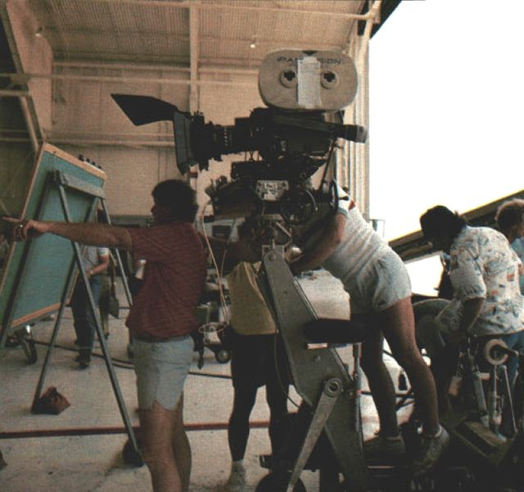
Create your own content!
You must complete the following criteria:
You must submit a script with the final video in the language of this class.
Your video must teach a skill.
e.g. Baking a cake, learning salsa dancing, how to use a character’s ultimate in Overwatch.
Make your own content three-minute minimum, five-minute maximum run-time.
You can use graphics or effects, but these must supplement the narration, not replace it.
Image credit: https://commons.wikimedia.org/wiki/File:Filming_of_Top_Gun_movie_(06)_1985.jpg
Notes:
Edit the time on the third bullet to fit the level of your class.

Slide 21
Using CapCut
Click “Create New” in the left-hand panel.
Click “Blank Canvas” or select a video ratio best suited for a chosen publishing platform.
Select the large plus-sign button to import videos or drag and drop them into the video editor. Continue uploading any media (video, audio, images, etc.) you want to use in your video.
Place your video clips, and any additional media into the timeline.
Arrange videos in sequential order, add effects, trim videos, and have fun editing your video!

Slide 22

Grab the Popcorn!
Take some time to watch your classmates’ videos!
Use the Google Form QR code to evaluate each video.
Rate the videos on:
  Accuracy of language spoken.
  Clarity of instructions given.
Notes:
Insert your own QR code prior to the start of the lesson.
Popcorn icons - free SVG & PNG Popcorn images - noun project. The Noun Project. (n.d.). Retrieved August 24, 2022, from https://thenounproject.com/browse/icons/term/popcorn/

