Slide 2
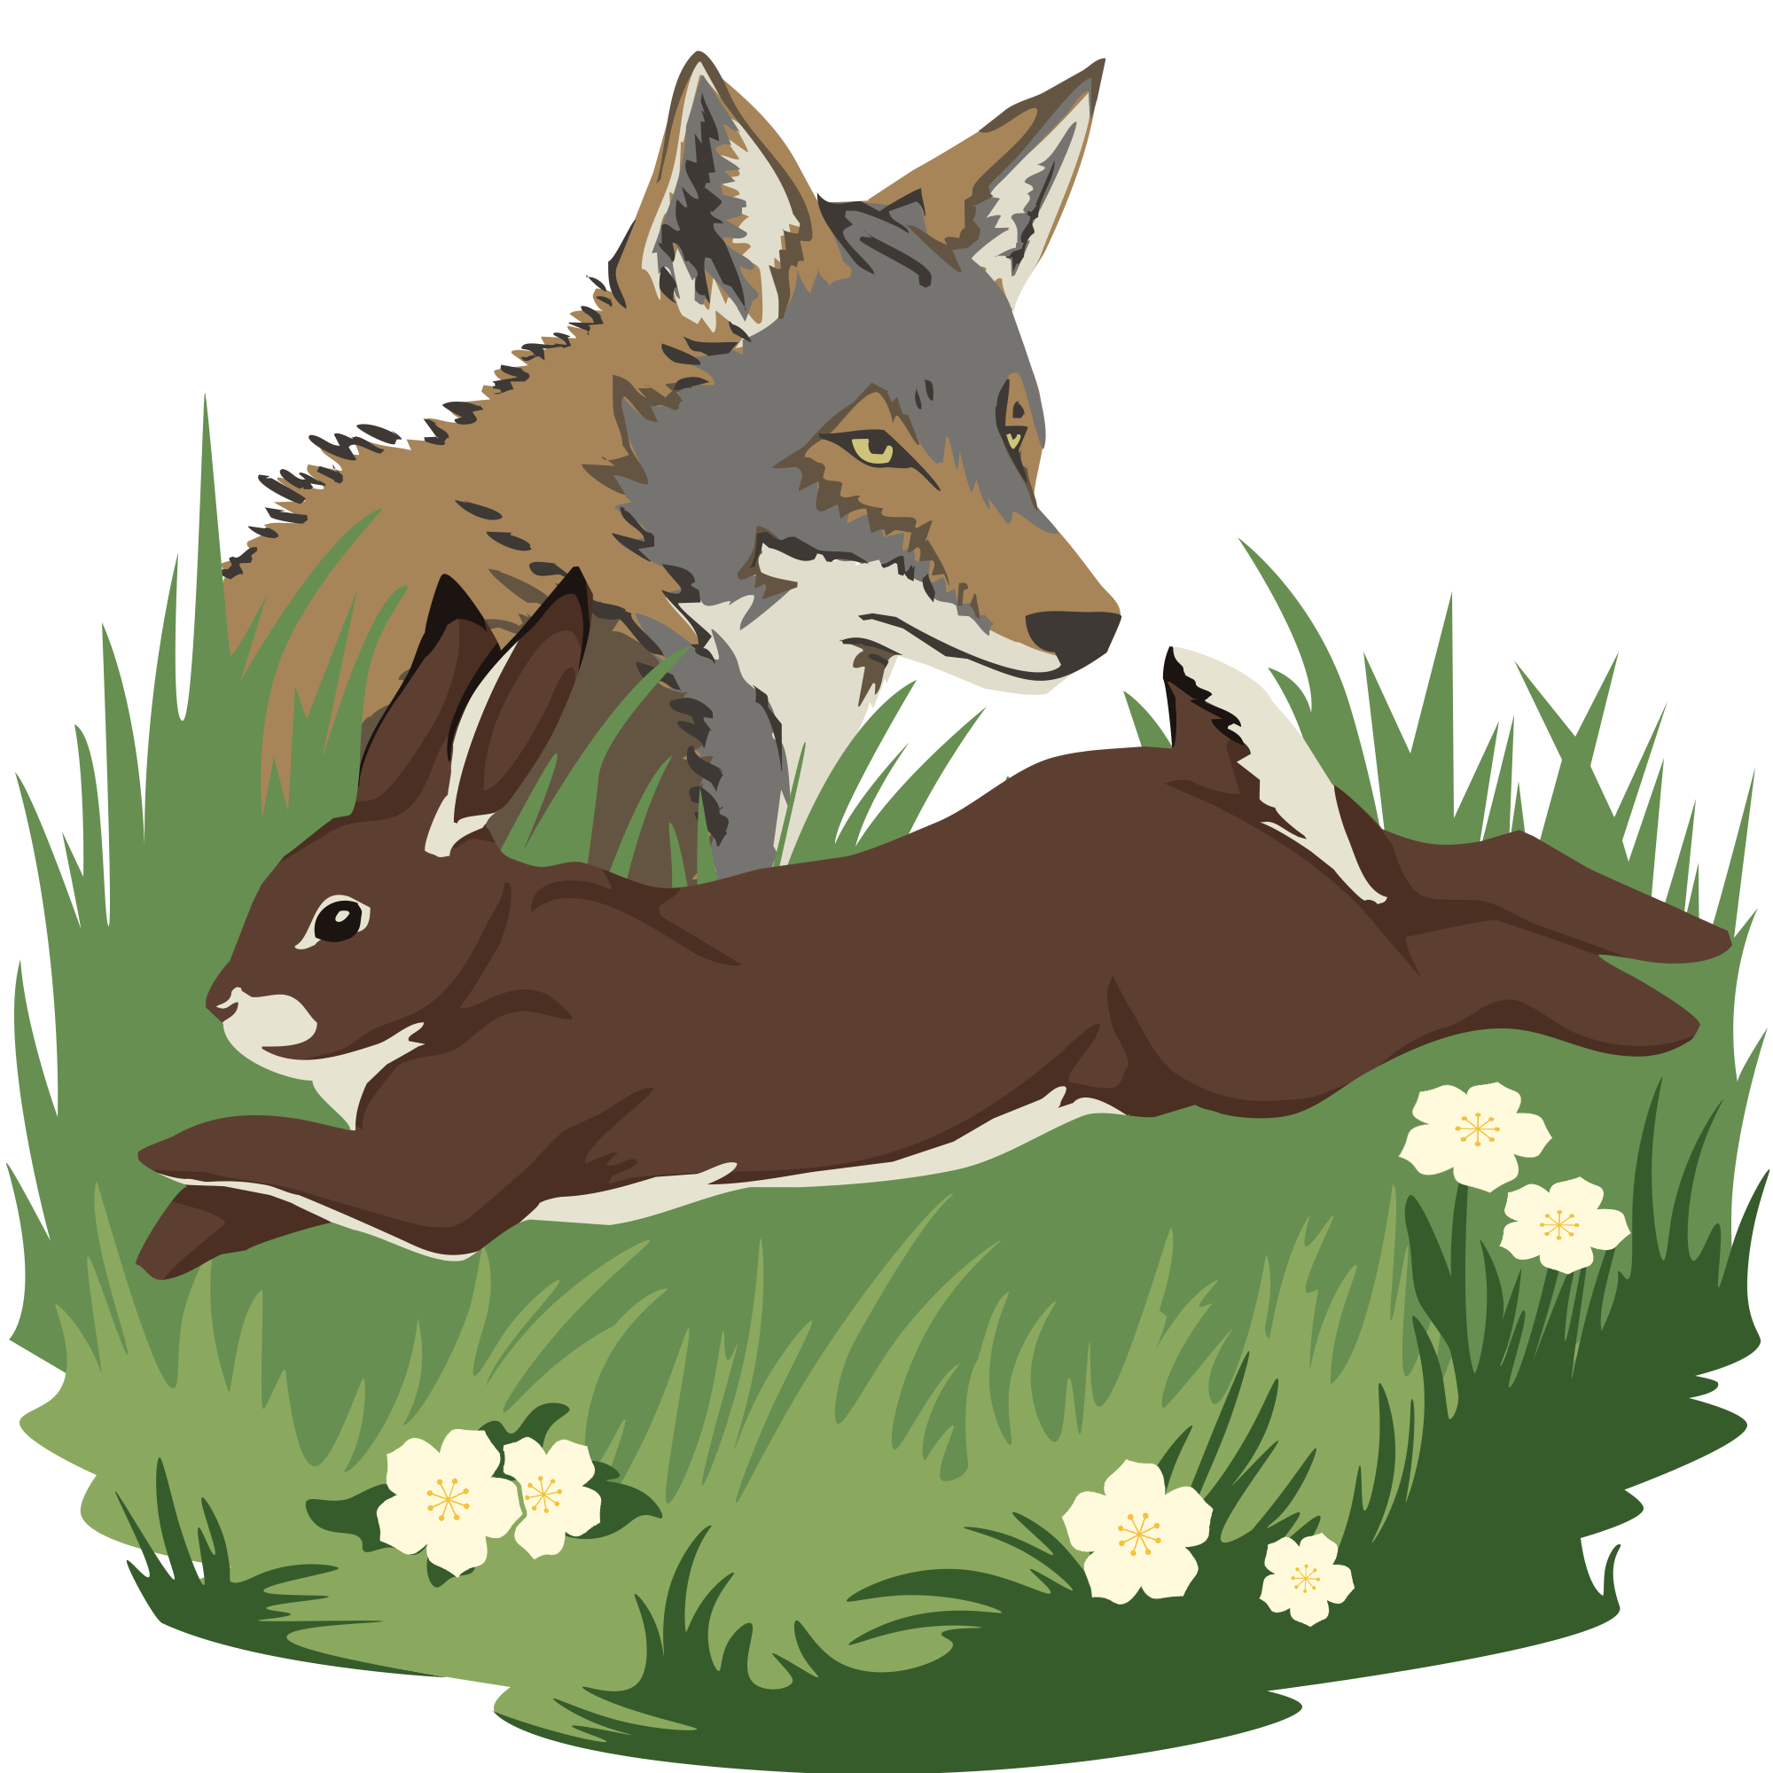
Seeing the Bigger Picture
Ecological Energy Pyramids and Science Illustration

Slide 3
Essential Question
How does energy flow through a food web?
How is illustration used to convey scientific information?

Slide 4
Lesson Objectives
Use a mathematical representation to support claims for the flow of energy among organisms in an ecosystem.
Take on the role of a scientific illustrator to demonstrate understanding of energy flow in ecosystems.

Slide 5
Tell Me Everything
What are all the things you know about the following two concepts?
Cellular respiration
What plants and animals use energy for

Slide 6
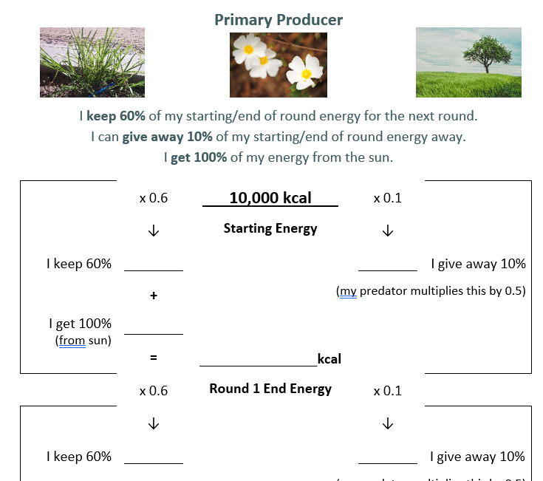
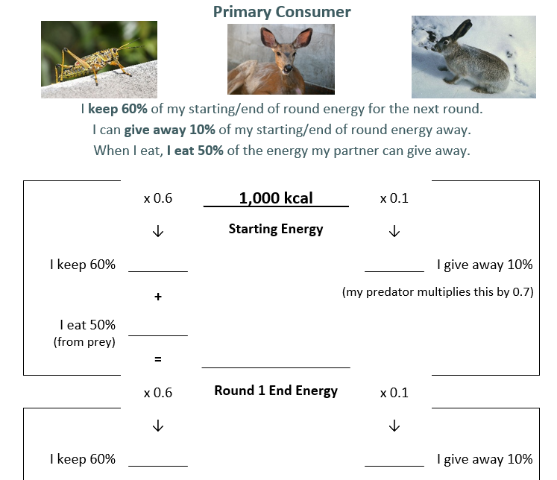
Filling Out Your Card
Prey
Predator
6,000
1,000
600
100
3,000
500
1,000 x 0.5 =
9,000
1,100
5,400
900
660
110

Slide 7
Round 1
Find a sun card (producers only) or a partner in the trophic level directly below you.
Calculate and record the amount of energy you gain from eating them.
Calculate the following:
End of round energy
Energy you keep next round (60%)
Energy you give away next round (10%)
Tertiary
Eats
Secondary
Eats
Primary
Eats
Producer

Slide 8
Round 2
Find a new sun card (producers only) or a new partner in the trophic level directly below you.
Calculate and record the amount of energy you gain from eating them.
Calculate the following:
End of round energy
Energy you keep next round (60%)
Energy you give away next round (10%)
Tertiary
Eats
Secondary
Eats
Primary
Eats
Producer

Slide 9
Round 3
Find another new sun card (producers only) or another new partner in the trophic level directly below you.
Calculate and record the amount of energy you gain from eating them.
Calculate the following:
End of round energy
Tertiary
Eats
Secondary
Eats
Primary
Eats
Producer

Slide 10
Trophic Energy Flow
Enter your class-specific instructions for calculating energy flow

Slide 11
Trophic Energy Flow
What can we conclude based on the results of the game?
What are some limitations of this model?

Slide 12
Reading
Insert your class-specific reading instructions here

Slide 13
Strike Out
With your group, write down as many key or main ideas from the unit without using your notes.

Slide 14
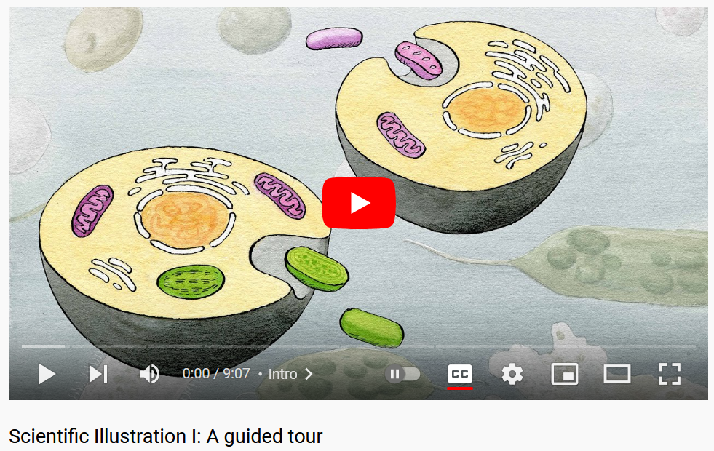
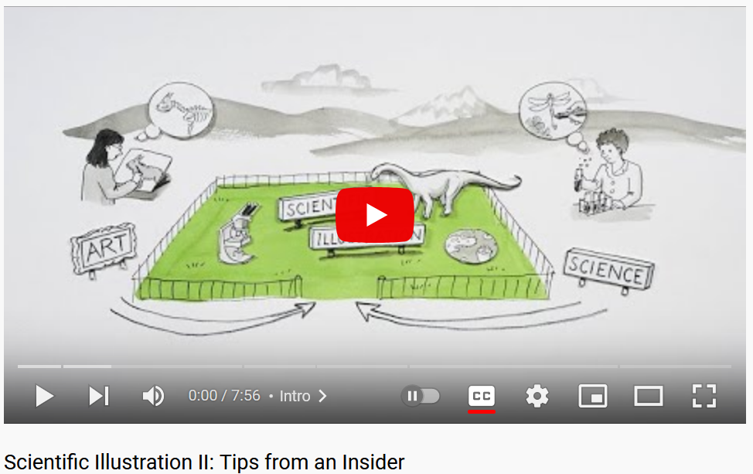
Career Spotlight: Scientific Illustrator
Notes:
YouTube. (2021). Scientific Illustration I: A guided tour. YouTube. Retrieved January 30, 2023, from https://www.youtube.com/watch?v=6hmbGg9rMWQ.
YouTube. (2022). Scientific Illustration Ii: Tips from an Insider. YouTube. Retrieved January 30, 2023, from https://www.youtube.com/watch?v=KvOXC2_5UCo.

Slide 15
Looks Like, Sounds Like, Feels Like
Imagine you are a scientific illustrator.
What does your job…
Look like?
Sound like?
Feel like?

Slide 16
How might scientific illustration be important for the work you have done so far in this lesson?

Slide 17
Work Like a Scientific Illustrator
Pretend you are a scientific illustrator and create an infographic that communicates what you have learned, using drawings and explanations.
Include in your infographic the following:
Where each trophic level gets its energy;
The efficiency of energy transfer through an ecosystem;
How energy is “lost” between trophic levels.

