Slide 2
Dissecting Diplomacy
Foreign Relations of Roosevelt, Taft, and Wilson

Slide 3
Analyze the following quote:
Diplomacy is the art of letting somebody else have your way.
-David Frost
Notes:
Engage:
Instructional Strategy: https://learn.k20center.ou.edu/strategy/139

Slide 4
Diplomacy Definition
The art and practice of conducting negotiations between nations.

Slide 5
Essential Question
How do presidents conduct foreign policy?

Slide 6
Lesson Objectives
Explain the diplomatic tactics used by Presidents Roosevelt, Taft, and Wilson.
Evaluate how diplomacy shapes foreign relations.

Slide 7
Diplomatic Dilemmas
Read the three dilemmas as a group.
Come up with a possible solution to each dilemma.
Be ready to discuss your solutions.
Notes:
Explore:

Slide 8
Diplomatic Dilemmas
This scenario is based on a situation President Roosevelt faced as president.
President Roosevelt had the Secretary of State propose a treaty with the Colombian government to build a canal in Panama. At the time, Panama was a colony of Colombia.
Colombia did not agree to the amount of money offered by the United States and refused.
When the people of Panama revolted against Colombia, the U.S. sent troops and helped Panama gain independence.
In return, Panama agreed to permit the U.S. build the canal.
Notes:
Explore:

Slide 9
Diplomatic Dilemmas
This scenario is based on a situation President Taft faced as president.
Taft asked American business owners to invest in central American countries by giving loans to businesses and starting new businesses in those countries.
He sent American troops to stop revolts of central American governments the United States supported.
Notes:
Explore:

Slide 10
Diplomatic Dilemmas
This scenario is based on a situation President Wilson faced as president.
President Madero of Mexico was overthrown in a coup d’etat and murdered by supporters of the coup.
President Wilson convinced Congress the head of the coup, Huerta, killed Madero and refused to recognize the new government.
Wilson ordered U.S. troops into the Mexico city of Veracruz and supported a new leader, Carranza, come to power.
Notes:
Explore:

Slide 11
Diplomacy Tactics
Summarize the diplomatic tactics used by the President from your reading.
As you read, summarize their tactics on the Note Catcher.
Share your summary with your group members.
Summarize the other president’s tactics on the Note Catcher.
Be ready to discuss how each president used diplomacy during their presidency.
Notes:
Explain:
Instructional Strategy: https://learn.k20center.ou.edu/strategy/179

Slide 12
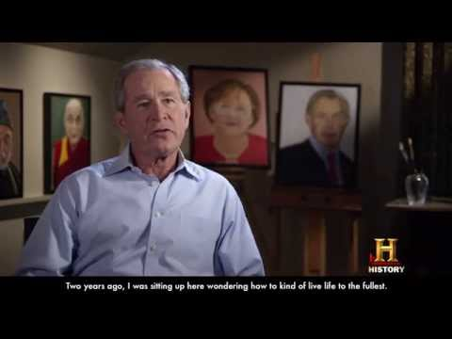
The Art of Leadership
Notes:
The Bush Center. (2014, April 4). "The art of leadership: A president's personal diplomacy" by @thebushcenter. YouTube. Retrieved August 25, 2022, from https://www.youtube.com/watch?v=QQJw-363WiQ
Instructional Strategies: WICK link
https://learn.k20center.ou.edu/strategy/116

Slide 13
Exit Ticket
How have former U.S. Presidents used diplomacy to benefit the United States?
Notes:
Evaluate:
Instructional Strategy: https://learn.k20center.ou.edu/strategy/125

