Slide 2
Prove Me Wrong
Two-Column and Paragraph Proofs

Slide 3
Essential Question
How can we use our knowledge of definitions, theorems, and postulates to justify our reasoning?

Slide 4
Lesson Objectives
Construct and complete two-column and paragraph proofs.
Use mathematical definitions, postulates, theorems, and properties as reasons to solve problems.

Slide 5
Opening Statements
In your group, visit each station and read and discuss each question.
Individually answer the question on a sticky note and place it on the wall next to the poster.
Repeat steps one and two at each station.

Slide 6
Opening Statements
Return to the poster you started at.
Read the sticky notes on your poster and organize the notes into common themes and ideas.
Prepare to share common themes your group identified.

Slide 7
Legally Blonde
https://youtu.be/GSu7BGbyJqc
Notes:
Movieclips. (2015, November 30). Legally Blonde (2001) – Elle wins! Scene (11/11) | Movieclips [Video]. YouTube. https://www.youtube.com/watch?v=GSu7BGbyJqc

Slide 8
Witness Testimony
Recall Elle’s line of questioning from the video.
With your partner, recreate Elle’s line of questioning by writing as much as you can remember on the Witness Testimony handout.
Work together to determine the reasoning behind each of Elle’s questions.

Slide 9
Witness Testimony
Argument | Line of Questioning | Reason
Building the argument
Tracy and the perm
Objection
Conclusion

Slide 10
Witness Testimony—Whole Class
What were the reasons for Elle’s questions?

Slide 11
Witness Testimony—Whole Class
What were the reasons for Elle’s questions?
What would have happened if Elle started her line of questioning by accusing the witness of the crime?

Slide 12
Witness Testimony—Whole Class
What were the reasons for Elle’s questions?
What would have happened if Elle started her line of questioning by accusing the witness of the crime?
Should a statement be included in an argument if it is not backed by a reason? Why or why not?

Slide 13
Witness Testimony—Whole Class
What were the reasons for Elle’s questions?
What would have happened if Elle started her line of questioning by accusing the witness of the crime?
Should a statement be included in an argument if it is not backed by a reason? Why or why not?
What must be present for an argument to be effective?

Slide 14
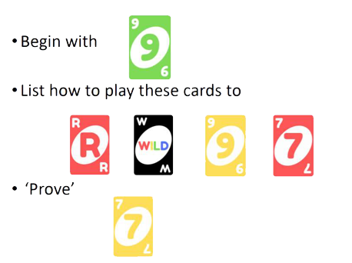
Uno Proofs
Play a card if it is…
The same color
The same number
Wild
Notes:
Mattel. (1971). Uno [Card game]. https://shop.mattel.com/products/uno-gdj85

Slide 15
Uno Proofs (Sample Response)
Card Played | Reason
1. | Given
2. | 2. Same number
3. | 3. Wild: Red
Card Played | Reason
4. | 4. Same color
5. | 5. Same color
6. | 6. Same number
Notes:
Mattel. (1971). Uno [Card game]. https://shop.mattel.com/products/uno-gdj85

Slide 16
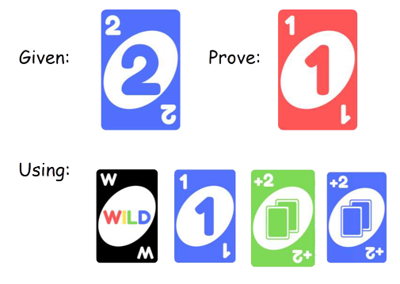
Uno Proofs
Card Played | Reason
1. 2. 3. 4. 5. 6.
Notes:
Mattel. (1971). Uno [Card game]. https://shop.mattel.com/products/uno-gdj85

Slide 17
Uno Proofs (Sample Response)
Card Played | Reason
1. | 1. Given
2. | 2. Same color
3. | 3. Same color
Card Played | Reason
4. | 4. Same number
5. | 5. Wild: Red
6. | 6. Same color
Notes:
Mattel. (1971). Uno [Card game]. https://shop.mattel.com/products/uno-gdj85

Slide 18
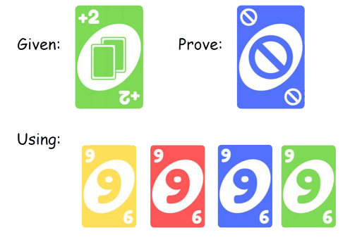
Uno Proofs
Card Played | Reason
1. 2. 3. 4. 5. 6.
Notes:
Mattel. (1971). Uno [Card game]. https://shop.mattel.com/products/uno-gdj85

Slide 19
Uno Proofs (Sample Response)
Card Played | Reason
1. | 1. Given
2. | 2. Same color
3. | 3. Same number
Card Played | Reason
4. | 4. Same number
5. | 5. Same number
6. | 6. Same color
Notes:
Mattel. (1971). Uno [Card game]. https://shop.mattel.com/products/uno-gdj85

Slide 20
Evidence—Vocabulary
Proof: A logical argument that shows a statement is true
Geometric proofs
Algebraic proofs
Etc.
Justify: To lay out your mathematical thought process step-by-step

Slide 21
Algebraic Proof
Statement | Reason
1.
2.
3.
4.
Given: 2x + 5 = 20 – 3x
Prove: x = 3
Using the:
Subtractions Property of Equality
Addition Property of Equality
Division Property of Equality

Slide 22
Evidence—Vocabulary
Two-column proof
Commonly used in Geometry
Left side holds all statements and conclusions
Right side explains why we know what we know
Paragraph proof
Contains the same information as a two-column proof.
Written in complete sentences.

Slide 23
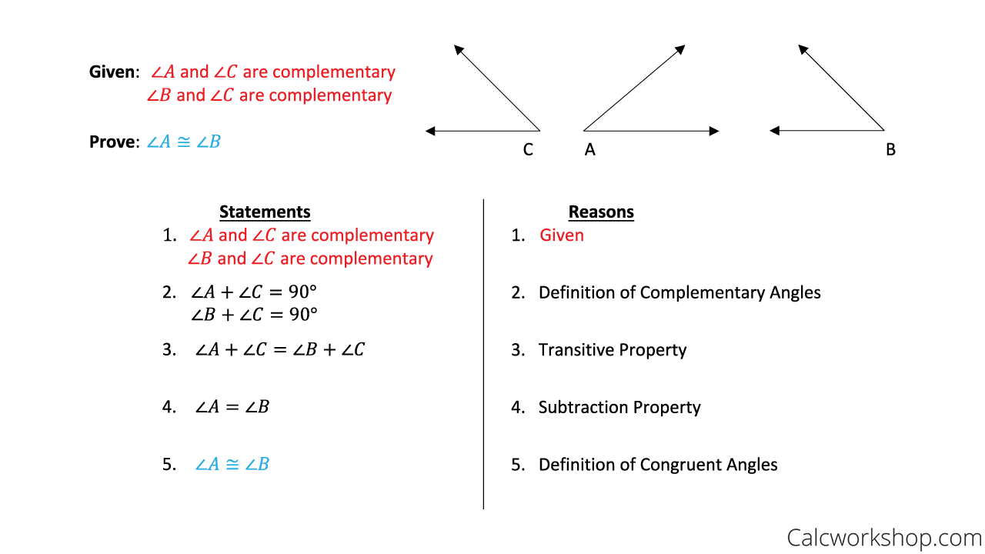
Comparing Types of Proofs
Two-Column Proof
Paragraph Proof
Given that ∠A and ∠C and ∠B and ∠C are complementary, then ∠A + ∠C = 90° and ∠B +∠C = 90° because of the definition of complementary angles. Both statements in line 2 equal 90°, so ∠A + ∠C = ∠B + ∠C because of the transitive property. I see that ∠C is in both sides of the equation so I can use the subtraction property to eliminate the repeated information. Because of the definition of congruent angles, I know that any angle that is equal must also be congruent and vice versa.
Notes:
CalcWorkshop. (2020). Two column proof [Image]. https://calcworkshop.com/reasoning-proof/two-column-proof/

Slide 24
Reasons—Check Your Knowledge
Definitions | Properties
Definition of angle bisector Definition of complementary angles Definition of congruent angles Definition of congruent segments Definition of midpoint Definition of right angles Definition of segment bisector Definition of supplementary angles Definition of vertical angles | Addition property of equality Distributive property Division property of equality Multiplication property of equality Reflexive property Substitution property of equality Subtraction property of equality Symmetric property Transitive property

Slide 25
Reasons—Check Your Knowledge
Postulates | Theorems
Angle addition postulate Linear pair postulate Segment addition postulate | Alternate Exterior Angles Theorem Alternate Interior Angles Theorem Angle Bisector Theorem Consecutive Interior Angles Theorem Corresponding Angles Theorem Midpoint Theorem Vertical Angles Theorem

Slide 26
Evidence—Information
There are more reasons you can use for proofs than those listed in the table.
Every time you learn a new definition, postulate, property, or theorem, it becomes a possible reason.
The most important part of a proof is a correct line of thinking.

Slide 27
Evidence—Information
There is more than one way to answer a proof.
If your proof is different from someone else’s proof, it doesn’t mean that yours is wrong.
Because there are many ways to write a proof, you will often see examples in which you are asked to complete a proof. This makes your proofs easier to compare and discuss.

Slide 28
Creating the Proof
Given: AC = AB + AB
Prove: AB = BC
Statement | Reason
1. | 1.
2. | 2.
3. | 3.
4. | 4.
As you go, always number all statements and reasons

Slide 29
Creating the Proof
First statement
Given: AC = AB + AB
Prove: AB = BC
Statement | Reason
1. AC = AB + AB | 1.
2. | 2.
3. | 3.
4. | 4.

Slide 30
Creating the Proof
First statement
Given: AC = AB + AB
Prove: AB = BC
Last statement
Statement | Reason
1. AC = AB + AB | 1.
2. | 2.
3. | 3.
4. AB = BC | 4.

Slide 31
Creating the Proof
First statement
Given: AC = AB + AB
Prove: AB = BC
Last statement
Statement | Reason
1. AC = AB + AB | 1. Given
2. | 2.
3. | 3.
4. AB = BC | 4.
First reason

Slide 32
Creating the Proof
Given: AC = AB + AB
Prove: AB = BC
Write a logical sequence of steps from the first to last statement.
Don’t forget to write a reason for each statement.
Statement | Reason
1. AC = AB + AB | 1. Given
2. AC = AB + BC | 2. Segment Addition Postulate
3. | 3.
4. AB = BC | 4.

Slide 33
Creating the Proof
Given: AC = AB + AB
Prove: AB = BC
Write a logical sequence of steps from the first to last statement.
Don’t forget to write a reason for each statement.
Statement | Reason
1. AC = AB + AB | 1. Given
2. AC = AB + BC | 2. Segment Addition Postulate
3. AB + AB = AB + BC | 3. Transitive Property
4. AB = BC | 4.

Slide 34
Creating the Proof
Given: AC = AB + AB
Prove: AB = BC
Write a logical sequence of steps from the first to last statement.
Don’t forget to write a reason for each statement.
Statement | Reason
1. AC = AB + AB | 1. Given
2. AB + BC = AC | 2. Segment Addition Postulate
3. AB + BC = AB + AB | 3. Transitive Property
4. BC = AB | 4. Subtraction Property

Slide 35
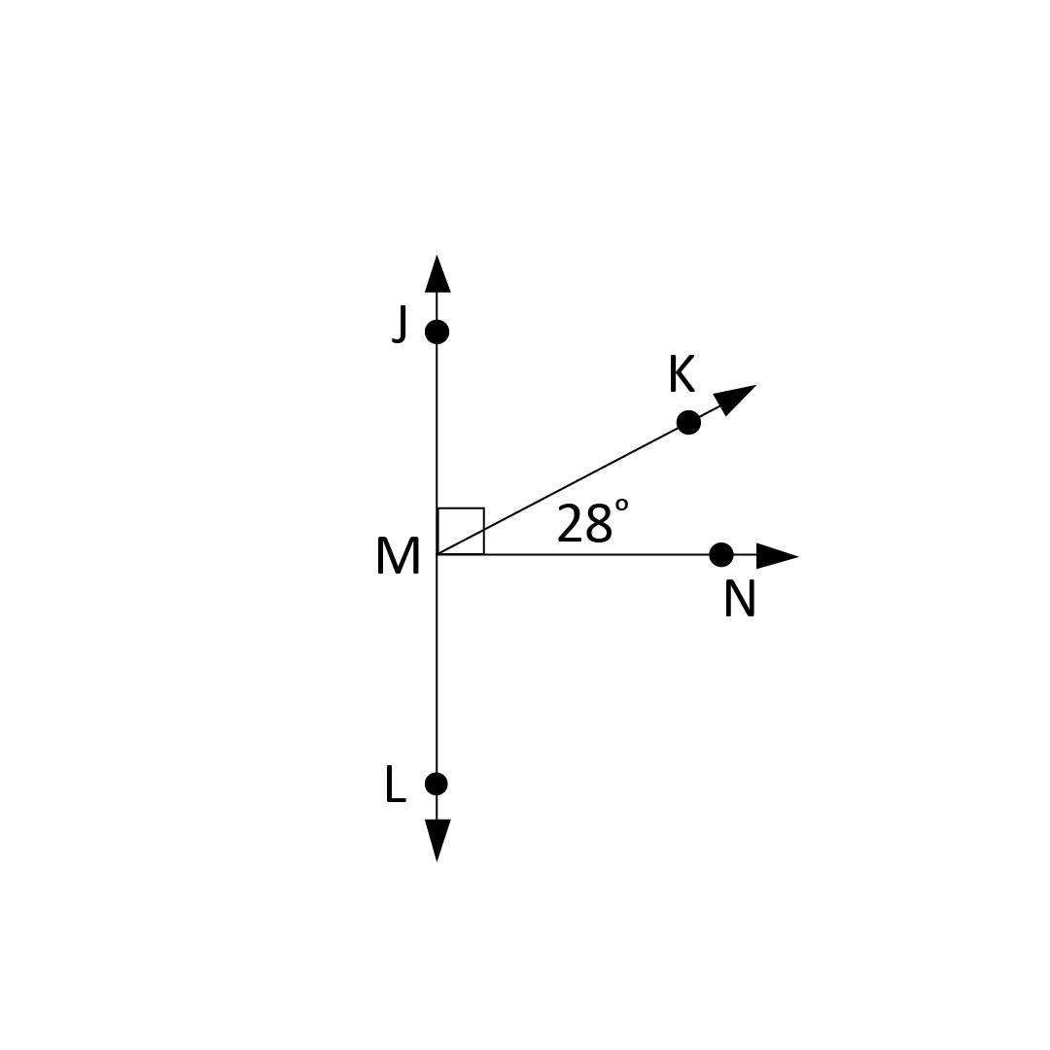
Completing the Proof
Given: ∠KMN = 28°
Prove: ∠JMN = 90°
Statement | Reason
1. 2. ∠JMK and ∠KMN are complementary angles 3. ∠JMK + ∠KMN = ∠JMN 4. ∠JMK + ∠KMN = 90° 5. | Given Definition of complementary angles

Slide 36
Completing the Proof
Given: ∠KMN = 28°
Prove: ∠JMN = 90°
Statement | Reason
1. ∠KMN = 28° 2. ∠JMK and ∠KMN are complementary angles 3. ∠JMK + ∠KMN = ∠JMN 4. ∠JMK + ∠KMN = 90° 5. | Given Definition of complementary angles

Slide 37
Completing the Proof
Given: ∠KMN = 28°
Prove: ∠JMN = 90°
Statement | Reason
1. ∠KMN = 28° 2. ∠JMK and ∠KMN are complementary angles 3. ∠JMK + ∠KMN = ∠JMN 4. ∠JMK + ∠KMN = 90° 5. ∠JMN = 90° | Given Definition of complementary angles

Slide 38
Completing the Proof
Given: ∠KMN = 28°
Prove: ∠JMN = 90°
Statement | Reason
1. ∠KMN = 28° 2. ∠JMK and ∠KMN are complementary angles 3. ∠JMK + ∠KMN = ∠JMN 4. ∠JMK + ∠KMN = 90° 5. ∠JMN = 90° | Given Given Definition of complementary angles

Slide 39
Completing the Proof
Given: ∠KMN = 28°
Prove: ∠JMN = 90°
Statement | Reason
1. ∠KMN = 28° 2. ∠JMK and ∠KMN are complementary angles 3. ∠JMK + ∠KMN = ∠JMN 4. ∠JMK + ∠KMN = 90° 5. ∠JMN = 90° | Given Given Angle Addition Postulate Definition of complementary angles

Slide 40
Completing the Proof
Given: ∠KMN = 28°
Prove: ∠JMN = 90°
Statement | Reason
1. ∠KMN = 28° 2. ∠JMK and ∠KMN are complementary angles 3. ∠JMK + ∠KMN = ∠JMN 4. ∠JMK + ∠KMN = 90° 5. ∠JMN = 90° | Given Given Angle Addition Postulate Definition of complementary angles Transitive Property

Slide 41
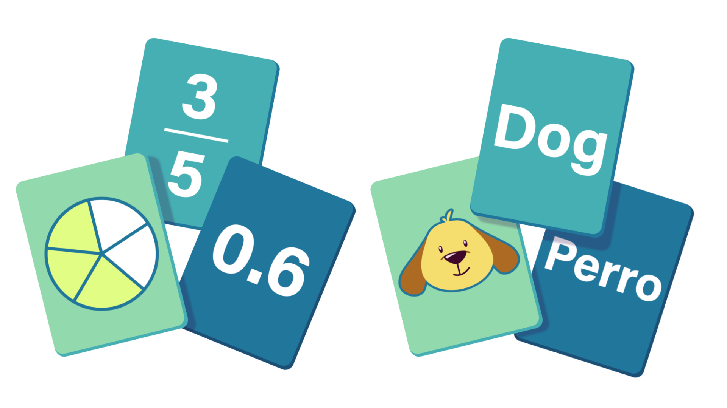
Cross-Examination
In groups, complete the given proofs using the provided statement and reason cards.
There is one card for each missing statement and missing reason.
Each card can only be used once.
When you are finished, raise your hand and your work will be checked.
Notes:
K20 Center. (n.d.). Card matching. Strategies. https://learn.k20center.ou.edu/strategy/1837

Slide 42
Interview with an Attorney
Notes:
K20 Center. (2022, September 22). K20 ICAP - Defense attorney (math) - Prove me wrong [Video]. YouTube. https://www.youtube.com/watch?v=RW4SVMW5pgg

Slide 43
Closing Arguments
Individually, write either a two-column or paragraph proof on your task card.

Slide 44
Verdict
Write your name on the back of your task card.
Under the proof you created, write the letter that best represents your feelings toward your answer.
G – Guessed
U – Unsure
S – Sure
Notes:
K20 Center. (n.d.). GUS method. Strategies. https://learn.k20center.ou.edu/strategy/76

