Slide 2
Triangles and Circles and Squares! Oh my!
Shapes in Character Design

Slide 3
Warm-Up
Draw three different, contrasting, shapes.
Fill each with one solid, contrasting color.
You can use markers, pens, pencils, or pastels, but stick to one medium for the entirety of the lesson.

Slide 4
Essential Question
How does shape inform character design?

Slide 5
Lesson Objective
Develop a portfolio of three original characters using contrasting color palettes, styles, etc.

Slide 6
Preflection
Answer the essential question:
How does shape inform character design?

Slide 7
Transform Your Shapes
Turn each shape into a character.
What is the shape? Is it a face? A body? A creature?
You can alter the proportions of the shape.
You can alter the shade of the color.
Each time you make a change, make it next to the previous version of the drawing so we can see progress.

Slide 8
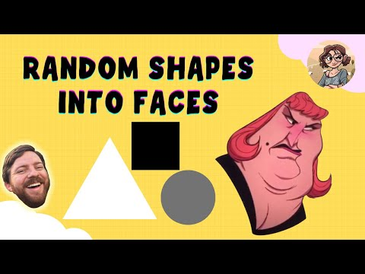
Notes:
jaaaaaa. (2021, August 5). Drawing shapes into faces! YouTube. Retrieved June 7, 2022, from https://www.youtube.com/watch?v=FQd3h9tTMvk

Slide 9
Resume Work!

Slide 10
Day 1 Student Survey
Notes:
https://www.youtube.com/watch?v=KUqHWMUljSw

Slide 11
Day 1 Student Survey
https://bit.ly/day1-k20Lesson

Slide 12
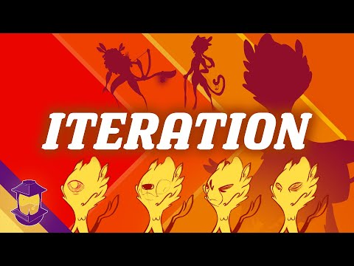
Notes:
YouTube. (2021, June 6). Iteration: An essential character design tool! YouTube. Retrieved June 7, 2022, from https://www.youtube.com/watch?v=KCF0-PBtHAA

Slide 13
Point of Most Significance
Think about the iteration process.
What is the most important factor of using iteration to create characters?

Slide 14
“Pass the Problem”
Make a new iteration of one of your characters.
Pass the drawing to a friend.
Your friend will make a new version of your character and offer some design suggestions. They can change aspects of the character including the color to help you see a different perspective.
Pass the paper back.
Make another iteration of your character incorporating their design suggestions.

Slide 15
Accessorize
Using only 1 extra color per character, add an accessory that helps to better define who they are. At this point, you can also decide if you want to keep the original color or if you think another color better suits your characters and accessory.
Check out the following slides for examples of what your paper might look like:

Slide 16
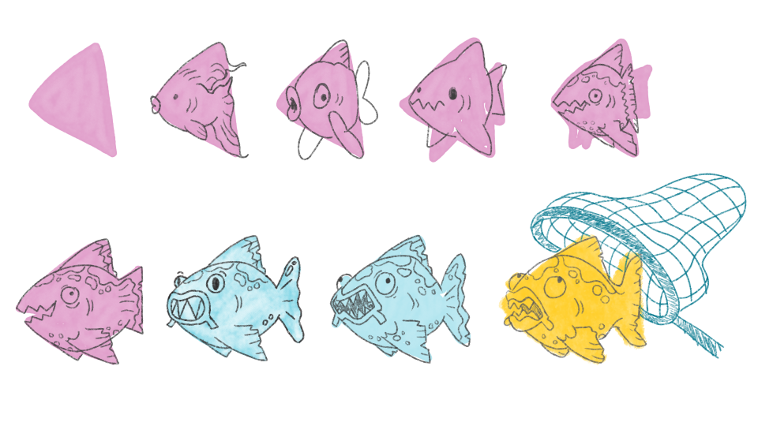

Slide 17
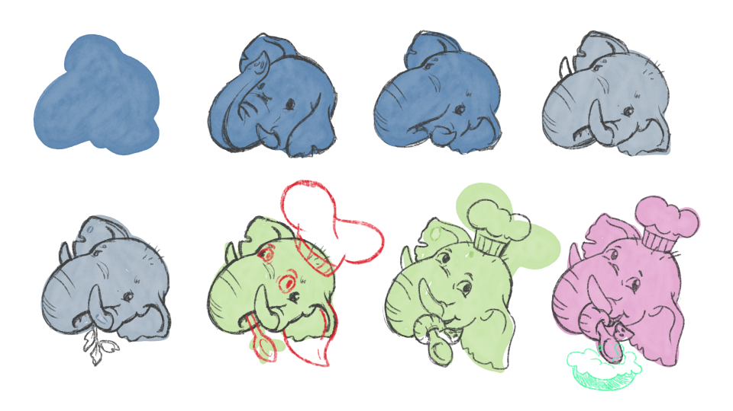

Slide 18
Preflection
Answer the essential question:
How does shape inform character design?

Slide 19
Chat Stations
Find your “Pass the Problem” partner and pair up with another pair to make groups of four.
Move through the question posters and write one complete answer for each question.

Slide 20
Day 2 Student Survey
Notes:
https://www.youtube.com/watch?v=hHqmk_9XVR0

Slide 21
Day 2 Student Survey
https://bit.ly/day2-k20lesson

