Slide 1
It Wasn’t Me!
The Crucible

Slide 2
Essential Questions
How does a collective fear affect a larger group?
How do theatrical choices and performance of a piece of literature influence a person’s understanding of that text?

Slide 3
Learning Objectives
Students will be able to:
Evaluate excerpts from “The Crucible” for literary devices that help support their understanding of the play.
Refine an excerpt from “The Crucible” in a modern interpretation.

Slide 4
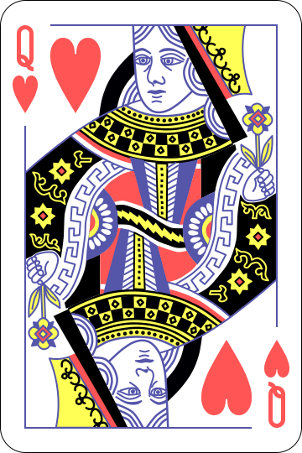
Who are the witches?
Your goal is to build the largest group possible that does NOT have a witch in it.
If you draw a Queen you will play the role of “witch.”
Any group found to include a witch will spend a week in the stocks.
Notes:
https://commons.wikimedia.org/wiki/File:English_pattern_queen_of_hearts.svg

Slide 5
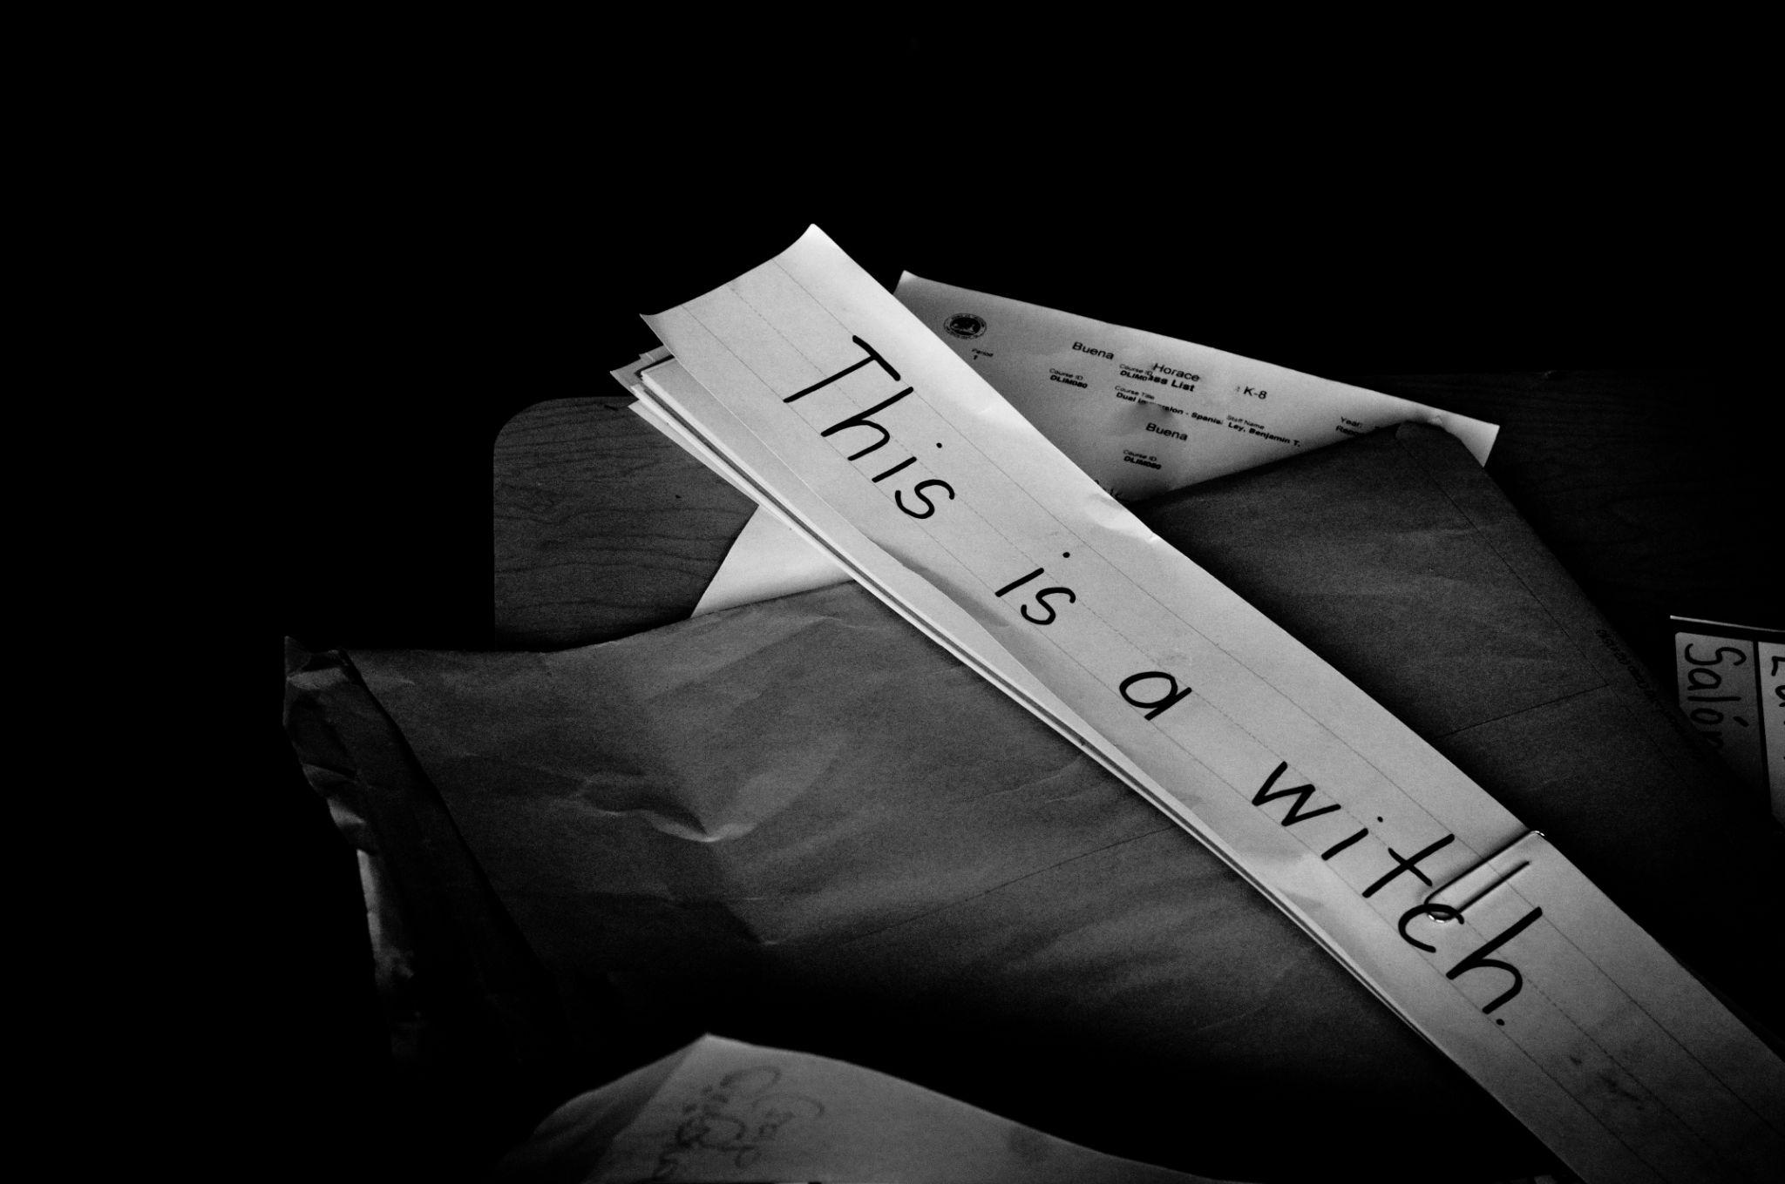
The Crucible by Arthur Miller
A dramatized and partially fictionalized play of the Salem Witch Trials.
Miller wrote this play as an allegory for McCarthyism when the US Government was persecuting people accused of being communists.
Notes:
https://www.flickr.com/photos/carbonnyc/9532678875

Slide 6
Stop and Jot
As you read the article, consider some parallels between the story and what you know about history.
When something comes to mind:
Stop reading
Jot down what you’re thinking in the margins

Slide 7
Stop and Jot
With your partner, discuss what you wrote down in the margin
Add any interesting thoughts your partner had to you paper
Be prepared to share out with the class

Slide 8
Novel in a Day
Read through your assigned section of “The Crucible”
Look for examples of the following:
Imagery
Tone
Symbolism
Irony

Slide 9
Imagery
[ˈimij(ə)rē]
noun
Compilation of sensory details which enables the reader to visualize the event.
Visually descriptive or figurative language, especially in a literary work.
Example: The white snow glistened as it began to melt in the warm sunlight.

Slide 10
Tone
[tōn]
noun
Speaker or narrator’s attitude toward the subject of the piece distinct from mood in that it is not used to evoke a particular feeling in the reader
The general character or attitude of a place, piece of writing, situation, etc.
Example: “Winter will pass, the days will lengthen, the ice will melt in the pasture pond. The song sparrow will return and sing, the frogs will awake, the warm wind will blow again.” - Charlotte’s Web

Slide 11
Symbolism
[ˈsimbəˌlizəm]
noun
Something used to represent a larger concept or idea
The use of symbols to represent ideas or qualities.
Example: A ring represents marriage and commitment.

Slide 12
Irony
[ˈīrənē]
noun
The opposite of what is expected to happen. This can occur in language, in situations, or in the behavior of characters.
The expression of one's meaning by using language that normally signifies the opposite, typically for humorous or emphatic effect.
Example: The teacher failed the test.

Slide 13
Novel in a Day
Read through your assigned section of “The Crucible”
Look for examples of the following:
Imagery
Tone
Symbolism
Irony
Record examples on your handout

Slide 14
Novel in a Day
Share your examples of the following:
Imagery
Tone
Symbolism
Irony
Record the examples shared by the other groups

Slide 15
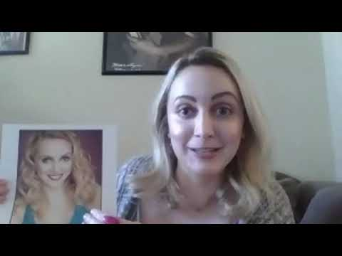
Notes:
https://www.youtube.com/watch?v=FOVSVcryf_8&list=PL-aUhEQeaZXIhi-ivvrQTrrEAlWvFWisR&index=14

Slide 16
Set the Scene
How might you bring your scene to life in a modern way?
Write down some ideas that come to mind.

Slide 17
Set the Scene
Using the section from the play that you analyzed earlier in the lesson, rewrite your scene using the information and ideas you just brainstormed.

Slide 18
Set the Scene
Using the section from the play that you analyzed earlier in the lesson, write a brief synopsis of how you would rewrite your scene using the information and ideas you just brainstormed.

Slide 19
You Get To Decide!
How would you cast the movie if it were remade today?

