Slide 2
The Giant Awakens
U.S. Involvement in World War II

Slide 3
Tip of the Iceberg
How did World War Two affect Americans?
Think about the question above.
Write what you already know about the question above the water line.
Write what you suspect about the question at the water line.
Notes:
K20 Center.(n.d.).Tip of the Iceberg.Strategies.https://learn.k20center.ou.edu/strategy/67

Slide 4
Essential Questions
How did World War Two impact Americans?

Slide 5
Lesson Objective
Understand the causes and effects of America’s involvement in World War Two.

Slide 6
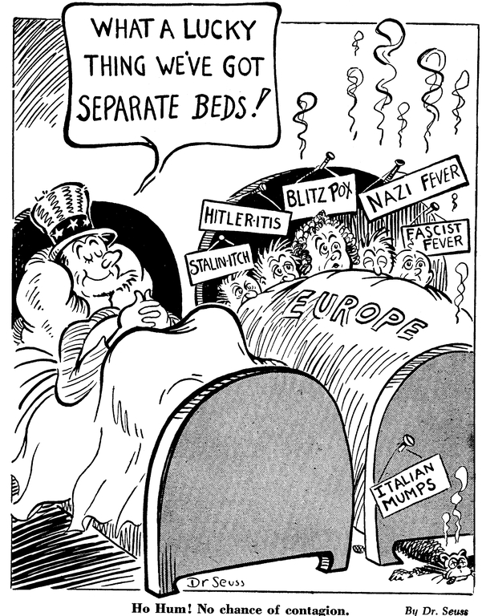
T.A.C.O.S.
T - What time frame is this?
A - What is the action? What is happening?
C – What is the caption?
O - What important objects or symbols are in the cartoon?
S - Write one sentence summarizing the meaning of the cartoon.
Notes:
K20 Center.(n.d.).T.A.C.O.S.Strategies.https://learn.k20center.ou.edu/strategy/1196
Ho hum! no chance of contagion. UC San Diego Library | Digital Collections. (n.d.). Retrieved September 9, 2022, from https://library.ucsd.edu/dc/object/bb38916372

Slide 7
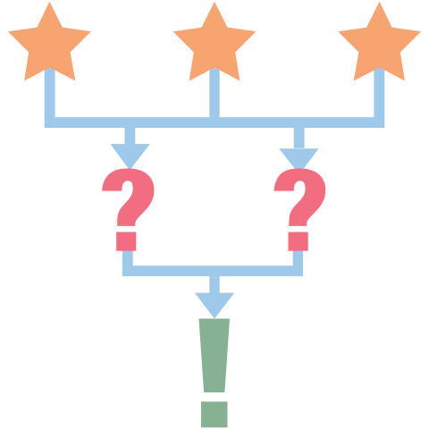
3-2-1 From Isolation to Involvement
Analyze the timeline events.
Answer the following:
3 - ways in which Hitler pushed the world into war.
2 - ways the US helped European countries indirectly.
1 - event that forced the US to join the war.
Notes:
K20 Center.(n.d.).Elbow Partners.Strategies.https://learn.k20center.ou.edu/strategy/116

Slide 8
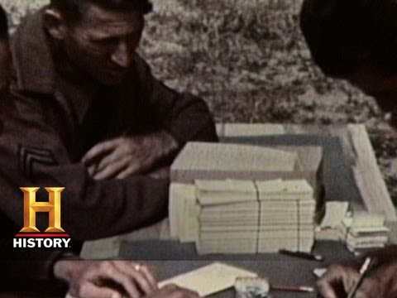
America Enters World War II
WWII In HD: America Enters World War II | History - YouTube
Notes:
History Channel. (2014, May 19). WWII in HD: America enters World War II | history. YouTube. Retrieved September 9, 2022, from https://www.youtube.com/watch?v=_yQyCTTPGuQ

Slide 9
Elbow Partner
Why did Americans remain neutral for so long during the war?
Should the US have joined sooner?
How did Americans react to the attack on Pearl Harbor?

Slide 10
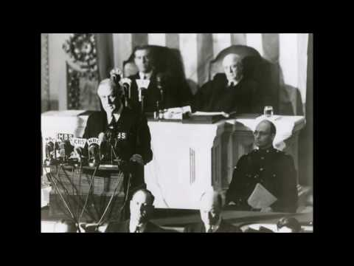
CUS and Discuss
As you listen to the Day of Infamy Speech complete the following:
Circle - unfamiliar words
Star - main ideas
Underline - supporting details for the main ideas
Franklin D. Roosevelt's Address to Congress, December 8, 1941 - YouTube
Notes:
FDR Library. (2016, October 27). Franklin D. Roosevelt's address to Congress, December 8, 1941. YouTube. Retrieved September 20, 2022, from https://www.youtube.com/watch?v=DbRYqLtg6LU&t=1s
K20 Center.(n.d.).CUS and Discuss. Strategies. https://learn.k20center.ou.edu/strategy/162

Slide 11
Historical Mingle
I was a soldier in the Civil War.
I lived in Ohio before the war as a farmer.
I joined voluntarily to support the Union.
I fought in the Battle of Antietam.
Notes:
K20 Center. (n.d.). Historical Mingle. Strategies. https://learn.k20center.ou.edu/strategy/184

Slide 12
Historical Mingle
Read over your historical character.
This is the role you will take on.
As you mingle around the room, introduce yourself and assume the point of view of your character.
Use the information on your paper to help you answer the question on the next slide.
Notes:
K20 Center. (n.d.). Historical Mingle. Strategies. https://learn.k20center.ou.edu/strategy/184

Slide 13
Historical Mingle
How did you support the war?
What impact did the war have on you?
Notes:
K20 Center. (n.d.). Historical Mingle. Strategies. https://learn.k20center.ou.edu/strategy/184
k20center. (2021, September 21). K20 Center 15 minute timer. YouTube. Retrieved September 19, 2022, from https://www.youtube.com/watch?v=m3zT2IxZQaw

Slide 14
Tip of the Iceberg
How did World War II affect Americans?
Think about the cartoon, video, Day of Infamy speech, Historical Mingle, and timeline.
Think about the question above.
Write what you have learned below the water line.
Notes:
K20 Center.(n.d.).Tip of the Iceberg.Strategies.https://learn.k20center.ou.edu/strategy/67

