Slide 2
Making Connections
Connecting Functions and Their Derivatives

Slide 3
Essential Question
How are the graphs of a function and its derivatives related?

Slide 4
Lesson Objectives
Given the graph of f, f’, or f’’, determine key features of the other two.
Use the graph of the first derivative, g’, to justify conclusions about the function, g.

Slide 5
I Notice, I Wonder
Create a table on the back of your Exploring Relationships handout.
I Notice… | I Wonder…
Notes:
K20 Center. (n.d.). I Notice, I Wonder. Strategies. https://learn.k20center.ou.edu/strategy/180

Slide 6
I Notice, I Wonder
Go to bit.ly/2derive.
With a partner, pick any 2 graphs and complete your I Notice, I Wonder table.
What do you notice?
What do you wonder?
Notes:
K20 Center. (n.d.). I Notice, I Wonder. Strategies https://learn.k20center.ou.edu/strategy/180

Slide 7
Exploring Relationships
Use your graphing calculator to graph y = x² + 4x – 5.
Assuming this is the first derivative:
What do we know about the function?
What do we know about the second derivative?
Notes:
K20 Center. (n.d.). Inverted Pyramid. Strategies. https://learn.k20center.ou.edu/strategy/173

Slide 8
Exploring Relationships
Find another pair of students and compare your answers.
Discuss and talk through differences.
As a group, come to a consensus for questions 1 and 2.
Notes:
K20 Center. (n.d.). Inverted Pyramid. Strategies. https://learn.k20center.ou.edu/strategy/173

Slide 9
Exploring Relationships: Sample Response 1

Slide 10
Exploring Relationships: Sample Response 2

Slide 11
Exploring Relationships
Use the same graph, y = x² + 4x – 5.
Assuming this is the second derivative:
What do we know about the function?
What do we know about the first derivative?
Notes:
K20 Center. (n.d.). Inverted Pyramid. Strategies. https://learn.k20center.ou.edu/strategy/173

Slide 12
Exploring Relationships
Find another pair of students, and compare your answers.
Discuss and talk through differences.
As a group, come to a consensus for questions 3 and 4.
Notes:
K20 Center. (n.d.). Inverted Pyramid. Strategies. https://learn.k20center.ou.edu/strategy/173

Slide 13
Exploring Relationships: Sample Response 3

Slide 14
Exploring Relationships: Sample Response 4

Slide 15
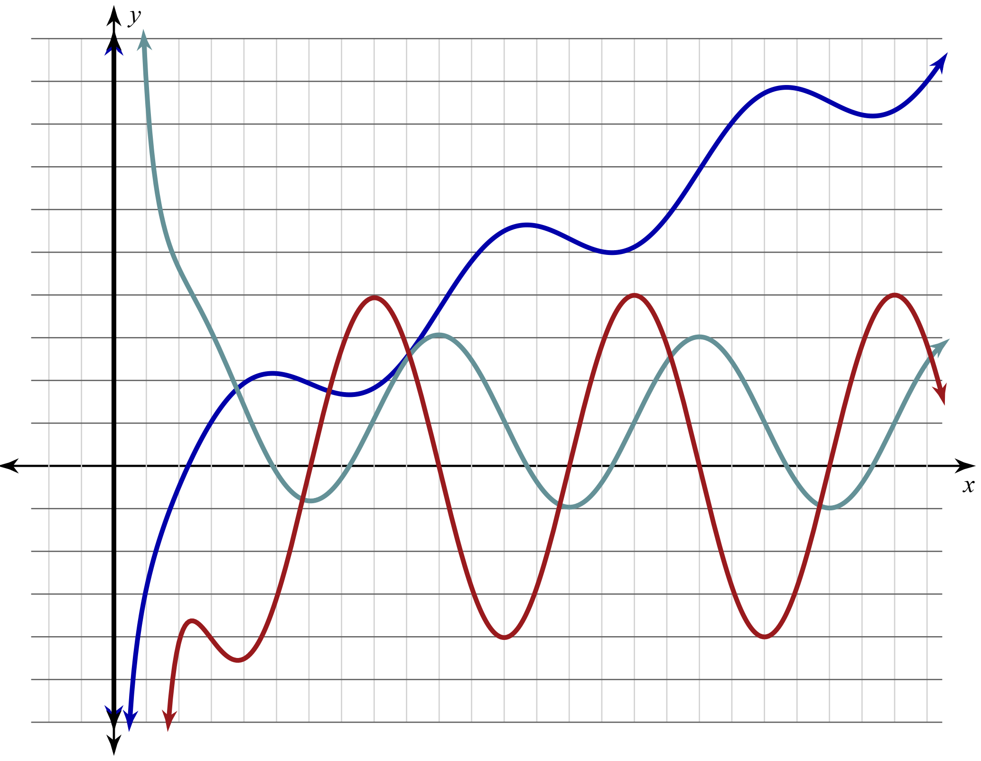
Which Graph is Which?
This graph contains f (x), f ’(x), and f ’’(x) but which one is which?
Take a moment to analyze the graph and make notes.
Trace each curve with a different coloring utensil.

Slide 16
Which Graph is Which?
The blue and red graphs are both increasing on (0, 2.4], so the green graph is f ’ or f ’’ because it has positive y-values on that interval.
The green graph changes from positive to negative at x = 5, so it’s the derivative of the graph that changes from increasing to decreasing at x = 5: the blue graph.
The green graph is decreasing on (0, 6] and the red graph has negative y-values on that interval.

Slide 17
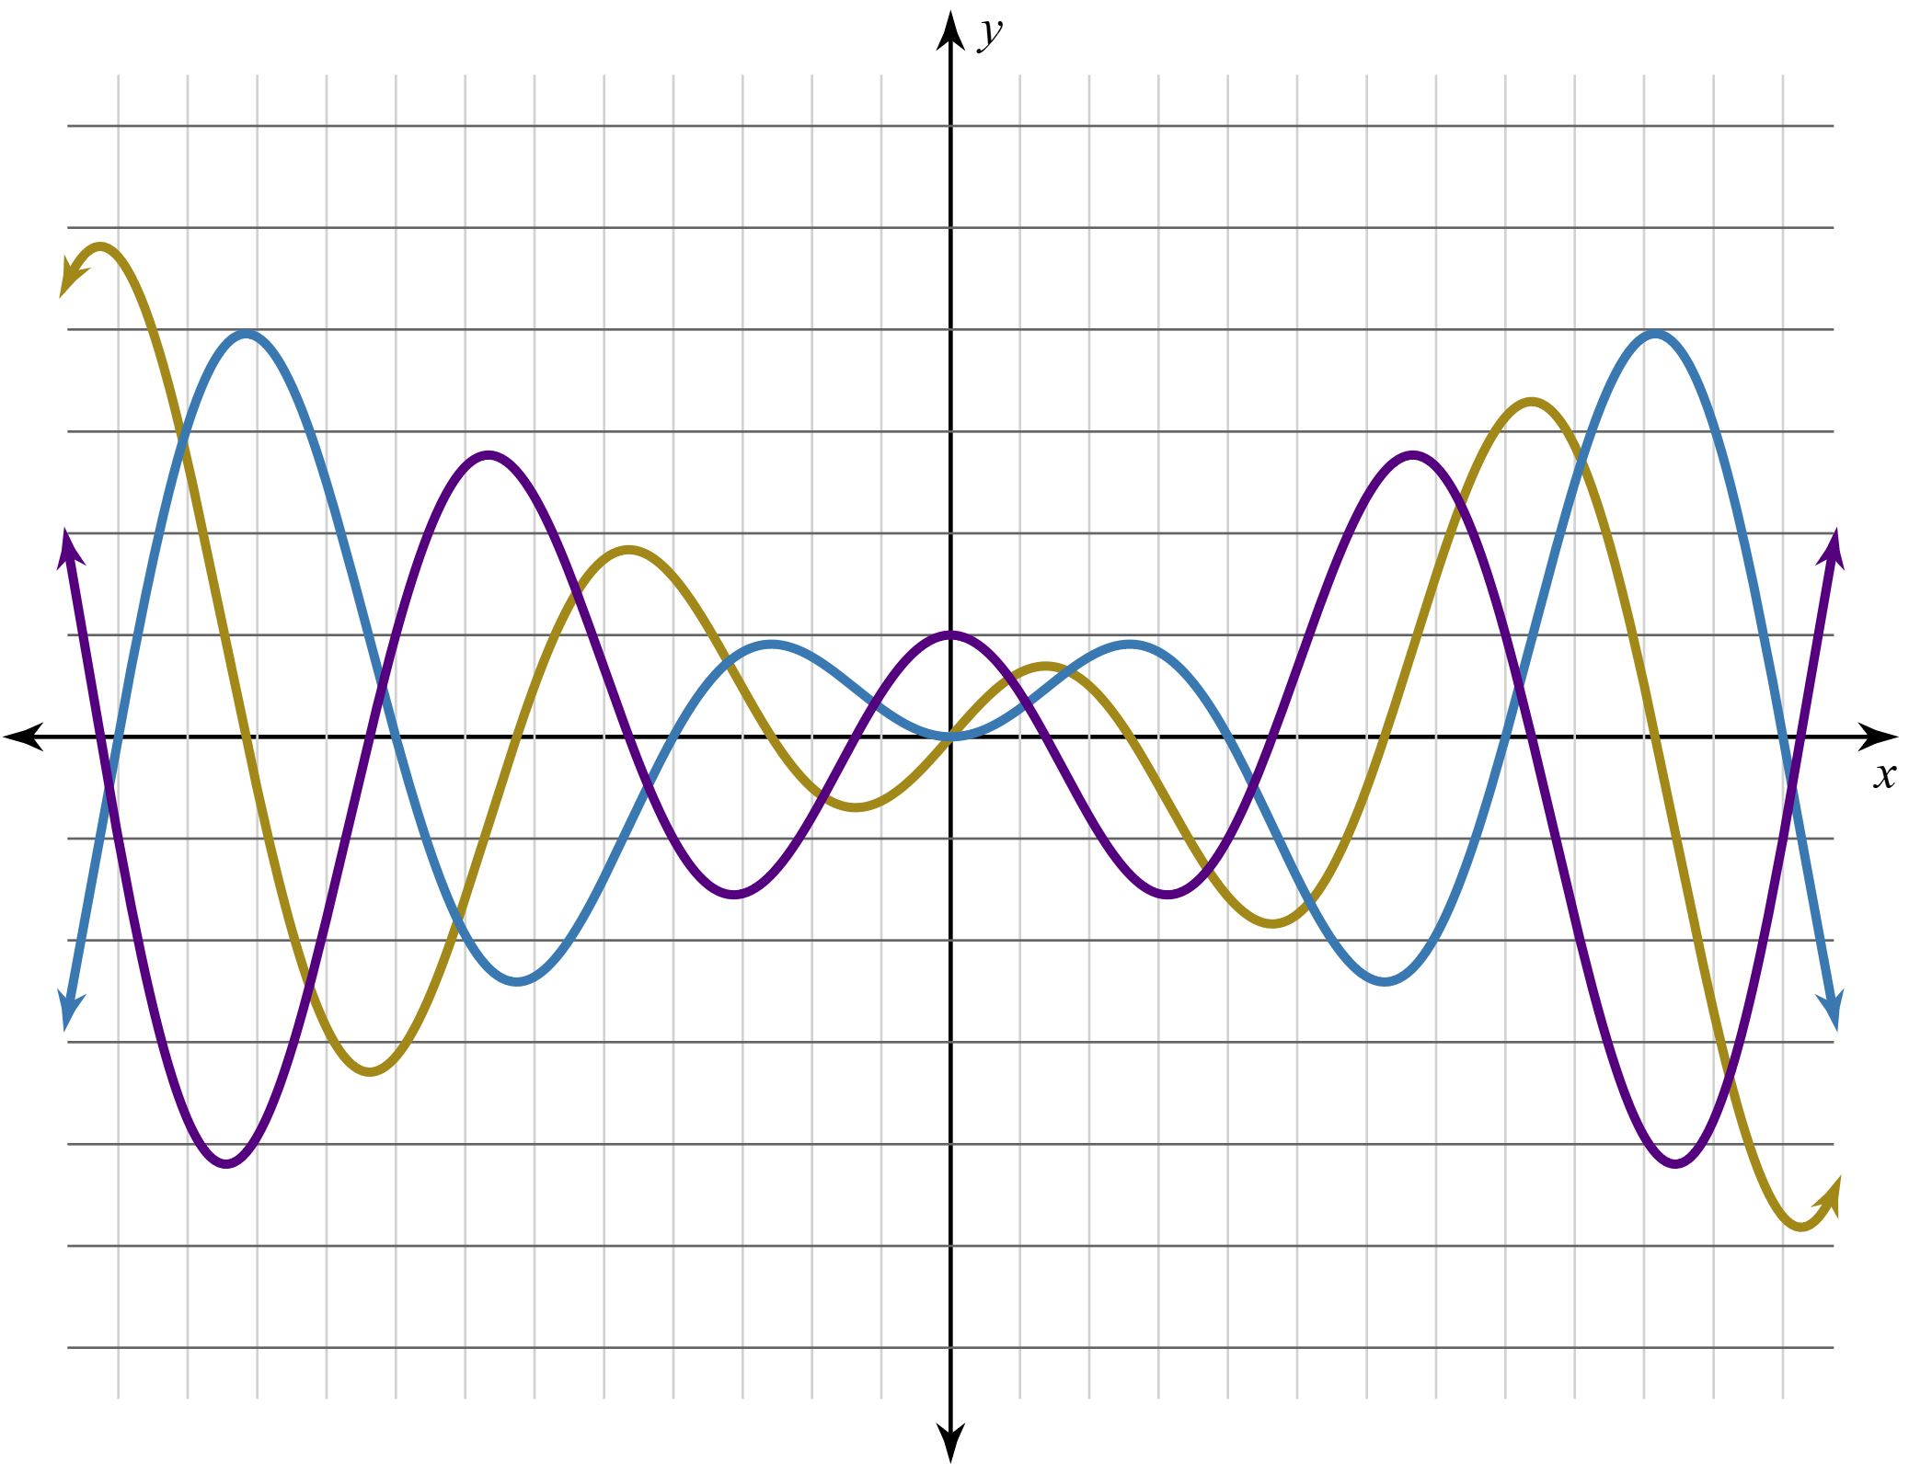
Which Graph is Which?

Slide 18
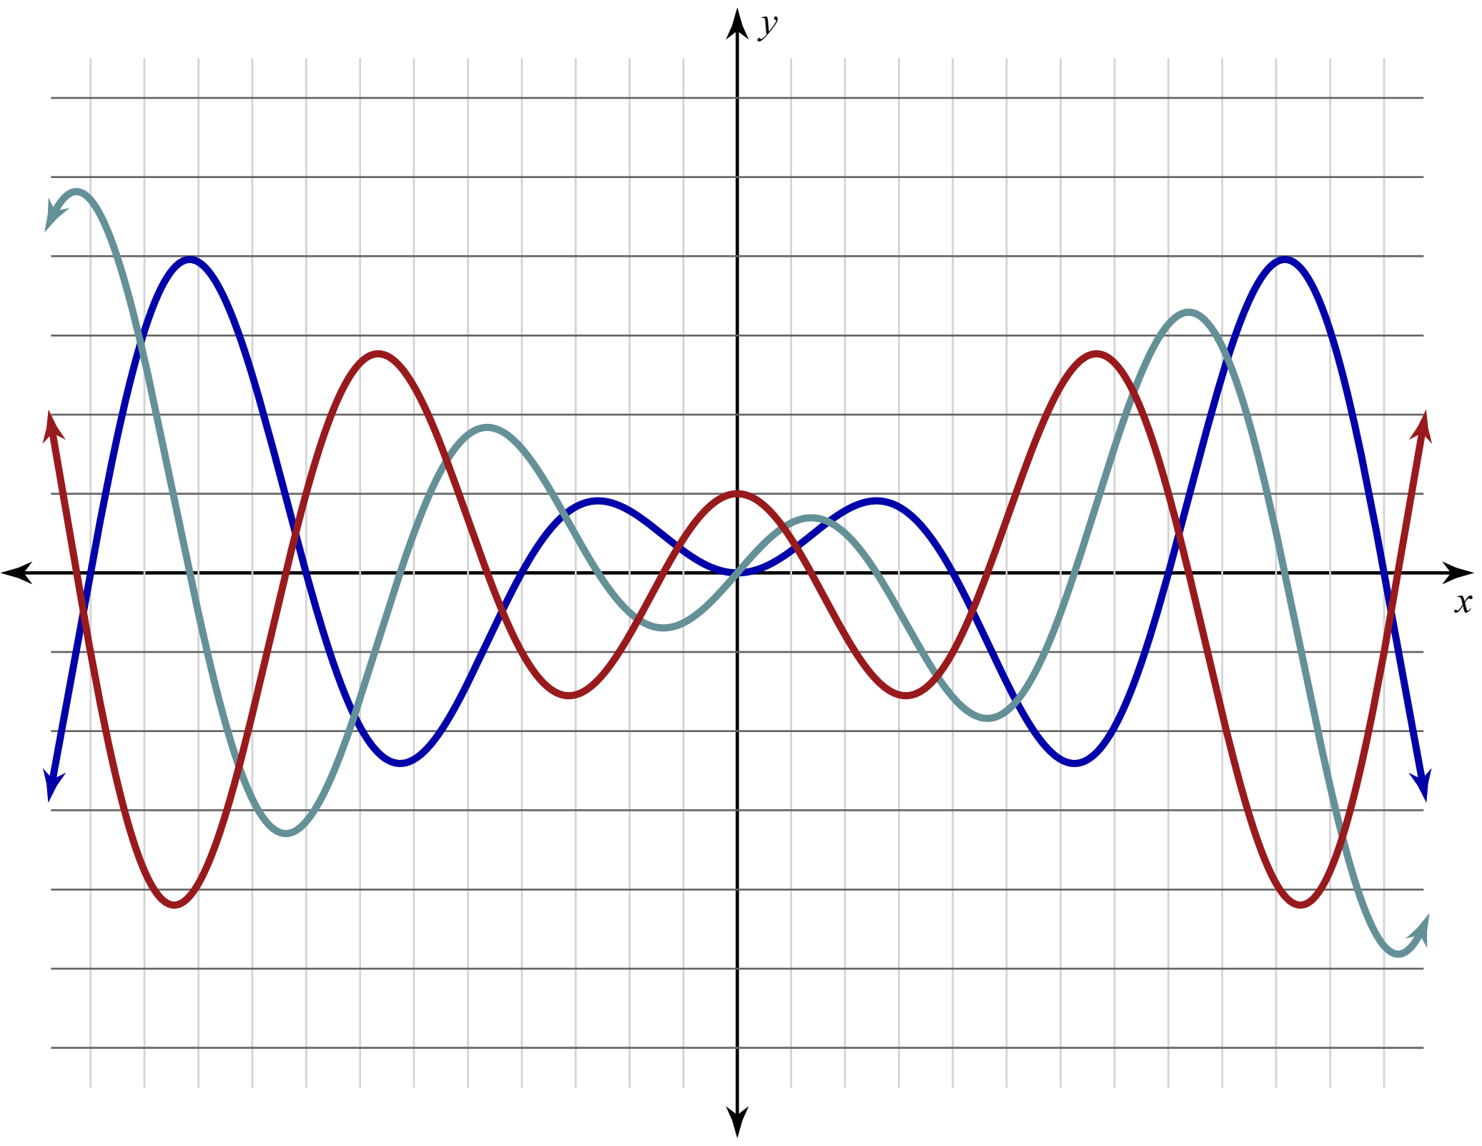
Which Graph is Which?
Check your work.
Explain how you know that this graph is correctly labeled.

Slide 19
Leap Frog
Arrange your cards however you would like on your desk.
You need to be able to find them quickly.
I am going to read an incomplete sentence.
One of your cards correctly completes my sentence.
The completed sentence must ALWAYS be true.

Slide 20
Leap Frog
Select the card that correctly completes my sentence and place it—facing me—on your forehead.
Once I read the answer, place the card back on the desk.
If you are correct, you will stand up and move to the next open seat.
If you are not correct, you will remain seated.

Slide 21
Exit Ticket
Individually answer the multiple-choice question on the Exit Ticket.
Show your work and justify your final answer.
* On the AP exam, you are not required to show your work or justify your response on the multiple-choice section. It is good practice for the free response section of the exam.
Notes:
K20 Center. (n.d.). Bell Ringers and Exit Tickets. Strategies. https://learn.k20center.ou.edu/strategy/125

