Slide 2
Elevating Angles, Part 1
Inverse Trigonometry: Introduction

Slide 3
Essential Question
How is trigonometry used to find the measures of unknown angles?

Slide 4
Lesson Objective
Apply inverse trigonometry functions to find unknown angle measures of right triangles.

Slide 5
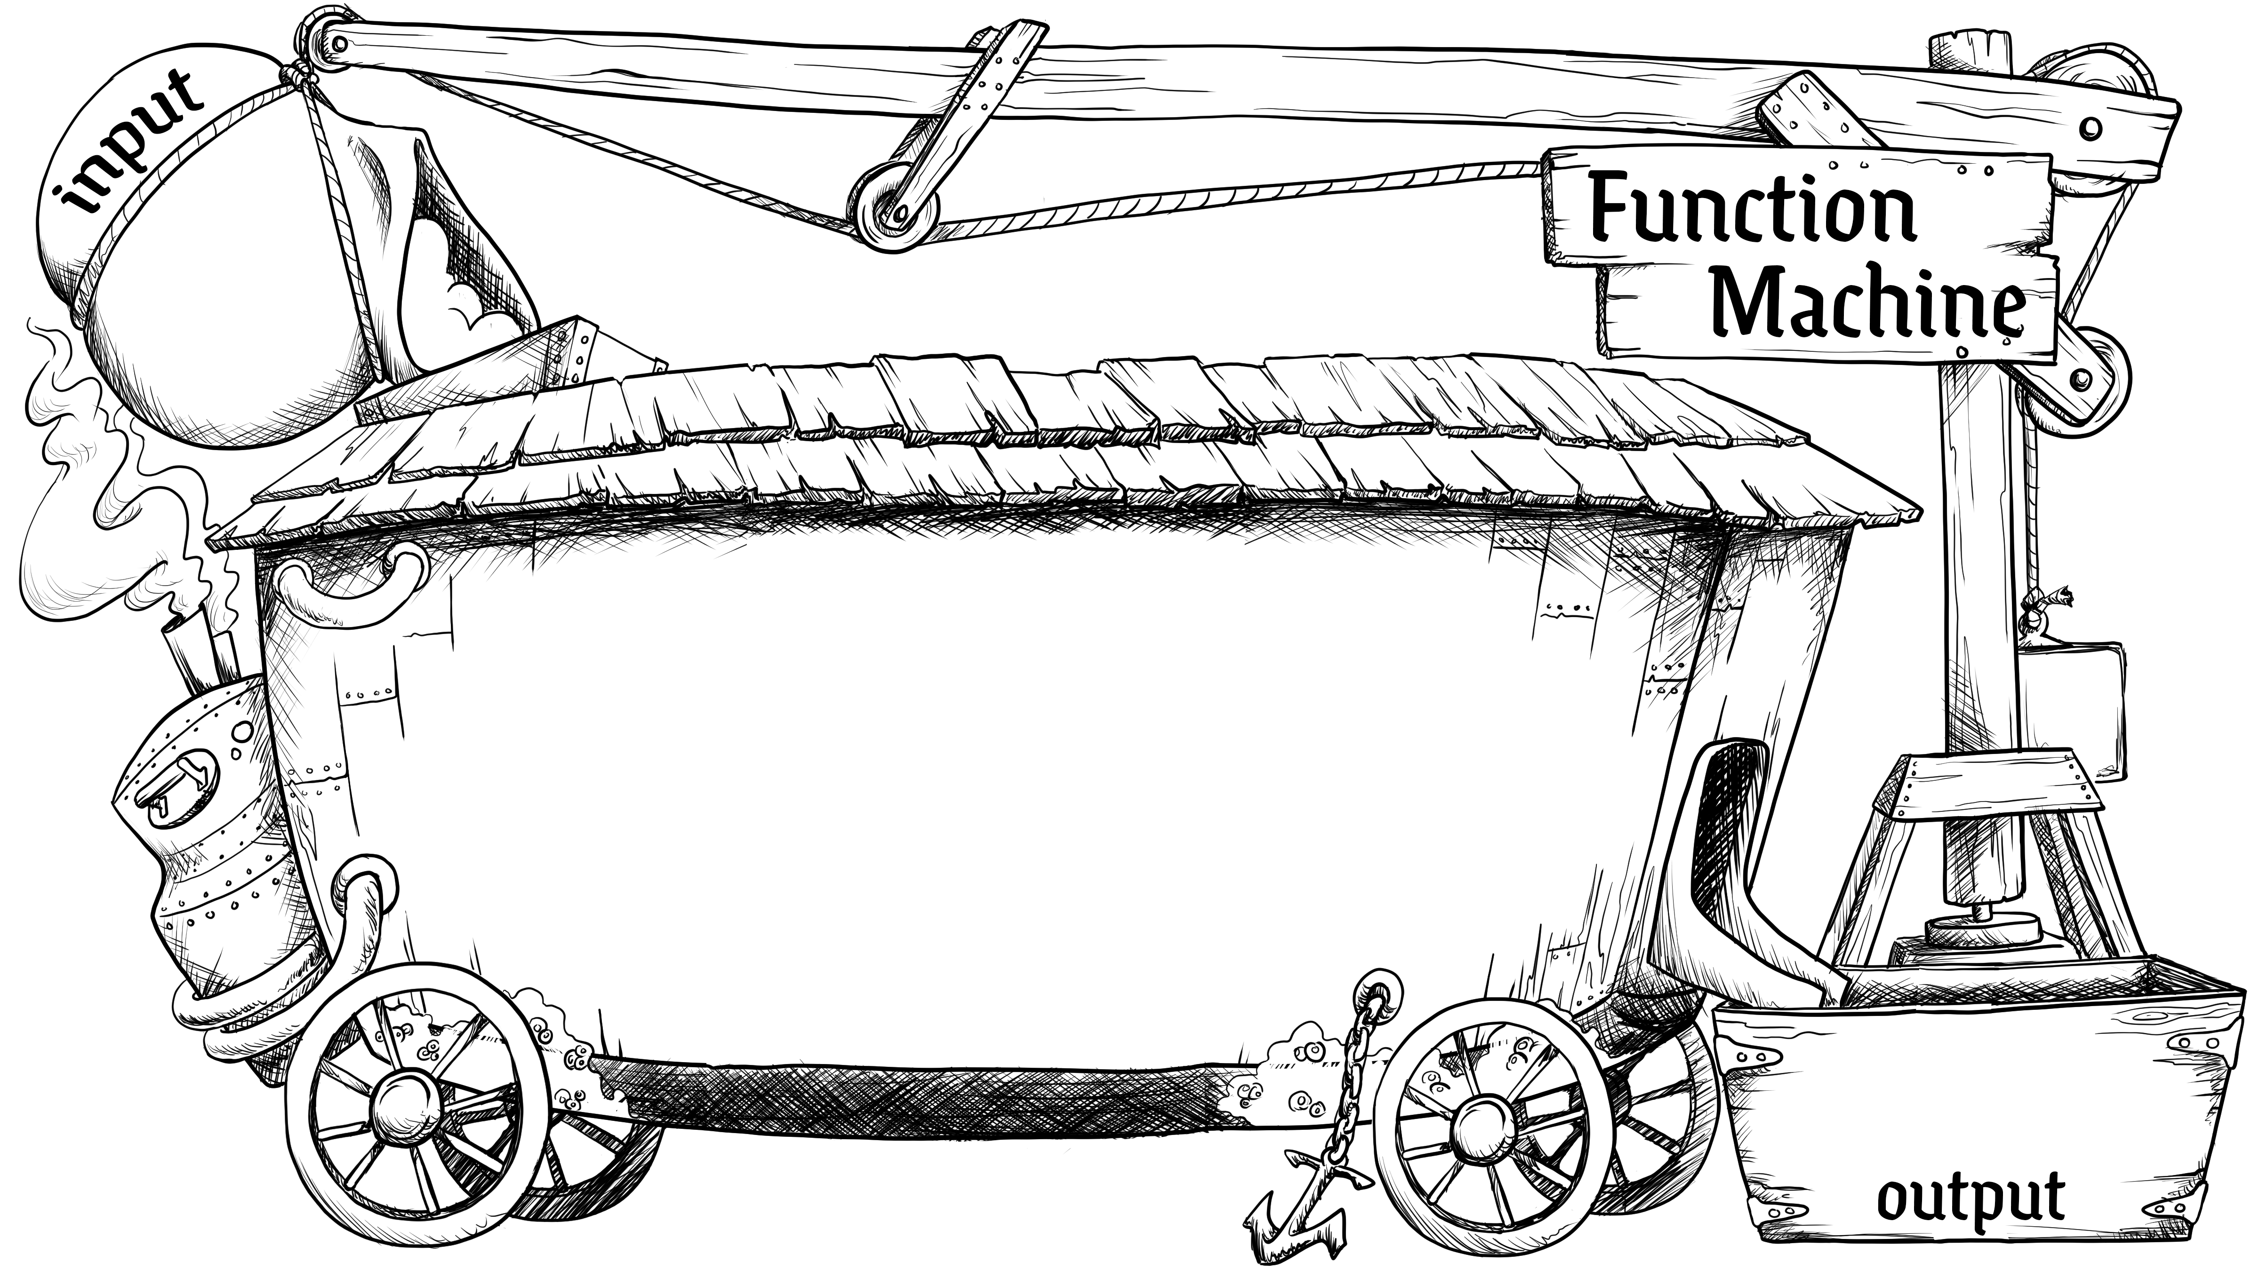
Function Machine
What are the inputs to a trigonometric function?
What are the outputs?
??
Function/Rule
??

Slide 6
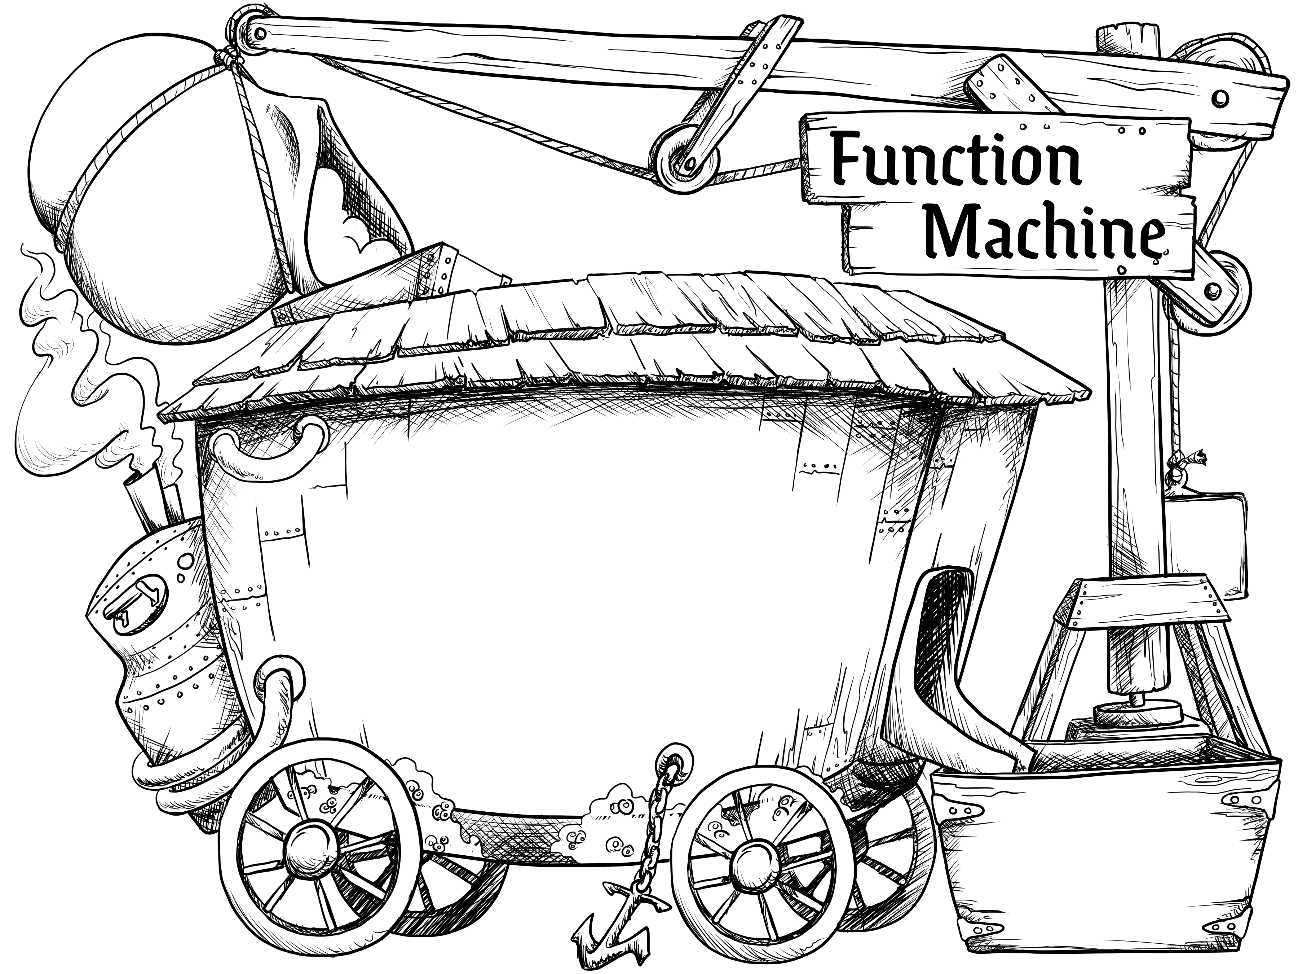
What Are the Inputs and Outputs?
??
??
Sine
Tangent
???
??
???
Cosine
???

Slide 7
What Are the Inputs and Outputs?
The angle measure is the input of a trig function.
The ratio of the lengths of two sides of the right triangle is the output of a
trig function.
θ
Sine
Cosine
Tangent
Ratio

Slide 8
Inputs and Outputs
Remember, certain triangles have simple angle measures and side-length ratios.
  30° – 60° – 90° triangles
  45° – 45° – 90° triangles
Use what you know about inputs, outputs, and special angles to complete the tables on your handout.

Slide 9
What About…
We know that trigonometric functions help us find ratios of right triangles for a given angle measure, but what if we don’t know θ?
Let’s consider a question that we do know the answer to: How do we find the value of x if given x + 3 = 5?

Slide 10

I Notice, I Wonder
Notice: What do you notice?
Wonder: What do you think
means?
Notes:
K20 Center. (n.d.). I Notice, I Wonder. Strategies. https://learn.k20center.ou.edu/strategy/180

Slide 11
Guided Notes
Let’s learn about inverse trigonometric functions that will help us solve for θ (our unknown angle).

Slide 12
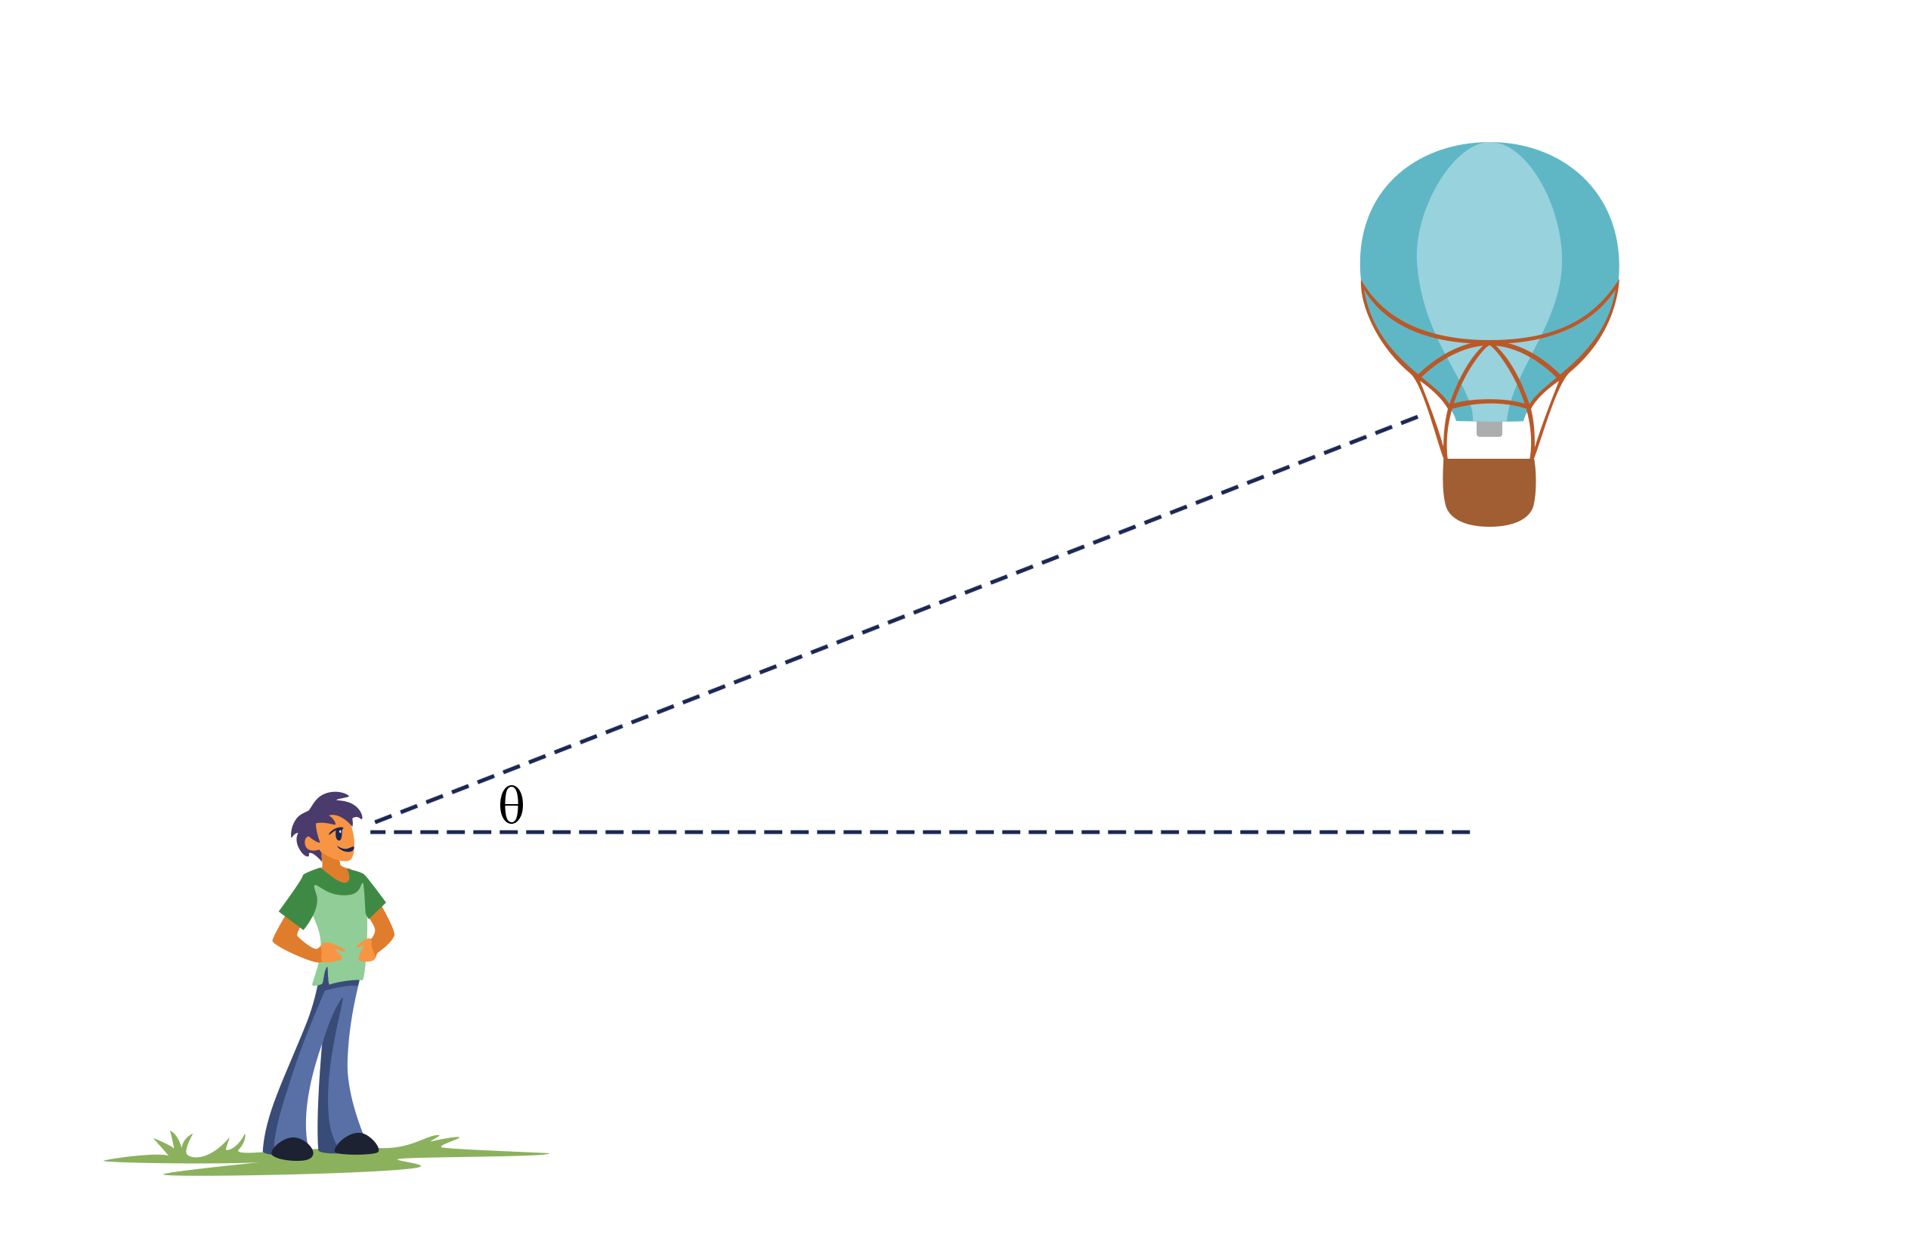
Angle of Elevation
Line of Sight
Angle of Elevation
Horizontal Line

Slide 13
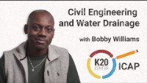
Civil Engineers Use Trigonometry
Civil Engineering and Water Drainage
Notes:
K20 Center. (May 2023). K20 ICAP - Civil Engineering and Water Drainage. YouTube. https://youtu.be/JVUnXjCW2-o

Slide 14
Go With the Flow
If the angle of elevation is less than 0.3° or greater than 6°, then the ditch should be lined with concrete.
Work with a partner to determine which segments of the drainage ditch needs a concrete liner or which can remain grass.

Slide 15
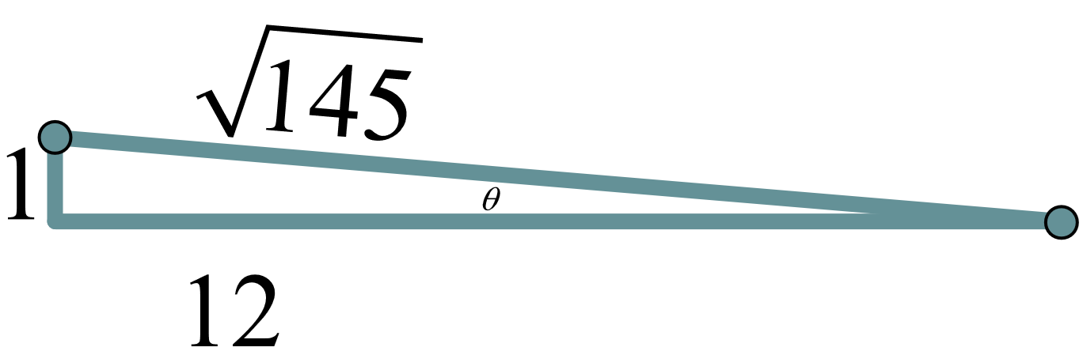
Go With the Flow (Segment 1 Solution)
We are given all three side lengths, so we can use any inverse trigonometric (trig) function.
0.3° < θ < 6°, so this segment
can remain grassed.

Slide 16
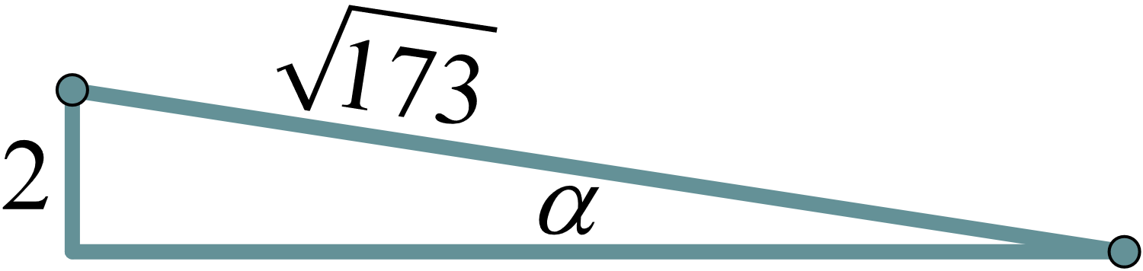
Go With the Flow (Segment 2 Solution)
We are given the length of the side opposite the angle and the hypotenuse, so we need to use inverse sine.
α > 6°, so this segment needs
a concrete liner.

Slide 17
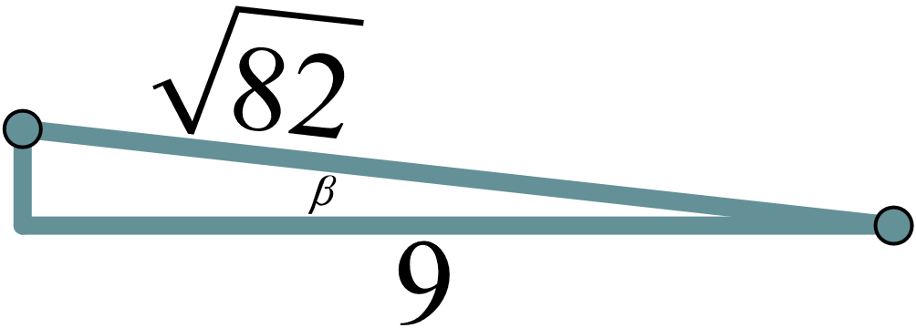
Go With the Flow (Segment 3 Solution)
We are given the length of the adjacent side and the hypotenuse, so we need to use inverse cosine.
β > 6°, so this segment needs
a concrete liner.

Slide 18
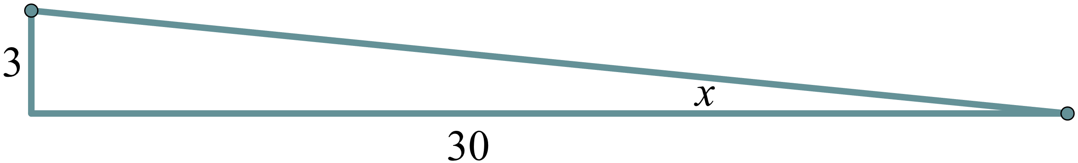
Go With the Flow (Segment 4 Solution)
We are given the lengths of the two legs, so we need to use inverse tangent.
0.3° < x < 6°, so this segment
can remain grassed.

Slide 19

What Did I Learn Today?
Reflect on what you learned during this lesson.
Write 2-3 sentences about what you learned.
  What did you learn that was new?
  How was what you learned related to something you already knew?
  What question(s) do you still have?
Notes:
K20 Center. (n.d.). What Did I Learn Today?. Strategies. https://learn.k20center.ou.edu/strategy/169

