Slide 1
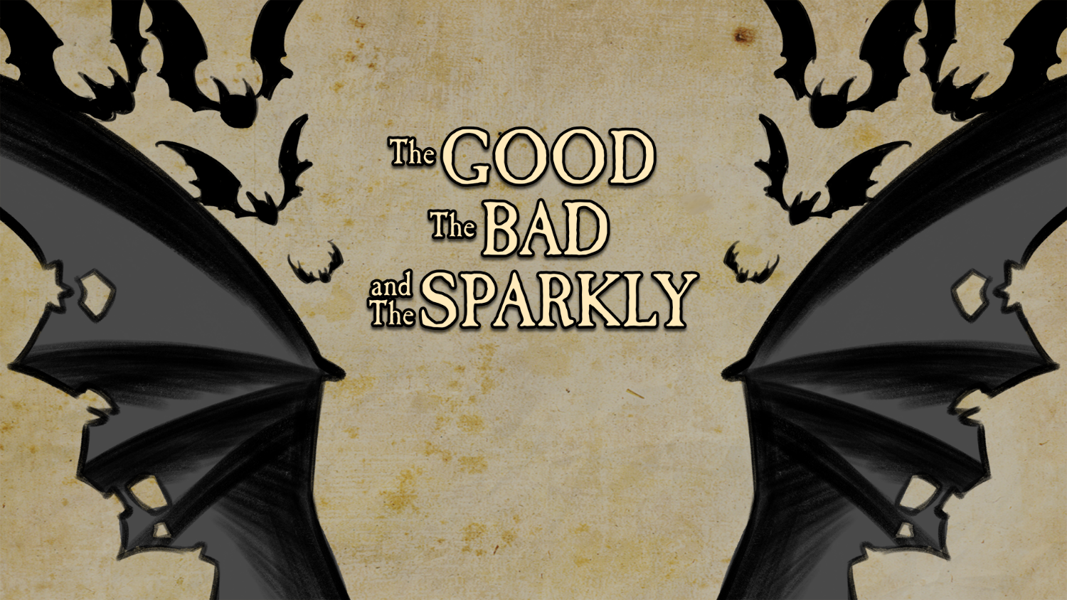
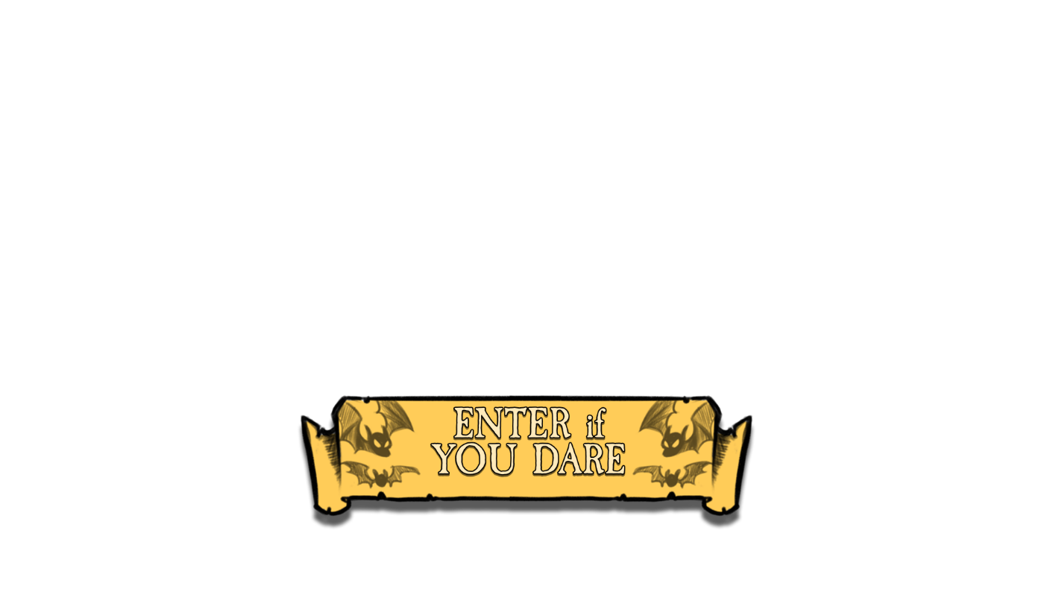

Slide 2

Essential Question
How do authors use similar tropes but come up with different variations of the same character?

Slide 3


Learning Objectives
Analyze the extent to which historical, cultural, and/or global perspectives affect an author's stylistic choices.
Evaluate how authors writing on the same issue reached different conclusions because of differences in assumptions, evidence, reasoning, and viewpoints.

Slide 4

Always, Sometimes, or Never True
Read each of the statements and decide whether it is:
  always true
  sometimes true
  never True
Make sure to justify your answer.

Slide 5
Always, Sometimes, or Never True?
Vampires have a reflection.

Slide 6
Always, Sometimes, or Never True?
To kill a vampire, you need to stake them in the heart.

Slide 7
Always, Sometimes, or Never True?
Vampires can’t enter a home without permission.

Slide 8
Always, Sometimes, or Never True?
Vampires can’t go out during the day.

Slide 9
Always, Sometimes, or Never True?
Vampires are compelled to count everything.

Slide 10
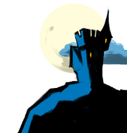
Tropes
[trohp]
noun
A recurring theme or motif, as in literature or art:
The heroic trope.
A convention or device that establishes a predictable or stereotypical representation of a character, setting, or scenario in a creative work:
From her introduction in the movie, the character is nothing but a Damsel in Distress trope.

Slide 11

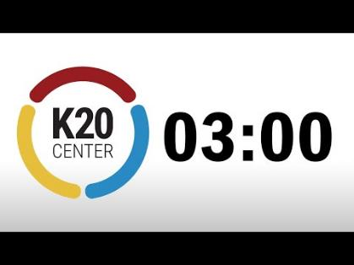
Affinity Process
What are some common vampire tropes?
Answer this question on your sticky notes.
Each separate answer should have its own sticky note.

Slide 12
Affinity Process
With your partner:
Read through your sticky notes.
Group any sticky notes that are similar together into a category. Label that category.

Slide 13

Affinity Process
With your group:
Read through your sticky notes.
Group any sticky notes that are similar together into a category. Label that category.

Slide 14
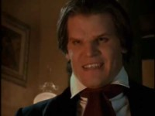
Buffy the Vampire Slayer
Notes:
YouTube. (2013). Angel - Introducing Angel Featurette (Season 1). YouTube. Retrieved October 3, 2022, from https://www.youtube.com/watch?v=G19HhL9H4JI

Slide 15
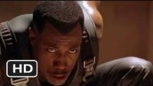
Blade
Notes:
YouTube. (2011). Blade Official Trailer #1 - (1998) HD. YouTube. Retrieved October 3, 2022, from https://www.youtube.com/watch?v=kaU2A7KyOu4

Slide 16
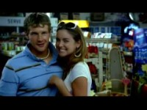
True Blood
Notes:
YouTube. (2009). True Blood Pilot Opening Sequence. YouTube. Retrieved October 3, 2022, from https://www.youtube.com/watch?v=7vmuHzhHEdI

Slide 17

The Strain
Notes:
YouTube. (2016). The Strain | Trailer | iflix. YouTube. Retrieved October 3, 2022, from https://www.youtube.com/watch?v=j-Y8B700lNA

Slide 18

Elbow Partners
With your partner, review your notes on the videos. Discuss:
Date of publication
Tropes
Possible influences on the writer

Slide 19
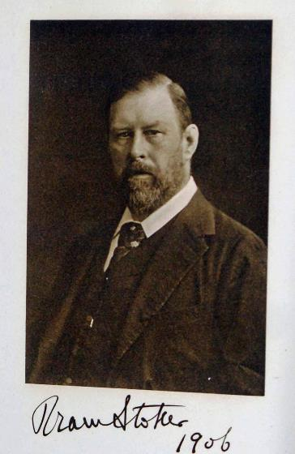
Bram Stoker
Author of Dracula
Inspired by
  Transylvanian folklore
  Vlad the Impaler
  Elizabeth Báthory
Choose the name “Dracula” because he thought it meant devil in Romanian.
Notes:
FluoritLaufer. (2022, April 26). Wikimedia Commons. Retrieved October 24, 2022, from https://commons.wikimedia.org/wiki/Main_Page

Slide 20
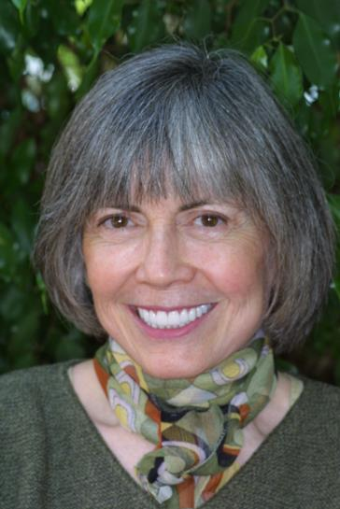
Anne Rice
Author of Interview With the Vampire (1976)
Born in New Orleans and raised by Irish Catholic parents
Mother died of alcoholism when she was a teen
Daughter died at six years old from leukemia, a form of blood cancer
Inspired by Stephen King’s Firestarter
Notes:
Snek01. (2006). Anne Rice. Wikimedia Commons. Retrieved October 24, 2022, from https://commons.wikimedia.org/wiki/File:Anne_Rice.jpg.

Slide 21
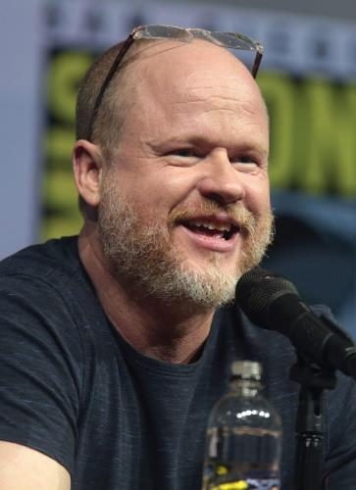
Joss Whedon & David Greenwalt
Created the character Angel for the television show Buffy the Vampire Slayer
Aired from 1997-2003
  The spin-off series, Angel, aired from 1999-2004
Offered a dichotomous look at good versus evil
  Angel is an Irish-Catholic from 18th century Ireland
  A vampire whose human soul was restored to him by a curse as a punishment
  This restored soul torments him with guilt and remorse
  According to Joss Whedon, the story takes place in Los Angeles because “there are a lot of demons in L.A. and a wealth of stories to be told.”
Notes:
Havens, Candace, Joss Whedon: The Genius Behind Buffy Benbella Books (May 1, 2003), p101-102.
Skidmore, G. (2018). Joss Whedon by Gage Skidmore 8. Wikimedia Commons. Retrieved October 24, 2022, from https://commons.wikimedia.org/wiki/File:Joss_Whedon_by_Gage_Skidmore_8.jpg.

Slide 22
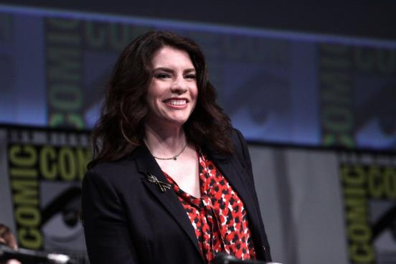
Stephenie Meyer
Author of the Twilight saga
Her Mormon faith influenced certain themes in her writing:
  Moral dilemma of mortal temptation
  Overcoming the natural man
  Immortality and eternal life
Influenced by literary classics
  Twilight: Pride and Prejudice by Jane Austen
  New Moon: Romeo and Juliet by William Shakespeare
  Eclipse: Wuthering Heights by Emily Brontë
  Breaking Dawn: A Midsummer Night’s Dream by William Shakespeare
Notes:
maybeMaybeMaybe. (2012). Stephenie Meyer (7585858874). Wikimedia Commons. Retrieved October 24, 2022, from https://commons.wikimedia.org/wiki/File:Stephenie_Meyer_(7585858874).jpg.

Slide 23
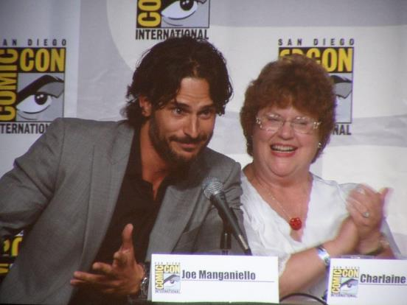
Charlaine Harris
Author of The Southern Vampire Mysteries series of novels
Television series “True Blood” adaptation aired from 2008–2014
Rather than acknowledging the legend that vampires are deceased humans who have risen from the dead to prey on the living, the vampires insist they are simply the victims of a medical condition that makes them allergic to sunlight and affects their dietary needs.
Notes:
Ibshopgirl. (2010). Joe Manganiello and Charlaine Harris. Wikimedia Commons. Retrieved October 24, 2022, from https://commons.wikimedia.org/wiki/File:Joe_Manganiello_and_Charlaine_Harris.jpg.

Slide 24
Marvin Wolfman
Creator of the character Blade
Introduced as supporting character in Marvel Comics’ The Tomb of Dracula #10 (July 1973)
Character inspired by Jim Brown, former NFL star

Slide 25
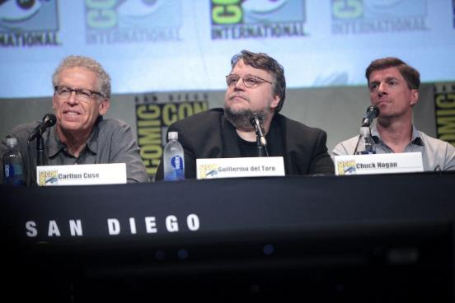
Guillermo del Toro and Chuck Hogan
Authors of The Fall, the inspirations for the television show “The Strain”
Aired from 2014–2017
Guillermo del Toro was raised a strict Catholic in Mexico
Notes:
Skidmore, G. (2015). Sdcc 2015 - Carlton Cuse, Guillermo del Toro & Chuck Hogan (19600034330). Wikimedia Commons. Retrieved October 24, 2022, from https://commons.wikimedia.org/wiki/File:SDCC_2015_-_Carlton_Cuse,_Guillermo_del_Toro_%26_Chuck_Hogan_(19600034330).jpg.

Slide 26
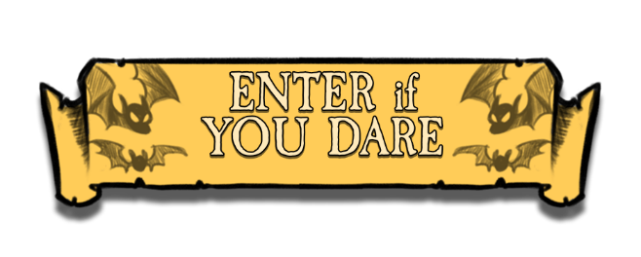
Storyline
https://k20center.ou.edu/e-learning/good-bad-sparkly/
In this activity, you will:
  Read excerpts from:
    Dracula
    Twilight
    Interview With the Vampire
  Read “A Field Guide to Vampires”
Take notes on your handout as you read.
You will not be able to advance to the next slide until you have clicked on and read all of the information.

Slide 27
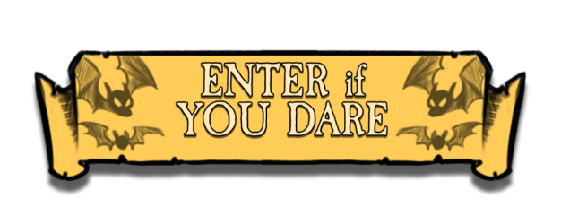
Reading Instructions
As you read the excerpts and the historical background on vampires, take notes on the characteristics you notice as well as possible influences on the authors.

Slide 28
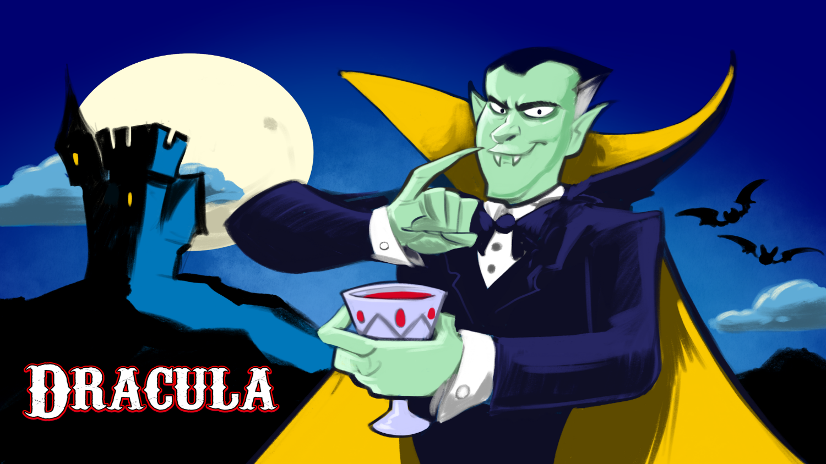


Slide 29
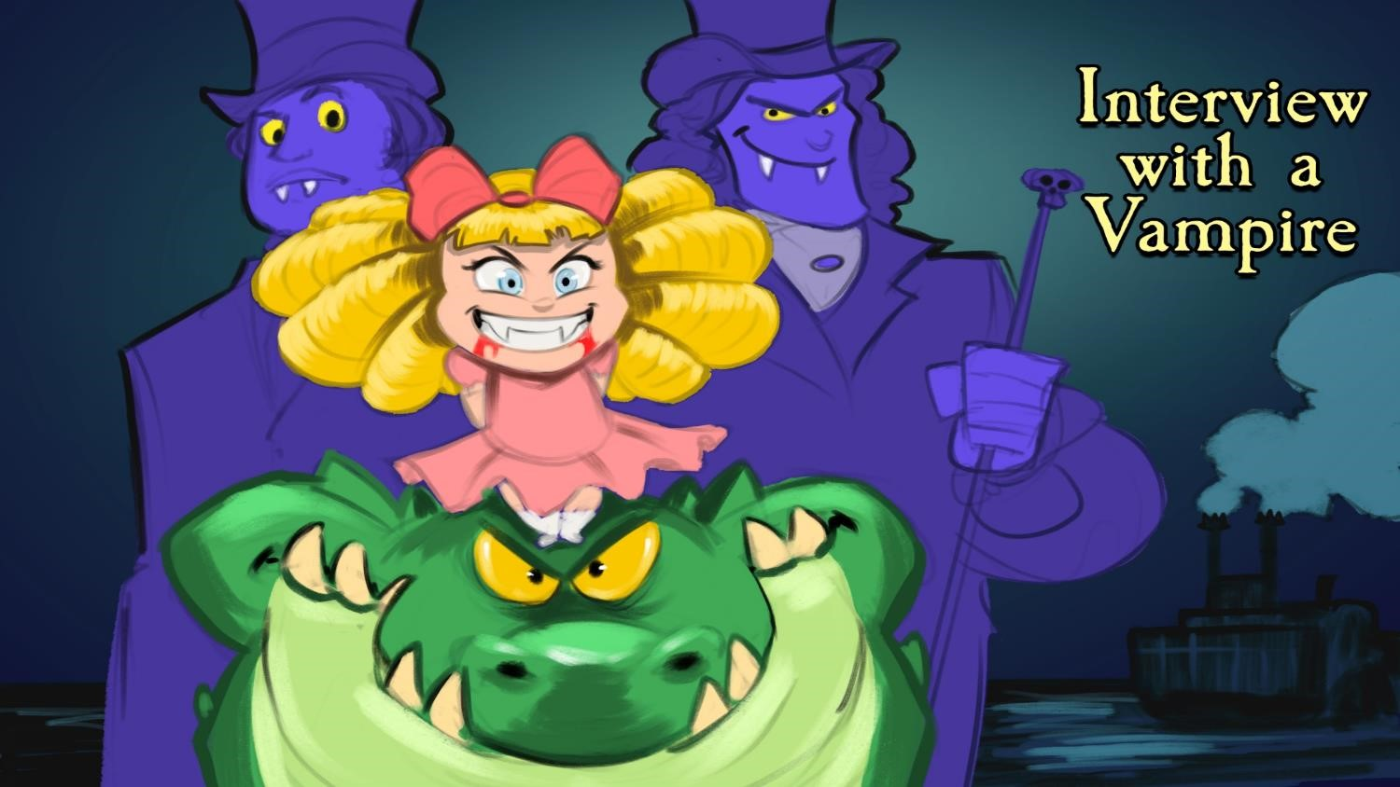

Slide 30
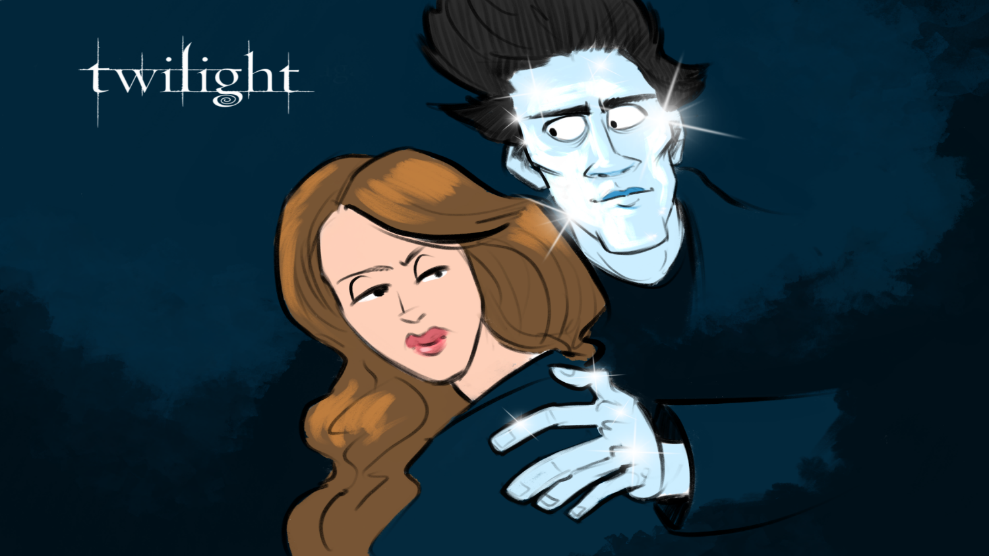

Slide 31
Card Matching
The goal of this activity is for you to take the knowledge gained to this point and determine how political, economical, and historical factors influenced the way the authors wrote about vampires in their stories.
Match the following:
  Influences on the writer
  Tropes

Slide 33

Dracula
Published: 1897
Influences on the author:
  Vlad the Impaler
  Elizabeth Báthory
Tropes:
  Vampires are restricted from entering homes without permission
  Vampires are wealthy
  Vampires can’t go outside during the day
  Vampires can’t be seen in mirrors
  Pale skin
  Alluring

Slide 35
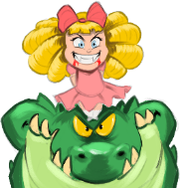
Interview with a Vampire
Published: 1976
Influences on the author:
  Child vampire based off of a child who recently passed away
Tropes:
  Can’t be recorded
  Vampires are wealthy
  Pale skin
  Weakness to sunlight
  Weakness to fire

Slide 36
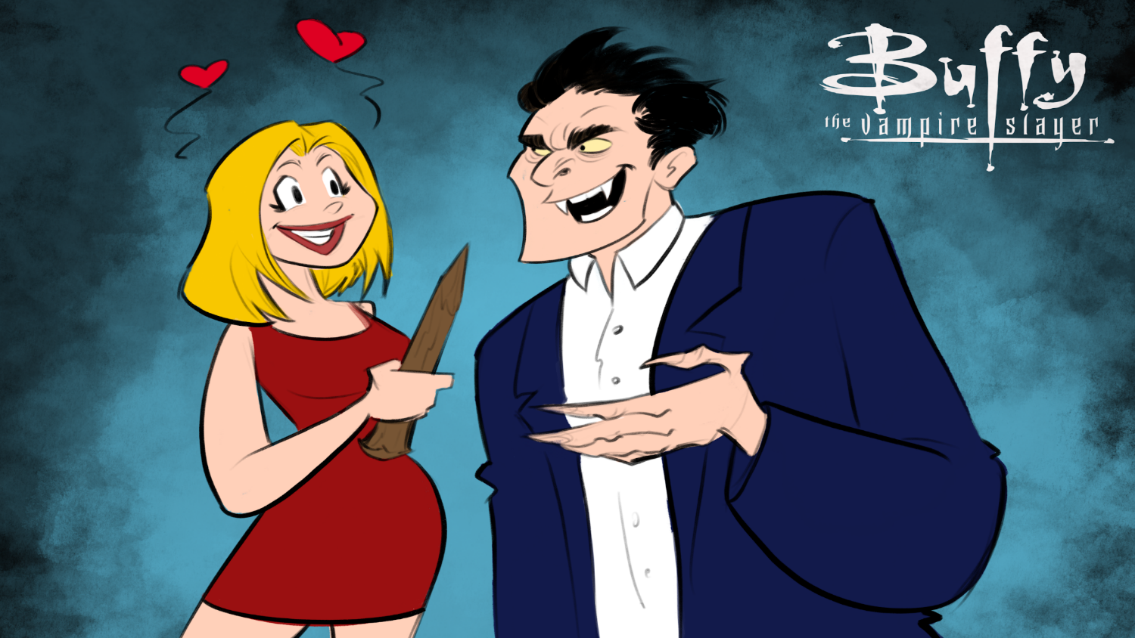

Slide 37
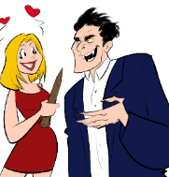
Buffy the Vampire Slayer
First appeared on television: 1997
Influences on the author:
  Catholicism
Tropes:
  Vampires are restricted from entering homes without permission
  Weakness to sunlight

Slide 39
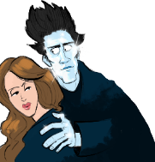
Twilight
Published: 2005
Influences on the author:
  Mormonism
Tropes:
  Vampires are restricted from entering homes without permission
  Beautiful
  Vampires form councils
  Vampires are wealthy
  Alluring
  Associated with sorcery or super powers
  Faster than normal

Slide 40
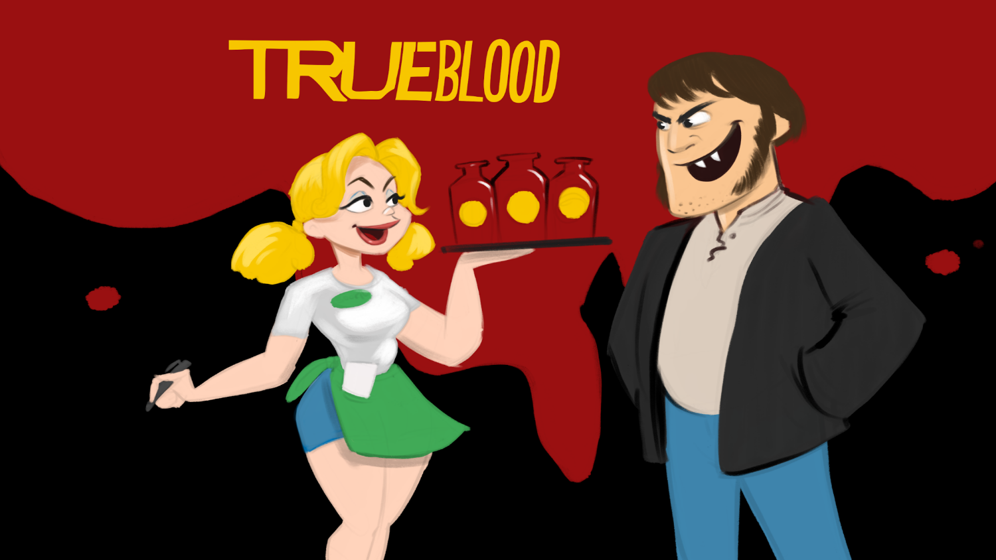

Slide 41
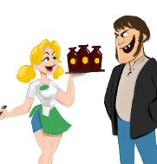
True Blood
First appeared on television: 2008
Influences on the author:
  Based on America’s fascination with youth and staying young as long as possible
Tropes:
  Vampires are restricted from entering homes without permission
  Vampires hide in plain sight
  Vampires are wealthy
  Alluring

Slide 42
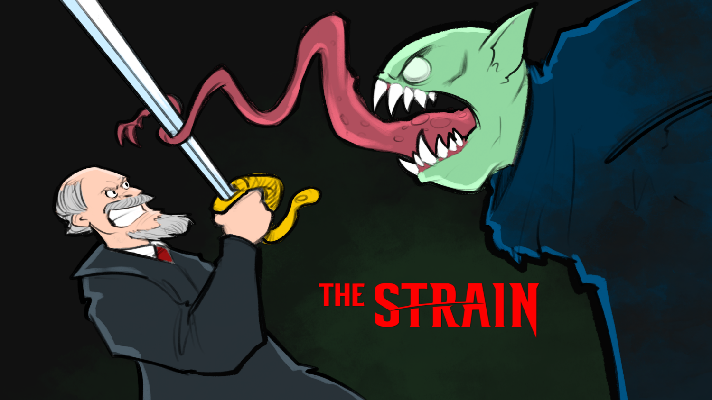

Slide 43
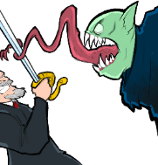
The Strain
First appeared on television: 2015
Tropes:
  Vampirism as a sickness
  Vampires are disfigured/inhuman
  Vampires form councils
  Associated with creatures of the night (bats and rats) but can’t shapeshift
  Vampires become detectives
  Weakness to sunlight

Slide 44

One-Pager
Create a One-Pager to answer the following questions:
  How do these authors address the same topic?
  How did these authors reach different conclusions due to the time period in which they wrote?
Make sure to include the following:
  Title
  Border around the page that includes the theme of the lesson
  Image that represents the subject
  A paragraph that answers each of the questions

