Slide 2
Words Before Blows
Julius Caesar
10th Grade ELA

Slide 3
With your partner, arrange the cards in a way that makes most sense to both of you.
Honeycomb Harvest
Notes:
K20 Center. (2020, September 16). Honeycomb harvest. Strategies. https://learn.k20center.ou.edu/strategy/61

Slide 4
Compare your honeycomb with a nearby group.
Did you sort some cards the same?
Did you sort any cards differently?
Explain to the other group why you sorted your cards the way you did.
Notes:
K20 Center. (2020, September 16). Honeycomb harvest. Strategies. https://learn.k20center.ou.edu/strategy/61

Slide 5
Essential Questions
In what ways are ideas communicated orally?
How do we persuade others?

Slide 6
Learning Objectives
Identify modes of persuasion in text and speech.
Analyze the effectiveness of a technique used in persuasive rhetoric.

Slide 7
I Notice,
I Wonder
I Notice
I Wonder
As you watch each commercial, write down your observations on the left side. Write any questions you have on the right.
Notes:
K20 Center. (2020, September 16). I notice, I wonder. Strategies. https://learn.k20center.ou.edu/strategy/180

Slide 8
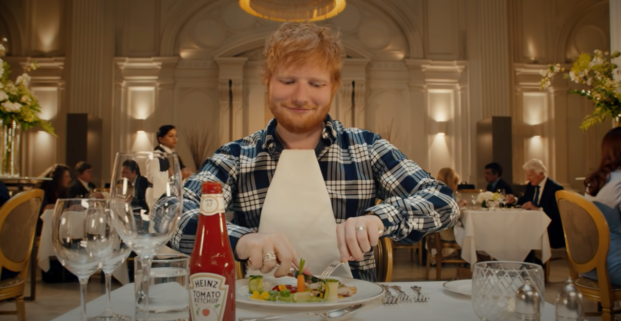
Notes:
Tell students that they are going to watch three short commercials, and as they watch each commercial, they need to write down their observations and any questions they may have. To play the video, click the image on the slide or paste the following link into your web browser: https://www.youtube.com/watch?v=keOaQm6RpBg
Video source: Heinz. (2019, June 17). Ed's Heinz Ad [Video]. YouTube. https://www.youtube.com/watch?v=keOaQm6RpBg

Slide 9
What did you notice? What do you wonder?

Slide 10
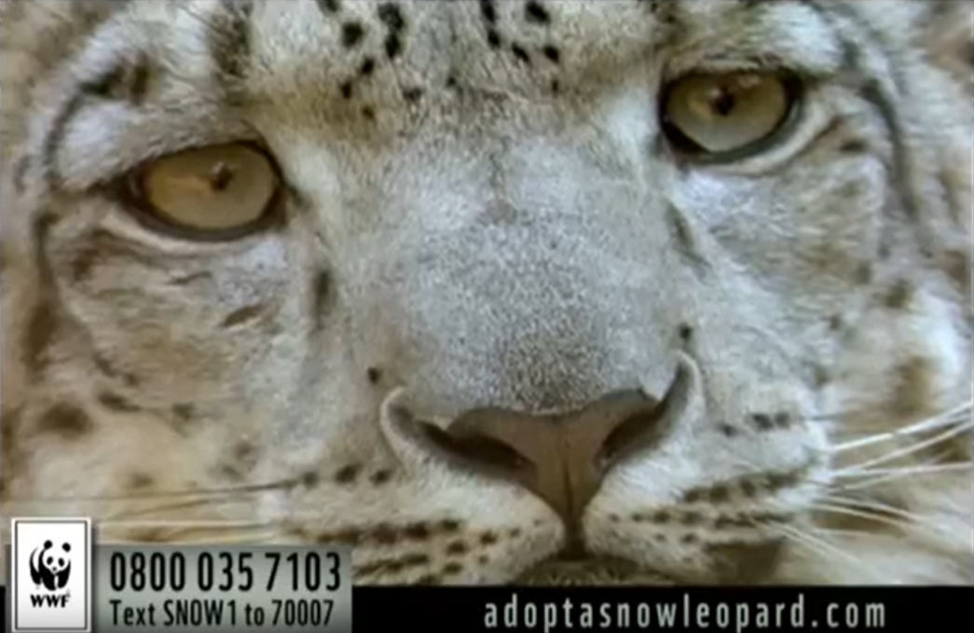
Notes:
Tell students that they are going to watch three short commercials, and as they watch each commercial, they need to write down their observations and any questions they may have. Click the picture, the link in the citation, or this link to watch the commercial: https://youtu.be/nvEgCg1yh30
Video source: NiceCrane287. (2012, July 28). Adopt a wild snow leopard – WWF [Video]. YouTube. https://youtu.be/nvEgCg1yh30

Slide 11
What did you notice? What do you wonder?

Slide 12
Notes:
Tell students that they are going to watch three short commercials, and as they watch each commercial, they need to write down their observations and any questions they may have. Click the picture, the link in the citation, or this link to watch the commercial: https://youtu.be/PplMjgh_QlM
Video source: AdFreakOne (2009, January 8). Campbell's Soup | "Light Versus” [Video]. YouTube. https://youtu.be/PplMjgh_QlM

Slide 13
What did you notice? What do you wonder?

Slide 14
Think about the play, Julius Caesar. Have any of the characters used these types of appeals (logos, pathos, ethos)?
Notes:
Note: It is not necessary for students to read Julius Caesar prior to completing this lesson, but you should only ask your students this question if they have read the play.

Slide 15
Why-Lighting
Read the speech.
Look for different modes of persuasion in the language. Highlight examples.
When you highlight, notate which mode the highlighted text represents and why.
Notes:
Pass the speech handouts to the students.
Number students off 1 through 3, and then assign the speech with the corresponding number. (If you have three colors of highlighters available, consider the Categorical Highlighting strategy discussed in the next slide.) Students will use this activity as a Jigsaw (see slide 15).
K20 Center. (2020, September 16). Why-lighting. Strategies. https://learn.k20center.ou.edu/strategy/128

Slide 16
Categorical Highlighting
Read the speech.
Using three different colors (one for each mode of persuasion), highlight examples of each mode in the speech.
When you highlight, notate which mode the highlighted text represents and why.
Notes:
K20 Center. (2020, September 16). Categorical highlighting. Strategies. https://learn.k20center.ou.edu/strategy/192

Slide 17
Jigsaw
Find two classmates who read different speeches than you. Form a group of three.
Share what you read in your speech.
What was the mode of persuasion?
Which words or phrases used in the speech helped you determine the mode of persuasion?
Notes:
K20 Center. (2020, September 16). Jigsaw. Strategies. https://learn.k20center.ou.edu/strategy/179

Slide 18
Nicholas Bartell
Nicholas is a theatre educator, adjunct professor, and actor.
He has worked for the Sooner Theatre of Norman, Lyric Theatre of Oklahoma, Norman Public Schools, and the University of Oklahoma.
He has taught speech and drama courses to students in all grade levels and college.

Slide 19
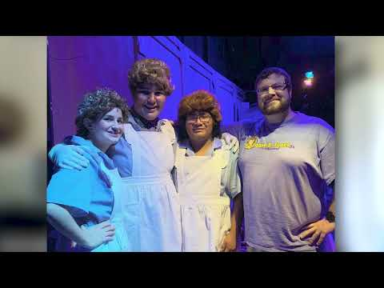
ICAP: Interview with Nicholas Bartell
Notes:
K20 Center. (2022, November 1). K20 ICAP - Words before blows [Video]. YouTube. https://www.youtube.com/watch?v=VXsRzFblGNI

Slide 20
3-2-1
What are 3 things you learned about having a career in the theatre world?
What are 2 things you would do if you wanted to become an actor?
What is 1 thing Nicholas said that really resonated with you?
Notes:
K20 Center. (2020, September 16). 3-2-1. Strategies. https://learn.k20center.ou.edu/strategy/117

Slide 21
Should Caesar have been assassinated? (CER) Persuade the citizens to join with Brutus and Cassius or with Mark Antony and the triumvirate.
Choose a mode of appeal (ethos, pathos, or logos).
Write a claim about whether Julius Caesar should have been assassinated or not.
Provide evidence from the play for your claim.
Provide your reasoning for how the evidence justifies the claim.
Notes:
K20 Center. (n.d.). Claim, Evidence, Reasoning (CER). Strategies. https://learn.k20center.ou.edu/strategy/156

