Slide 2
Function Junction
Introduction to Functions

Slide 3
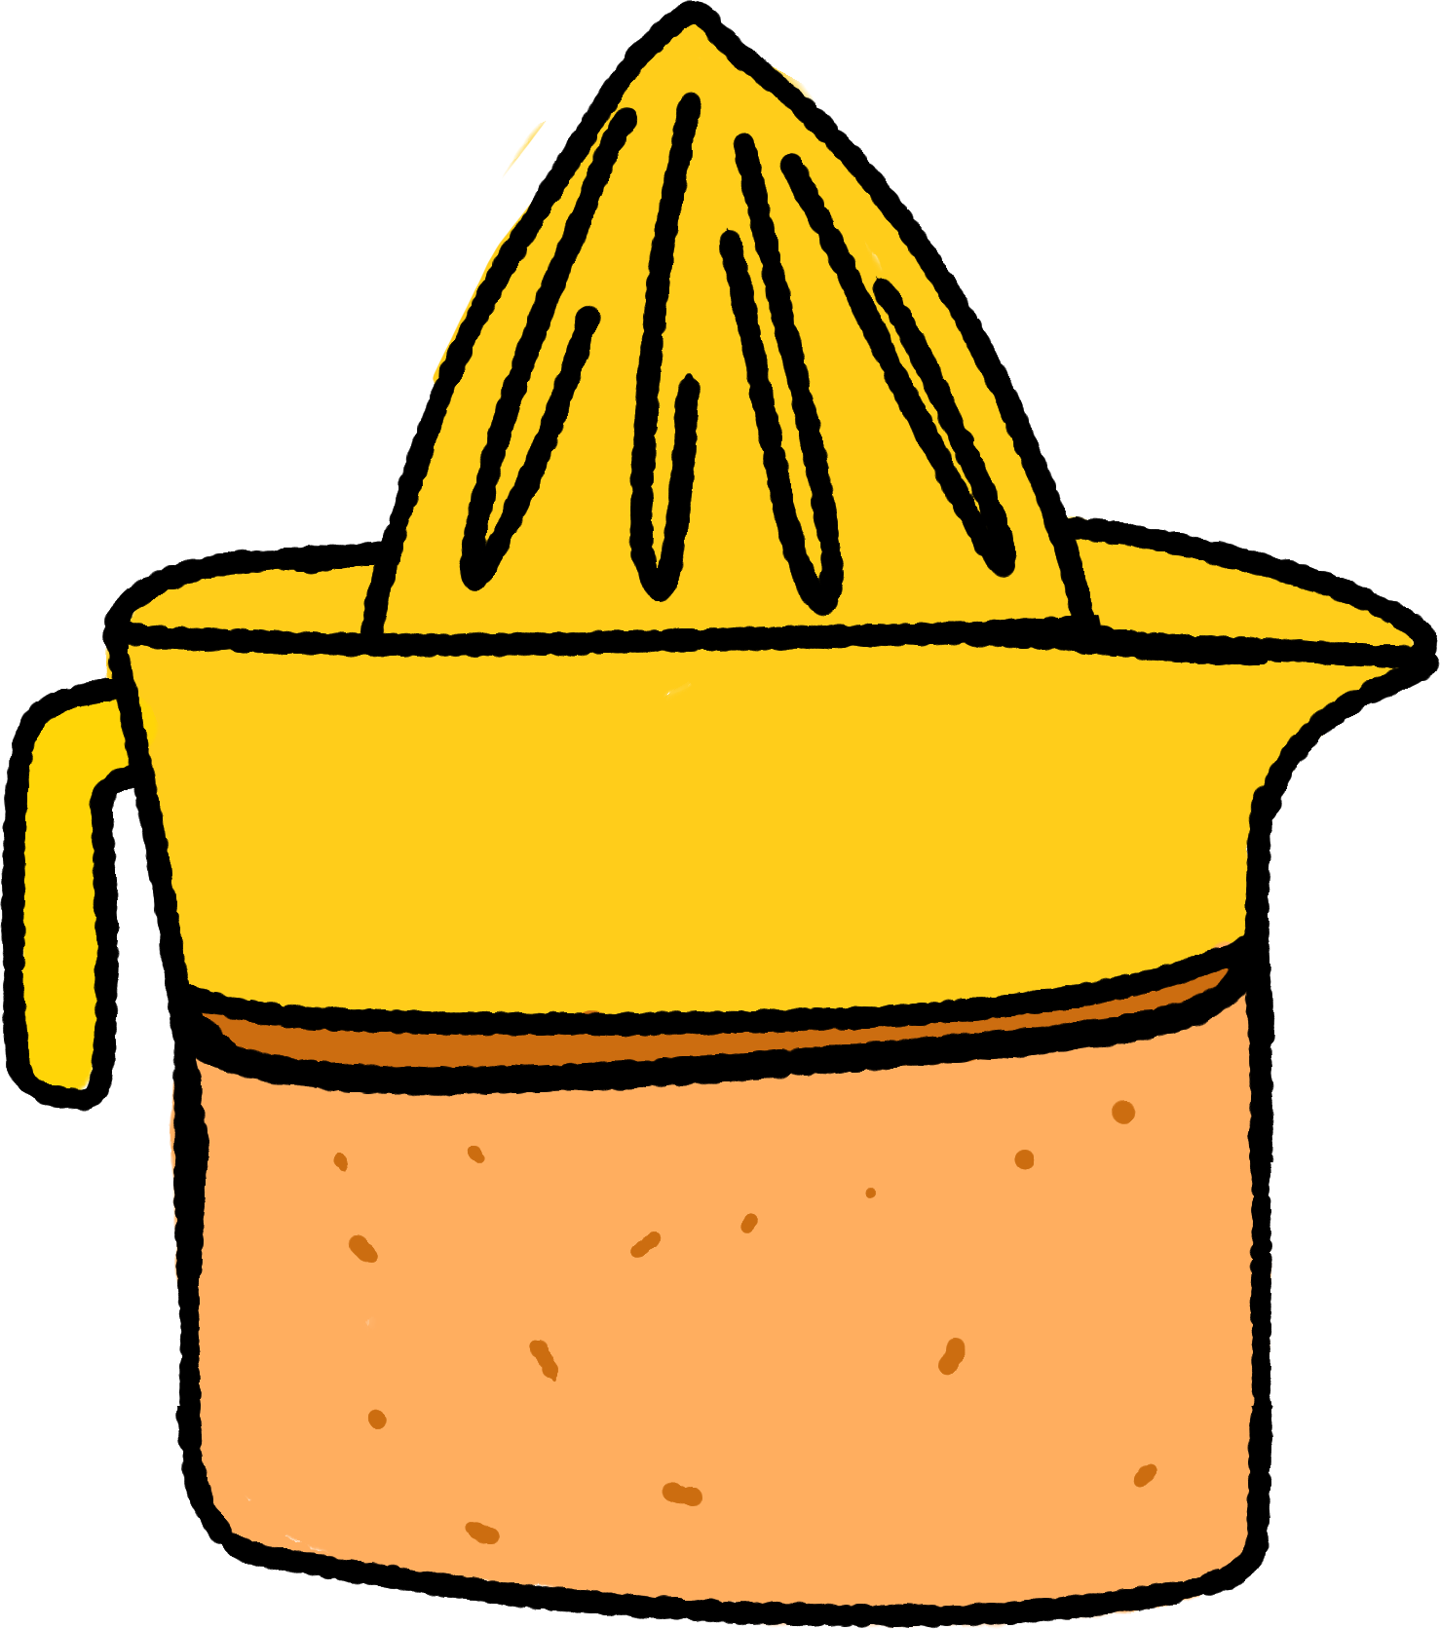
Riddle Me This…
What do a toaster, a juicer, and a paper shredder have in common?
Notes:
K20 Center. (n.d.). Think-Pair-Share. Strategies. https://learn.k20center.ou.edu/strategy/139

Slide 4
They Have Inputs and Outputs!
outputs
inputs

Slide 5
Essential Question
How can we represent relations?

Slide 6
Lesson Objectives
Determine if a relation is or is not a function.
Identify the independent and dependent variables and the domain and range of a given function.

Slide 7
Finding Patterns
Work with your partner to find the pattern for each set of problems.
Use the pattern to complete all problems in each set.

Slide 8
Finding Patterns (Sample Responses)

Slide 9
Finding Patterns (Sample Responses)

Slide 10
Finding Patterns: Summary
How did you know what to do?
What patterns did you notice?

Slide 11
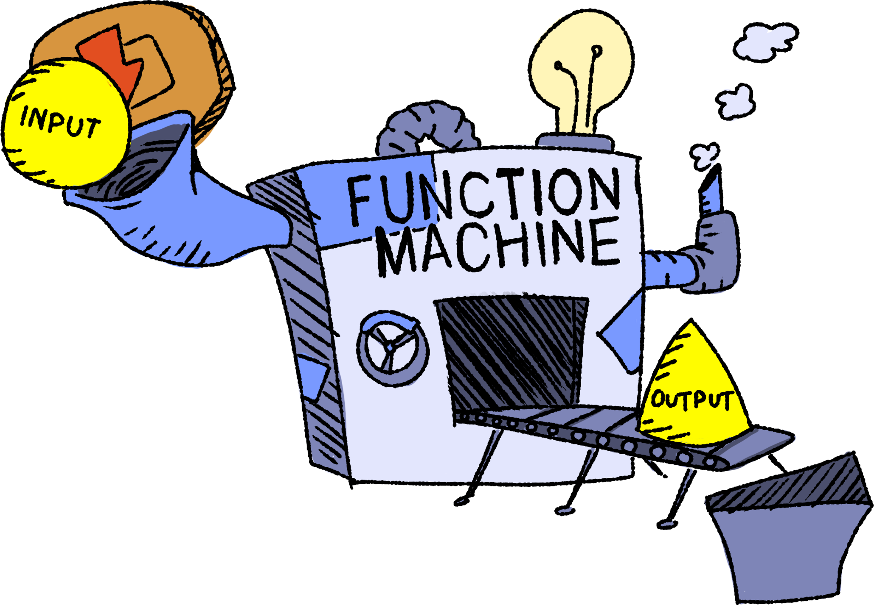
Guided Notes: Vocabulary
input: the independent variable
output: the dependent variable
function: a relation where each input has only one output

Slide 12
Guided Notes: Vocabulary
domain: set of all possible inputs
range: set of all possible outputs

Slide 13
Guided Notes: Notation
input
output
the value of the f function at a given x-value

Slide 14
Guided Notes: Examples
If a toaster is a function of the bread slice put into it, then what would be the input and what would be the output?

Slide 15
Guided Notes: Examples
Input: bread slice: b
Function: toaster: T( )
Output: toasted bread slice: T(b)
How would you describe the domain and range?

Slide 16
Guided Notes: Examples
Input: bread slice: b
Function: toaster: T( )
Output: toast: T(b)
Domain: what our input can be: {things that fit in the toaster}
Range: what our output can be: {toasted things}

Slide 17
Guided Notes: Examples
Juicer: J
fruit: f
juice drink: d
What would J(f ) mean?
What would be the input?
What would be the output?
Describe the domain of J(f ).
Describe the range of J(f ).

Slide 18
Guided Notes: Examples
What would J(f ) mean? J(f ) is the output
What would be the input? f, the fruit
What would be the output? J(f ) or d, the juice
Describe the domain of J(f ). Anything you could press with the juicer
Describe the range of J(f ). The liquid you would get out of the juicer

Slide 19
Guided Notes: Examples
How could we use function notation for the paper shredder? What is the input, function, and output?

Slide 20
Guided Notes: Examples (Sample Response)
paper: p
shredder: S
shredded paper: t
S(p) would be the output (shredded paper) of the shredder function.

Slide 21
Numbered Heads Together
Everyone in your group needs a different number: 1–4
Write this number on your handout.
Work together to find the rule.
Prepare to individually share what your group discussed.
Notes:
K20 Center. (n.d.). Numbered heads together. Strategies. https://learn.k20center.ou.edu/strategy/2476

Slide 22
Guess My Rule: Relation 1
Input: _____ |  | Output: _____
triangle |  | 3
square |  | 4
hexagon |  | 6
rectangle |  | 4
octagon |  | 8
Rule: _________
_____________
_____________

Slide 23
Guess My Rule: Relation 1
Number of sides of a polygon
Input: _____ |  | Output: _____
triangle |  | 3
square |  | 4
hexagon |  | 6
rectangle |  | 4
octagon |  | 8
p
Rule: _________
_____________
_____________
N(p)
Domain
Range

Slide 24
Guess My Rule: Relation 2
Input: _____ |  | Output: _____
a |  | 1
m |  | 2
i |  | 1
t |  | 2
y |  | 1, 2
Rule: _________
_____________
_____________

Slide 25
Guess My Rule: Relation 2
1 if the letter is a vowel, 2 if the letter is a consonant
Input: _____ |  | Output: _____
a |  | 1
m |  | 2
i |  | 1
t |  | 2
y |  | 1, 2
l
Rule: _________
_____________
_____________
_____________
_____________
v
Not a Function

Slide 26
Guess My Rule: Relation 3
Input: _____ |  | Output: _____
5 |  | –10
–3 |  | 6
2 |  | –4
–1 |  | 2
0 |  | 0
Rule: _________
_____________
_____________

Slide 27
Guess My Rule: Relation 3
Multiply by negative 2
Input: _____ |  | Output: _____
5 |  | –10
–3 |  | 6
2 |  | –4
–1 |  | 2
0 |  | 0
n
Rule: _________
_____________
T(n)
Domain
Range

Slide 28
Guess My Rule: Relation 4
Input: _____ |  | Output: _____
2 |  | 4
4 |  | 16
5 |  | 25
0 |  | 0
–1 |  | 1
Rule: _________
_____________
_____________

Slide 29
Guess My Rule: Relation 4
Multiply the number by itself (square it)
Input: _____ |  | Output: _____
2 |  | 4
4 |  | 16
5 |  | 25
0 |  | 0
–1 |  | 1
d
Rule: _________
_____________
_____________
_____________
S(d)
Domain
Range

Slide 30
Guess My Rule: Relation 5
Input: _____ |  | Output: _____
3 |  | 3
4 |  | 2, 4
5 |  | 5
6 |  | 2, 3, 6
7 |  | 7
Rule: _________
_____________
_____________

Slide 31
Guess My Rule: Relation 5
List the factors of the number, except for 1
Input: _____ |  | Output: _____
3 |  | 3
4 |  | 2, 4
5 |  | 5
6 |  | 2, 3, 6
7 |  | 7
c
Rule: _________
_____________
_____________
_____________
F(c)
Domain
Range

Slide 32
Guess My Rule: Relation 6
Input: _____ |  | Output: _____
–1 |  | –1
3
–2
2
Rule: _________
_____________
_____________

Slide 33
Guess My Rule: Relation 6
1 over the number or multiplicative inverse of the number
Input: _____ |  | Output: _____
–1 |  | –1
3
–2
2
x
Rule: _________
_____________
_____________
_____________
_____________
M(x)
Domain
Range

Slide 34
How Do Search Engines Work?
Is a search engine a function?
If so, what would be the domain? The range?
If not, why not?
Keep these questions in mind as you watch the following video.

Slide 35
How Do Search Engines Work?
How Search Works
Notes:
Google. (2010, March 4). How search works [Video]. YouTube. https://www.youtube.com/watch?v=BNHR6IQJGZs

Slide 36
Two-Minute Paper
Is a search engine a function?
If so, what would be the domain? The range?
If not, why not?
2-Minute Timer
Notes:
K20 Center. (n.d.). Two-minute paper. Strategies. https://learn.k20center.ou.edu/strategy/152
K20 Center. (2021, September 21). K20 Center 2 minute timer [Video]. YouTube. https://youtu.be/HcEEAnwOt2c?si=IjQ0Z14eT1CEtWwS

