Slide 2
Annotating A Text
Style and syntax

Slide 3
Essential Question
How does an author’s writing style give meaning to a text?

Slide 4
Objectives
Students will analyze and annotate an article.
Students will write an argumentative paragraph.

Slide 5
Word Bank: Dashing Through the Snow
Write a sentence containing two or more of the words from the Word Bank.
boys |  | fear |  | speed
 | stuck |  | careful
teenage |  | adult |  | snowmobile
 | snow |  | winter

Slide 6
Word Bank: Don’t Box Me In
Write a sentence containing two or more of the words from the Word Bank.
moving |  | boxes |  | packed
 | workmen |  | buy
spiders |  | dogs |  | offer
 | crazy |  | improvements

Slide 7
Prediction
Based on the title, make a prediction about the content of the article. When you receive the article, write your prediction next to the title.

Slide 8
Dashing Through the Snow
Barry, D. (1997). Dashing through the snow. Dave Barry is From Mars and Venus. Crown Publishers.
Skiing is an exciting winter sport, but it is not for everybody. For example, it is not for sane people. Sane people look at skiing, and they say: “WAIT a minute. I’m supposed to attach slippery objects to my feet and get on a frozen chair dangling from a scary-looking wire; then get dumped off on a snow-covered slope so steep that the mountain goats are wearing seat belts; and then, if by some miracle I am able to get back down without killing myself, I’m supposed to do this AGAIN??”
As I get older--which I am currently doing at the rate of about five years per year--this is more and more how I view skiing. I’ve been looking for an alternative winter sport that does not force a person to become so intimately involved with gravity. And so I recently went to Idaho (official state motto: “Convenient to Montana”) to experience two winter sports that seemed better-suited to the mature sportsperson in the sense you can do them while sitting down. In an effort to make my trip as tax-deductible as humanly possible, I’ve decided to write a two-part series about these sports. This week’s Featured Winter Sport is: snowmobiling.

Slide 9
Don’t Box Me In
Barry, D. (1991). Don’t Box Me In. Dave Barry Talks Back. Crown Publishers.
We’re moving again. We’re not moving far: Maybe two miles, as the heat-seeking radar-equipped South Florida Stealth Mosquito flies. It’s hard to explain why we’re doing this. Call it a crazy whim. We just woke up one morning and said, “I know! Let’s put everything we own into boxes!”
And that’s what we’re doing. The giant cardboard mines of Peru are working overtime to meet our box needs, because we have a LOT of stuff that we need to take, including many precious heirlooms such as our calculator in which all the keys work perfectly except for the “4,” and our complete, mint-condition set of 1978 VISA statements (try replacing THOSE at today’s prices). Stuffwise, we are not a lean operation. We’re the kind of people who, if we were deciding what absolute minimum essential items we’d need to carry in our backpacks for the final, treacherous ascent to the summit of Mount Everest, would take along these aquarium filters, just in case.

Slide 10
Paragraphs
Number each paragraph of the article.

Slide 11
Reading Prompt
As you read, notice the author’s word choice and use of hyperbole.
Write this question at the top of the page:
“How does Barry use exaggeration to communicate his message?”

Slide 12
How to mark the text:
Highlight examples of hyperbole (exaggeration) and write the meanings in the margin
Circle key terms, repeated words, or examples of strong diction
Underline main ideas and summarize them in the margins
Draw arrows to label connections noticed in the text
Write questions in the margins next to sections that are unclear or cause the reader to wonder something

Slide 13
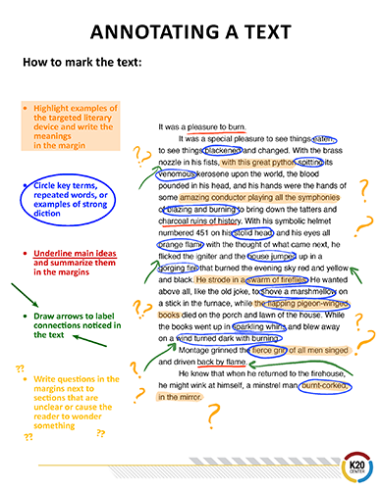

Slide 14
Dashing Through the Snow
Barry, D. (1997). Dashing through the snow. Dave Barry is From Mars and Venus. Crown Publishers.
Skiing is an exciting winter sport, but it is not for everybody. For example, it is not for sane people. Sane people look at skiing, and they say: “WAIT a minute. I’m supposed to attach slippery objects to my feet and get on a frozen chair dangling from a scary-looking wire; then get dumped off on a snow-covered slope so steep that the mountain goats are wearing seat belts; and then, if by some miracle I am able to get back down without killing myself, I’m supposed to do this AGAIN??”
As I get older--which I am currently doing at the rate of about five years per year--this is more and more how I view skiing. I’ve been looking for an alternative winter sport that does not force a person to become so intimately involved with gravity. And so I recently went to Idaho (official state motto: “Convenient to Montana”) to experience two winter sports that seemed better-suited to the mature sportsperson in the sense you can do them while sitting down. In an effort to make my trip as tax-deductible as humanly possible, I’ve decided to write a two-part series about these sports. This week’s Featured Winter Sport is: snowmobiling.

Slide 15
Don’t Box Me In
Barry, D. (1991). Don’t Box Me In. Dave Barry Talks Back. Crown Publishers.
We’re moving again. We’re not moving far: Maybe two miles, as the heat-seeking radar-equipped South Florida Stealth Mosquito flies. It’s hard to explain why we’re doing this. Call it a crazy whim. We just woke up one morning and said, “I know! Let’s put everything we own into boxes!”
And that’s what we’re doing. The giant cardboard mines of Peru are working overtime to meet our box needs, because we have a LOT of stuff that we need to take, including many precious heirlooms such as our calculator in which all the keys work perfectly except for the “4,” and our complete, mint-condition set of 1978 VISA statements (try replacing THOSE at today’s prices). Stuffwise, we are not a lean operation. We’re the kind of people who, if we were deciding what absolute minimum essential items we’d need to carry in our backpacks for the final, treacherous ascent to the summit of Mount Everest, would take along these aquarium filters, just in case.

Slide 16
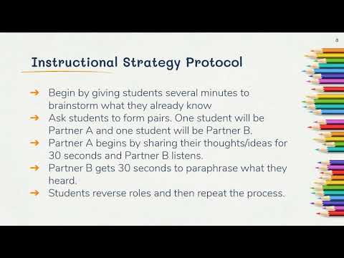
30-Second Expert

Slide 17
30-Second Expert
In pairs, you will take turns as the speaker and as the listener.
The speakers will share how annotation helps them analyze the text and determine the author’s purpose and point of view. Each student will have only 30 seconds to share. The speaker starts out by stating, “I am an expert on this topic because I know…” and finish with the information you are sharing.
When the speaker has finished, the listener will say, “According to (partner’s name),” then summarize what their partner just shared.
The listener should then ask, “Did I get that right?”
After the speaker clears up any misconceptions, each student should record any new information gained on their paper.
The students will then reverse roles of speaker and listener and go through the process again.

Slide 18
Word Bank: Dashing Through the Snow
boys |  | fear |  | speed
 | stuck |  | careful
teenage |  | adult |  | snowmobile
 | snow |  | winter
Go back to the original sentence you wrote using some or all of these words. Using your annotated article, either revise your original sentence or write completely new sentences using the vocabulary words in the word bank.

Slide 19
Word Bank: Don’t Box Me In
moving |  | boxes |  | packed
 | workmen |  | buy
spiders |  | dogs |  | offer
 | crazy |  | improvements
Go back to the original sentence you wrote using some or all of these words. Using your annotated article, either revise your original sentence or write completely new sentences using the vocabulary words in the word bank.

Slide 20

Exit Ticket
Share your responses to this question:
“How do writers use exaggeration to communicate messages in creative and interesting ways?”

