Slide 2
Should I Get My Mole Checked Out?
Using Indirect Measurements to Determine Mole Ratios

Slide 3
Essential Question
How can we best measure that which we cannot directly see?

Slide 4
Lesson Objectives
Carry out an investigation to determine optimal ratios of reactants.
Connect personal experiences to the struggles of scientists.

Slide 5
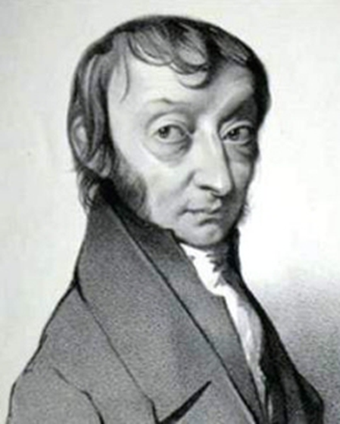
Amedeo Avogadro
Italian chemist Amedeo Avogadro first published his hypothesis, which stated the directly proportional relationship between volume of gas and quantities of gas molecules, in 1811.
For more than 50 years, many scientists disagreed over whether it was true.
The argument was not settled until after Avogadro’s death when, in 1857, Rudolf Clausius provided sufficient evidence to prove the theory.
Amedeo Avogadro
1776-1856
Notes:
Causey, R.L. (1971). Avogadro’s hypothesis and the Duhemian pitfall. Journal of Chemical Education, 48(6), 365-367. https://doi.org/10.1021/ed048p365

Slide 6
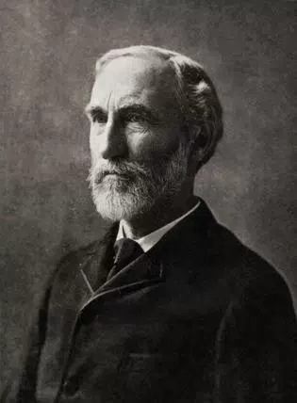
Why Did It Take So Long to Confirm the Hypothesis?
The short answer: Because too many things were unknown at the time.
Pierre Duhem is credited with presenting the main issue of testing hypotheses.
Usually, it is impossible to test just one hypothesis at a time—so multiple hypotheses are tested at one time. So how does a scientist determine whether the results support one hypothesis or another?
Pierre Duhem
Notes:
Wikipedia. (n.d.). Pierre Duhem. [Digital Image]. https://en.wikipedia.org/wiki/Pierre_Duhem#:~:text=Pierre%20Duhem%20believed%20that%20experimental%20theory%20in%20physics,all%20concepts%20are%20connected%20to%20each%20other%20logically.

Slide 7
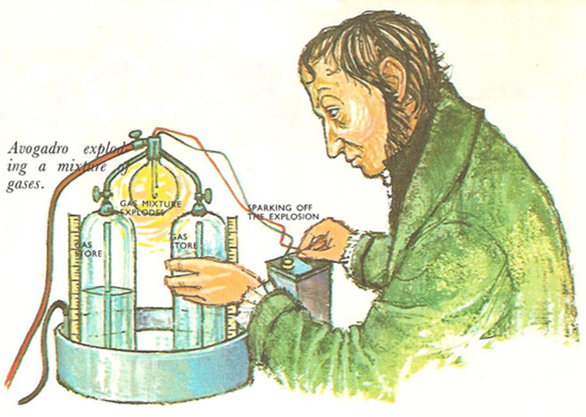
Too Many Unanswered Questions
Scientists did not think it was a bad hypothesis, but too many questions had not been answered.
  What is the structure of an atom?
  How do atoms bond together?
  Do molecules actually exist?
Notes:
Darling, David. (n.d.). Amedeo Avogadro. [Digital Image]. https://www.daviddarling.info/encyclopedia/A/Avogadro.html

Slide 8
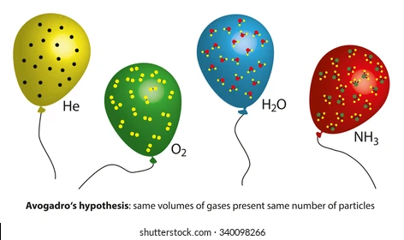
Avogadro’s Unproven Assumptions
Gas molecules are made from more than one atom (polyatomic).
Molecules are polyatomic in certain ways.
Notes:
BrainKart.com. (n.d.). Avogadro Hypothesis. [Digital Image]. https://www.brainkart.com/article/Avogadro-Hypothesis_39645/

Slide 9
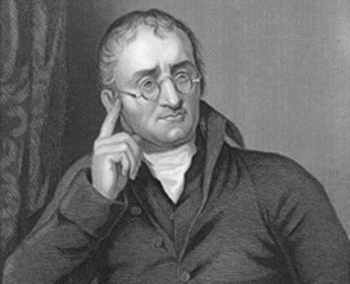
Dalton’s Response to Avogadro’s Hypothesis
John Dalton rejected Avogadro’s hypothesis.
Dalton did not believe the polyatomic molecule theory.
Dalton believed that if a compound were made, it took only one atom of each element.
  Example: Water=HO instead of H₂O
John Dalton
Notes:
Wikipedia. (n.d.). John Dalton. [Digital Image]. https://en.wikipedia.org/wiki/John_Dalton

Slide 10
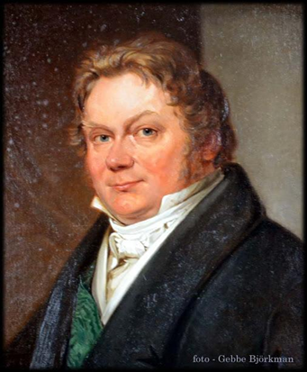
Berzelius’s Response to Avogadro’s Hypothesis
Jons Jacob Berzelius thought all atoms had a charge, so two negatively charged oxygens would not attract and bond together.
He agreed with the idea that equal volumes of two gases contained the same number of atoms, but they were not molecules.
Jons Jacob Berzelius
Notes:
Wikipedia. (n.d.). Jons Jacob Berzelius. [Digital Image]. https://en.wikipedia.org/wiki/J%C3%B6ns_Jacob_Berzelius

Slide 11
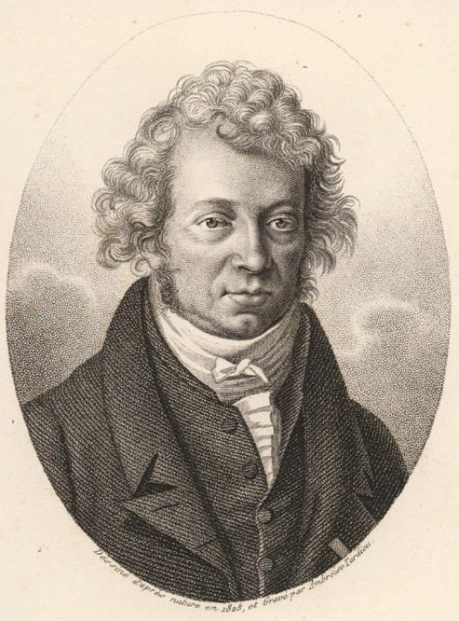
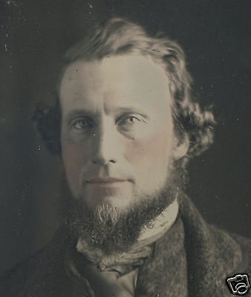
Ampère’s and Gaudin’s Responses to Hypothesis
André-Marie Ampère did not disagree with polyatomic molecules, but he guessed the wrong chemical formulas.
Marc Gaudin, one of his students, provided the wiggle room that the molecular formulas could be adjusted, but he was an unknown student whom no one took seriously.
André-Marie Ampère
M. A. A. Gaudin
Notes:
Wikipedia. (n.d.). Andre-Marie Ampere. [Digital Image]. https://en.wikipedia.org/wiki/Andr%C3%A9-Marie_Amp%C3%A8re
Wikipedia. (n.d.). Marc Antoine August Gaudin. [Digital Image]. https://en.wikipedia.org/wiki/Marc_Antoine_Auguste_Gaudin

Slide 12
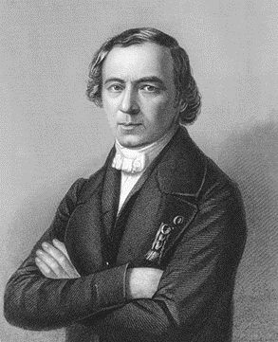
Dumas’s Rejection of Avogadro’s Hypothesis
Famous scientist Jean-Baptiste Dumas flatly refused to accept any of Avogadro’s Hypothesis.
He believed that, instead of the existence of multiple atoms, single atoms could break apart during a chemical reaction.
Jean-Baptiste Dumas
Notes:
Wikipedia. (n.d.). Jean-Baptiste Dumas. [Digital Image]. https://en.wikipedia.org/wiki/Jean-Baptiste_Dumas

Slide 13
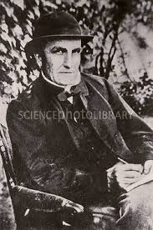
Waterson’s Support of the Hypothesis
By 1845, Scottish physicist J. J. Waterson had unsuccessfully attempted to publish a paper supporting Avogadro’s Hypothesis.
Waterson tried to connect the hypothesis with the Law of Combining Volumes, which states that volumes are additive.
John James Waterson
Notes:
Wikipedia. (n.d.). John James Waterson. https://en.wikipedia.org/wiki/John_James_Waterston

Slide 14
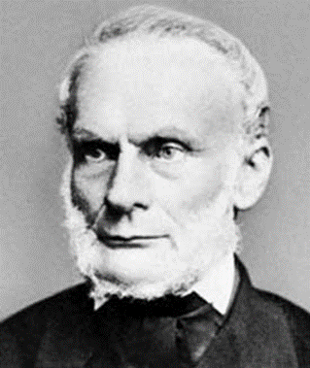
Clausius’s Validation of the Hypothesis
In 1857, German physicist and mathematician Rudolf Clausius published an article stating that energy does exist between two atoms bonded together.
He argued that bonds can be broken and reformed.
This argument made polyatomic molecules very possible, thus supporting Avogadro’s Hypothesis.
Rudolf Clausius
Notes:
Wikipedia. (n.d.). Rudolf Clausius. [Digital Image]. https://en.wikipedia.org/wiki/Rudolf_Clausius

Slide 15
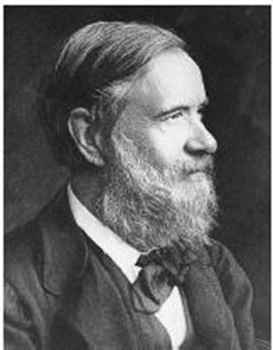
Final Validation of the Hypothesis
In 1860, highly regarded and influential Italian chemist Stanislao Cannizzaro took what Clausius had said further.
He used Avogadro’s Hypothesis to show a systematic way to determine atomic and molecular weights existed.
This was the step needed for the general scientific community to finally accept the hypothesis as scientific truth.
Stanislao Cannizzaro
Notes:
Wikipedia. (n.d.) Stanislao Cannizzaro. [Digital Image]. https://en.wikipedia.org/wiki/Stanislao_Cannizzaro

