Slide 2
Building Arguments with Evidence
English language arts
Grade 10

Slide 3
Essential Question
What techniques do writers use to convince their readers?

Slide 4
Learning Objective
Students will construct an argument using a claim, evidence, and reasoning.

Slide 5
Activating Prior Knowledge:
The Greatest Issue Facing Youth Today
What are three things you learned and now know from the previous lesson?

Slide 6
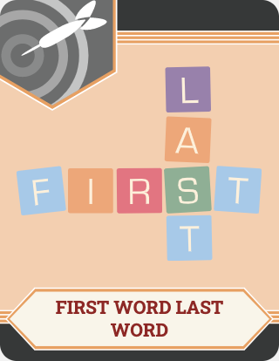

I Notice, I Wonder
As you watch the upcoming video, write down five things you notice.

Slide 7


Slide 8
I Notice, I Wonder
Now that you have watched the video, what are two things you wonder?

Slide 9
Constructing a Written Argument
Go to the NY Times Website
Choose any topic with accompanying article that you find important.
On a scrap piece of paper, write for ONE MINUTE: Explain why you have chosen your topic. Do not worry about spelling or grammar.
Turn to an elbow partner and explain why you are choosing your topic/article.

Slide 10

Constructing a Written Argument
Copy and paste your article into a Google Doc.
Use the Why-Lighting strategy to highlight any passage(s) you find important. Comment on the passage(s) in the margin(s) and explain why you chose the passage(s).

Slide 11
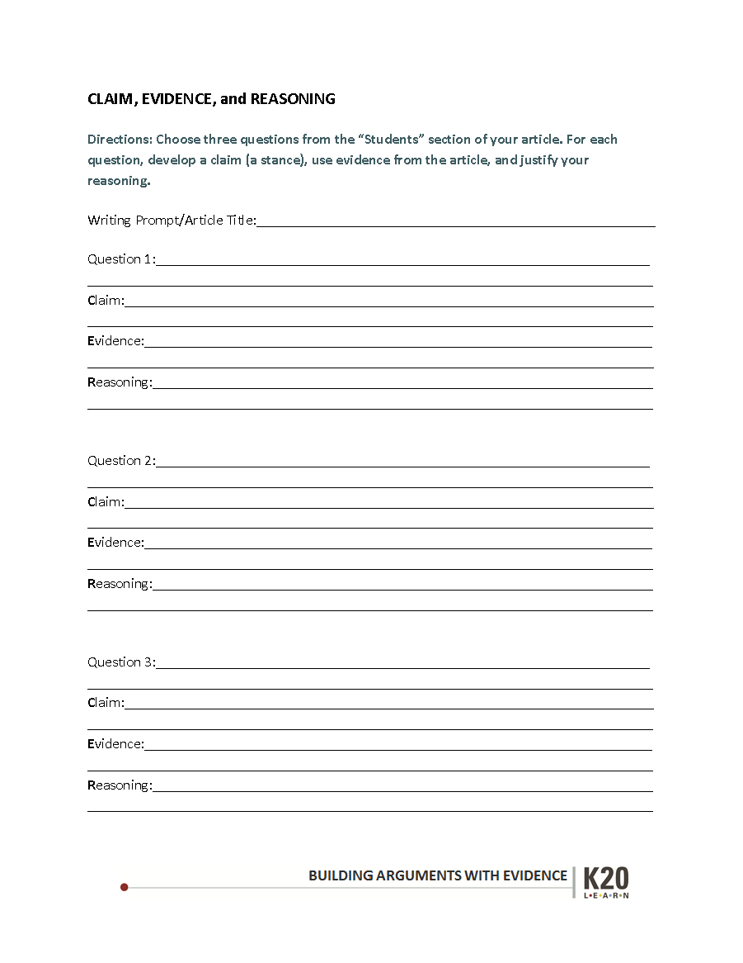
C-E-R
Complete at least THREE questions at the bottom of the prompt/article you chose, in the STUDENTS section. Write the questions you chose in the QUESTIONS sections of your handout.

Slide 12
C-E-R
Now you will be crafting your response, using a claim, evidence, and reasoning.
Claim: Original response
Evidence: Support from the article
Reasoning: Explanation

Slide 13
Argument Outline
Use the argument outline to construct a thesis and develop your essay.
THESIS: the guiding, arguable statement or claim an essay attempts to prove
through evidence and reasoning.

