Slide 2
Risk and Reward
Discrete Random Variables and Probability Distribution

Slide 3
Essential Question
How do I determine the likelihood of the outcomes of a scenario?

Slide 4
Lesson Objectives
Calculate the probability, the mean (expected value), and the standard distribution of a discrete random variable.
Represent the probability distribution for a discrete random variable as a graph and as a table.

Slide 5
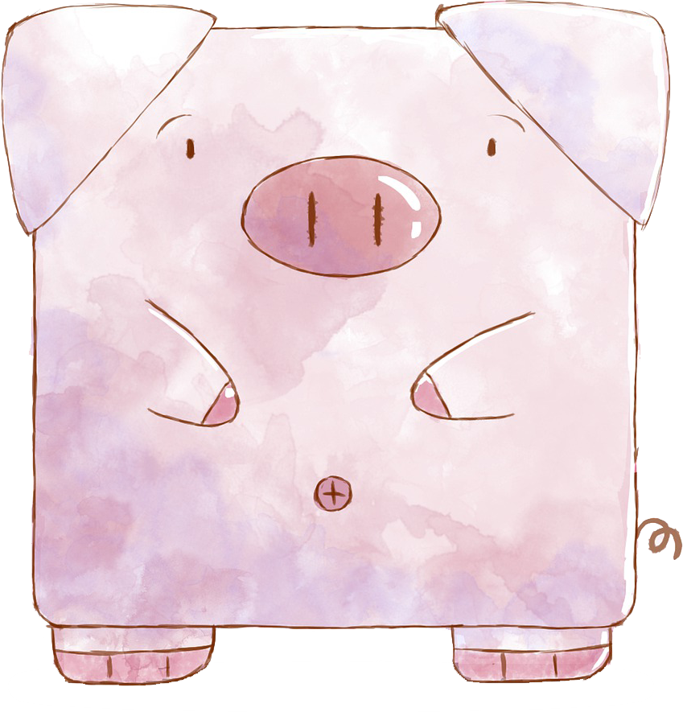
Greedy Pig
This game has five rounds and is played with partners.
If you roll a 1 or 3–6, write down that number as points you earned.
However, if you roll a 2, you lose all points for that round, and the round ends.
You may choose to stop rolling and end the round at any time.
If your partner chooses to end their round, you can keep playing.
Each person needs to keep track of their own score.
Notes:
Minas, M. (2020, March 30). Greedy Pig. [Video]. YouTube. https://youtu.be/4KgRfUwpxPU
Kanyawath, K. [Once1nuenG] (2019, August 21). Pig. [Illustration]. Pixabay. https://pixabay.com/illustrations/pig-cartoon-pig-cartoon-animal-4417320/

Slide 6
Greedy Pig: Example
Player 1 | Score Each Round | Total Points
Round 1 |  | 0
Player 2 | Score Each Round | Total Points
Round 1 |  | 11
Notes:
Minas, M. (2020, March 30). Greedy Pig. [Video]. YouTube. https://youtu.be/4KgRfUwpxPU
Kanyawath, K. [Once1nuenG] (2019, August 21). Pig. [Illustration]. Pixabay. https://pixabay.com/illustrations/pig-cartoon-pig-cartoon-animal-4417320/

Slide 7
Greedy Pig: Class Discussion
How did you decide when to end your round?
What are some possible strategies to maximize your score?
Notes:
Kanyawath, K. [Once1nuenG](2019, August 21). Pig. [Illustration]. Pixabay. https://pixabay.com/illustrations/pig-cartoon-pig-cartoon-animal-4417320/

Slide 8
Greedy Pig: Class Top Scores
Let’s find out the two top scorers!
For the two top scorers:
What were your scores?
What were your strategies?
Notes:
Kanyawath, K. [Once1nuenG](2019, August 21). Pig. [Illustration]. Pixabay. https://pixabay.com/illustrations/pig-cartoon-pig-cartoon-animal-4417320/

Slide 9
Heads or Tails: Possible Outcomes
Imagine tossing a fair coin three times. With your elbow partner, complete the handout.
Possible Outcomes | Number of Heads

Slide 10
Heads or Tails: Likelihood
Number of Heads | 0 | 1 | 2 | 3
Probability of That Number of Heads
Do you see a pattern? If so, describe it.
Are TTH and HTT the same outcome? How do you know if the order matters?

Slide 11
Heads or Tails: Sample Response
Possible Outcomes | Number of Heads
HHH HHT HTH HTT THH THT TTH TTT | 3 2 2 1 2 1 1 0
Number of Heads | 0 | 1 | 2 | 3
Probability of That Number of Heads

Slide 12
Definitions
Random variables: A numerical representation of an outcome from a random experiment
Notation: Use the capital letter X.
Examples:
There are two types of random variables: discrete and continuous.

Slide 13
Definitions: Types of Random Variables
Discrete random variables: Values can only be countable numbers (positive integers); typically result from counting something.
Examples:
Continuous random variables: Values can be any number; typically result from measuring something.
Examples:

Slide 14
Definitions
Probability distribution: A table or graph that lists the probability for each outcome

Slide 15
Example 1: Flipping a Fair Coin
Given the probability distribution table, create a histogram to display the data.
 | 0 | 1 | 2 | 3

Slide 16
Example 1: Flipping a Fair Coin
Given the probability distribution table, create a histogram to display the data.
 | 0 | 1 | 2 | 3

Slide 17
Example 1: Flipping a Fair Coin
Given the probability distribution table, create a histogram to display the data.
 | 0 | 1 | 2 | 3

Slide 18
Example 1: Flipping a Fair Coin
Given the probability distribution table, create a histogram to display the data.
 | 0 | 1 | 2 | 3

Slide 19
Example 1: Flipping a Fair Coin
Given the probability distribution table, create a histogram to display the data.
 | 0 | 1 | 2 | 3

Slide 20
Example 1: Flipping a Fair Coin
Determine P(1 ≤ X ≤ 3).

Slide 21
Example 1: Flipping a Fair Coin
Determine P(1 ≤ X ≤ 3) = P(X = 1 or X = 2 or X = 3)

Slide 22
Example 1: Flipping a Fair Coin
Determine P(1 ≤ X ≤ 3) = P(X = 1 or X = 2 or X = 3)
= P(X = 1) + P(X = 2) + P(X = 3)
= $\frac{3}{8}+ \frac{3}{8}+ \frac{1}{8}=$

Slide 23
Example 1: Flipping a Fair Coin
Determine P(1 ≤ X ≤ 3) = P(X = 1 or X = 2 or X = 3)
= P(X = 1) + P(X = 2) + P(X = 3)
= $\frac{3}{8}+ \frac{3}{8}+ \frac{1}{8}= \frac{7}{8}$
This means that 87.5% of the time, we should see at least 1 head with 3 coin flips.

Slide 24
Take Note
Each probability, P(X ) , must be between 0 and 1, inclusive: 0 ≤ P(X ) ≤ 1.
The sum of all the possible probabilities is 1: ∑ P(x_{i}) = 1.

Slide 25
Definitions
Mean (expected value): This is not an ordinary average; it is a weighted average
Formula:
Standard deviation:
Notation:

Slide 26
Example 2: Drawing Cards
♡
♤
There is a deck of four cards: an ace of hearts, 2 of hearts, 3 of hearts, and an ace of spades. One card is randomly drawn, replaced, and a second card is drawn. Let X be the sum of the two drawn cards, where the ace has a value of 1.
With your elbow partner, create a probability distribution table and graph.
Notes:
K20 Center. (n.d.). Elbow Partners. Strategies. https://learn.k20center.ou.edu/strategy/116

Slide 27
Example 2: Drawing Cards
♡
♤
Sample Space
A♡, A♡ | 2
A♡, 2♡ | 3
A♡, 3♡ | 4
A♡, A♤ | 2
2♡, A♡ | 3
2♡, 2♡ | 4
2♡, 3♡ | 5
2♡, A♤ | 3
Sample Space
3♡, A♡ | 4
3♡, 2♡ | 5
3♡, 3♡ | 6
3♡, A♤ | 4
A♤, A♡ | 2
A♤, 2♡ | 3
A♤, 3♡ | 4
A♤, A♤ | 2
2
3
4
5
6
Notes:
K20 Center. (n.d.). Elbow Partners. Strategies. https://learn.k20center.ou.edu/strategy/116

Slide 28
Example 2: Drawing Cards
♡
♤
2
3
4
5
6
Notes:
K20 Center. (n.d.). Elbow Partners. Strategies. https://learn.k20center.ou.edu/strategy/116

Slide 29
Example 2: Drawing Cards
♡
♤
2
3
4
5
6
Notes:
K20 Center. (n.d.). Elbow Partners. Strategies. https://learn.k20center.ou.edu/strategy/116

Slide 30
Example 2: Drawing Cards
♡
♤
Calculate the expected value and standard deviation.

Slide 31
Example 2: Drawing Cards
♡
♤
Calculate the expected value and standard deviation.
The sum of two randomly selected cards will typically vary from the mean (3.5) by 1.173 units.
Notes:
K20 Center. (n.d.). Elbow Partners. Strategies. https://learn.k20center.ou.edu/strategy/116

Slide 32
Monty Hall Problem
You are on a game show, and you get to choose one out of three doors. One has a car; the other has goats.
Monty Hall, the original host of Let’s Make a Deal, knows where the car is!
Which door do you choose?
Move to the corresponding wall!
1
2
3

Slide 33
Monty Hall Problem
1
3
Monty opens door 2.
There is a goat behind it!
Do you want to pick a different door?

Slide 34
Monty Hall Problem
Should you switch doors? Is there a benefit to switching?

Slide 35
Monty Hall Problem
Should you switch doors? Is there a benefit to switching?
If you switch, you have a 2/3 chance of winning the car.

Slide 36
Monty Hall Problem
Should you switch doors? Is there a benefit to switching?
If you switch, you have a 2/3 chance of winning the car.
If you stick to your original choice, you have a 1/3 chance of winning.

Slide 37
Monty Hall Problem
Should you switch doors? Is there a benefit to switching?
If you switch, you have a 2/3 chance of winning the car.
If you stick to your original choice, you have a 1/3 chance of winning.
You are more likely to win the car if you switch doors.
Why?

Slide 38
Monty Hall Problem
Monty Hall Problem
Notes:
Numberphile. (2014, May 22). Monty Hall Problem [Video]. YouTube. https://youtu.be/4Lb-6rxZxx0

Slide 39
Quality Control Underwriter
You are about to watch a video of Jerimiah Elwell talking about his career and how he uses statistics and probability. Take notes to answer the following after the video.
What discrete random variables does he mention?
Describe a way that he uses statistics and/or probability in his job.
List two new things you learned from the interview.

Slide 40
Quality Control Underwriter
K20 ICAP: Risk & Reward
Notes:
K20 Center. (December 5, 2020). K20 ICAP – Risk & Reward [Video]. YouTube. https://youtu.be/CJ-SdJlLr3U

Slide 41
Quality Control Underwriter
What discrete random variables does he mention?
How does he use statistics and/or probability in his job?
What two new things did you learn?

Slide 42
Choice Board
Answer enough questions to earn 6 points.
1 point | 2 points | 3 points
Fair Dice | Baseball | Create Your Own
Eye Color | Spinner Game | Music
Reflection | Actuaries | Let’s Make a Deal
Notes:
K20 Center. (n.d.). Choice Board. Strategies. https://learn.k20center.ou.edu/strategy/73

