Slide 2
Honor and Remembrance
Stories of the Holocaust

Slide 3
Essential Question
Why should we remember the Holocaust?

Slide 4
Lesson Objectives
Investigate what happened during the Holocaust and the circumstances that led up to World War II.
Learn about the experiences of victims, survivors, and rescuers and then construct honorary plaques that retell their stories.

Slide 5
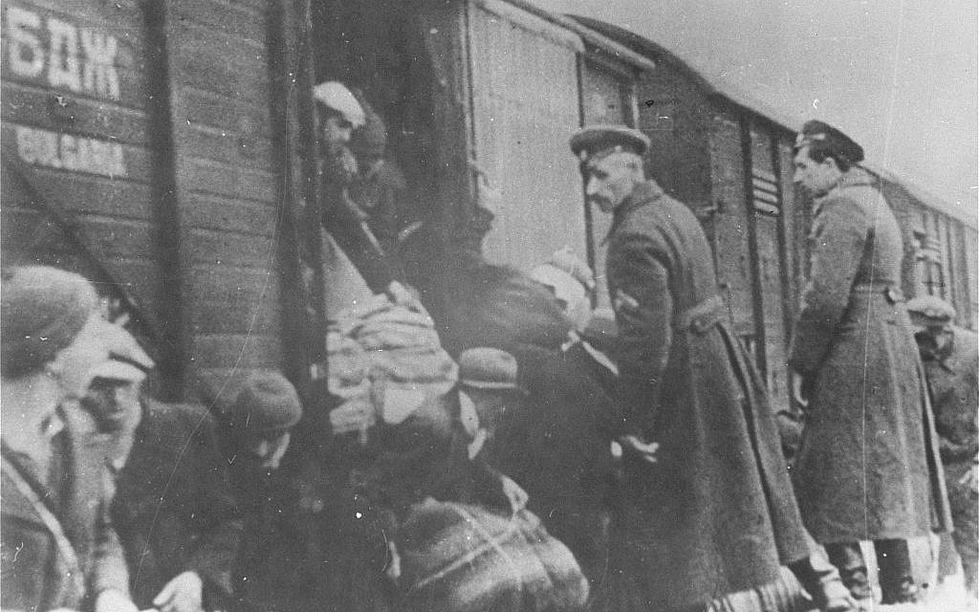
True or False?
Antisemitism, or hatred of Jewish people, did not exist until the Holocaust.
Bulgaria deports Macedonian Jews to Treblinka
Notes:
Unknown photographer. (1943, March 22). Bulgaria deporting the Macedonian Jews to Treblinka. Wikimedia Commons. Retrieved November 1, 2022, from https://commons.wikimedia.org/wiki/File:Bulgaria_deporting_the_Macedonian_Jews.jpg

Slide 6
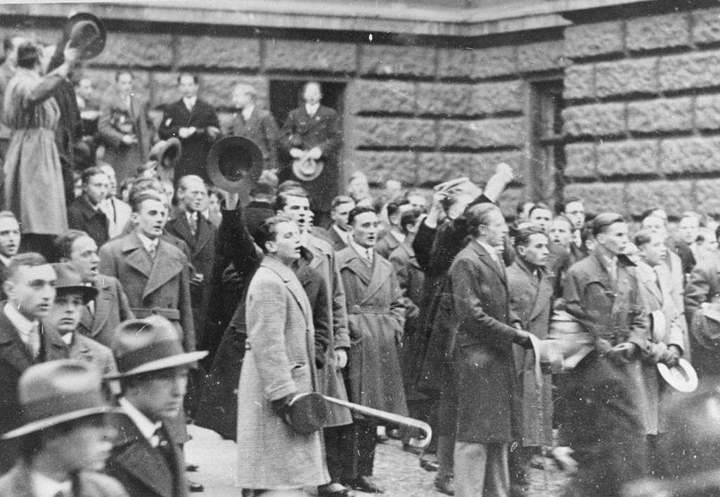
True or False?
              Answer: False
              Antisemitism, which led to the murder of six million Jews during the Holocaust, had existed for centuries prior to the start of the Holocaust.
Students riot at University of Vienna after Nazis attempt to prevent Jews from entering
Notes:
Unknown photographer. (1941, January 1). Students riot at the University of Vienna after Nazi attempt to prevent Jews from entering the university - picryl public domain search. PICRYL. Retrieved November 1, 2022, from https://picryl.com/media/students-riot-at-the-university-of-vienna-after-nazi-attempt-to-prevent-jews-cf83c0

Slide 7
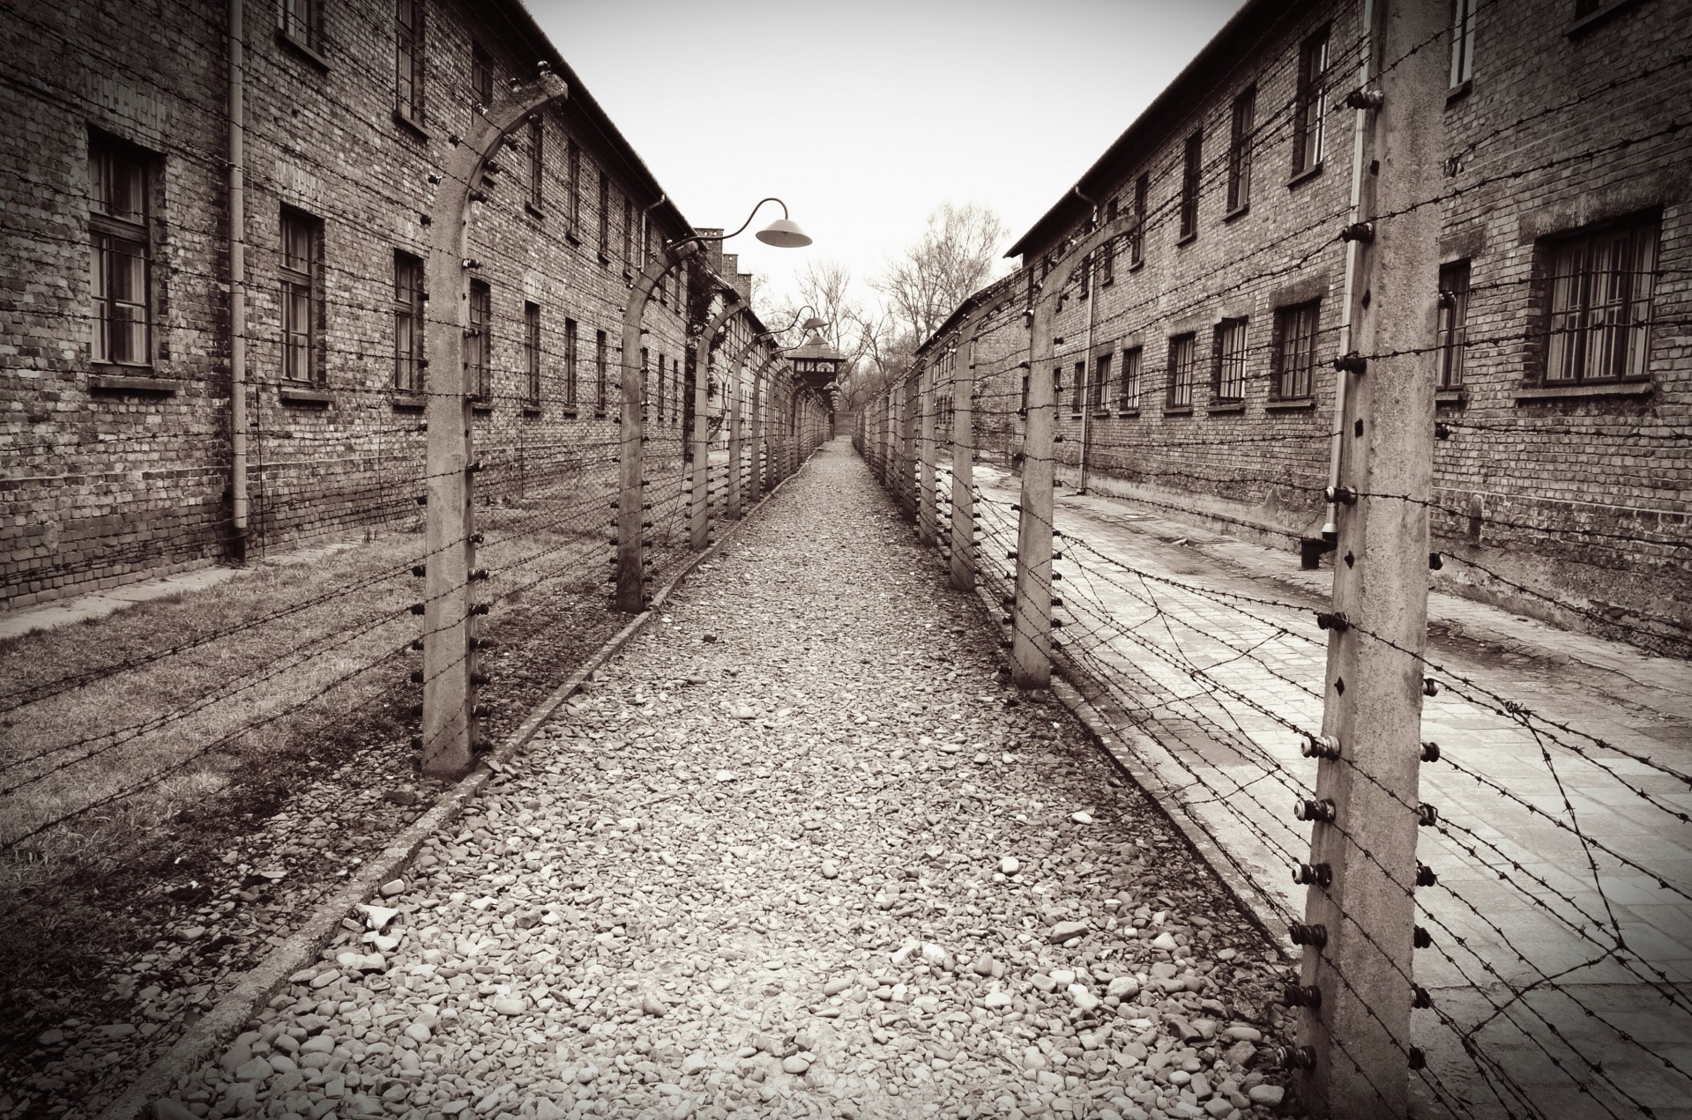
True or False?
The Nazis created only a few concentration camps for prisoners in Europe.
Auschwitz concentration camp
Notes:
Lally, D. (n.d.). Auschwitz/Birkenau. Free Stock Photo - Public Domain Pictures. Retrieved November 1, 2022, from https://publicdomainpictures.net/en/view-image.php?image=92977&picture=auschwitzbirkenau

Slide 8
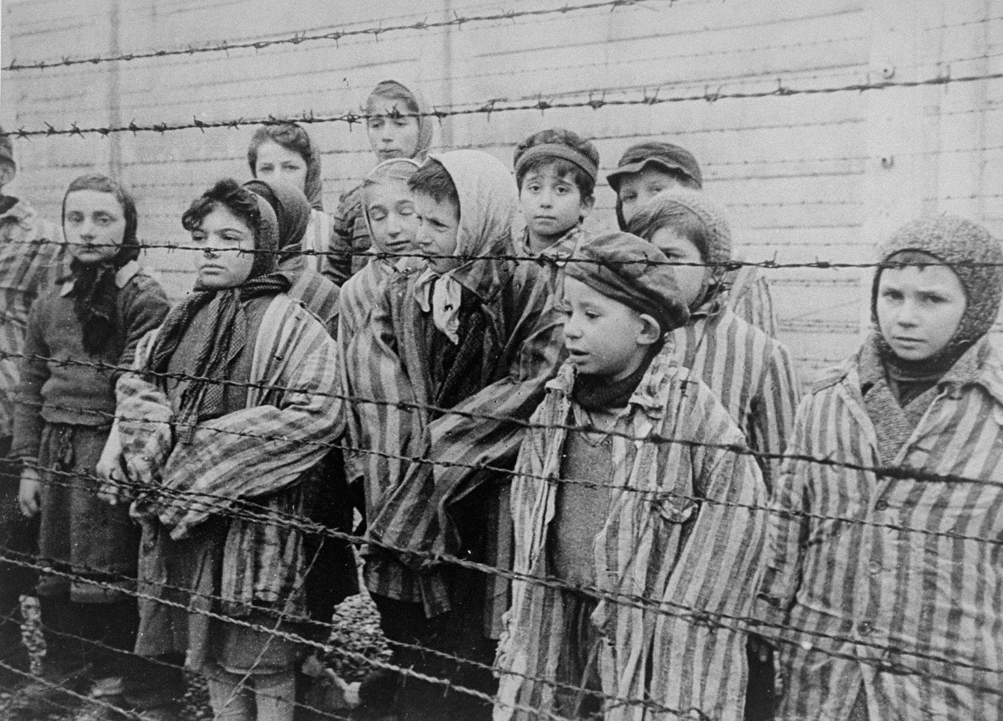
True or False?
              Answer: False
              There were over 43,000 camps. The main kinds of concentration camps were labor camps and extermination (death) camps.
Child survivors of Auschwitz
Notes:
United States Holocaust Memorial Museum. (2015, January 16). 1389.4 holocaust A. Flickr. Retrieved November 1, 2022, from https://www.flickr.com/photos/ushmm/16269109876/in/photostream/

Slide 9
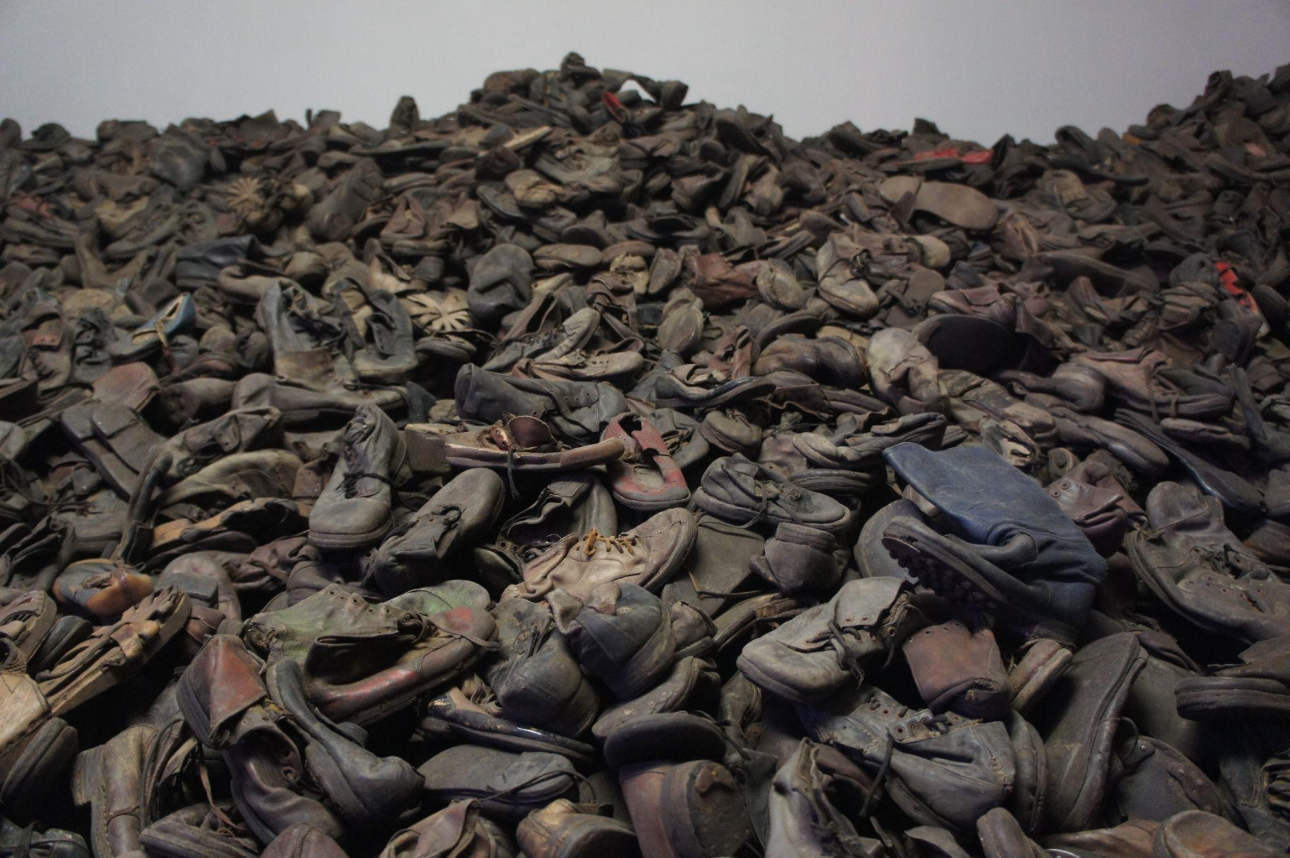
True or False?
Most victims of the Holocaust were murdered at the Auschwitz death camp.
One day’s collection of shoes from a death camp
Notes:
Bibi595. (2012, January 30). Auschwitz Museum shoes. Wikimedia Commons. Retrieved November 1, 2022, from https://commons.wikimedia.org/wiki/File:Auschwitz_Muzeum_Shoes.jpg

Slide 10
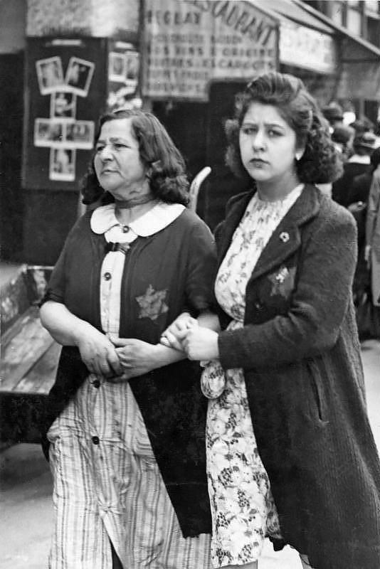
True or False?
              Answer: False
              Two million Jews, roughly a third of the Jews killed during the Holocaust, were killed outside of the camps. Many of them were shot by Nazis and thrown into mass graves.
Jewish women forced to wear yellow badges
Notes:
Unknown photographer. (1942, June). Jewish women with yellow star, Paris. Wikimedia Commons. Retrieved November 1, 2022, from https://commons.wikimedia.org/wiki/File:Bundesarchiv_Bild_183-N0619-506,_Paris,_J%C3%BCdische_Frauen_mit_Stern.jpg

Slide 11
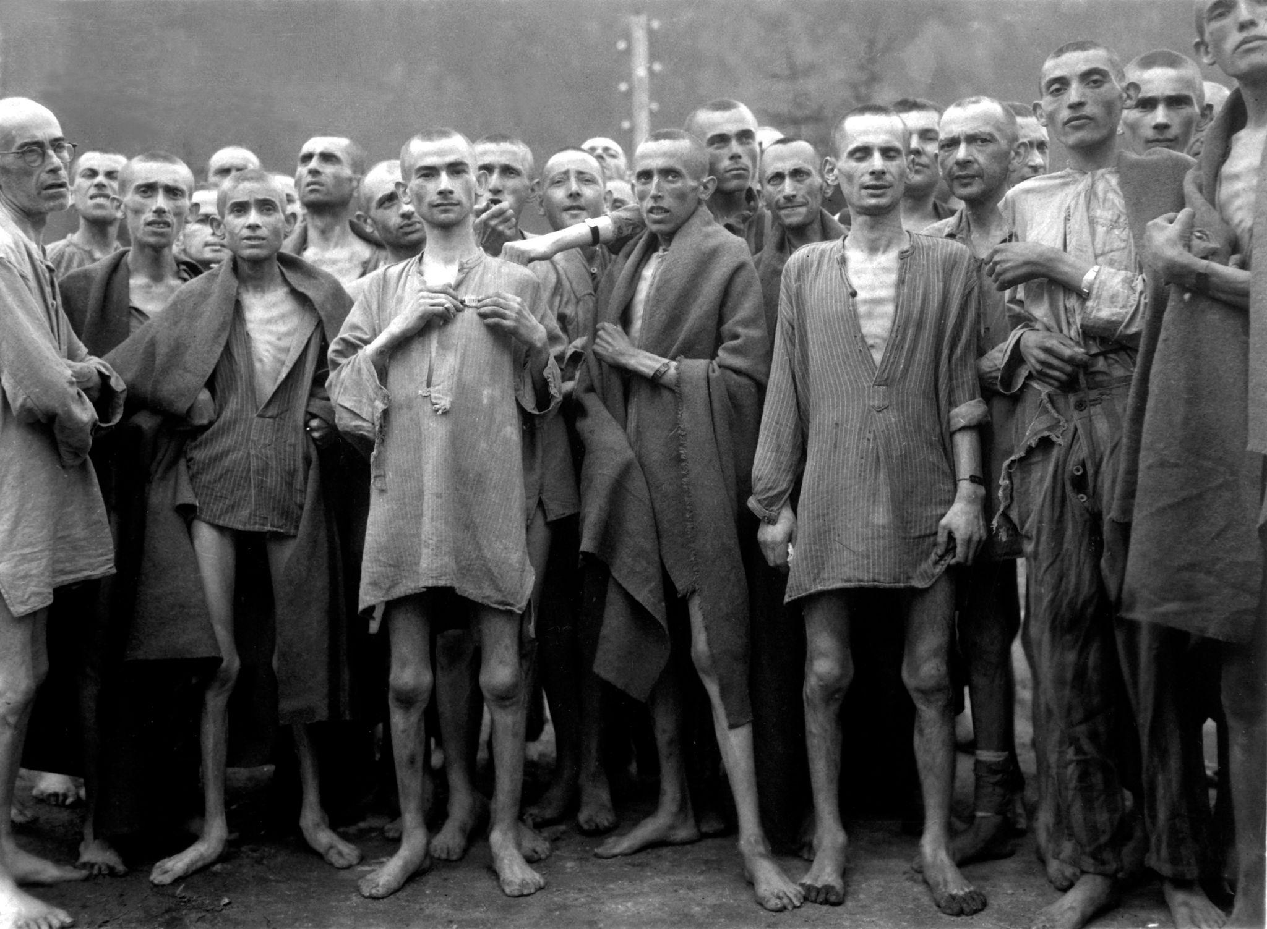
True or False?
Most victims of the Holocaust were Jewish.
Concentration camp victims, 1945
Notes:
Pingnews.com. (2007, November 4). Public domain: WWII: Concentration camp victims, 1945 (HD-SN-99-02762 DOD/Nara). Flickr. Retrieved November 1, 2022, from https://www.flickr.com/photos/pingnews/1861149964/in/photostream/

Slide 12
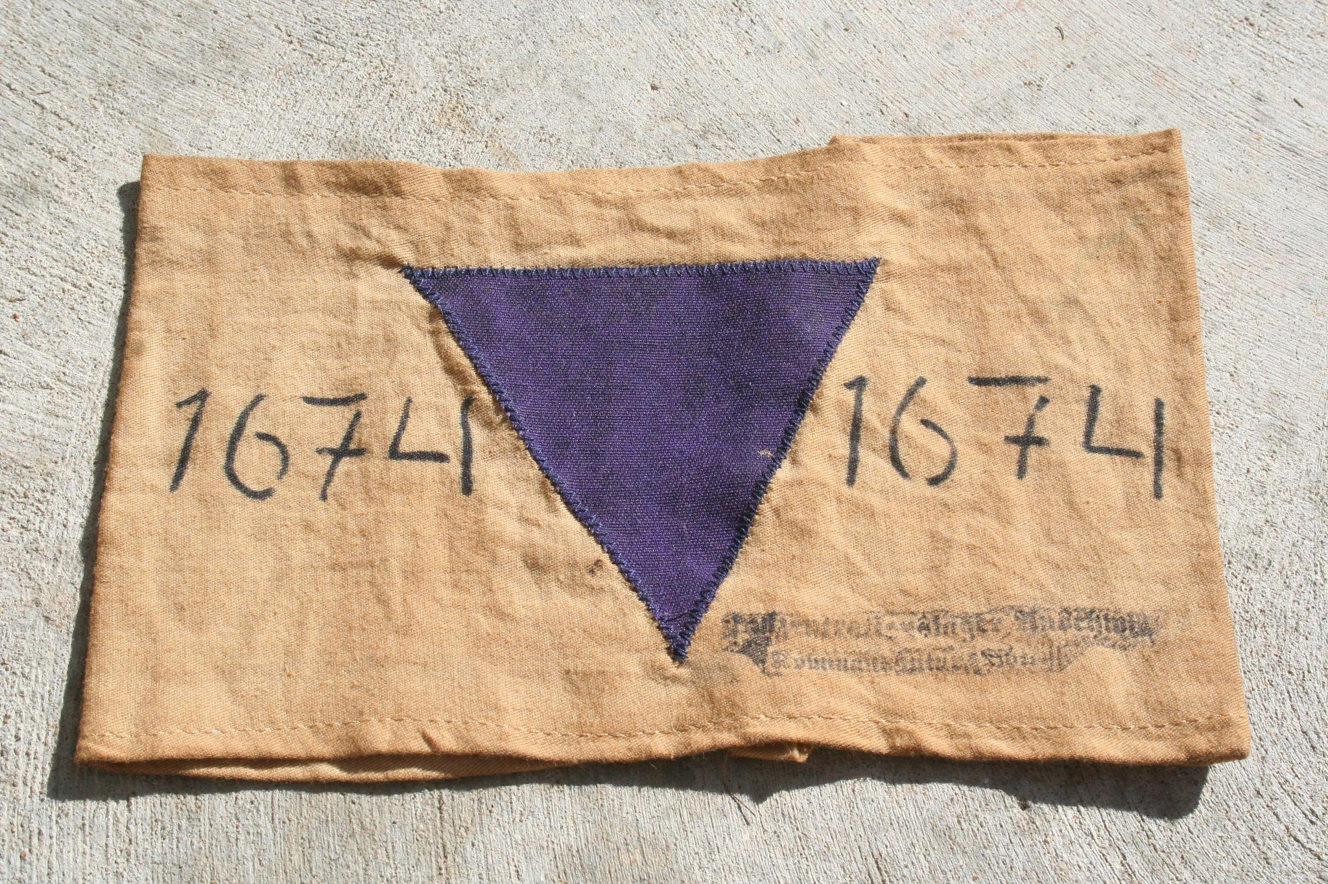
True or False?
              Answer: True
              However, nearly half of the 12 million
              victims of the Holocaust were not Jewish.
              The rest were people Adolf Hitler and his
              Nazi Party considered to be threats to
              Germany. These included members of the
              Roma ethnic group, Jehovah’s Witnesses, mentally or physically disabled people, communists, gay people, people who opposed the Nazi agenda, and people who were caught trying to save those targeted by the Nazis.
Badge identifying a Jehovah’s Witness
Notes:
Teacher’s Note: The Nazis had a badge system to help them identify the specific group each of their prisoners belonged to.
Coreyjo. (2009, August 31). JW armband. Wikimedia Commons. Retrieved November 4, 2022, from https://commons.wikimedia.org/wiki/File:Purple_Triangle.JPG

Slide 13

S-I-T
Read over the quotes from victims,
survivors, rescuers, and perpetrators.
Record your thoughts.
  What is surprising to you?
  What is interesting to you?
  What is troubling to you?
Notes:
K20 Center. (2021, February 12). S-I-T (surprising, interesting, troubling). Strategies. https://learn.k20center.ou.edu/strategy/926

Slide 14

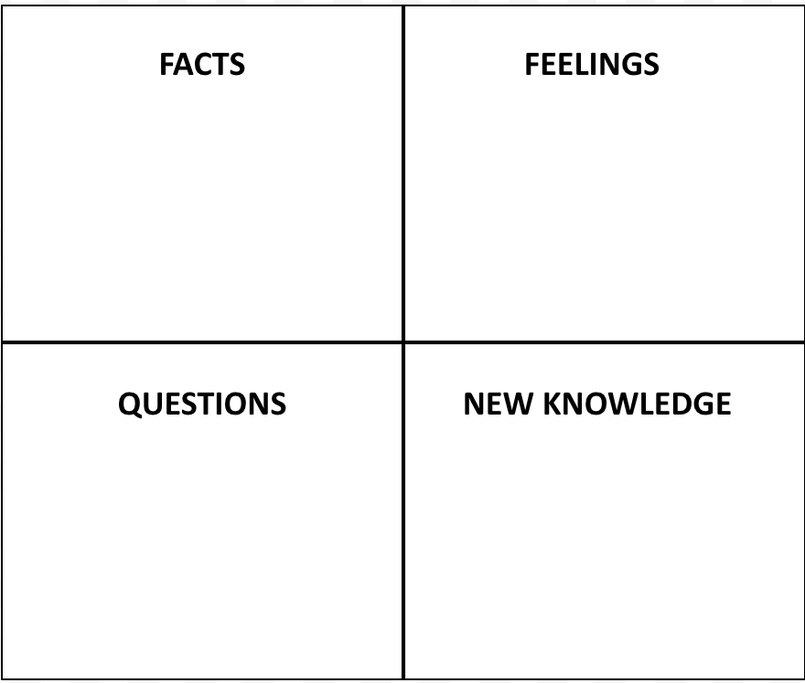
Window Notes
Read through the Holocaust Timeline Infogram: k20.ou.edu/timeline
Fill out the four quadrants of the handout as you read.
Notes:
K20 Center. (2020, September 16). Window notes. Strategies. https://learn.k20center.ou.edu/strategy/189

Slide 15
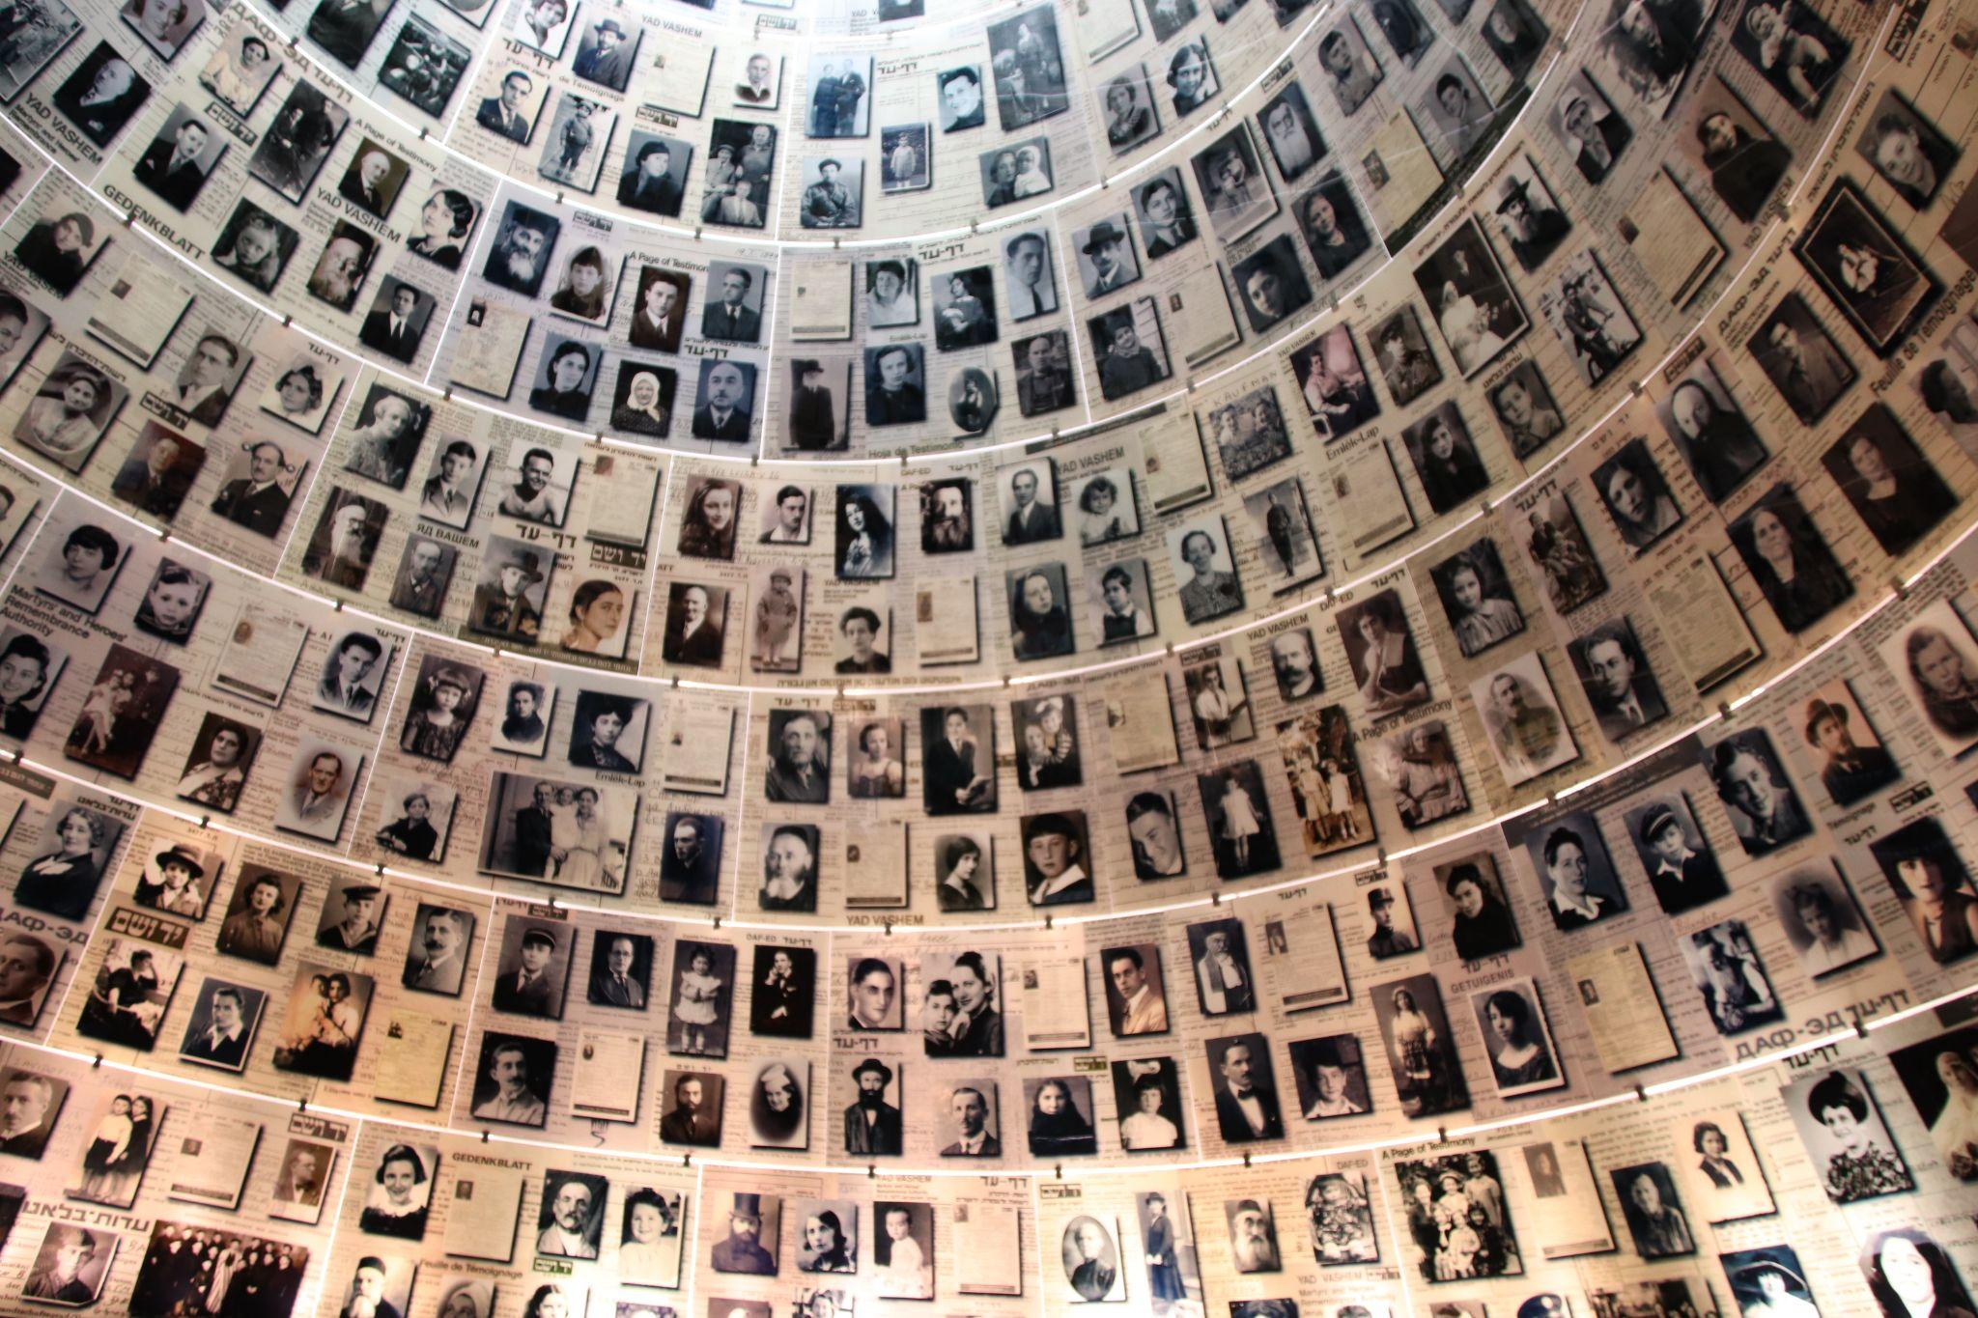
Wall of Honor
You will research a victim, survivor, or rescuer from the Holocaust. As a class, you will then create a Wall of Honor.
Yad Vashem Holocaust Memorial with photos of victims
Notes:
Todd, G. (2018, July 8). Yad Vashem Holocaust memorial photos of victims. Flickr. Retrieved November 1, 2022, from https://www.flickr.com/photos/101561334@N08/42555526014
Yad Vashem Holocaust Memorial Photos of Victims

Slide 16

Wakelet Research
Research Criteria
Name | Date of birth | Date of death
Are they a victim, survivor, or rescuer? | Age | Country
Job (if applicable) | Summary of their experience | Why were they targeted?
Wakelet: k20.ou.edu/holocaust
Notes:
K20 Center. (2022, March 9). Wakelet. Tech tools. https://learn.k20center.ou.edu/tech-tool/2180

Slide 17
Creating a Plaque of Honor
Include the following in your Plaque of Honor:
Picture of the person (or drawing)
Person’s name
Where they are from
Interesting facts about their lives
A summary of their experiences during the Holocaust

Slide 18

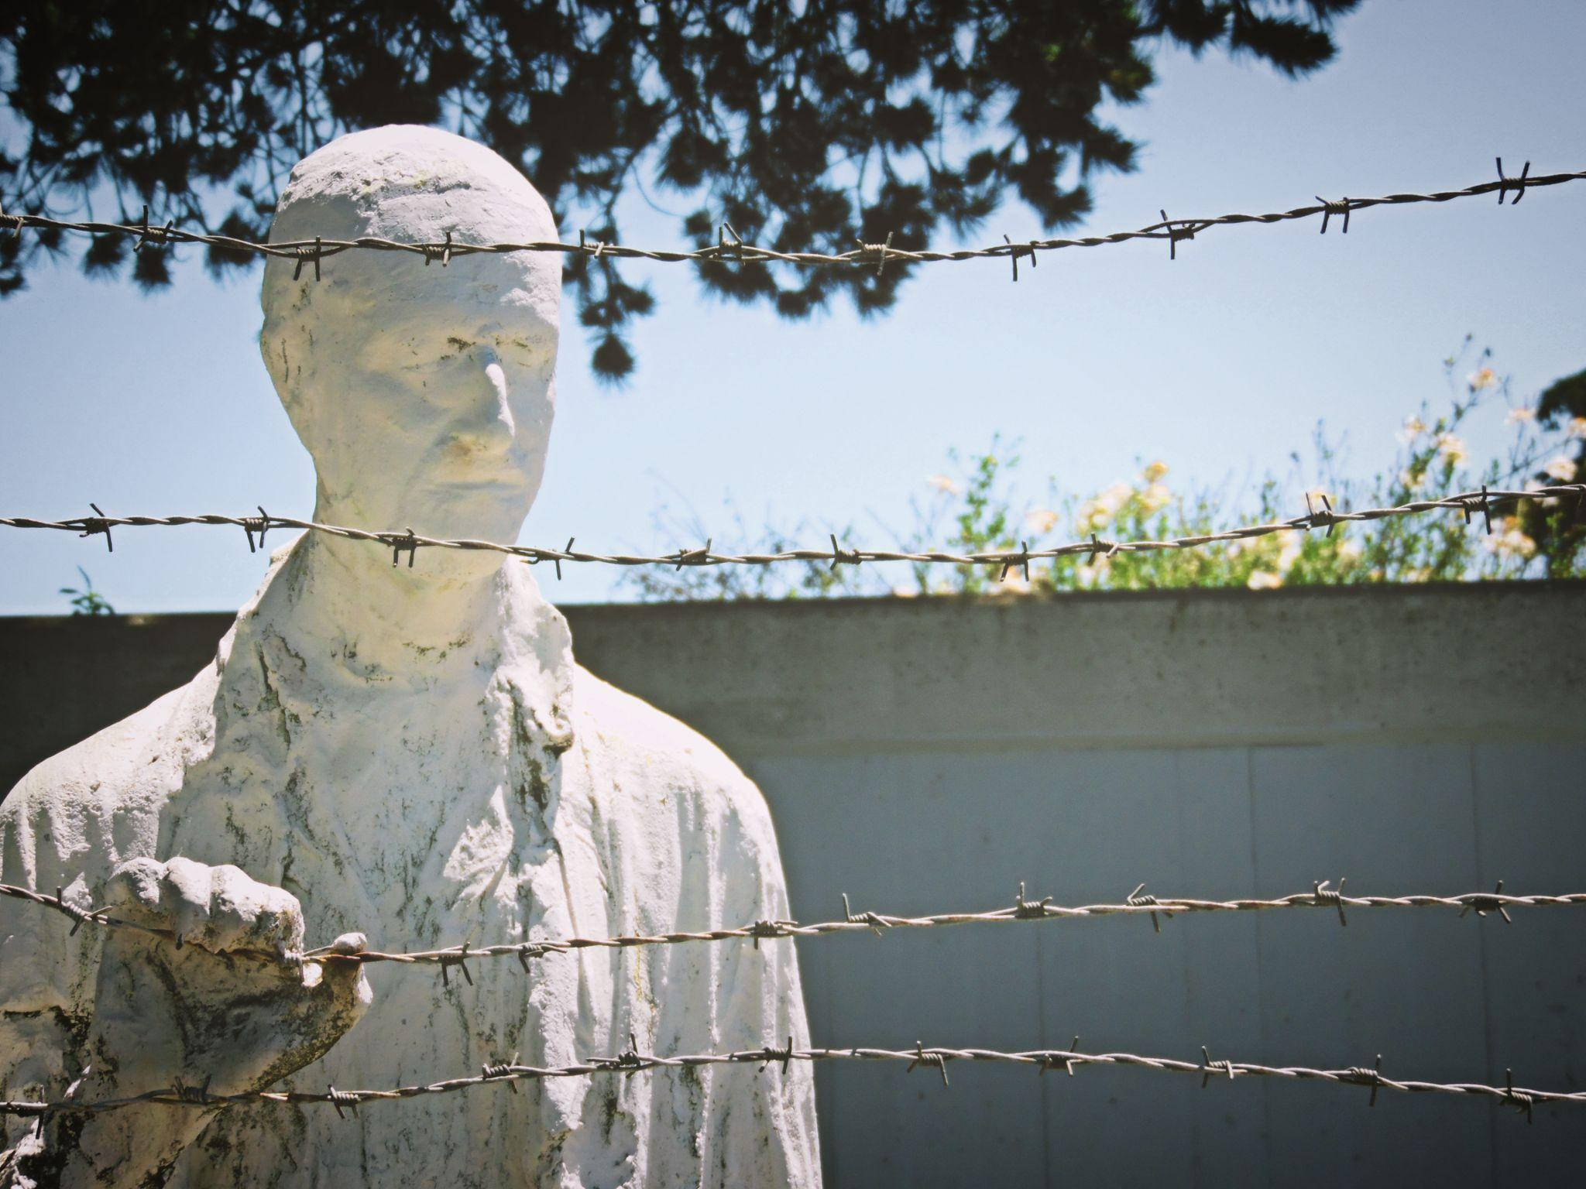
Wall of Honor Gallery Walk
Take time to walk around and learn about those whose lives were affected by the Holocaust.
Have one person in your group stay behind to present your honorary plaque to others.
Notes:
K20 Center. (2020, September 16). Gallery walk / Carousel. Strategies. https://learn.k20center.ou.edu/strategy/118
Unknown photographer. (n.d.). Free Images & Free Stock Photos. PxHere. Retrieved November 1, 2022, from https://pxhere.com/en/photo/1065527

Slide 19

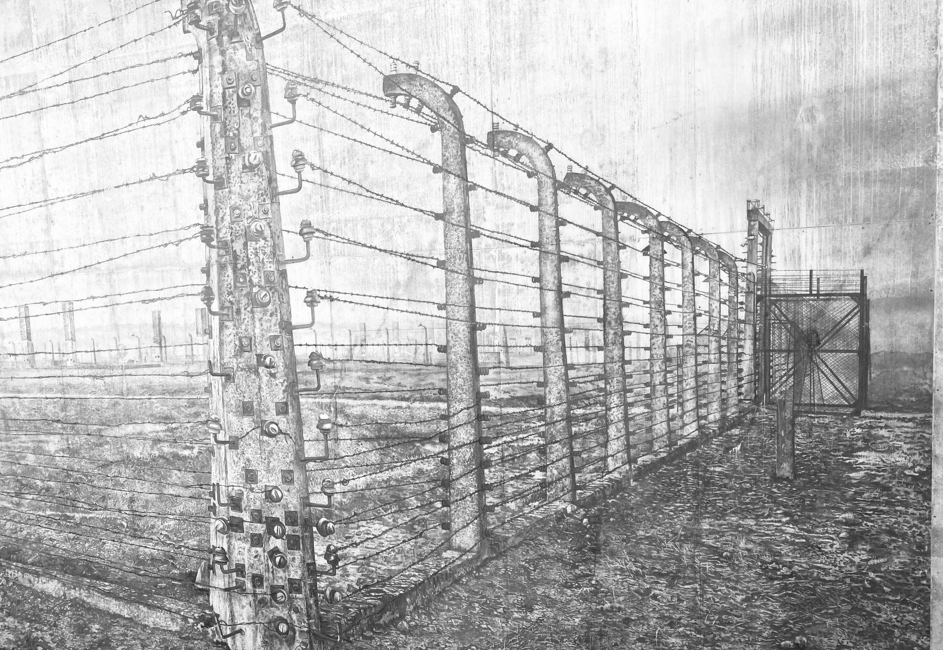
Exit Ticket
              Why should we remember the Holocaust?
Notes:
Dunn, R. (2021, August 20). Holocaust museum. Flickr. Retrieved November 1, 2022, from https://www.flickr.com/photos/rdb466/51390397562
K20 Center. (2020, September 16). Bell ringers and exit tickets. Strategies. https://learn.k20center.ou.edu/strategy/125

