Slide 2
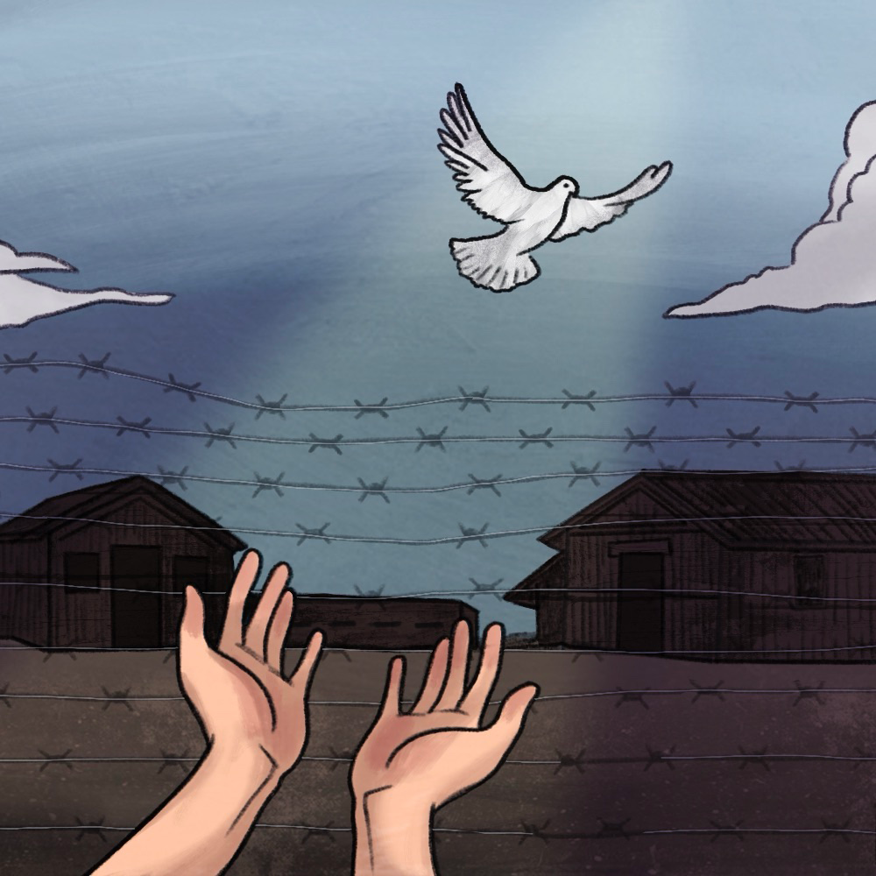
Honor and Remembrance
Stories of the Holocaust

Slide 3
Essential Question
Why should we remember the Holocaust?

Slide 4
Learning Objectives
Investigate what happened during the Holocaust and the circumstances that led up to World War II.
Learn about the experiences of victims, survivors, and rescuers and then construct honorary plaques that retell their stories.

Slide 5
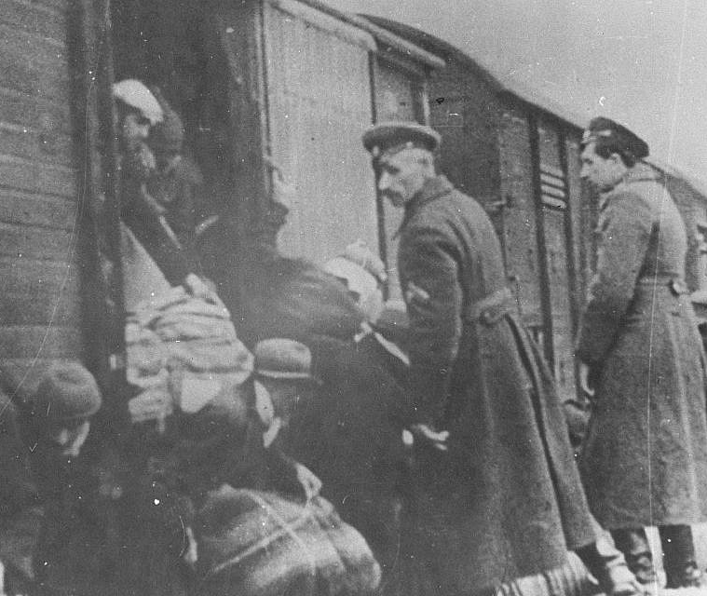
True or False?
Antisemitism, or hatred of Jewish people, did not exist until the Holocaust.
Bulgaria deports Macedonian Jews to Treblinka
Notes:
Bulgaria deporting the Macedonian Jews to Treblinka [Photograph]. (1943, March 22). Wikimedia Commons. https://commons.wikimedia.org/wiki/File:Bulgaria_deporting_the_Macedonian_Jews.jpg

Slide 6
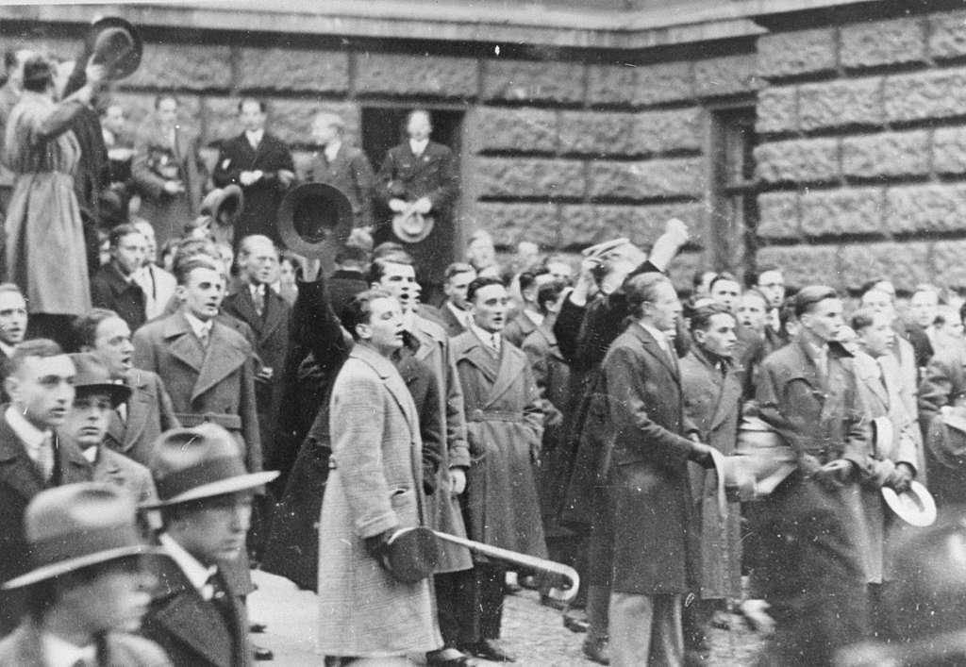
True or False?
              Answer: False
              Antisemitism, which led to the murder of six million Jews during the Holocaust, had existed for centuries prior to the start of the Holocaust.
Students riot at University of Vienna after Nazis attempt to prevent Jews from entering
Notes:
Students riot at the University of Vienna after Nazi attempt to prevent Jews from entering the university [Photograph]. (n.d.). Picryl. https://picryl.com/media/students-riot-at-the-university-of-vienna-after-nazi-attempt-to-prevent-jews-cf83c0

Slide 7
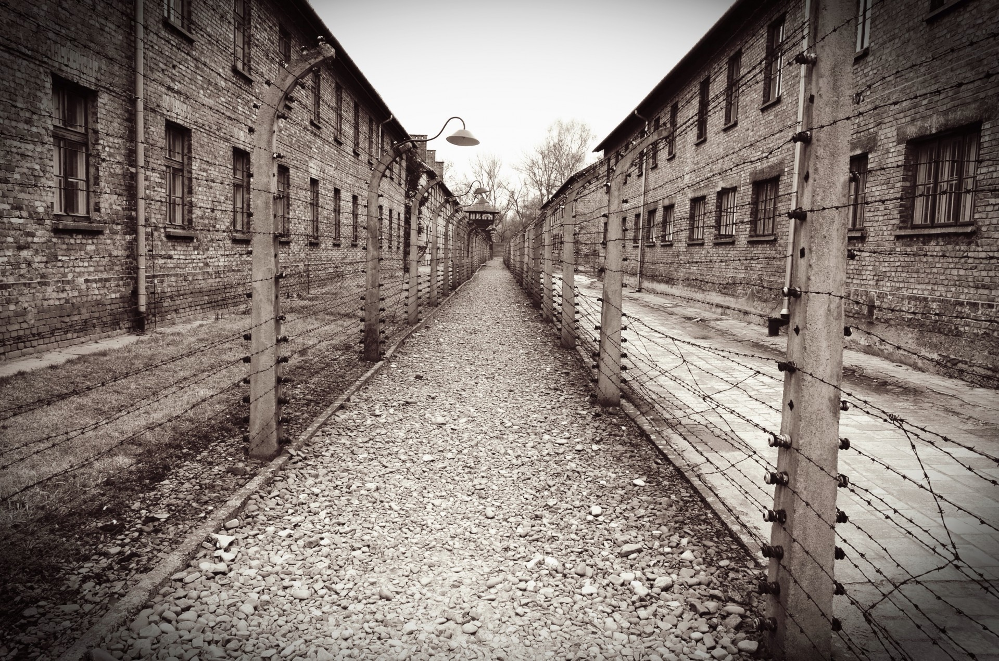
True or False?
The Nazis created only a few concentration camps for prisoners in Europe.
Auschwitz concentration camp
Notes:
Lally, D. (n.d.). Auschwitz/Birkenau [Photograph]. Public Domain Pictures. https://publicdomainpictures.net/en/view-image.php?image=92977&picture=auschwitzbirkenau

Slide 8
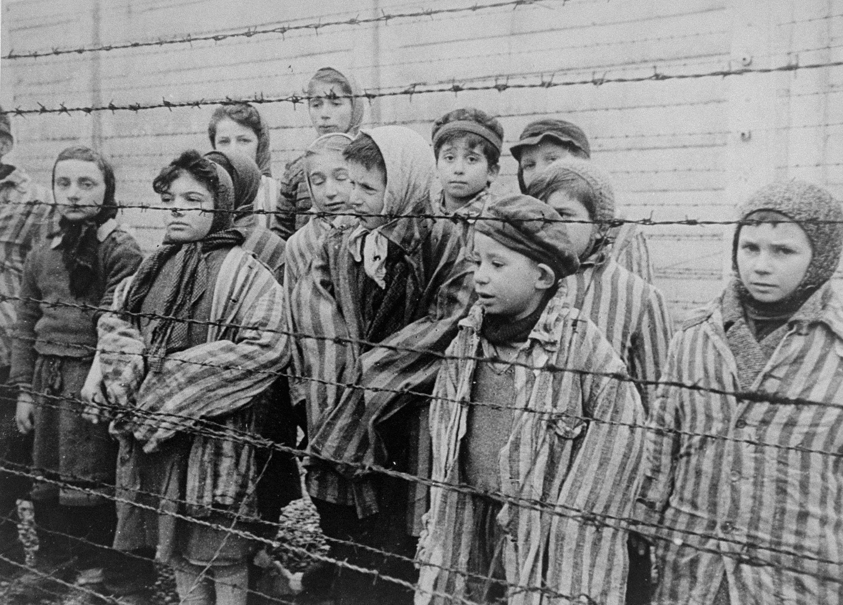
True or False?
              Answer: False
              There were over 43,000 camps. The main kinds of concentration camps were labor camps and extermination (death) camps.
Child survivors of Auschwitz
Notes:
United States Holocaust Memorial Museum. (2015, January 16). 1389.4 Holocaust A [Photograph]. Flickr. https://www.flickr.com/photos/ushmm/16269109876/in/photostream/

Slide 9
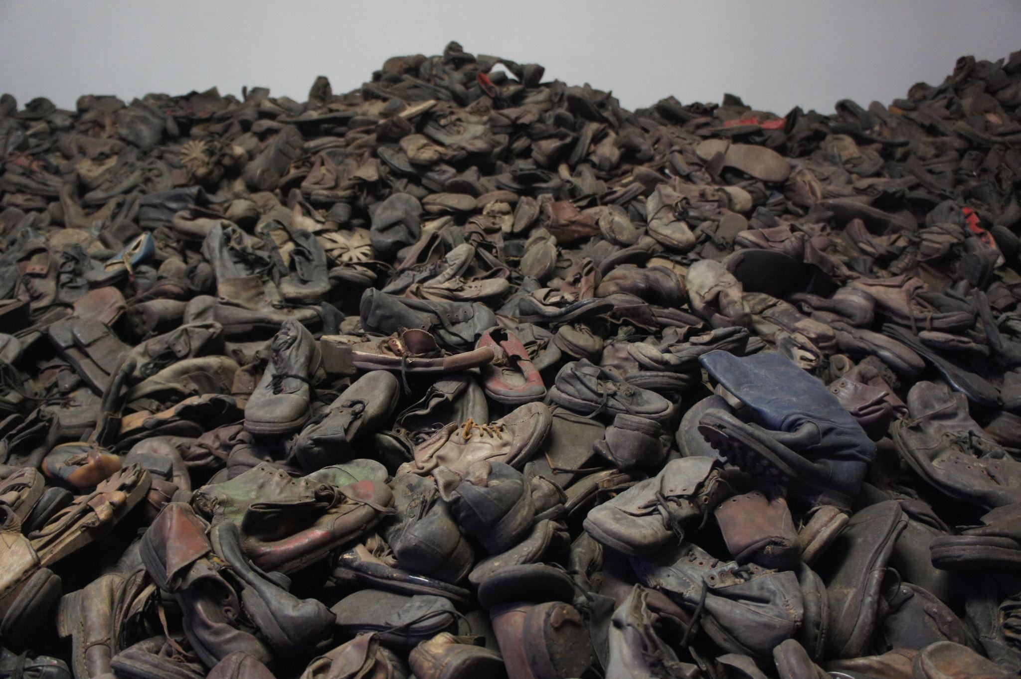
True or False?
Most victims of the Holocaust were murdered at the Auschwitz death camp.
One day’s collection of shoes from a death camp
Notes:
Bibi595. (2012, January 30). Auschwitz Museum shoes [Photograph]. Wikimedia Commons. https://commons.wikimedia.org/wiki/File:Auschwitz_Muzeum_Shoes.jpg

Slide 10
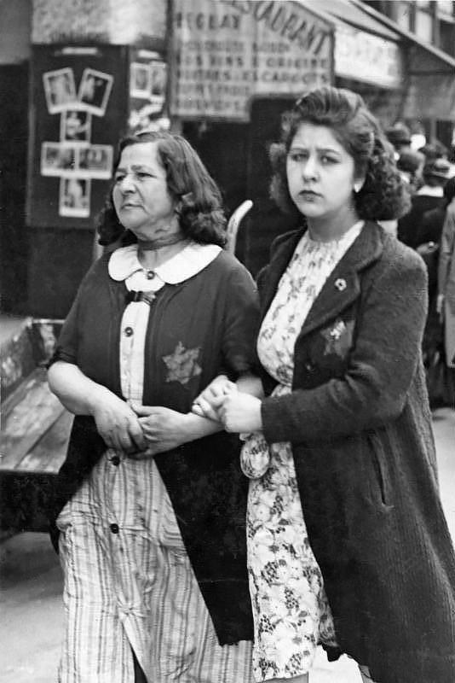
True or False?
              Answer: False
              Two million Jews, roughly a third of the Jews killed during the Holocaust, were killed outside of the camps. Many of them were shot by Nazis and thrown into mass graves.
Jewish women forced to wear yellow badges
Notes:
Jewish women with yellow star, Paris [Photograph]. (1942). Wikimedia Commons. https://commons.wikimedia.org/wiki/File:Bundesarchiv_Bild_183-N0619-506,_Paris,_J%C3%BCdische_Frauen_mit_Stern.jpg

Slide 11
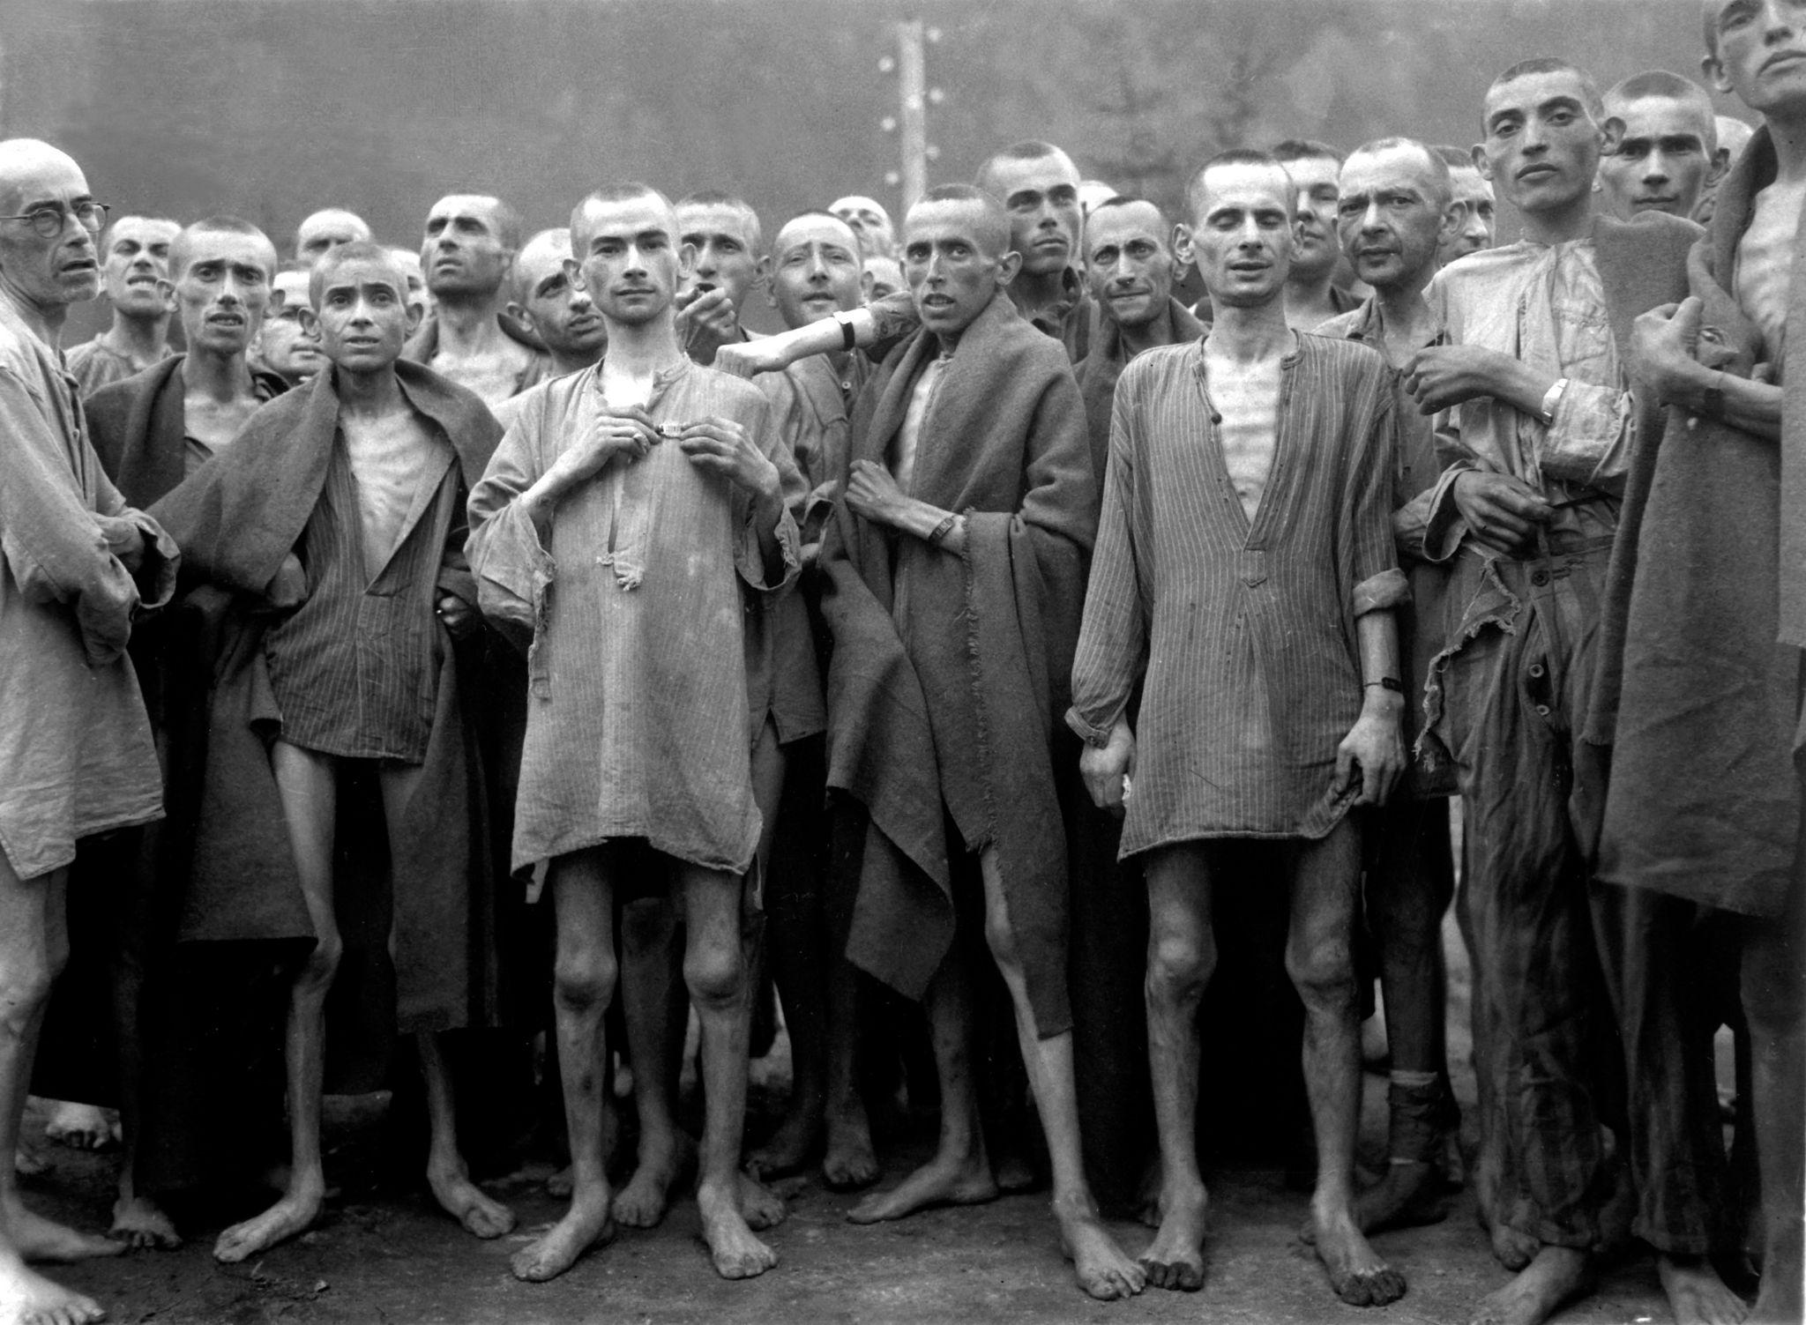
True or False?
Most victims of the Holocaust were Jewish.
Concentration camp victims, 1945
Notes:
Ping News. (2007, November 4). WWII: Concentration camp victims, 1945 [Photograph]. Flickr. https://www.flickr.com/photos/pingnews/1861149964/in/photostream/

Slide 12
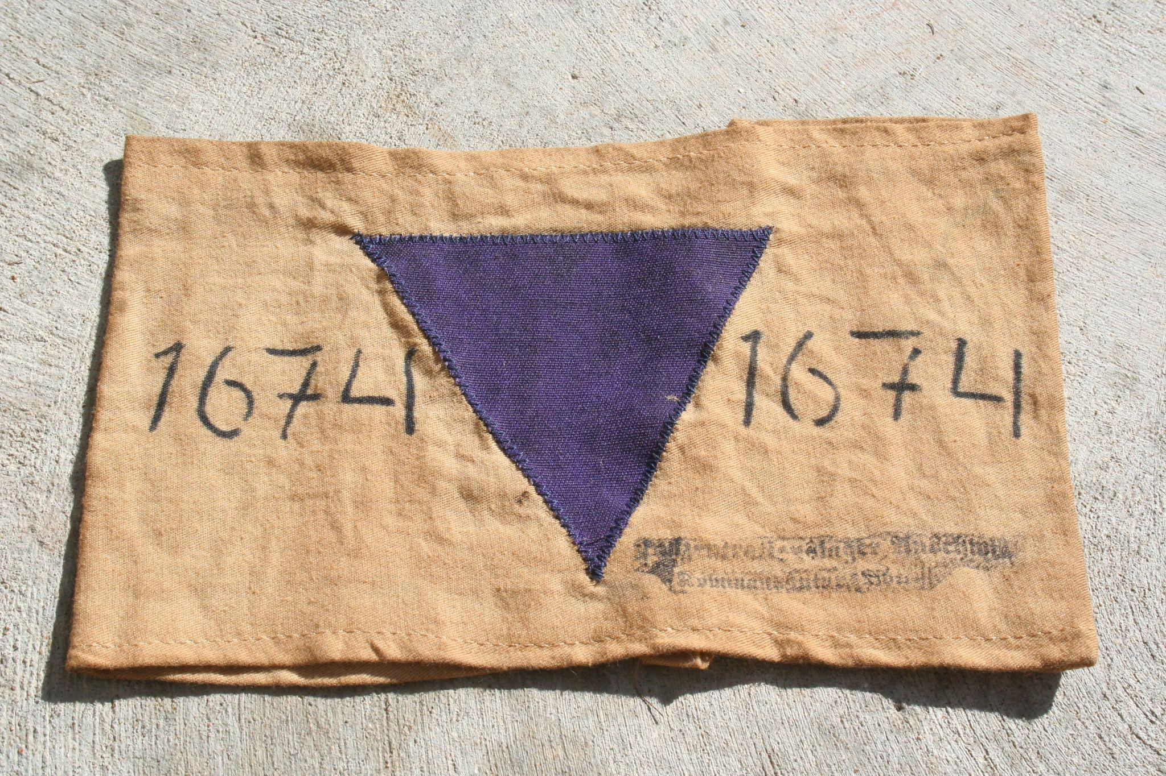
True or False?
Answer: True
              However, nearly half of the 12 million
              victims of the Holocaust were not Jewish. The rest were people Adolf Hitler and his Nazi Party considered to be threats to
              Germany. These included members of the Roma ethnic group, Jehovah’s Witnesses, mentally or physically disabled people, communists, gay people, people who opposed the Nazi agenda, and people who were caught trying to save those targeted by the Nazis.
Badge identifying a Jehovah’s Witness
Notes:
Teacher’s Note: The Nazis had a badge system to help them identify the specific group each of their prisoners belonged to.
Coreyjo. (2009, August 31). JW armband [Photograph]. Wikimedia Commons. https://commons.wikimedia.org/wiki/File:Purple_Triangle.JPG

Slide 13

S-I-T
Read the quotes from victims, survivors,
rescuers, and perpetrators.
Record your thoughts.
  What is surprising to you?
  What is interesting to you?
  What is troubling to you?
Notes:
K20 Center. (n.d.). S-I-T (surprising, interesting, troubling). Strategies. https://learn.k20center.ou.edu/strategy/926

Slide 14
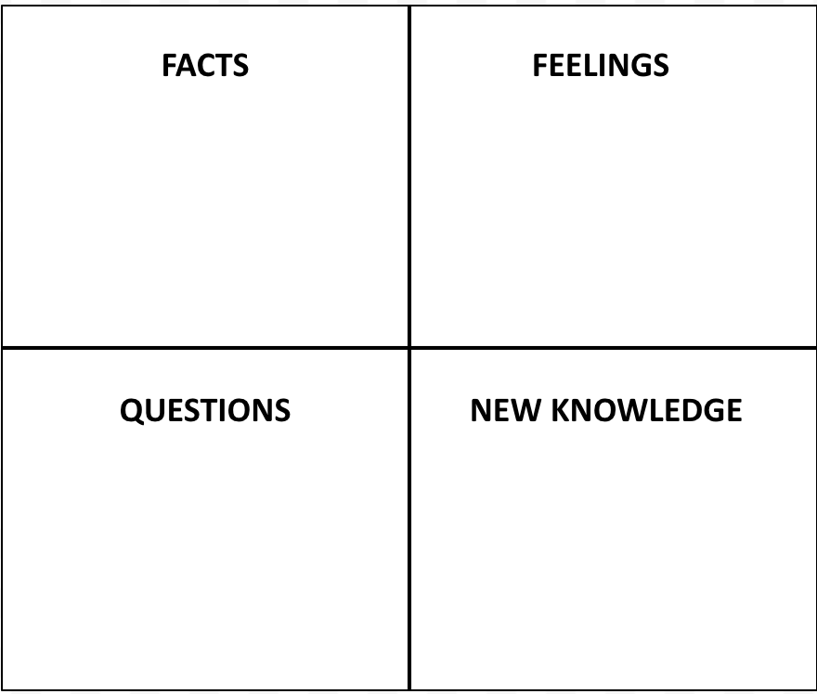
Window Notes
Read the Holocaust timeline Infogram: k20.ou.edu/timeline
After reading, complete the four quadrants of your Window Notes.
Notes:
K20 Center. (n.d.). Window notes. Strategies. https://learn.k20center.ou.edu/strategy/189

Slide 15
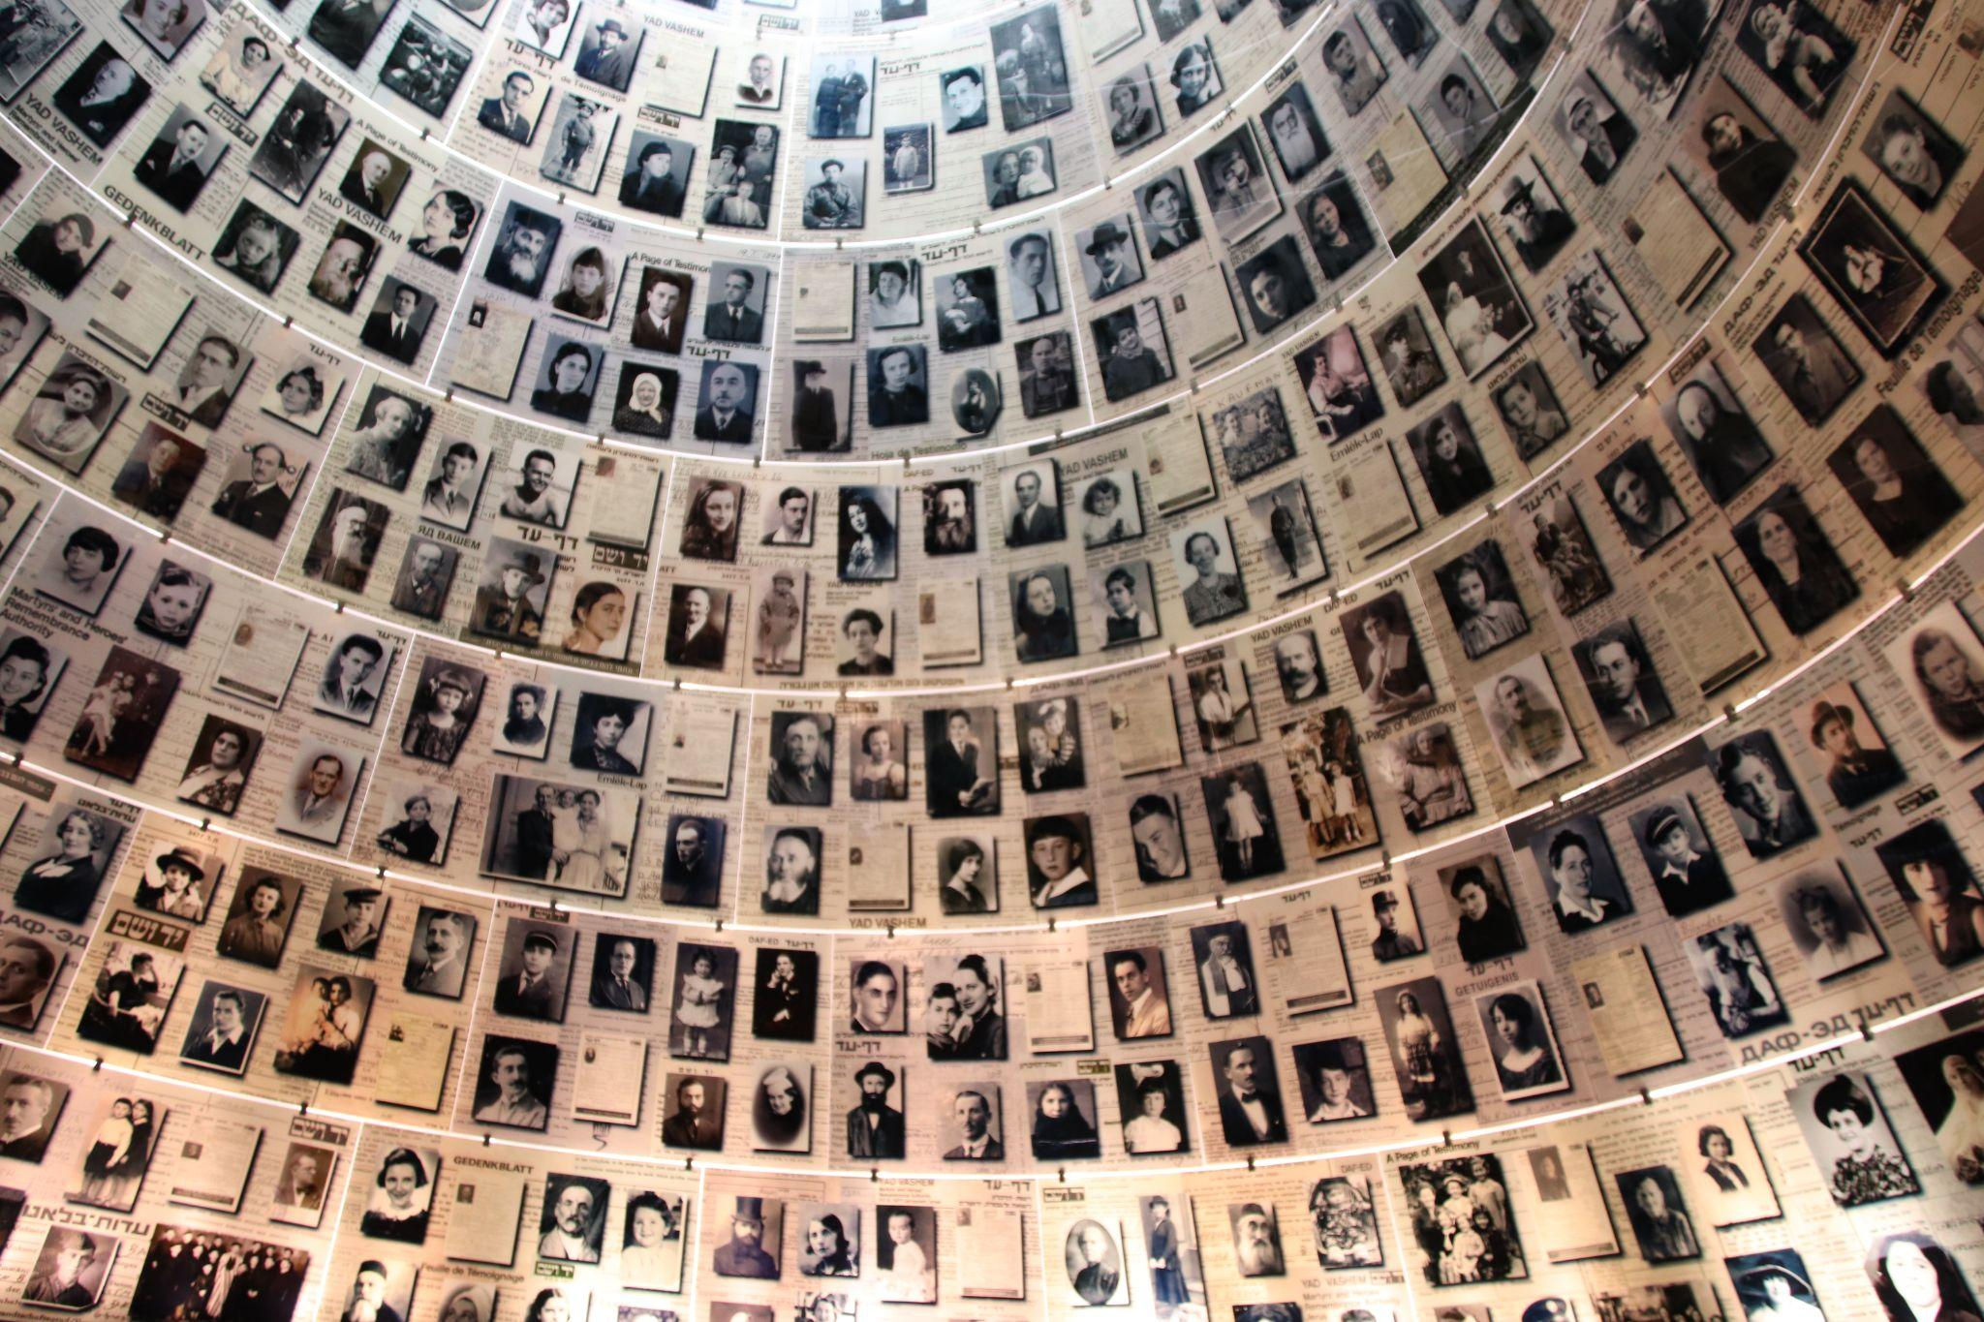
Wall of Honor
Research a victim, survivor, or rescuer from the Holocaust.
Your figure will be part of a class Wall of Honor.
Yad Vashem Holocaust Memorial with photos of victims
Notes:
Todd, G. (2018, July 8). Yad Vashem Holocaust memorial photos of victims. Flickr. https://www.flickr.com/photos/101561334@N08/42555526014

Slide 16
Holocaust Research
Research Criteria
Name | Date of birth | Date of death
Are they a victim, survivor, or rescuer? | Age | Country
Job (if applicable) | Summary of their experience | Why were they targeted?
Research Link: https://k20.ou.edu/si

Slide 17
Creating a Plaque of Honor
Include the following in your honorary plaque:
Picture of the person (or drawing)
Person’s name
Where they are from
Interesting facts about their lives
A summary of their experiences during the Holocaust

Slide 18

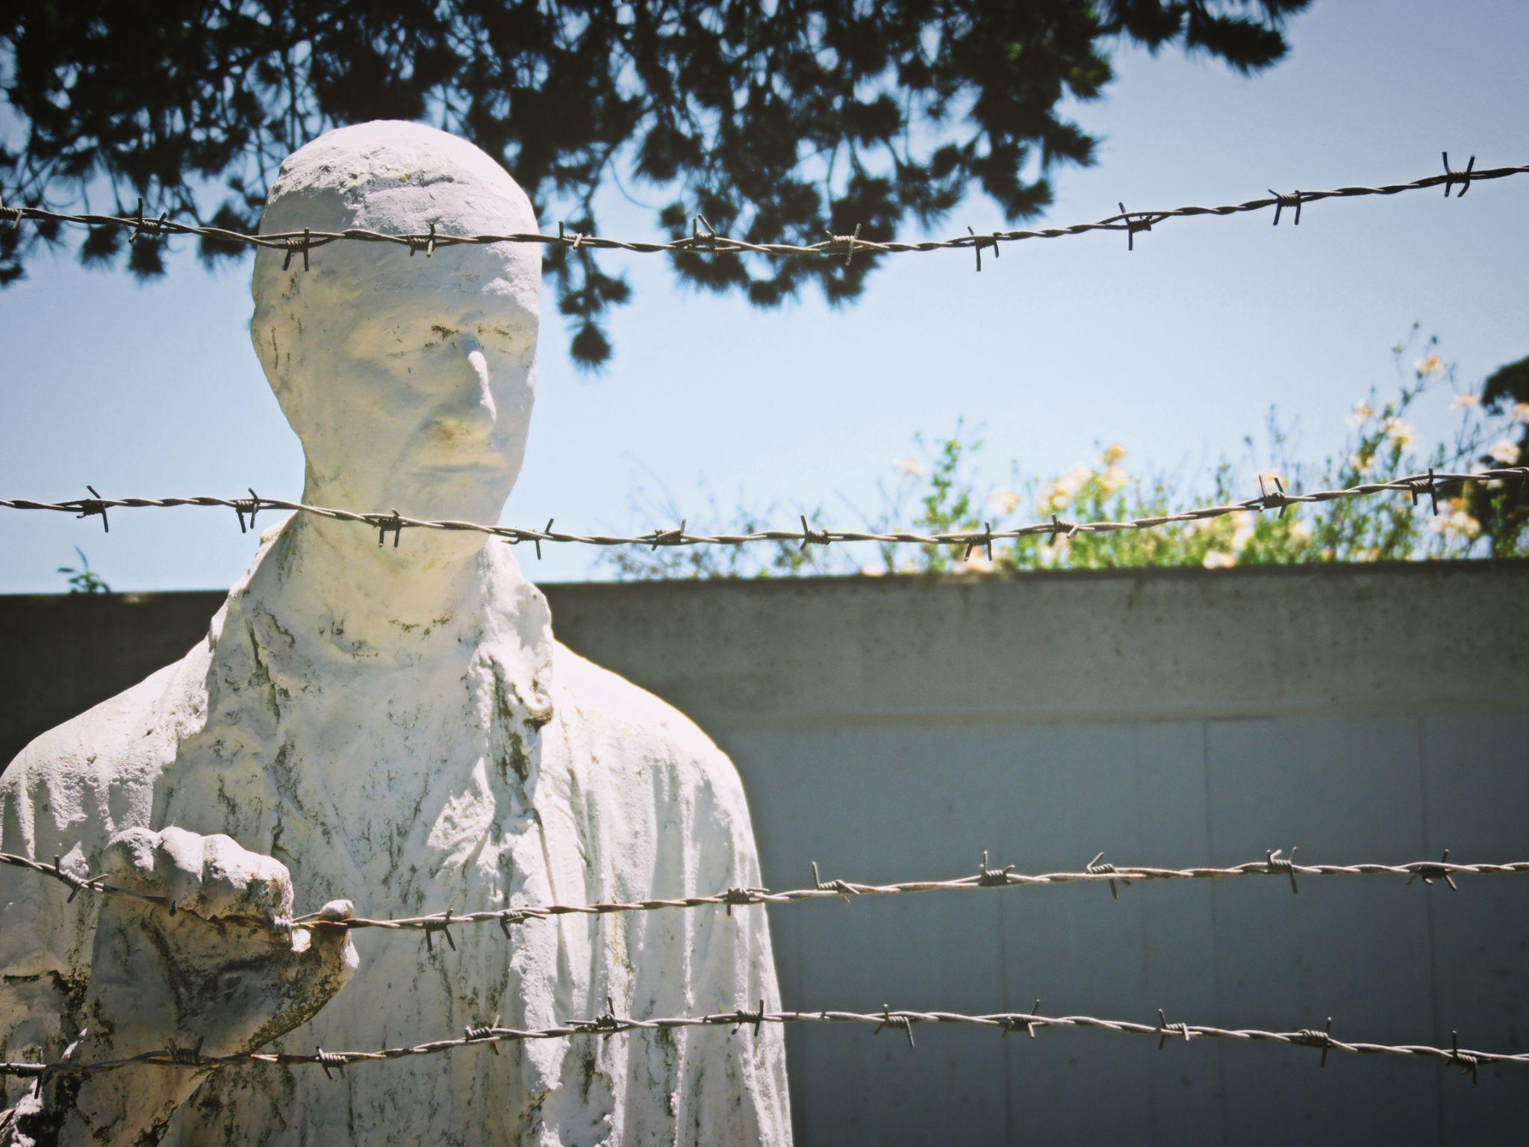
Wall of Honor Gallery Walk
Have one person in your group stay behind to present your honorary plaque to others.
Walk around the room and learn about those whose lives were affected by the Holocaust.
Notes:
K20 Center. (n.d.). Gallery walk / carousel. Strategies. https://learn.k20center.ou.edu/strategy/118
Outdoor monument to the Holocaust depicting a person gripping barbed wire [Photograph]. Pxhere. https://pxhere.com/en/photo/1065527#google_vignette

Slide 19

Exit Ticket
Why should we remember the Holocaust?
Notes:
K20 Center. (n.d.). Bell ringers and exit tickets. Strategies. https://learn.k20center.ou.edu/strategy/125

