Slide 1
World Regions Map

Slide 2
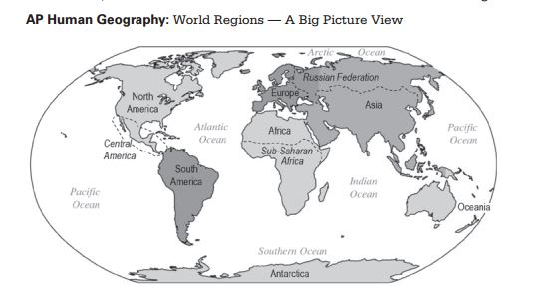
Notes:
The College Board. (2015). Human geography: Course description. Retrieved from https://secure-media.collegeboard.org/digitalServices/pdf/ap/ap-human-geography-course-description.pdf

