Slide 2
Breaking News
The Role of the Media in Nixon’s Presidency

Slide 3
Agree or Disagree?
For each of the following statements, decide whether you:
Strongly Agree
Agree
Disagree
Strongly Disagree
Indicate your decision on your handout and explain in writing how you made your decision.

Slide 4
Statement 1
If a president participates in a crime,
he or she should be held responsible.

Slide 5
Statement 2
Elected officials can be trusted.

Slide 6
Statement 3
The behavior of political figures
greatly influences Americans’ lives.

Slide 7
Statement 4
The President should be able to stop media companies from reporting information.

Slide 8
Essential Question
How does the media impact the role of the president?

Slide 9
Lesson Objective
Evaluate the role of the media in Nixon’s presidency.

Slide 10

Reporting the News
Review the newspaper article snippets.
Use the Reporting the News Graphic.
Organizer to take notes.
  On the left column, record your observations about each article.
  On the right side, record how you think this impacted Nixon’s presidency.

Slide 11

Nixon and Watergate
As you watch the video, make note of something that is:
Surprising
Interesting
Troubling

Slide 12
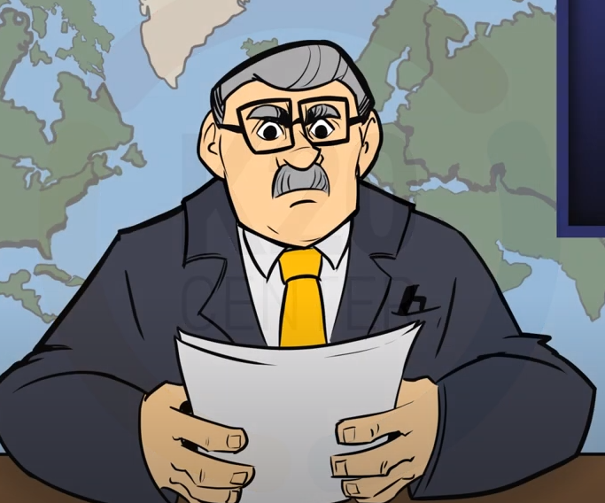
Nixon and Watergate
Breaking News
https://youtu.be/FF5GVCVD6N4

Slide 13

Nixon’s Presidency
What was the Watergate scandal?
How did the media play a role in the Watergate scandal?
Do you think resigning was the right decision?

Slide 14
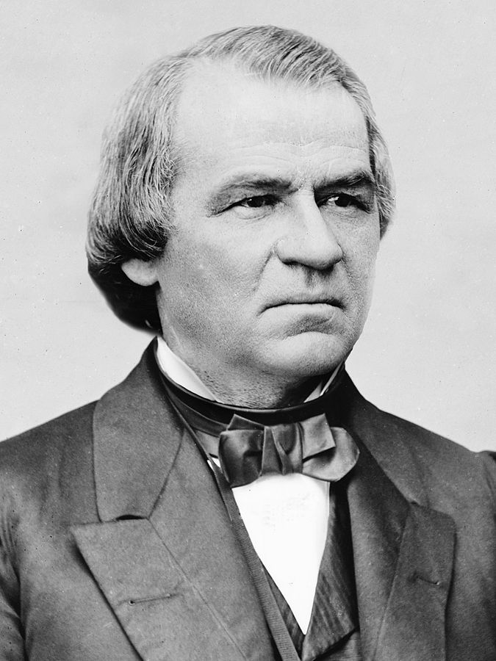
Trial by Senate: President Andrew Johnson
              1865-1869
Impeachment Charges
Johnson fired his Secretary of War without Senate approval. This violated the Tenure of Office Act, a law that was later deemed unconstitutional.
The Senate voted on 3 of the 11 articles.
Notes:
Brady, M. (1875). President Andrew Johnson [Photograph]. Wikimedia Commons. https://commons.wikimedia.org/wiki/File:President_Andrew_Johnson.jpg

Slide 15
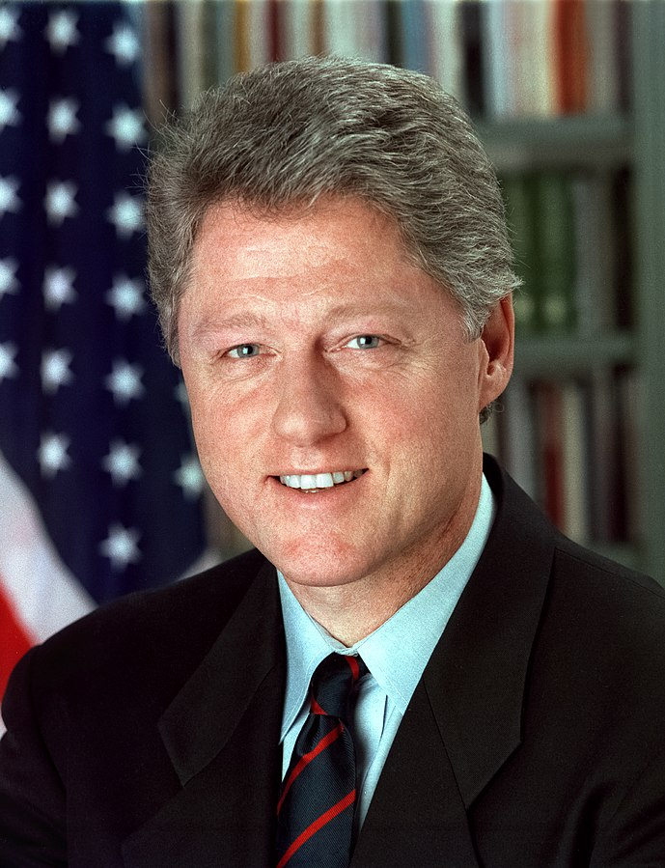
Trial by Senate: President Bill Clinton
              1993-2001
Impeachment Charges
Clinton lied under oath about a relationship with a White House staff member, calling into question his integrity and honesty.
Notes:
McNeely, B. (January 1, 1993). Bill Clinton [Photograph]. Wikimedia Commons. https://commons.wikimedia.org/wiki/File:Bill_Clinton.jpg

Slide 16
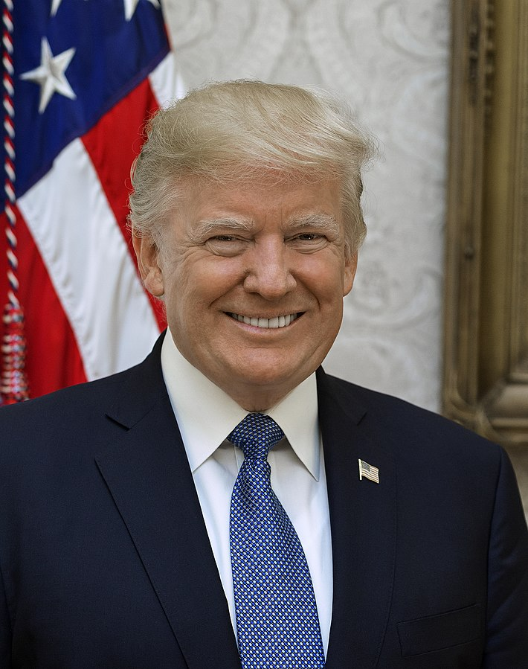
Trial by Senate: President Donald Trump
              2017-2021
Impeachment Charges
Record of a phone call where the president allegedly used his power to get re-election assistance from the leader of Ukraine motivated his first impeachment charges.
The riot at the U.S. Capitol on Jan. 6, 2021, initiated the second impeachment charge.
Notes:
Craighead, S. (October 6, 2017). Donald Trump Official Portrait [Photograph]. Wikimedia Commons. https://commons.wikimedia.org/wiki/File:Donald_Trump_official_portrait.jpg

Slide 17

Trial By Senate
Consider the history of presidential impeachment and removal from office.
Why do you think no president has ever been removed from office?

Slide 18
Trial By Senate
Why do you think no president has ever
been removed from office?
1. Make a claim. (Do not yet explain your reasoning.) | 2. Read the claim in the first box. Add something to support that claim.
3. Read the claim in the first box. Make a counter-argument or provide evidence that challenges the claim. | 4. Read boxes 1-3. Summarize the three boxes in your own words.
Notes:
Read boxes 1-3. Summarize the three boxes in your own words.

Slide 19

Exit Ticket
Answer the following question:
How did the media impact Nixon’s presidency?

