Slide 2
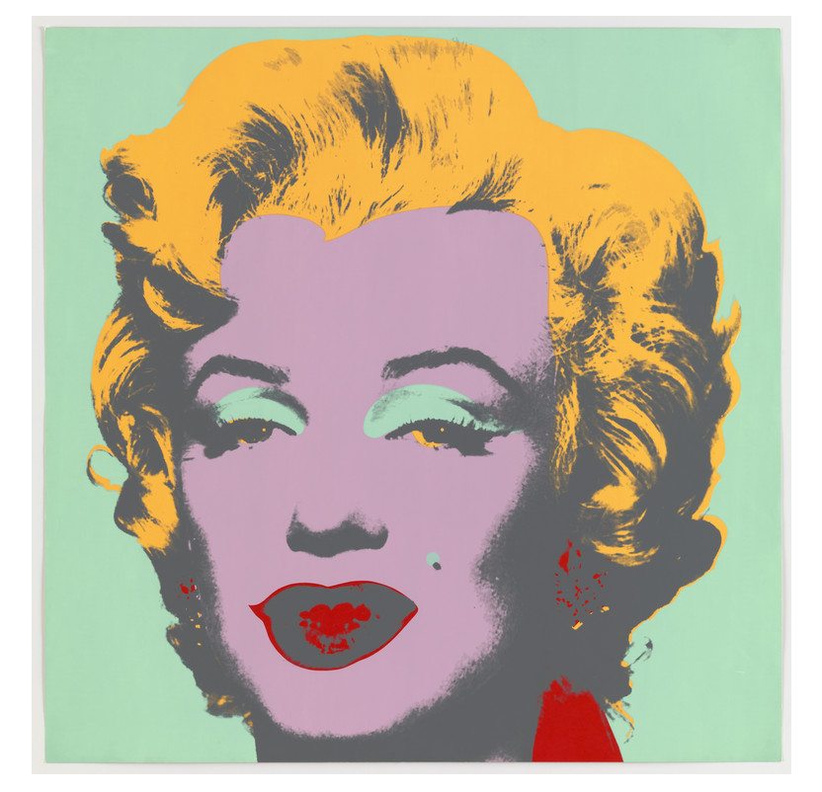
Artwork #1
Notes:
Warhol, A. (1967). Untitled from Marilyn Monroe [Screenprint]. Museum of Modern Art. https://www.moma.org/collection/works/61246

Slide 3
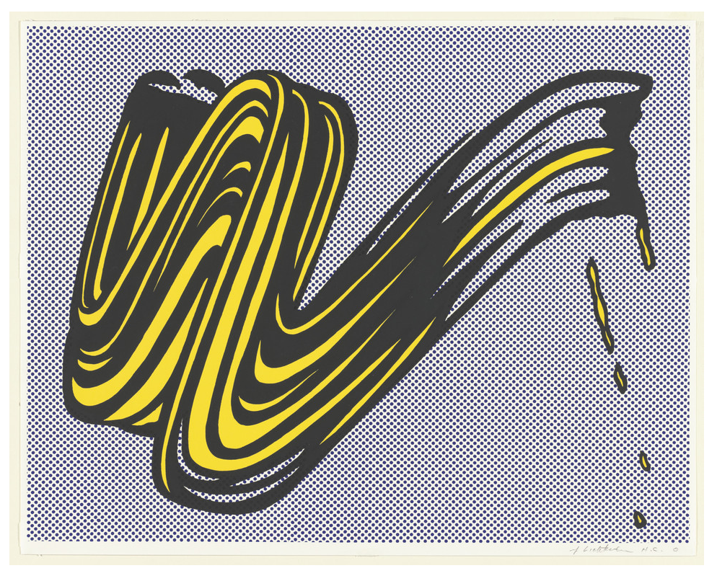
Artwork #2
Notes:
Lichtenstein, R. (1965). Brushstroke [Screenprint]. Museum of Modern Art. https://www.moma.org/collection/works/60284

Slide 4
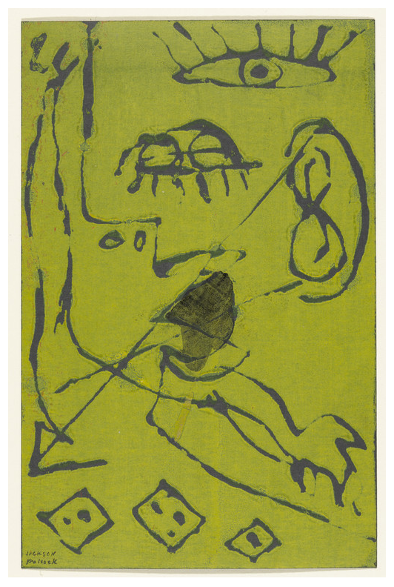
Artwork #3
Notes:
Pollock, J. (ca. 1943–44). Untitled [Screenprint]. Museum of Modern Art. https://www.moma.org/collection/works/60935

Slide 5
4-2-1
On your 4-2-1 handout, fill each box in the top row with an idea of what the art pieces have in common.
When your teacher tells you, find a partner and narrow your four choices down to two.
Finally, at your teacher’s instruction, you and your partner should find another pair to work with and narrow your two choices down to one.
Notes:
K20 Center. (n.d.). 4-2-1. Strategies. https://learn.k20center.ou.edu/strategy/142

Slide 6
Clearly, This Is Art
Making screen prints with transparencies

Slide 7
Essential Question
How does one design art for screen printing?

Slide 8
Lesson Objective
Use screen printing techniques to create an article of clothing with an original design.

Slide 9
30 Second Expert
On a sheet of paper, draw a T-Chart.
On the top of the left side, write “What I know about screen printing.”
On the top of the right side, write “What I learned from my partner.”
Select a partner with whom to work.
Notes:
K20 Center. (n.d.). 30-second expert. Strategies. https://learn.k20center.ou.edu/strategy/1048

Slide 10
30 Second Expert
When you have finished watching the video or reading the article, fill the left side with all of the steps you think are in the process of screen printing.
When you have finished your analysis, take thirty seconds to listen to what your partner found and write anything in the right column anything they have that you don’t.
Repeat this process so they can do the same.

Slide 11
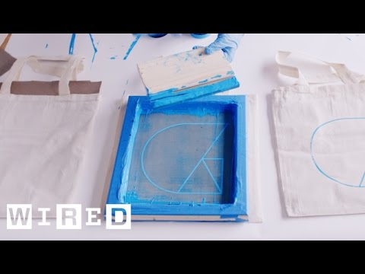
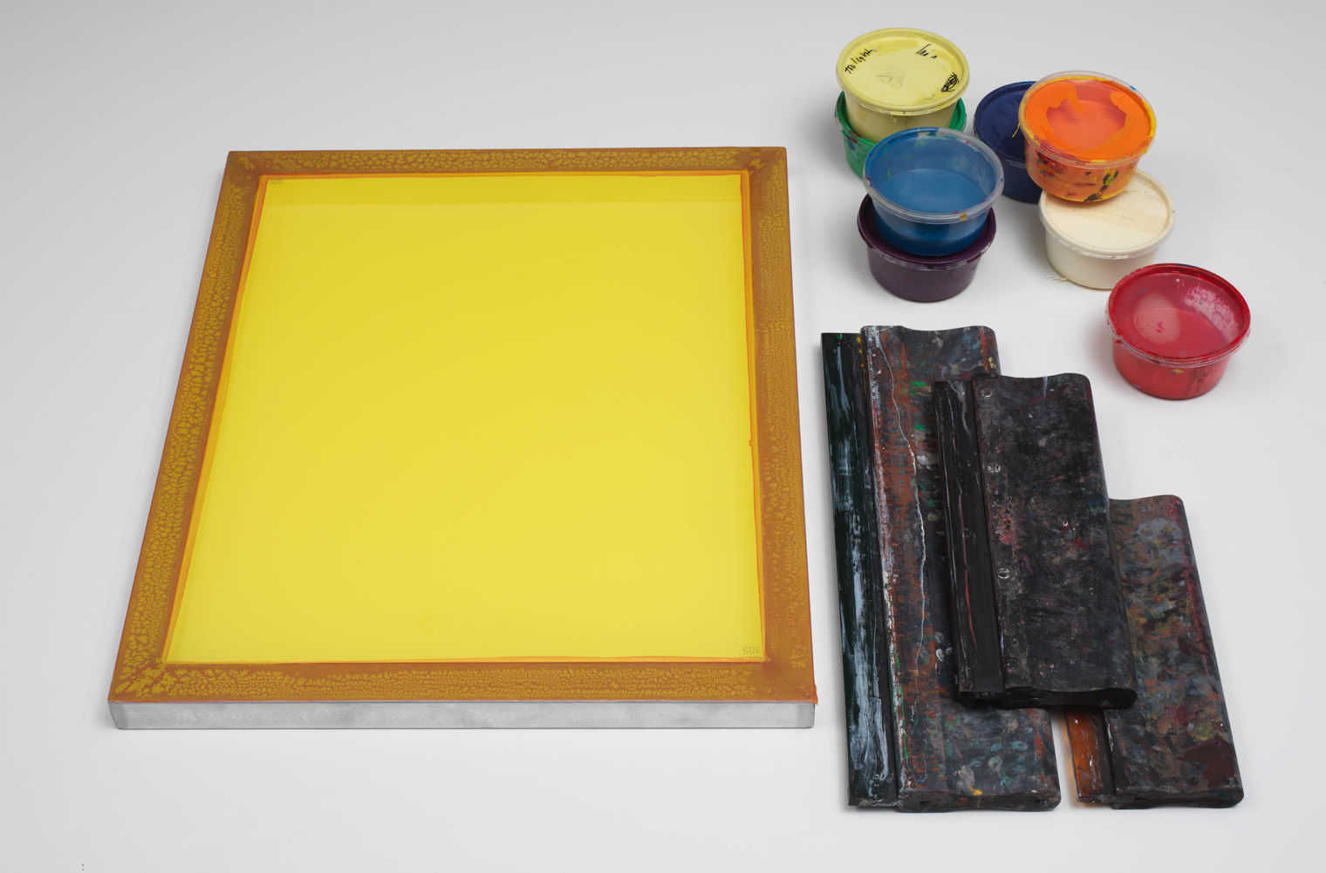
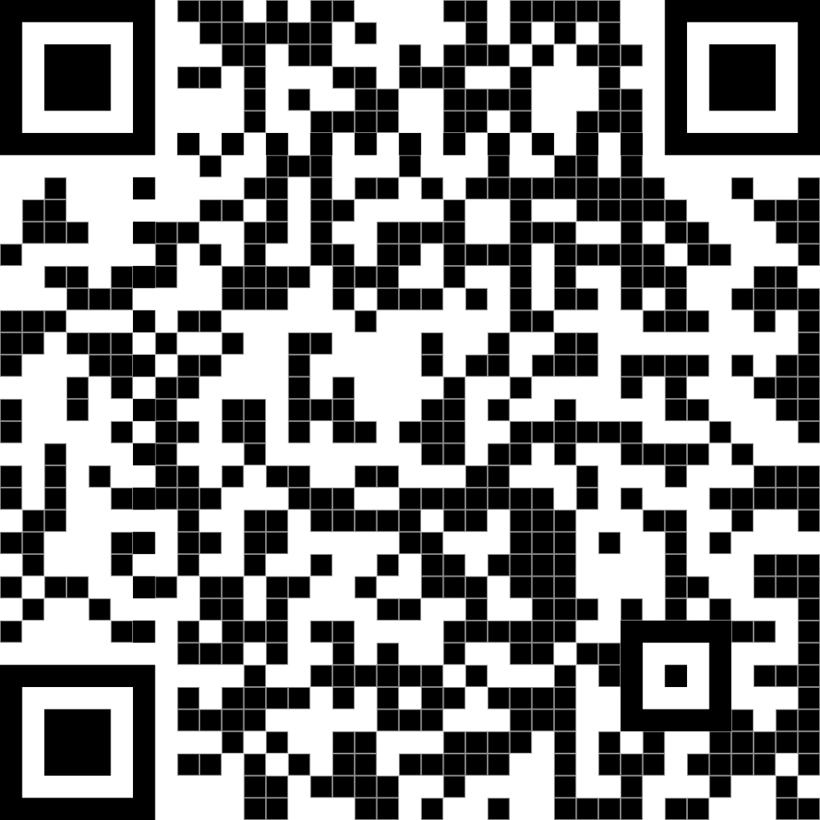
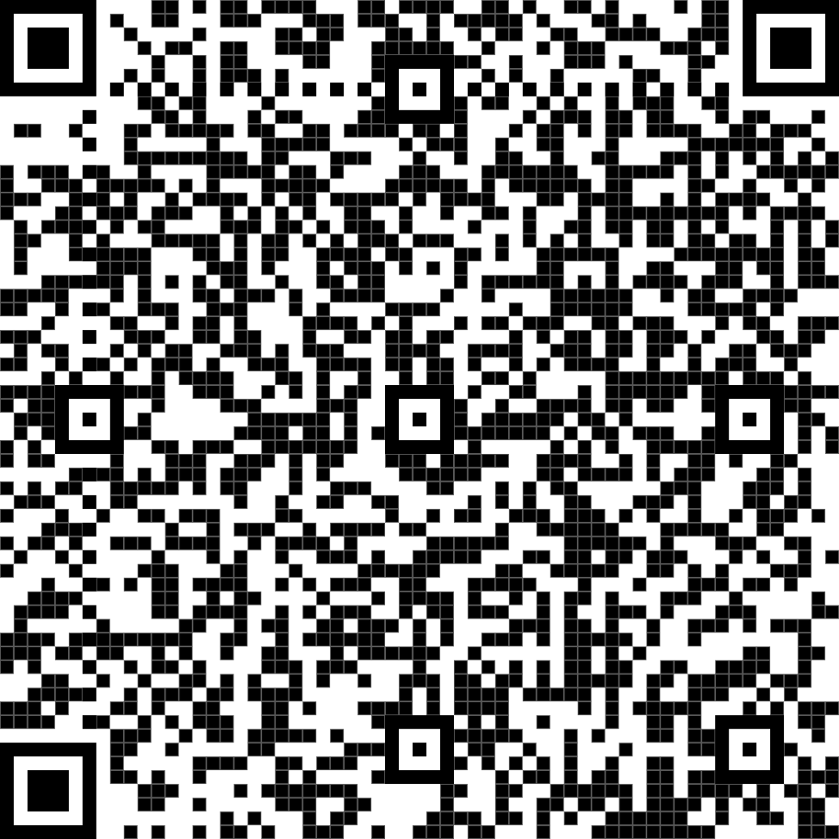
Read or Watch
Notes:
Screenprint. (n.d.). The Metropolitan Museum of Art. https://www.metmuseum.org/about-the-met/collection-areas/drawings-and-prints/materials-and-techniques/printmaking/screenprint
Speedball Art. (2017, October 13). Introduction to photo emulsion [Video]. YouTube. https://www.youtube.com/watch?v=LAWEseSxRt4&list=PLP4qSsVxTu2qKs-ODGgHVBZYRhDbw12_y

Slide 12
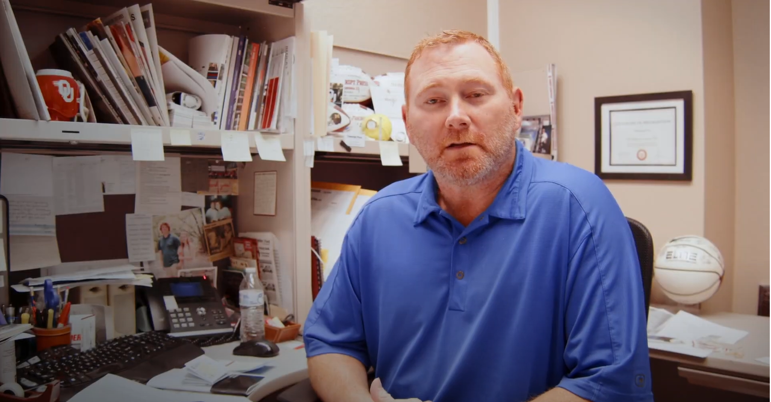
Screenprinting Business Video
Notes:
K20 Center. (n.d.). Clearly this is art. [Video]. YouTube. https://www.youtube.com/watch?v=tS068QvRc0k

Slide 13
Airplane Landing
Your teacher will give you a card with a number on it.
Your group will answer the questions in the order of numbers on the card.
Every group will present in order, even if some groups have the same answer.
Notes:
K20 Center. (n.d.). Airplane landing. Strategies. https://learn.k20center.ou.edu/strategy/78

Slide 14
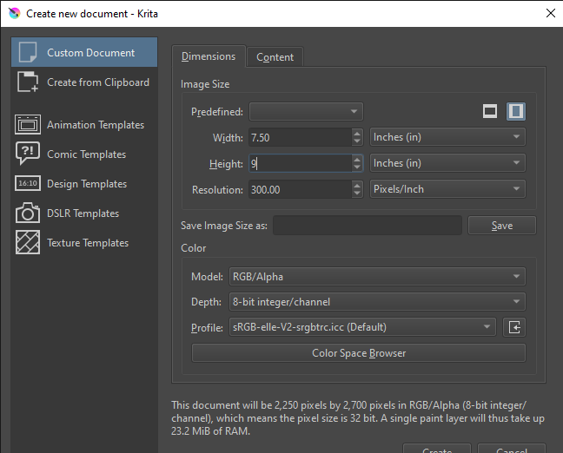
Designing your print
Use only the color black.
Use bold lines. The thinner the lines of their design are, the more difficult it will be to transfer.
Your design must be 7”x 9” or smaller. You can select the size when you make a new document by changing the pixel option to inches.

Slide 15
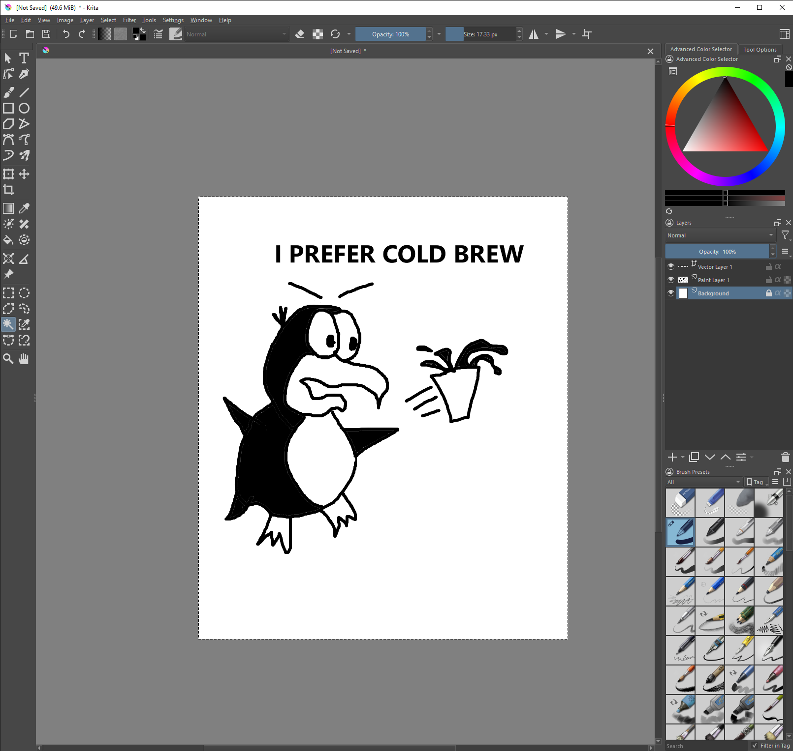
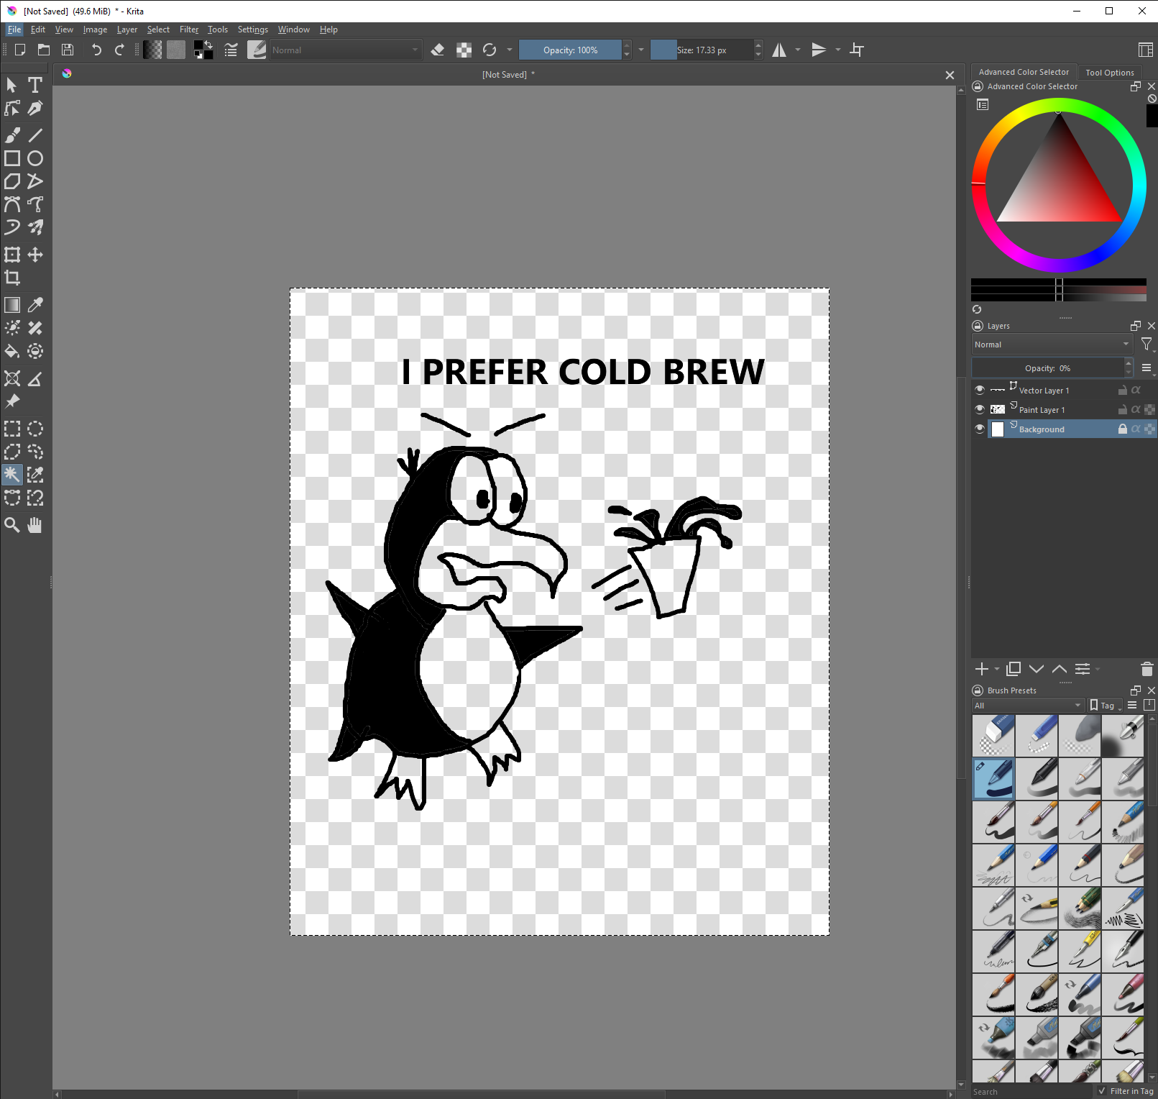
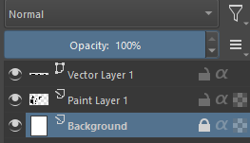
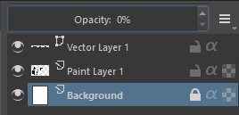
To set the image to transparent, select the Background layer and move the Opacity from 100% to 0%.

Slide 16
Print your shirts!
Place your shirt under the screen and center it.
Pour a line of ink on the top edge of your screen.
Use your squeegee to pull the ink across the design.
Doing this in one swipe down and one swipe up is most effective.

Slide 17
Reflection
Use your device to record a one-minute reflection of the past week. Answer the following questions:
Could I do screen printing for a living?
What did you enjoy about the screen-printing process?
What did you not enjoy about the screen-printing process?
Is screen printing a career you might pursue?

