Slide 2
Comparative Embryology Claim Cards

Slide 3
Claim #1
Animals start as pre-formed, microscopic versions of themselves and just grow bigger. That is, a mouse embryo would look like a tiny mouse that would grow into a bigger mouse before being born.

Slide 4
Claim #2
The more general parts of animals appear earlier in the embryo than the more special parts. From the most general parts the less general are developed, and so on, until finally the most special arises.

Slide 5
Claim #3
An embryo will go through all the different evolutionary kinds of animals within its history before ending as the final animal. (For example, a gorilla embryo would start like a parasite embryo, then like a fish embryo, then like an amphibian embryo, then finally be most like a gorilla embryo.)

Slide 6
Claim #4
Every embryo of all species, instead of passing through the other species, rather becomes separated from them as the embryo develops.

Slide 7
Claim #1 Analyzed
Animals start as pre-formed, microscopic versions of themselves, and just grow bigger. That is, a mouse embryo would look like a tiny mouse that would grow into a bigger mouse before being born.
This is called the Preformation Theory, or Preformationism.
Was popular in the 16th and 17th centuries until microscopes were utilized.
A reproduction of a drawing from 1695 of a tiny person inside a sperm, which is what preformationism believed was true

Slide 8
Claim #2 Analyzed
The more general parts of animals appear earlier in the embryo than the more special parts. From the most general forms the less general are developed, and so on, until finally the most special arises.
This is the first half of Von Baer’s Laws of Embryology, which was first introduced in 1828.
In this picture, the earliest (or youngest) embryo are at the left. The left embryo is the most basic. As the embryo develops, the chicken becomes more specialized.

Slide 9
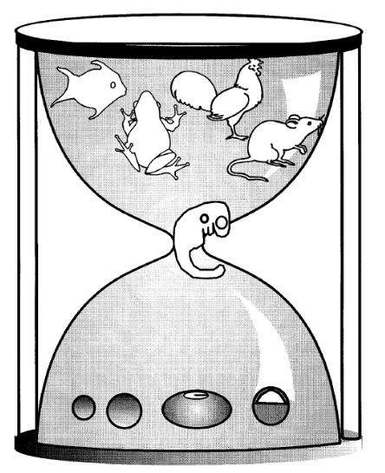
Claim #3 Analyzed
An embryo will go through all the different evolutionary kinds of animals within its history before ending as the final animal. (For example, a gorilla embryo would start like a parasite embryo, then like a fish embryo, then
like an amphibian embryo, then finally
be most like a gorilla embryo.)
This is called the Recapitalization Theory,
first introduced by Haeckel in 1868. It says
that all animals go through every previous
evolutionary version while an embryo.
Even though, as we’ve explored, most
embryos are very similar and go through a
very similar progression, in 1997 a
detailed study was published showing
that the physical similarities aren’t because
of past versions, since similar looking embryo
structures turn into very different organs.
The old idea that all embryos started out exactly the same with all animals, then change into different animals as they develop.

Slide 10
Claim #4 Analyzed
Every embryo of all species, instead of passing through the other species, rather becomes separated from them as the embryo develops.
This is the second half of Von Baer’s Laws of Embryology.
Just as embryos develop from basic to complex, they don’t develop complex parts of other species, just complex parts for their species.
The earliest embryos on top and the later versions at the bottom. The early embryos are very similar, but as they develop, they each develop specific characteristics, not developing all characteristics then losing some.

