Slide 2
Do Three Sides Make a Right?
Converse of the Pythagorean Theorem and Inequality Theorems

Slide 3
Essential Question
How do I use side lengths to determine if a triangle is acute, obtuse, or right?

Slide 4
Lesson Objectives
Determine if three side lengths can make a triangle.
Compare side lengths to determine the type of triangle that is created.

Slide 5

Think-Pair-Share
On the following slides you will be given a problem:
Answer the question on your own.
Write any questions you have on your paper.
Discuss your answer with your group.
Share your group's answer with the class.

Slide 6
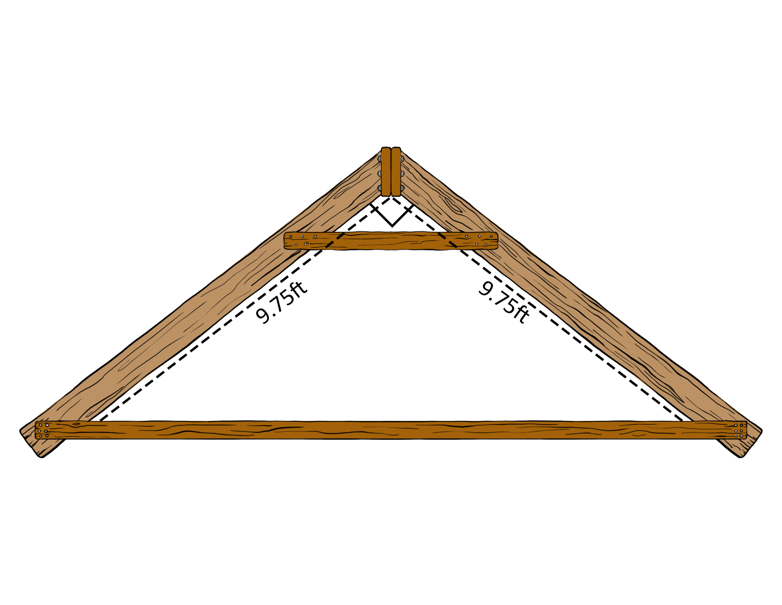
What is the length of the 3rd side?
Answer the question on your own.
Discuss answers with the group.
Share your group’s answers with the class.
?

Slide 7
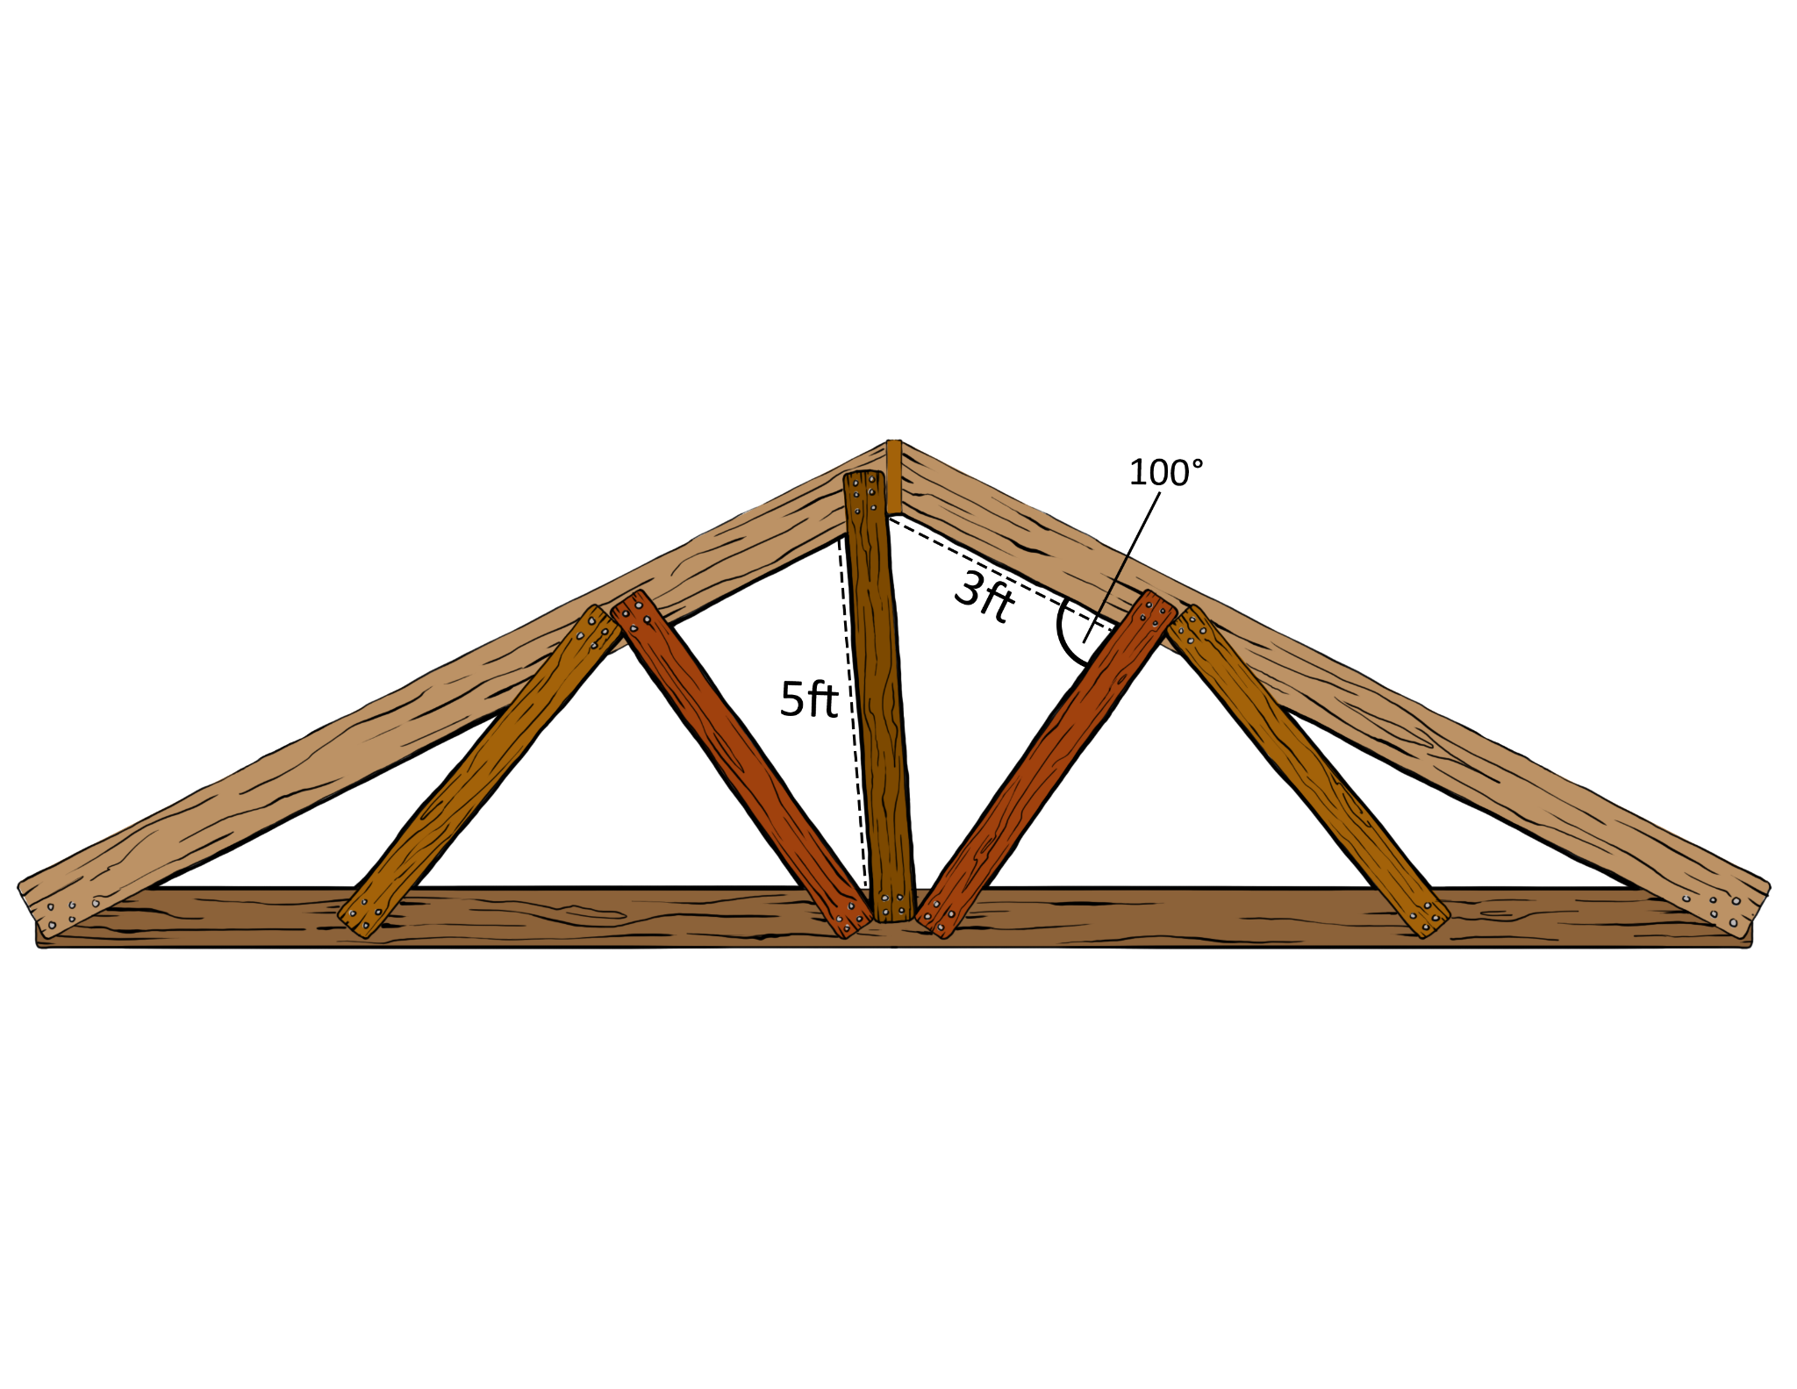
What do you think the length of the 3rd side is?
Answer the question on your own.
Discuss answers with the group.
Share your group’s answers with the class.
?

Slide 8

Chain Notes
Each group gets one sheet of paper.
The first person writes one thing they know about triangles.
Pass the paper around and take turns writing one fact at a time.
Keep taking turns until you have all facts written down.
Be prepared to share your facts with the class.
Notes:
Because this slide activates prior knowledge, slides 8-10 will be optional in the narrative

Slide 9
Triangles
Notes:
Slide 9 is intentionally left blank (referenced in the narrative)

Slide 10
Triangles
3-sided polygon
  (a polygon is a closed shape with straight lines)
Two legs and a hypotenuse
  (Right triangle only)
Acute, Obtuse, Right
  (Classify by angle)
Equilateral, Isosceles, Scalene
  (Classify by sides)

Slide 11
Is It a Triangle?
With your partner, use the GeoGebra activity to decide if the set of numbers is a triangle.
Go to: GeoGebra.org/m/tgwg6tnj
Use the table on your “Is It a Triangle?” handout to keep track of your findings.
Complete the rest of the handout after you complete the GeoGebra activity.

Slide 12
Is It a Triangle?
Which set(s) were not a triangle?
How do we know?

Slide 13
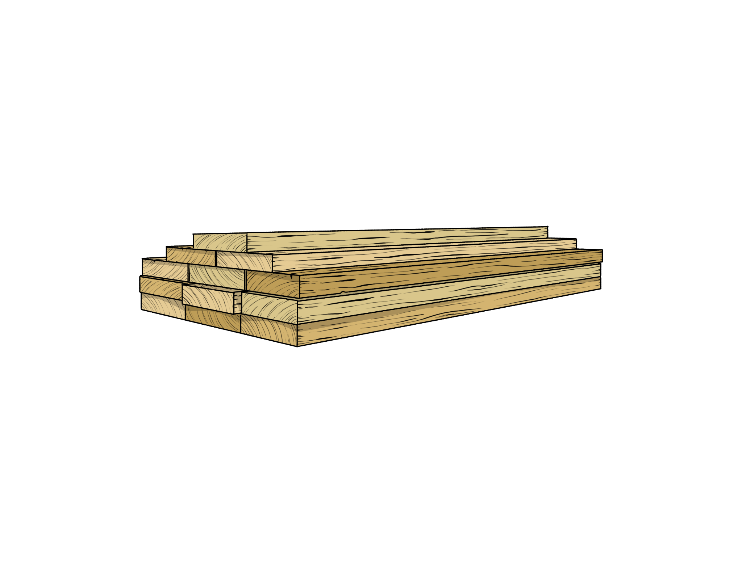
Is It a Triangle?
What makes the set on the right a triangle, but not the one on the left?
1, 2, 3
3, 4, 5

Slide 14
Is It a Triangle?
What makes the set on the right a triangle, but not the one on the left?
1, 2, 3
1 + 2 = 3
3, 4, 5
3 + 4 > 5

Slide 15
Is It a Triangle?
To be a triangle, the following inequality must be true.
a + b > c

Slide 16
Which number set(s) made right triangles?
How do we know?

Slide 17
Which number set(s) made right triangles?
3, 4, 5

Slide 18
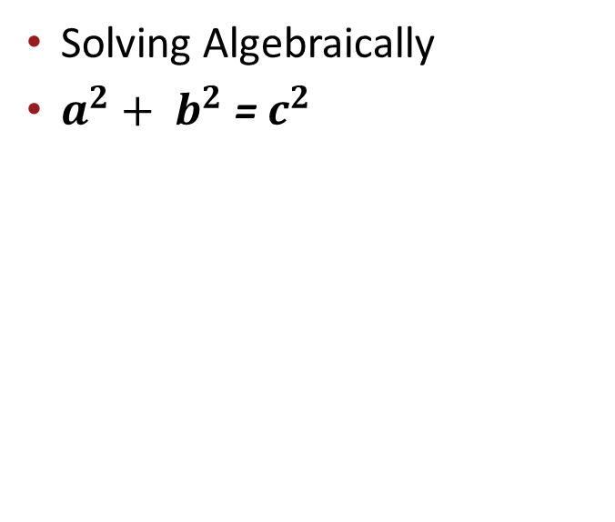
Which number set(s) made right triangles?
3, 4, 5

Slide 19
Which number set(s) made right triangles?
3, 4, 5
5, 12, 13

Slide 20
Which number set(s) made an acute triangle?
How do we know?

Slide 21
Which number set(s) made acute triangles?
12, 16, 18

Slide 22

Which number set(s) made acute triangles?
12, 16, 18

Slide 23
Which number set(s) made acute triangles?
12, 16, 18
3, 3, 4

Slide 24
Which number set(s) made an obtuse triangle?
How do we know?

Slide 25
Which number set(s) made obtuse triangles?
6, 5, 10

Slide 26

Which number set(s) made obtuse triangles?
6, 5, 10

Slide 27
Which number set(s) made obtuse triangles?
6, 5, 10
3, 4, 7

Slide 28
Card Sort
Given the side lengths, sort them into the correct category.

Slide 29
Construction Planning
2x4s are pieces of lumber that are 8 feet long.
Given 4 pieces of this lumber, decide how you will cut the lumber to create the following triangles:
  Acute
  Obtuse
  Right
Indicate what the side length will be and if there will be any excess lumber.

