Slide 1
Introduction to Expository Writing
Expository Writing
English Language Arts

Slide 2

Word Splash
Description
Sequence
Comparison
Cause and Effect
Problem and Solution
Notes:
Option 1 (younger students or those who need differentiation)

Slide 3
Word Splash
Features
Details
Chronological Order
Venn Diagram
Relationships
Questioning
Solutions
Notes:
Option 2

Slide 4
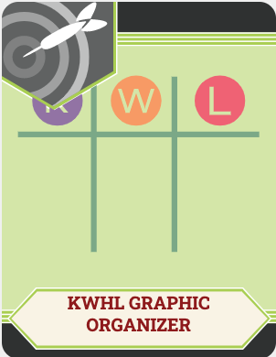
KWL Chart
On a sticky note:
Define expository writing
List two details about what is included in an expository essay.
Put this sticky note under the K on the class chart.

Slide 5
KWL Chart
On a sticky note, ask two questions you have about expository writing.
Put this sticky note under the W on the class chart.

Slide 6
Essential Questions
What is expository writing?
How does expository writing expose information in a variety of ways?

Slide 7
Learning Objectives
Identify the different types of expository writing.
Explain key characteristics of each type of expository writing.
Review essay sets to determine the level with which they have been written appropriately under the guidelines of an expository text.
Compose an expository essay.

Slide 8
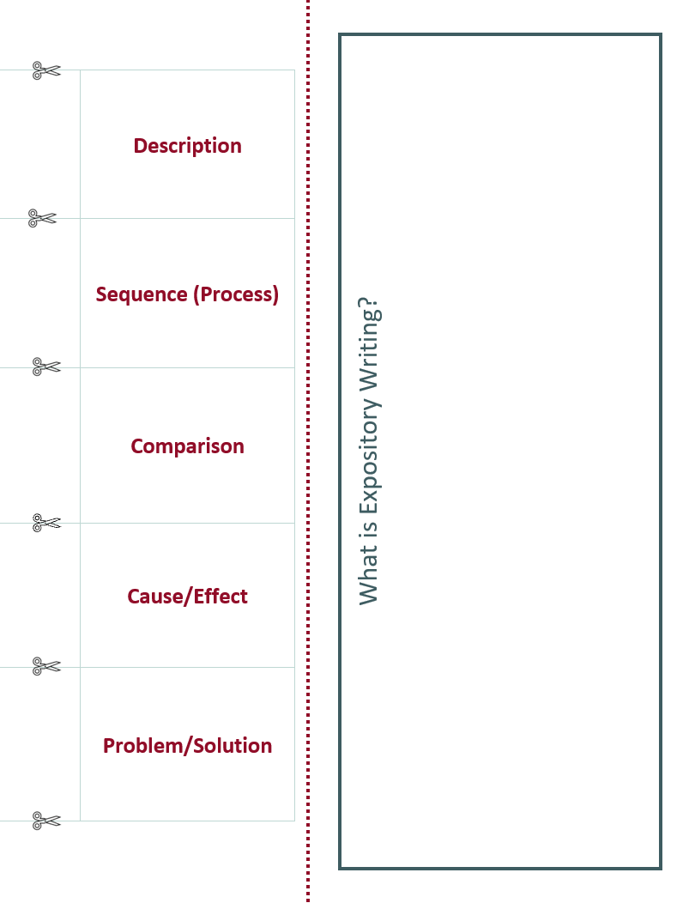
Expository Foldable Directions
Cut along the horizontal lines that separate the writing styles.
Fold your paper vertically along the dotted line.
Do not cut beyond the dotted line!

Slide 9

Photo Deconstruction
For each part of the photo, describe what you are seeing:
People
Places
Objects
What do you notice?
Infer and interpret what you see using evidence from the photo.

Slide 10
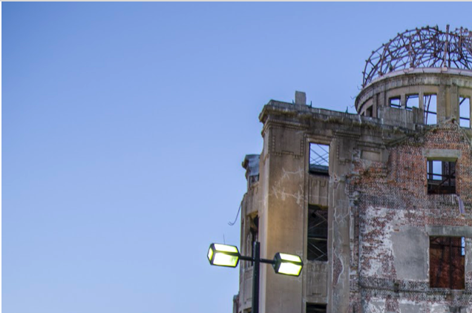

Slide 11


Slide 12


Slide 13


Slide 14
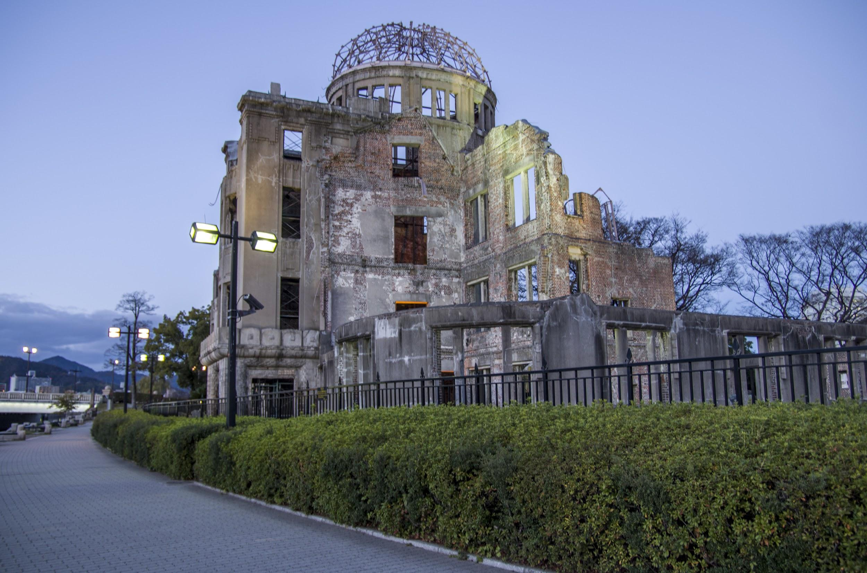
Notes:
Image Source: BirdsEyeLV. (2014, Dec. 6). Atomic bombing dome. Wikimedia Commons. https://commons.wikimedia.org/wiki/File:Atomic_bombing_dome_-_panoramio.jpg
Licensed under the Creative Commons Attribution-Share Alike 3.0 Unported license.

Slide 15
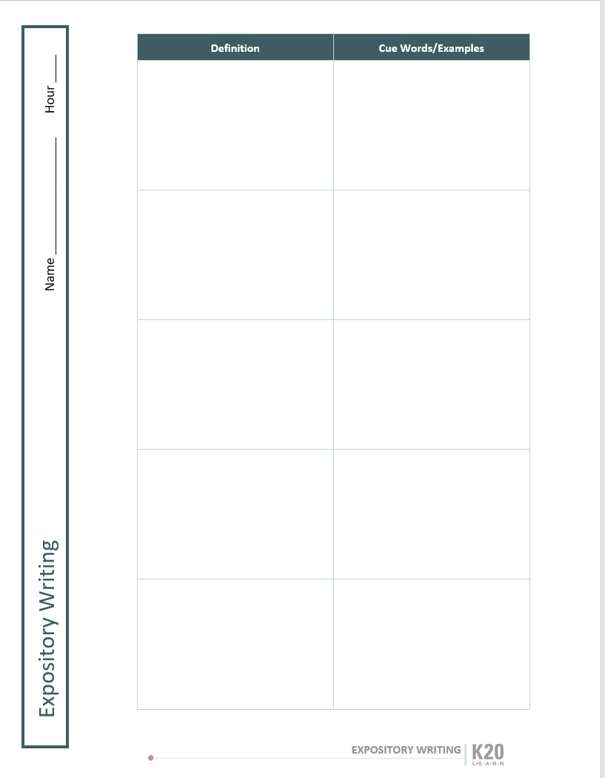
Expository Foldable
Open the Description flap on your Expository Foldable handout and write a definition of descriptive writing in your own words.

Slide 16

List-Group-Label
Find and list the events surrounding the creation of the Atomic Bomb Dome.
What is the Atomic Bomb Dome?
What event “created” it?
What happened just before this event?
What events led up to this event?
Group events together. For example:
By day.
By month.
By country.
Be prepared to justify how and why you grouped your events in a particular way.

Slide 17
Expository Foldable
Open the Sequence (Process) flap on your expository foldable and write a definition of process writing in your own words.

Slide 18
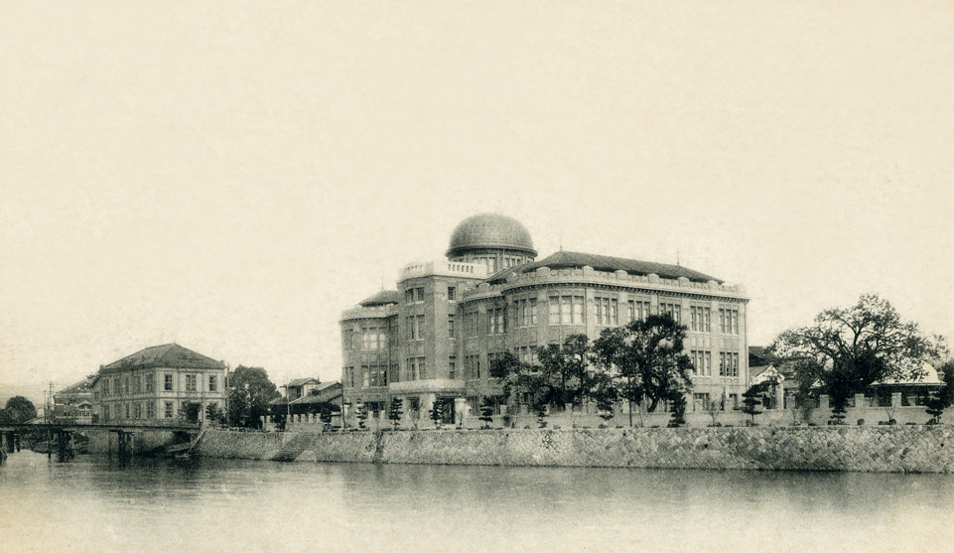
Venn Diagram
Using a Venn Diagram, compare the two images of the historic Atomic Bomb Dome.
Similarities
Differences
Notes:
Top Image Source: Unknown. (n.d.). Hiroshima Commercial Museum Wikimedia Commons. https://commons.wikimedia.org/wiki/File:Hiromuseum.jpg
Public Domain
Bottom Image Source: BirdsEyeLV. (2014, Dec. 6). Atomic bombing dome. Wikimedia Commons. https://commons.wikimedia.org/wiki/File:Atomic_bombing_dome_-_panoramio.jpg
Licensed under the Creative Commons Attribution-Share Alike 3.0 Unported license.

Slide 19
Expository Foldable
Open the Comparison flap on your Expository Foldable handout and write a definition of comparison writing in your own words.

Slide 20

Chain Notes – Part 1
Read and answer the question at the top of your paper.
Pass your paper to the person on your right.

Slide 21
Chain Notes – Part 2
Read the question and answer at the top of the paper that was just handed to you.
Add supporting details or evidence to the response that has already been given.
Pass the paper to the person on your right.

Slide 22
Chain Notes – Part 3
Read the question, answer, and supporting details that have already been given.
Add additional supporting details and evidence.
Pass the paper to the person on your right.

Slide 23
Chain Notes – Part 4
You should now have your original
paper back!
Read responses and supporting evidence provided by others.
Summarize all of the information.

Slide 24
Expository Foldable
Open the Cause and Effect flap on your expository foldable and write a definition of cause and effect writing in your own words.

Slide 25

Pass the Problem – Part 1
Read the problem description that you received.
Work with your partner to design a multi-step solution to your problem.

Slide 26
Pass the Problem – Part 2
Pass your problem/solution paper to another pair.
Read the problem/solution that was just handed to you.
With your partner, continue to work on solving the problem, picking up where the last pair left off.

Slide 27
Pass the Problem – Part 3
Pass your problem/solution paper to a third pair.
Read the problem/solution that was just handed to you.
With your partner, modify and complete the solution you received from your classmates.
Make notes and prepare to justify your reasoning.

Slide 28
Expository Foldable
Open the Problem and Solution flap of your Expository Foldable handout and write a definition of problem and solution writing in your own words.

Slide 29

Anchor Chart
With your team, research the specifics of one style of expository writing.
Create an anchor chart that includes the following information:
  Definition
  Key characteristics
  Cue words

Slide 30
Expository Foldable
As each group shares, add new information to your Expository Foldable handout.

Slide 31
Expository Writing
Choose one of following prompts for your paragraph:
Description | Deconstruct one of the images from the Time 100 Images list.
Sequence | Sequence 10 things you want to do in your life before you die in order from highest to lowest priority.
Comparison | Compare and contrast two characters from your favorite movie.
Cause and Effect | Explain the effects of image- and video-based social media sites like Snapchat or Instagram on teenagers’ social interactions.
Problem and Solution | Create a multi-step solution to the problem of students struggling to pay attention in class.
Notes:
Goldberger, B., Moakley, P., & Pollack, K. (n.d.). 100 photographs: The most influential images of all time. Time. http://100photos.time.com/

Slide 32

Two Stars and a Wish
Swap paragraphs with a partner.
Read your partner’s paragraph and provide feedback to help them improve their writing.
  2 positive statements about their writing (the stars)
  1 area of improvement (the wish)

Slide 33
KWL Chart
On a sticky note:
Write down at least 3 things you learned during the lesson.
Stick this sticky note under the L on the class chart.

