Slide 2
Are You Thinking What I Am Thinking?
Persuasive Writing

Slide 3
All kids should play sports.

Slide 4

Fold the Line
Line yourself up on whether you agree with the statement or not.
Discuss the prompt with a nearby classmate who might share a similar opinion to your own.
Now, fold the line and find a new partner.
Debate your stance with this new partner.
Notes:
The directions fly in one at a time when you click.

Slide 5
Essential Question
How can our writing persuade others?

Slide 6
Lesson Objectives
Understand how to persuade someone with your words.
Learn what makes a persuasive essay strong and convincing.

Slide 7
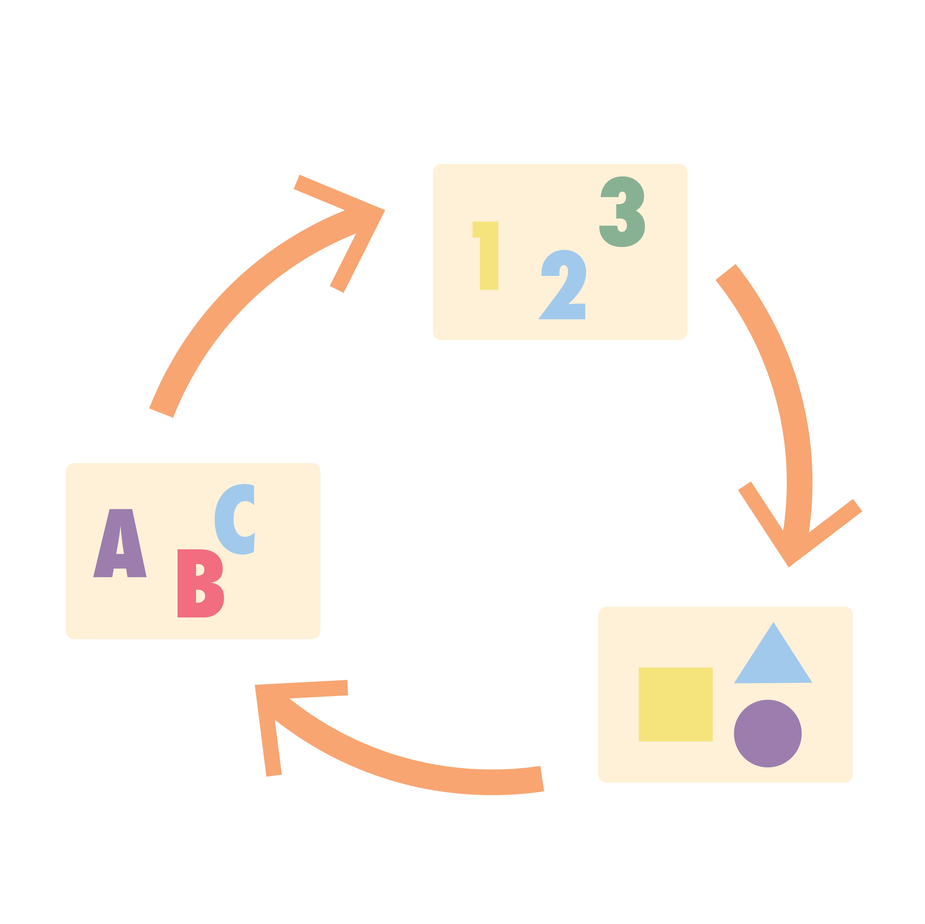
Find the Persuasive Elements
What is the claim or wish in this scenario?
Identify two pieces of evidence that support the claim.
Explain why the reasoning in this example is strong or weak.

Slide 8
Persuasive Essay
A persuasive essay, also known as an argumentative or opinion essay, is written when you are trying to convince someone of something based on your beliefs and ideas, backed by reasons.

Slide 9

Persuasive Essay Layout
Paragraph 1:
Introduction: State your claim/position
Paragraphs 2-4: (3 reasons, 1 paragraph per reason)
Reason: Opening
Supporting Evidence
Concluding Statement
Paragraph 5:
Conclusion
Notes:
You may want to display this slide during the writing time or make sure this information is written on a chart or the board.

Slide 10
Questions to Think About
What is persuasive writing?
What needs to be in the introduction?
Why is it essential to include reasoning or evidence?
What goes into the conclusion of the writing?
What words can help with transitions for this type of writing?

Slide 11
Some Persuasive Writing Topics
We should not have a school dress code.
Pets should be allowed in school.
School break times should be longer.
There should be no homework.
I should get a pocket money raise from my parents
I should be able to go to bed later.
Year-round school is a good/bad idea
Life without the internet would be…
Keeping animals in zoos is…
I should be allowed to have a pet (or another pet!).
I should be able to stay at home on my own.
Everyone should learn a foreign language.
Nobody should litter.
Everyone should have to exercise every day.
We should all grow our own vegetables.
Smoking should be banned for everyone.
Saving the Planet is….
Celebrities matter because…
Notes:
These are just some ideas in case students can’t think of something on their own.

Slide 12
Some Persuasive Words
Some people believe that
In my opinion
Therefore
For this reason
I feel that
I am sure that
Surely
It is certain
Firstly,
Secondly,

