Slide 2

Multimodal Narrative Writing
Thumbprint Biography

Slide 3
Essential Questions
Who am I?
What makes me “me”?

Slide 4
Learning Objectives
I can plan a multimodal narrative.
I can combine visual elements and figurative language to tell a unique personal story.

Slide 5


Quick Write
What makes you unique?
What sets you apart from everyone else and makes you you?
Write for 5 minutes; then share one piece of information with a partner.
Notes:
K20 Center. K20 Center 5-minute timer [Video]. YouTube. https://www.youtube.com/watch?v=EVS_yYQoLJg&list=PL-aUhEQeaZXLMF3fItNDxiuSkEr0pq0c2&index=8
K20 Center. (n.d.). Think-pair-share. Strategies. https://learn.k20center.ou.edu/strategy/139

Slide 6
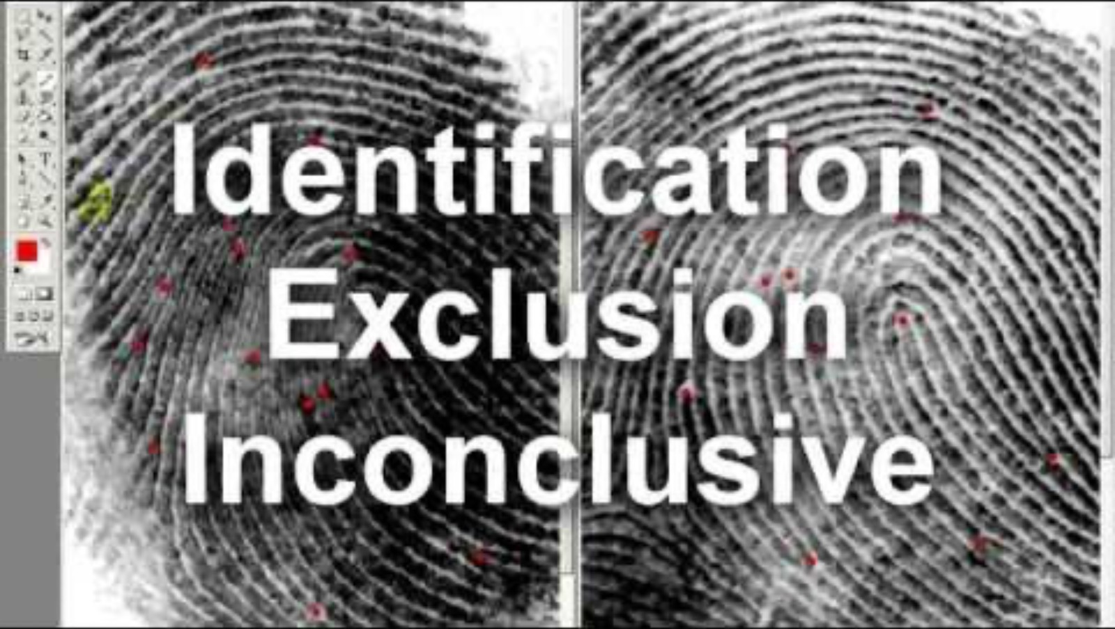

Unique Fingerprints
While watching the videos:
  Analyze your fingerprints.
  Pay special attention to the lines of your thumbprint. You will use them later.
After watching the videos:
  Analyze a partner’s fingerprints.
  Share what you discovered.
Notes:
Life Noggin, (2015, January 22). Why is every fingerprint unique? [Video]. YouTube. https://www.youtube.com/watch?v=5-OI95dpNSM
Ray Forensics. (2010, November 22). How to compare fingerprints - The Basics [Video]. YouTube. https://www.youtube.com/watch?v=IrpTqKkgygA

Slide 7
Draw Your Thumbprint
Draw a large oval (or use the template).
Fill it in with your thumbprint lines.

Slide 8

Pre-Writing
On a separate sheet of paper, answer the guiding questions. Use complete sentences to tell your story. Only write about things you don’t mind sharing.
Generate your own questions about your story that you are able to answer.
When you are finished, discuss your answers and questions with your partner.
Notes:
K20 Center. (n.d.). Question generating. Strategies. https://learn.k20center.ou.edu/strategy/167

Slide 9

Fill In Your Thumbprint
Use your answers to the guiding questions and the answers to the questions you generated to fill in your thumbprint oval.
Notes:
K20 Center. (n.d.). Gallery walk / carousel. Strategies. https://learn.k20center.ou.edu/strategy/118

Slide 10

Gallery Walk
Place your Thumbprint Autobiography on your desk.
Move around the room to read your classmates’ Thumbprint Autobiographies.
Use sticky notes to leave at least one positive comment for each autobiography you read.

Slide 11
Extension: Revisit Quick Write
Go back and look at your quick write from the beginning
of the lesson. Extend it by writing about what you learned
or remembered about yourself during this process.
What makes you unique?
What sets you apart from everyone else and makes you you?

