Slide 2
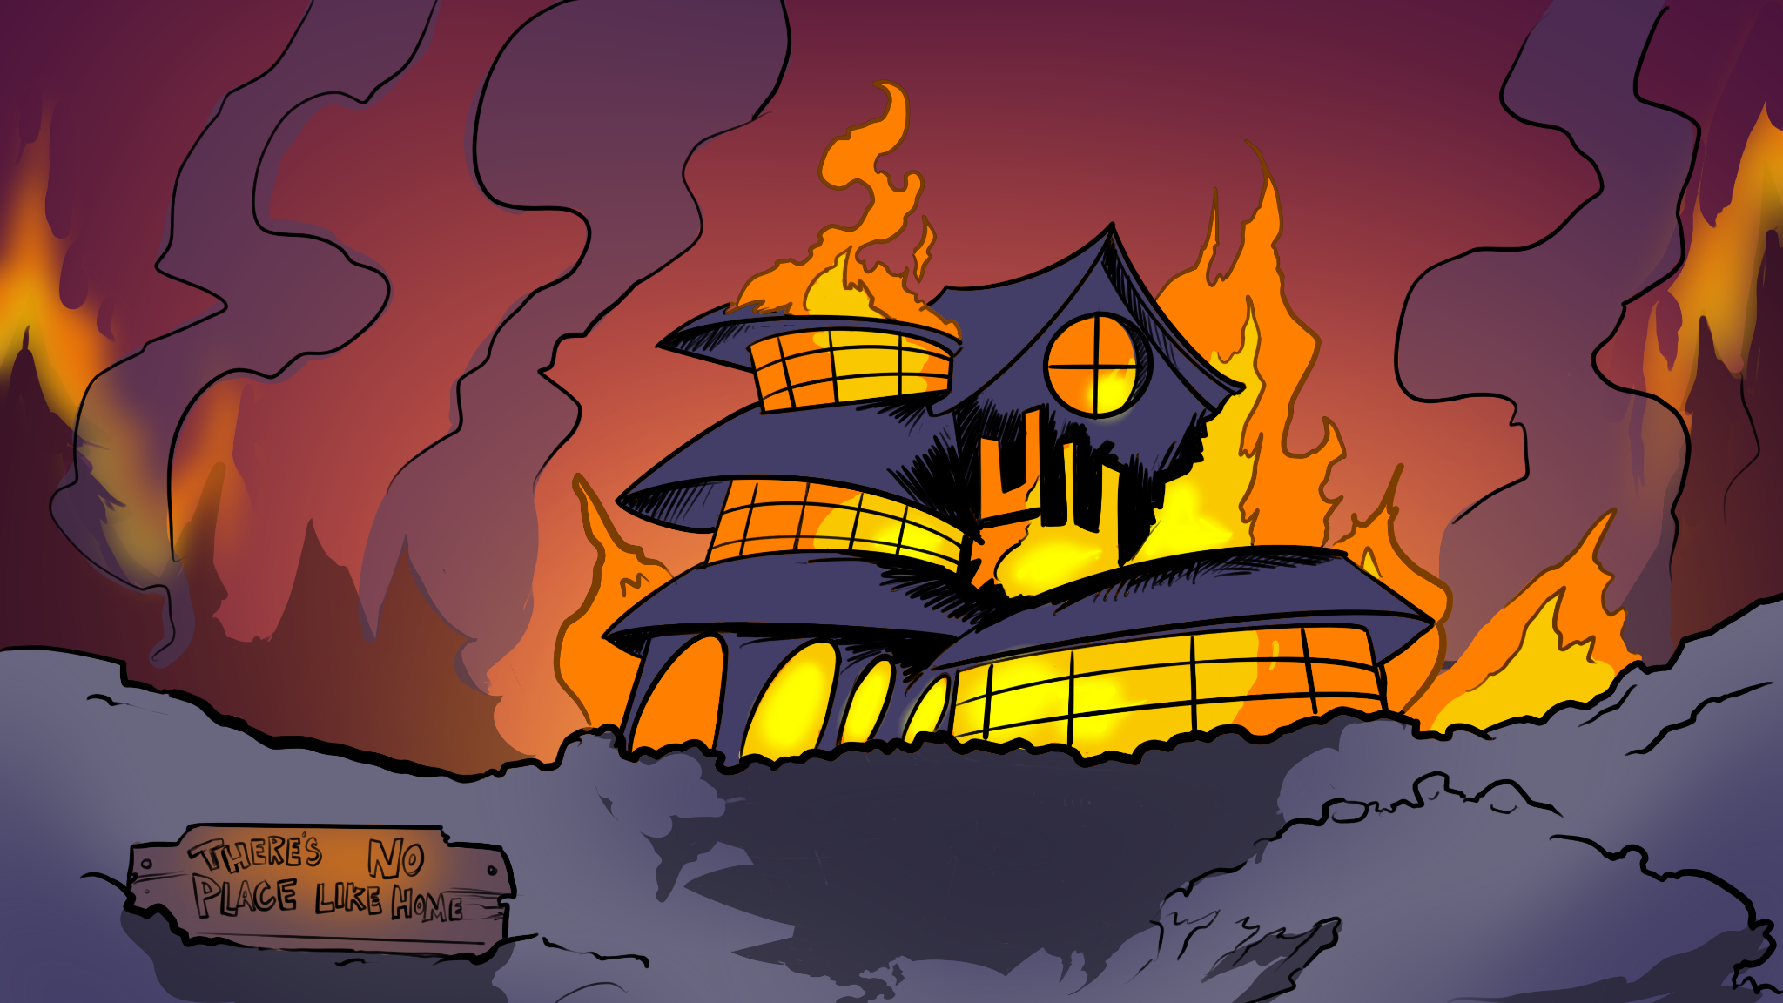
There’s No Place Like Home
Analyzing imagery in Ray Bradbury’s “There Will Come Soft Rains”

Slide 3
Lesson Objectives
Analyze imagery in a text and its effect on mood and tone
Write a CER explaining your literary analysis
Describe what a profession in real estate looks like

Slide 4
Essential Question
How does imagery affect the mood and tone of a text?

Slide 5
Bell Ringer
What makes a house a “Smart House”?
Would you want to live in a smart home? Why or why not?
Notes:
K20 Center. (n.d.). Bell Ringers and Exit Tickets. Strategy. https://learn.k20center.ou.edu/strategy/125
YouTube. (2019, July 1). A day in the life of a smart home. YouTube. https://www.youtube.com/watch?v=909Nn9_hrlM

Slide 6
Chat Stations
In groups of 2-3, visit each chat station. Discuss the question in your groups and write one takeaway using the half-sheet handout. You will have 3-5 minutes at each station.
Notes:
K20 Center. (n.d.).Chat Stations. Strategy. https://learn.k20center.ou.edu/strategy/944

Slide 7
Chat Station Norms
Each person will share their thoughts.
Invite everyone to speak.
Take turns to listen and ask questions.
Stay on topic.

Slide 8
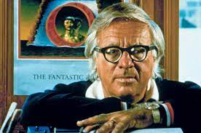
Who is Ray Bradbury?
Born: August 22, 1920
Died: June 5, 2012
Nationality: American
Genres: Science Fiction, Fantasy, Horror, Mystery
Notable Works:
“There Will Come Soft Rains” (1950)
“The Pedestrian” (1951)
“A Sound of Thunder” (1952)
Fahrenheit 451 (1953)
Notes:
Encyclopædia Britannica, inc. (n.d.). Ray Bradbury: Media. Encyclopædia Britannica. from https://www.britannica.com/biography/Ray-Bradbury/images-videos#/media/1/76755/231130

Slide 9
Stop and Jot
Title your paper “There Will Come Soft Rains”
Number your paper 1 to 8 with some space between each number.
When the audio stops, on your paper jot down the answers to the questions.
Notes:
K20 Center. (n.d.). Stop and Jot. Strategy. https://learn.k20center.ou.edu/strategy/168

Slide 10
“There Will Come Soft Rains” by Ray Bradbury
Listen to the short story as the audio plays and highlight anywhere there is imagery.
Pause to complete the Stop and Jots and be prepared to discuss as we read.
Notes:
YouTube. (2015, November 14). 'there will come soft rains' - ray bradbury || scifi short story. YouTube. https://www.youtube.com/watch?v=P142xPtua-c
Use the following list to pause the video and give students the time to stop and jot responses on their handout.
Stop and Jot 1: 2:34
Stop and Jot 2: 3:25
Stop and Jot 3: 4:39
Stop and Jot 4: 7:41
Stop and Jot 5: 10:07
Stop and Jot 6: 11:22
Stop and Jot 7: 14:57
Stop and Jot 8:end of video

Slide 11
Literary Analysis CERs
How does the imagery in the story affect the mood and tone of the story?
Claim: The imagery in Ray Bradbury’s “There Will Come Soft Rains” affects the mood and tone by ______.
Evidence: [insert textual evidence].
Reasoning:
Evidence: [insert textual evidence].
Reasoning:
Notes:
K20 Center. (n.d.).Claim, Evidence, Reasoning (CER). Strategy. https://learn.k20center.ou.edu/strategy/156

Slide 12
Literary Analysis CERs
How does the imagery in the story affect the mood and tone of the story?
Claim: The imagery in Ray Bradbury’s “There Will Come Soft Rains” affects the mood and tone by ______.
Evidence: For example, [insert textual evidence].
Reasoning: This shows ______. This is important because ______.
Evidence: Furthermore, [insert textual evidence].
Reasoning: This shows ______. This is important because ______.

Slide 13
Notes:
YouTube. (2023b, August 1). K20 ICAP - No Place Like Home. YouTube. https://www.youtube.com/watch?v=y-ZO260qcpM

Slide 14
Two Stars And A Wish
What were two things you learned from the interview and/or today’s lesson?
What is one thing you wish to learn more about this profession?
Notes:
K20 Center. (n.d.).Two Stars and a Wish. Strategy. https://learn.k20center.ou.edu/strategy/83

