Slide 2
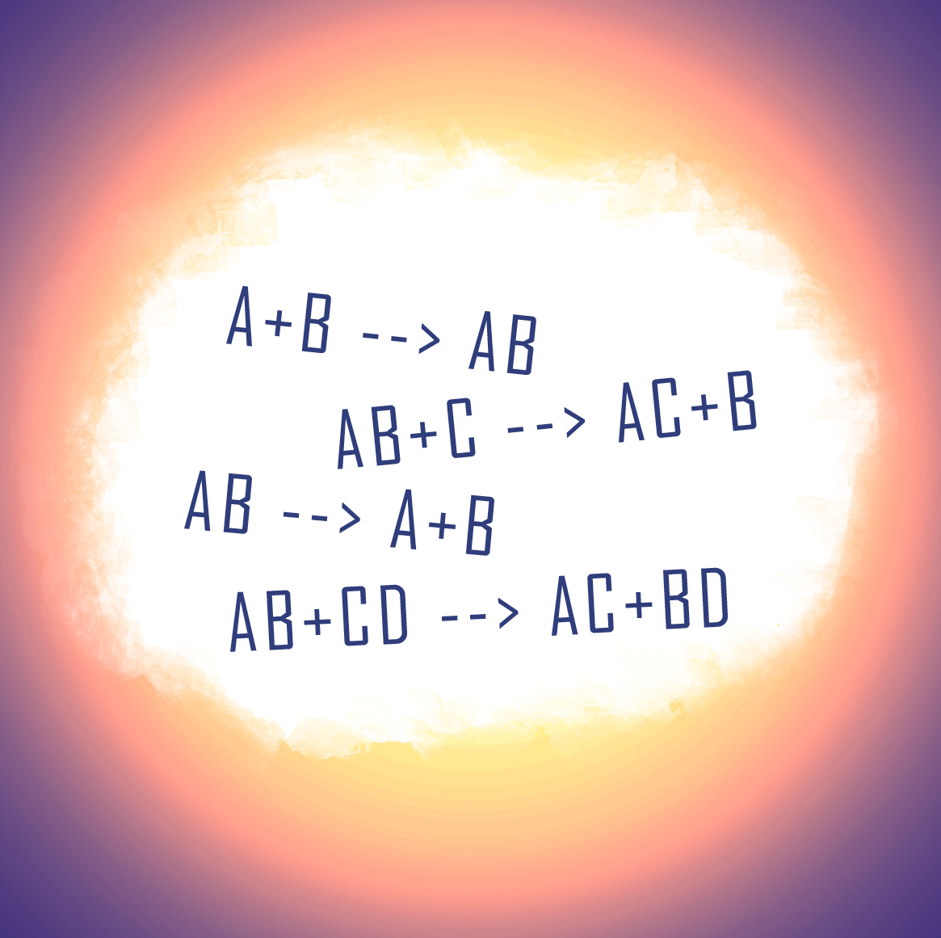
Happy, Sad, Sleepy, Mad
Classifying Chemical Reactions

Slide 3
Essential Question
What patterns are present in chemical reactions?

Slide 4
Learning Objective(s)
Recognize different types of reactions.
Classify reactions into different types.

Slide 5
Parts of a Chemical Formula
Reactant + Reactant → Product(s)
Reactants
  Starting substances in a reaction
Reaction (yield)
  Actual reaction process (the arrow)
Products
  Substance(s) formed as a result of the reaction

Slide 6

Kids vs. Food - Chicken Feet
https://www.youtube.com/watch?v=xBSzlvQOvfk&t=1s
Notes:
Kids REACT. (2 Aug., 2016). KIDS vs. FOOD - CHICKEN FEET [Video]. YouTube. https://www.youtube.com/watch?v=xBSzlvQOvfk&t=1s

Slide 7
Kids vs. Food - Chicken Feet
Reactant + Reactant → Product(s)
Reactants
  The kids and the chicken feet
Reaction (yield)
  Kids eating the chicken feet
Products
  How the kids feel after eating the chicken feet

Slide 8

Reaction Card Sort: Instructions
Group similar reactions together.
Use sticky notes to label the reaction groups.
  e.g. synthesis
Use sticky notes to explain why you grouped those reactions together.
Walk around the room to look at other groups’ reaction categories.
Notes:
K20 Center. (n.d.). Card sort. Strategies. https://learn.k20center.ou.edu/strategy/147

Slide 9
Reaction Card Sort: Solutions
Synthesis: Many reactants become one product
4Fe(s) + 3O₂(g) → 2Fe₂O₃(s)
N₂(g) + 3H₂(g) → 2NH₃(g)
2SO₂(g) + O₂(g) → 2SO₃(g)
MgO(s)+ H₂O(l) → Mg(OH)₂(aq)
P₂O₅(g) + 3H₂O(l) → 2H₃PO₄(aq)
SO₃(g) + H₂O(l) → H₂SO₄(aq)

Slide 10
Reaction Card Sort: Solutions
Decomposition: One reactant becomes many products
MgCO₃(s) → MgO(s) + CO₂(g)
8Li₂S(s) → 16Li(s) + S₈(s)
2H₂O(l) → 2H₂(g) + O₂(g)
2KClO₃(s) → 2KCl(s) + 3O₂(g)
2Na₂O₂(s) → 2Na₂O(s) + O₂(g)
(NH₄)₂CO₃(s) → 2NH₃(g) + H₂O(l) + CO₂(g)

Slide 11
Reaction Card Sort: Solutions
Single Replacement: Part of one ionic compound is removed or replaced by another element
2FeCl₃(aq) + 3Zn(s) → 2Fe(s) + 3ZnCl₂(aq)
2Al(NO₃)₃(aq) + 3Ca(s) → 3Ca(NO₃)₂(aq) + 2Al(s)
Mg(s) + CuSO₄(aq) → MgSO₄(aq) + Cu(s)
2Al(s) + 6HCl(aq) → 2AlCl₃(aq) + 3H₂(g)
Cl₂(g) + 2NaBr(aq) → 2NaCl(aq) + Br₂(l)
ZnBr₂(aq) + F₂(g) → ZnF₂(aq) + Br₂(l)

Slide 12
Reaction Card Sort: Solutions
Double Replacement: Ionic compounds dissolved in water switch partners
AgNO3(aq) + NaCl(aq) → AgCl(s) + NaNO3(aq)
2HNO3(aq) + Mg(OH)2(aq) → Mg(NO3)2(aq) + 2H2O(l)
Na2CO3(aq) + CaCl2(aq) → CaCO3(s) + 2NaCl(aq)
FeS(s) + 2HCl(aq) → H2S(g) + FeCl2(aq)
HCl(aq) + NaOH(aq) → H2O(l) + NaCl(aq)
FeBr3(aq) + K3PO4(aq) → FePO4(s) + 3KBr(aq)

Slide 13
Reaction Card Sort: Solutions
Precipitation: Two ionic compounds dissolved in water make a solid, these are also double replacement reactions
FeBr₃(aq) + K₃PO₄(aq) → FePO₄(s) + 3KBr(aq)
Na₂CO₃(aq) + CaCl₂(aq) → CaCO₃(s) + 2NaCl(aq)
AgNO₃(aq) + NaCl(aq) → AgCl(s) + NaNO₃(aq)

Slide 14
Reaction Card Sort: Solutions
Acid/Base: When H⁺ and OH⁻ combine to make H₂O, these are also double replacement reactions
HCl(aq) + NaOH(aq) → H₂O(l) + NaCl(aq)
2HNO₃(aq) + Mg(OH)₂(aq) → Mg(NO₃)₂(aq) + 2H₂O(l)

Slide 15
Reaction Card Sort: Solutions
Combustion: When an element or compound combines with oxygen, these are also synthesis reactions
2SO₂(g) + O₂(g) → 2SO₃(g)
4Fe(s) + 3O₂(g) → 2Fe₂O₃(s)

Slide 16
Reaction Card Sort: Solutions
Oxidation-reduction: The charge or oxidation state of an element changes from reactants to products
4Fe(s) + 3O₂(g) → 2Fe₂O₃(s) | 2FeCl₃(aq) + 3Zn(s) → 2Fe(s) + 3ZnCl₂(aq)
N₂(g) + 3H₂(g) → 2NH₃(g) | 2Al(NO₃)₃(aq) + 3Ca(s) → 3Ca(NO₃)₂(aq) + 2Al(s)
8Li₂S(s) → 16Li(s) + S₈(s) | Mg(s) + CuSO₄(aq) → MgSO₄(aq) + Cu(s)
2SO₂(g) + O₂(g) → 2SO₃(g) | 2Al(s) + 6HCl(aq) → 2AlCl₃(aq) + 3H₂(g)
2H₂O(l) → 2H₂(g) + O₂(g) | Cl₂(g) + 2NaBr(aq) → 2NaCl(aq) + Br₂(l)
2KClO₃(s) → 2KCl(s) + 3O₂(g) | ZnBr₂(aq) + F₂(g) → ZnF₂(aq) + Br₂(l)
2Na₂O₂(s) → 2Na₂O(s) + O₂(g)

Slide 17
Reaction Lab: Instructions
Read the instructions on the Lab Guide handout carefully.
When you are finished at one station, make sure to clean it up before moving to the next one.
Fill out your answers and observations as you go.
Follow all safety precautions!

Slide 18
Reaction Lab: Solutions
Station 1:
Single replacement, redox
2Zn + 2HCl → H₂ + 2ZnCl

Slide 19
Reaction Lab: Solutions
Station 2:
Decomposition
CuCO₃ → CuO + CO₂

Slide 20
Reaction Lab: Solutions
Station 3:
Combustion, synthesis, redox
2Mg + O₂ → 2MgO

Slide 21
Reaction Lab: Solutions
Station 4:
Double replacement, precipitation
KI + Pb(NO₃)₂ → KNO₃ + PbI₂ (s)

Slide 22
Reaction Lab: Solutions
Station 5:
Synthesis, redox
Cu + S → CuS

Slide 23
Reaction Lab: Solutions
Station 6:
Acid/Base
HCl + NaHCO₃ → NaCl + CO₂ + H₂O

Slide 24

Chalk Talk
Walk around to each of the four posters. Each poster has a question on it.
Think about the question silently.
Write your answer on the poster.
Move to the next poster and repeat the process.
Notes:
K20 Center. (n.d.). Chalk talk. Strategies. https://learn.k20center.ou.edu/strategy/197

