Slide 2
What Wolf Pack Do You Belong To?

Slide 3
Scoring Your Quiz
Add up all of your answers to see which wolf pack you belong to!
Total number of As
Total number of Bs
Total number of Cs
Total number of Ds
Total number of Es

Slide 4
Which Wolf Pack Do You Belong To?
Skinwalkers of the Navajo People
Berserkers of the Viking Warrior Culture
Lobisomem of Brazilian and Portuguese Folklore
Wurdulac from Slavic History
Lycaon of Greek Mythology

Slide 5
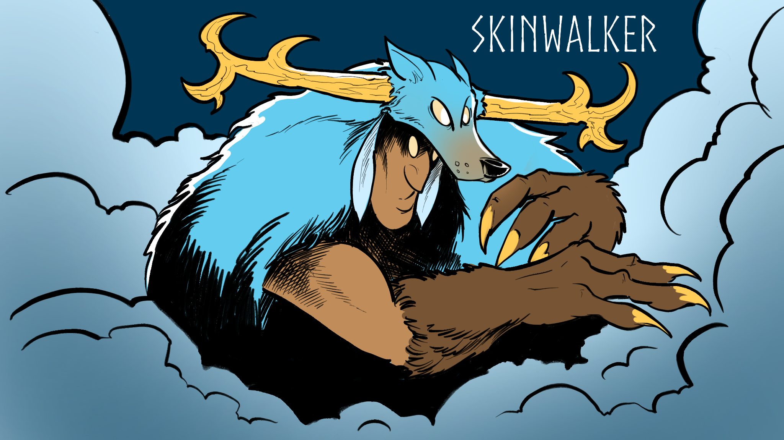
If you answered with mostly As…

Slide 6
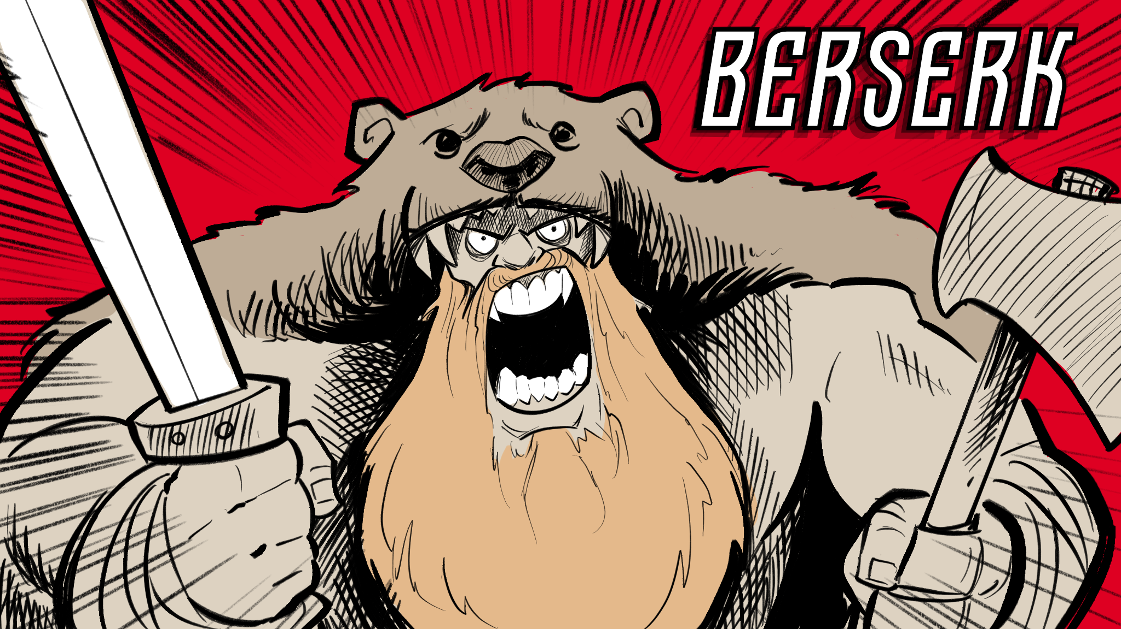
If you answered with mostly Bs…

Slide 7
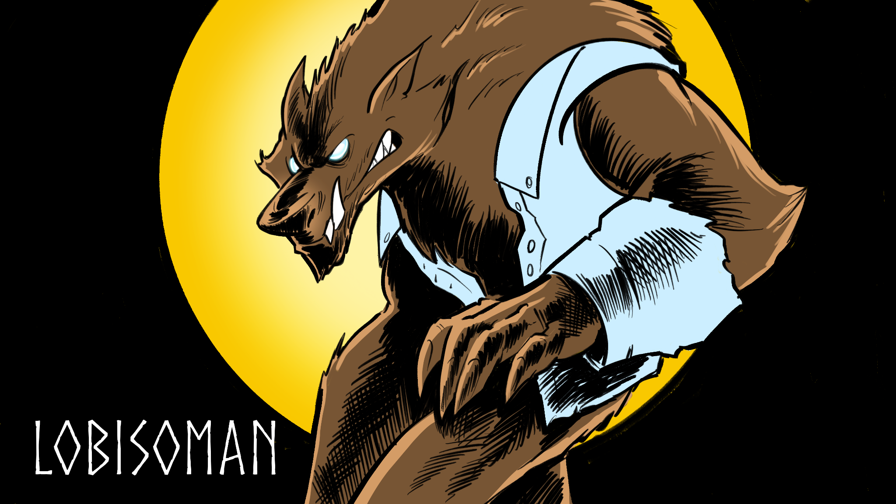
If you answered with mostly Cs…

Slide 8
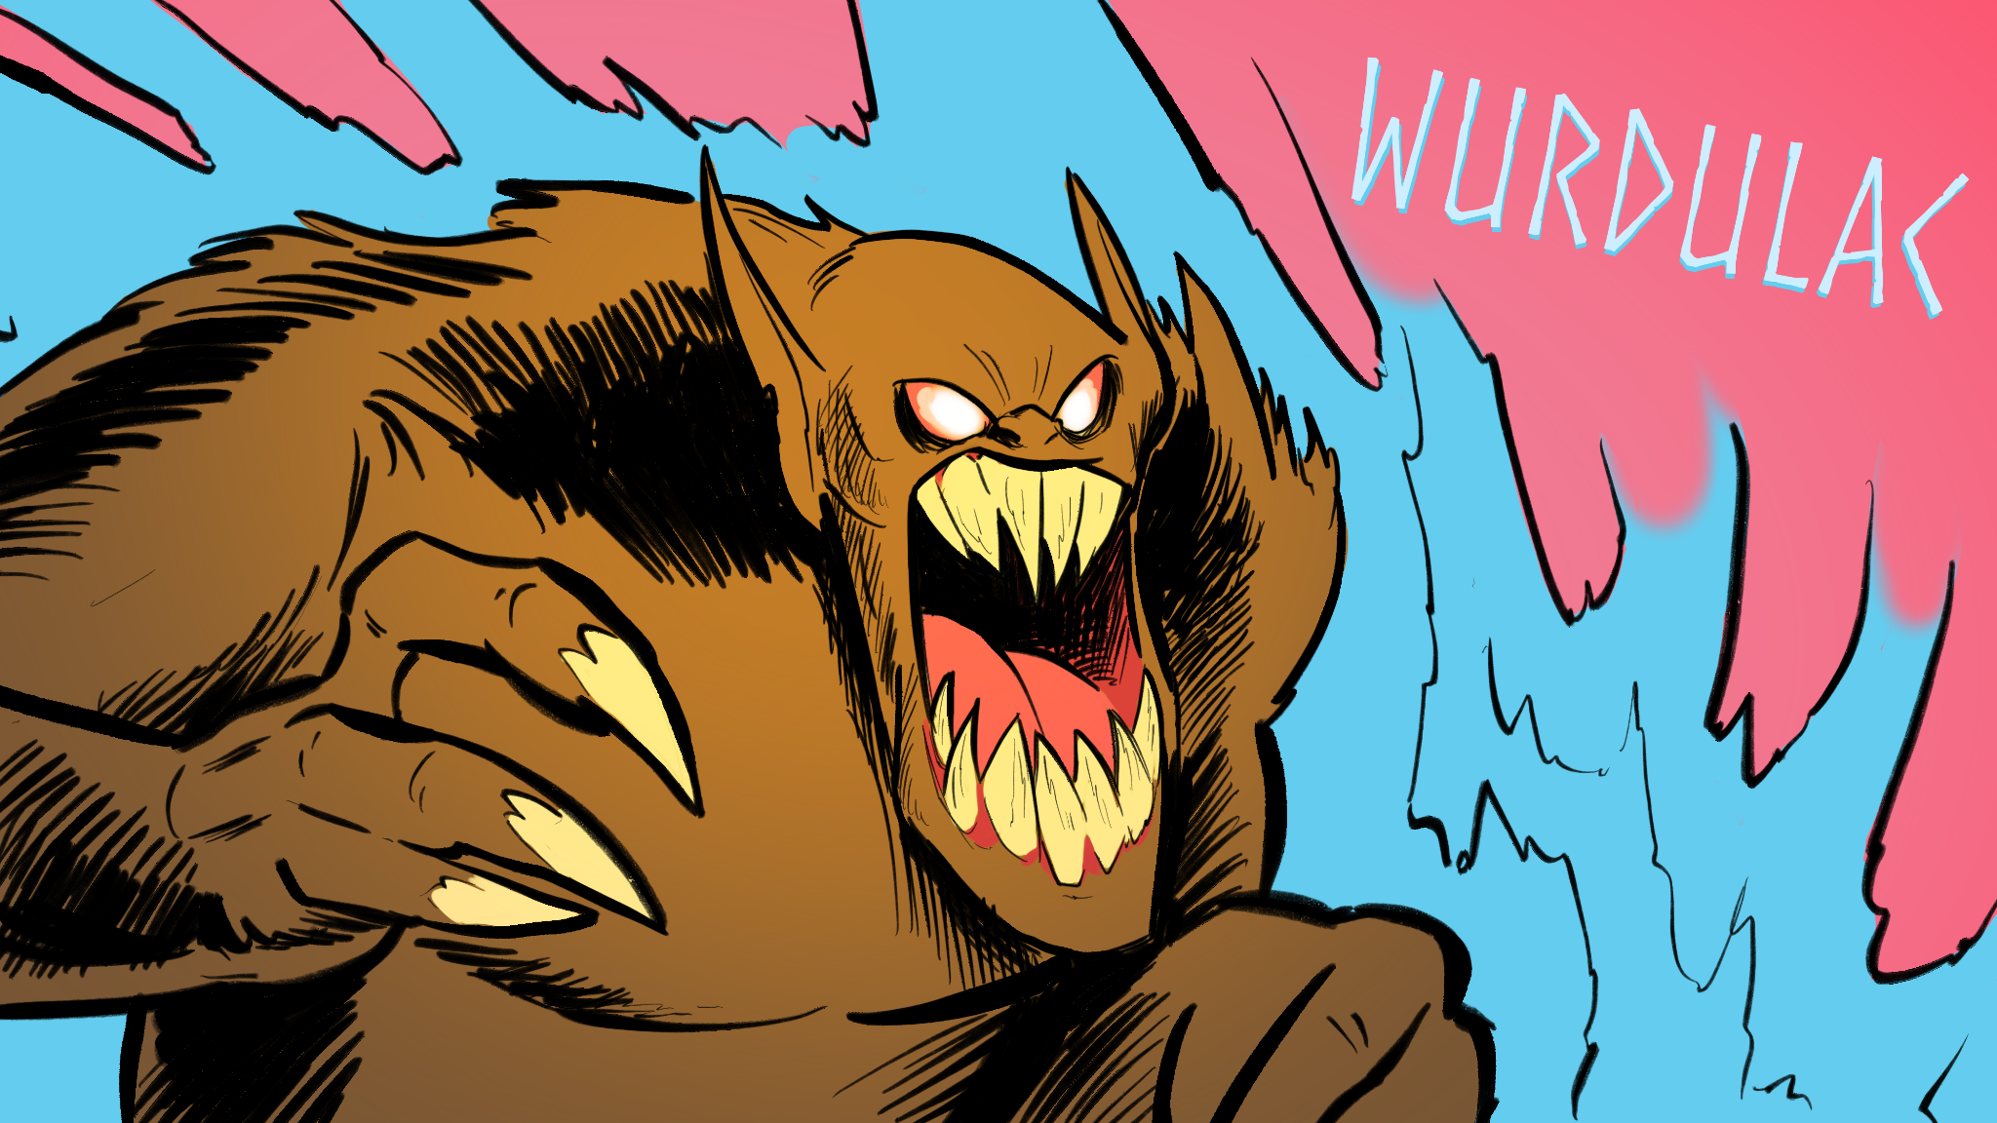
If you answered with mostly Ds…

Slide 9
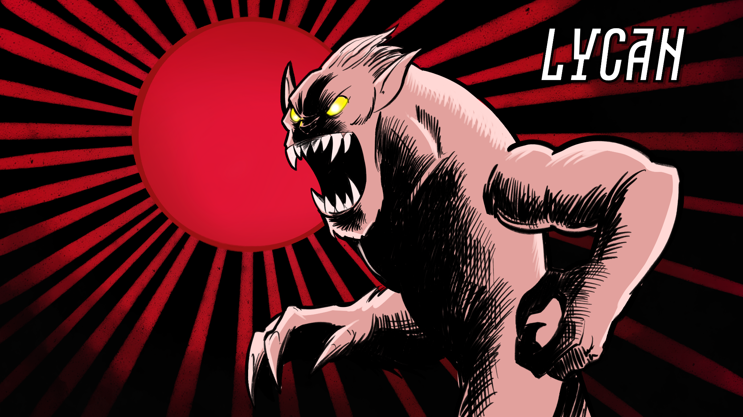
If you answered with mostly Es…

Slide 10
Essential Question
How do authors use similar tropes but come up with different variations of the same character?

Slide 11
Learning Objectives
Students synthesize their understanding of different cultural representations of mythological creatures by creating a movie poster of their werewolf creature.
Students compose a monologue of their “change” experience based on a werewolf lore.

Slide 12
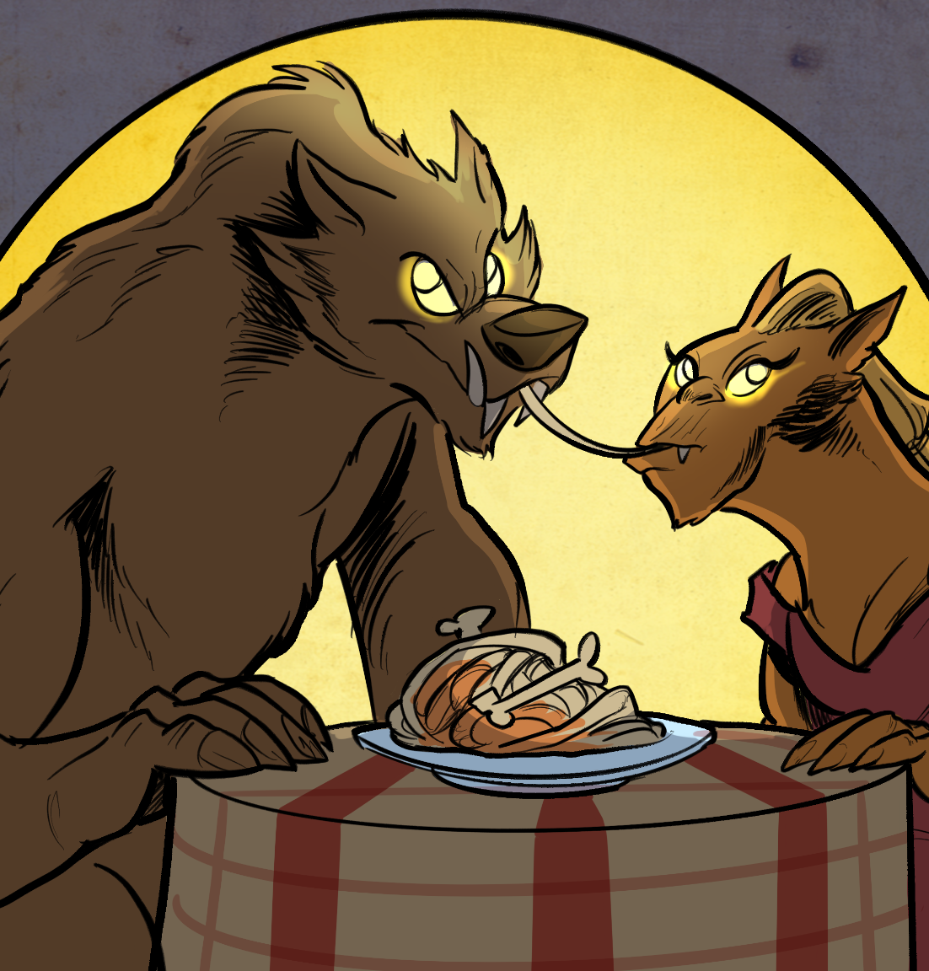
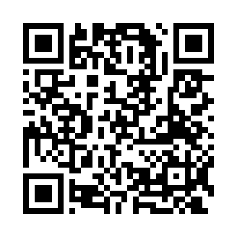
My Wolf Pack
Open the Wakelet with the linked articles.
Read only those articles that pertain to your wolf pack.
Take notes on your handout.
https://wakelet.com/wake/_nP1cMRD9f9_qk_ifMpYQ

Slide 13
Collaborative Word Cloud
Work with your pack to create a word cloud that highlights the different descriptive words found in your reading.
If everyone in the pack made note of a word, write it in large letters.
If some people in the pack made note of a word, write it in medium-sized letters.
If only one person made note of a word, write it in smaller letters.

Slide 14
Werewolf
[wer-wulf]
noun
wer man + wulf wolf
A person transformed into a wolf or capable of assuming a wolf’s form.
In folklore, a werewolf is an individual who can shapeshift into a wolf either purposely or after being placed under a curse or affliction (often a bite or the occasional scratch from another werewolf) with transformation occurring on the night of a full moon.

Slide 15
Archetype
[ar-che-type]
noun
The original pattern or model of which all things of the same type are representations or copies:
He is the archetype of a successful businessman.

Slide 16
Tropes
[trohp]
noun
A trope is a recurring theme or motif, as in literature or art.
The heroic trope.
A trope is a convention or device that establishes a predictable or stereotypical representation of a character, setting, or scenario in a creative work.
From her introduction in the movie, the character is nothing but a Damsel in Distress trope.

Slide 17
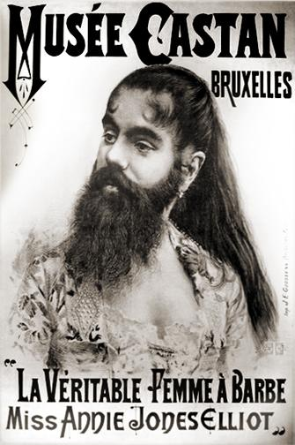
Hypertrichosis
Werewolf syndrome
This syndrom is a rare and curious condition that causes excessive hair growth anywhere on a person’s body.
Notes:
https://en.wikipedia.org/wiki/Annie_Jones_(bearded_woman)

Slide 18
Movie Poster
Work with your pack to create a movie poster that includes the following:
Write a brief one sentence synopsis of your story.
Identify setting. Include where the lore originated.
Explain the story’s relation to the culture it operates in.
Create a visual of your creature and how the pack envisons them.

Slide 19
Notes:
Universal. (2015). Dracula one sheet movie posters. Wikimedia Commons. Retrieved January 30, 2023, from https://commons.wikimedia.org/wiki/File:Dracula_one_sheet_movie_posters.jpeg.

Slide 20
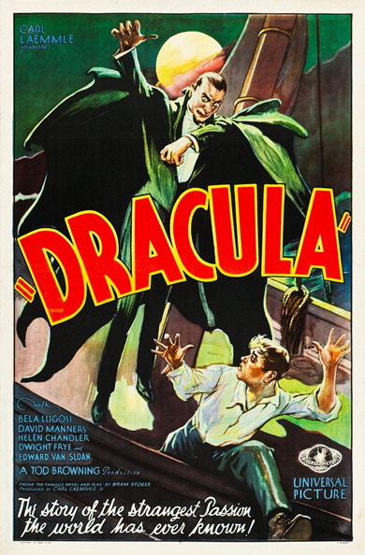
Movie Poster
Work with the pack to create a movie poster that includes the following:
Brief one sentence synopsis of your story.
Setting that explains where the lore originated.
Reference or relation to the culture.
Visual of the creature and how the pack envisons them.
Notes:
Universal. (2020). Dracula (1931 film poster - Style F). Wikimedia Commons. Retrieved January 30, 2023, from https://commons.wikimedia.org/wiki/File:Dracula_(1931_film_poster_-_Style_F).jpg.

Slide 21
Inside Out
In the innermost circle, write down what you know about monologues.
What are they?
What are some examples?
What goes into one?

Slide 22
Inside Out
Share your innermost circle with a partner.
As your partner shares with you what they have written down, record any new ideas in your middle circle.

Slide 23
Inside Out
As you view examples of monologues, record any new information or ideas in the outermost circle.
What do you notice?
What is included?
How might you create your own monologues?

Slide 24
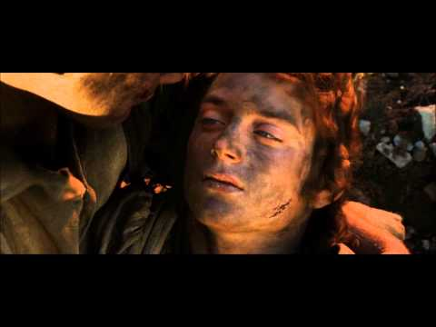
Lotr The Return of the King
Notes:
YouTube. (2014). Lotr The Return of the King - "I Can't Carry It For You... But I Can Carry You". YouTube. Retrieved January 30, 2023, from https://www.youtube.com/watch?v=BKIgv8AhffA.

Slide 25
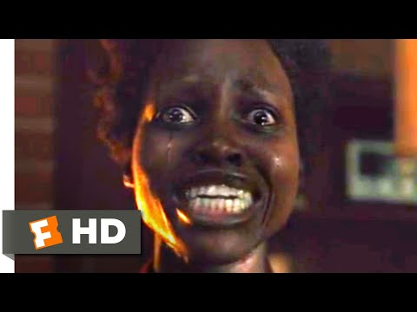
Meet the Tethered Scene
Notes:
YouTube. (2019). Us (2019) - Meet the Tethered Scene (3/10). YouTube. Retrieved January 30, 2023, from https://www.youtube.com/watch?v=vh7_WKODlE8.

Slide 26
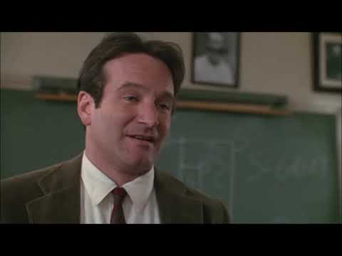
Dead Poets Society: “Rip it out” Scene
Notes:
YouTube. (2021). Dead Poets Society - "Rip it out" scene. YouTube. Retrieved January 30, 2023, from https://www.youtube.com/watch?v=8x0COtH4Vrw.

Slide 27
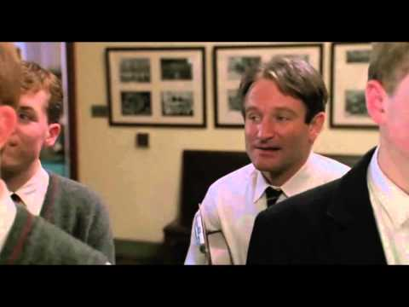
Dead Poet’s Society: “Carpe diem. Seize the Day”
Notes:
YouTube. (2014). "Carpe diem. Seize the day." - Dead Poets Society. YouTube. Retrieved January 30, 2023, from https://www.youtube.com/watch?v=vi0Lbjs5ECI.

Slide 28
What is a monologue?
What are some different examples of monologues?
What goes into a monologue?

Slide 29
What is a Monologue?
[mono-logue]
noun
A monologue is a speech delivered by one person that exposes their inner thoughts and provides insights into his or her character.
The character/person speaks their thoughts about a specific event or situation and tells us how they are feeling at that particular moment.
Monologues are always written in first person (I think/I feel).
Notes:
https://learn.squibler.io/writing/screenplay/how-to-write-a-monologue/

Slide 30
Types of Monologues
Soliloquy
Interior Monologue
Dramatic Monologue
Stand-up comedy
Specific songs in musical theater
Villain Speeches
Rants
Notes:
https://learn.squibler.io/writing/screenplay/how-to-write-a-monologue/

Slide 31
Writing a Monologue in 7 Easy Steps!
Define the purpose of the monologue.
Develop the character profile.
Identify the audience.
Create a powerful beginning.
Write the middle part.
Craft a clear ending.
Refine and tweak.
Notes:
https://learn.squibler.io/writing/screenplay/how-to-write-a-monologue/

Slide 32
How am I Feeling? What am I Thinking?
On your identity chart:
Place your name in the center of the circle along with the name of the werewolf you learned about.
Around the circle, write words or phrases that describe:
How you might feel during your transformation.
What you might be thinking during your transformation.

Slide 33
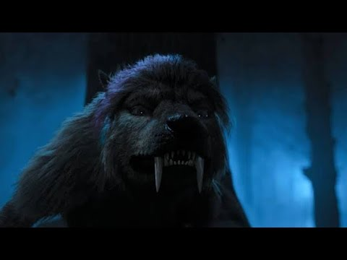
Enid Werewolf Transformation
Notes:
https://www.youtube.com/watch?v=e69Qt9gin88

Slide 34
Wolfing Out
Consider everything you have learned today about your wolf pack identity.
Write a monologue about what it would be like to “Wolf Out.”
Use the following to help you:
My Wolf Pack (Reading Note Catcher)
Collaborative Word Cloud with descriptive words
Movie poster for inspiration
Identity Chart for key words and phrases about the feelings of wolfing out
What is a Monologue (Inside Out Chart)
Monologue Anchor Chart

Slide 35
Two Stars and a Wish
In your group of three, you will take turns reading each other’s monologues.
As you read the monologues of your partners share two stars and one wish about their writing.
Two Stars: What did your partner do well in their writing?
One Wish: What could your partner do to make their monologue even better?

