Slide 2
Timmy Made Mistakes
Science Lab Safety
7th-12th grade

Slide 3
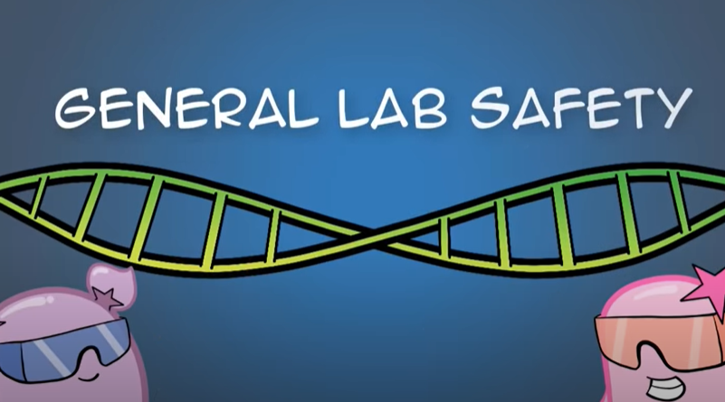
Notes:
ENGAGE: Either do a live demo where the teacher shows incorrect lab procedures / behaviors. OR show the video linked above (it’s 5:30 long).
Video: https://www.youtube.com/watch?v=MEIXRLcC6RA&feature=youtu.be

Slide 4
Inspector Station Rotation
As a group, on my mark, inspect the lab station(s).
Write down what is unsafe about each and how you would make it safe.

Slide 5
Share out your findings
Groups will share their answers with the entire class.

Slide 6
You choose
Comic
Music
Create a comic about lab safety.
Create a song or rap about lab safety.
Notes:
comic image source: https://pixabay.com/illustrations/superhero-words-pow-bam-bomb-3774074/
microphone / music source: https://libreshot.com/microphone-and-music-notes/

Slide 7
Show N Tell
Present your comic or musical creation to the class.
Answer this question - what are you going to do to make sure your group is safe during labs? Write this on the station rotation sheet you filled out.
Notes:
Image source: https://commons.wikimedia.org/wiki/File:America%27s_Got_Talent_2015_logo.png

